Slide 1
RE BASICS :
THE REQUIREMENTS ENGINEERING PROCESS
PERTEMUAN 8
AGUNG MULYO WIDODO
TEKNIK INFORMATIKA

Slide 2
KEMAMPUAN AKHIR YANG DIHARAPKAN
The Requirements Engineering Process
Problem Domain and the System/Software-to-be
Requirements Engineering: Main Activities
The beginning is the most important part of the work.¹
Notes:
a

Slide 3

BUKU PEMBELAJARAN
Jeremy Dick, Elizabeth Hull, Ken Jackson, Requirements Engineering, Springer-Verlag, 2004
Soren Lauesen Software Requirements - Styles and Techniques, Addison Wesley, 2002
Ian K. Bray , An Introduction to Requirements Engineering, Addison Wesley,
2002
Colin Hood, Simon Wiedemann , Stefan FichtingerUrte Pautz ,Requirements Management, Springer-Verlag, 2008

Slide 4
REFERENSI
B. A. Nuseibeh and S. M. Easterbrook, Requirements Engineering: A Roadmap. In A. C. W. Finkelstein (ed) The Future of Software Engineering, ACM Press, 2000
http://www.cs.toronto.edu/~sme/papers/2000/ICSE2000.pdf
Simson Garfinkel, History's Worst Software Bugs, Wired News, 2005
http://www.wired.com/news/technology/bugs/0,2924,69355,00.html
INCOSE Requirements Working Group
http://www.incose.org/practice/techactivities/wg/rqmts/
Tools Survey: Requirements Management (RM) Tools
http://www.incose.org/productspubs/products/rmsurvey.aspx
http://www.volere.co.uk/tools.htm
IEEE (1993) Recommended Practice for Software Requirements Specifications. IEEE Std 830-1993, NY, USA.
IEEE (1995) Guide for Developing System Requirements Specifications. IEEE Std P1233/D3, NY, USA.
Requirements Engineering Conference
http://www.requirements-engineering.org/

Slide 5
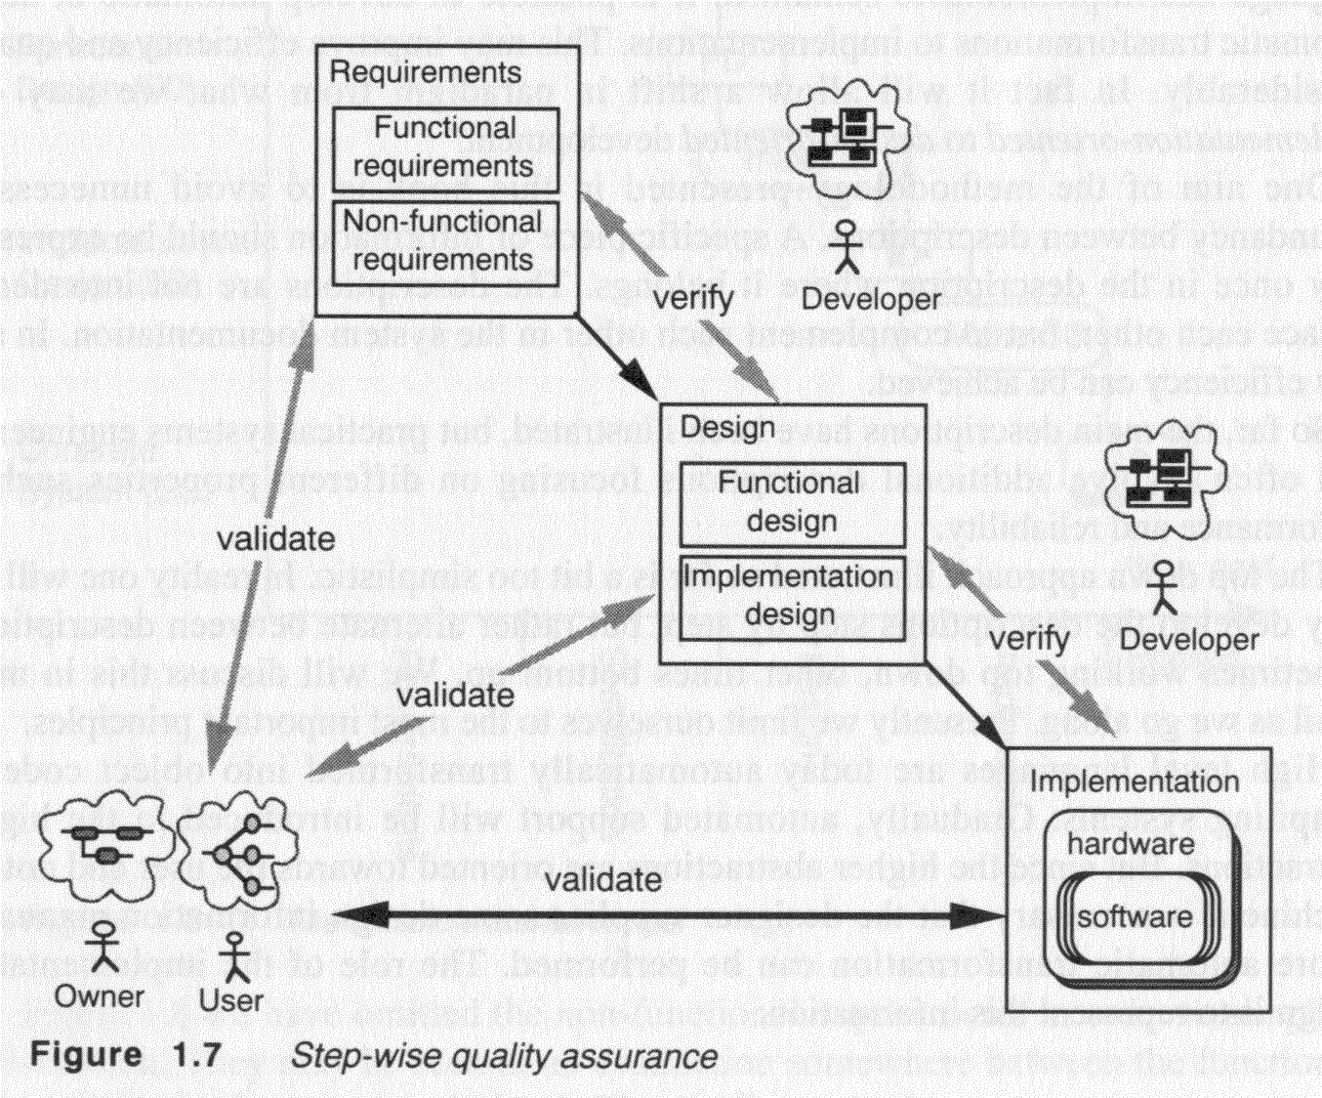
Requirements within the software development process

Slide 6
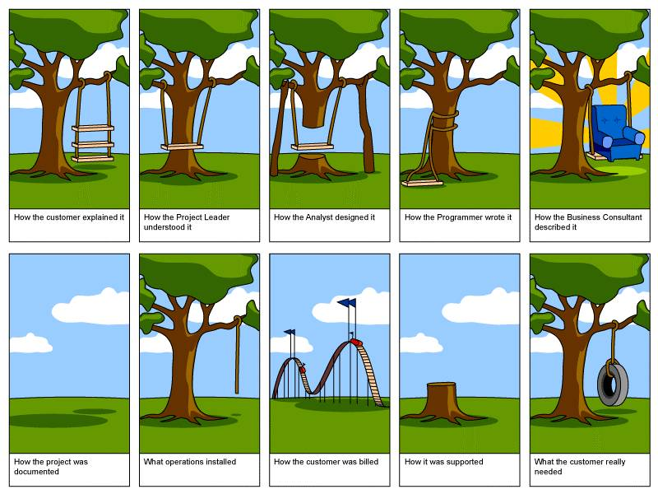
What is the right system to build ?

Slide 7
The Requirements Engineering Process

Slide 8
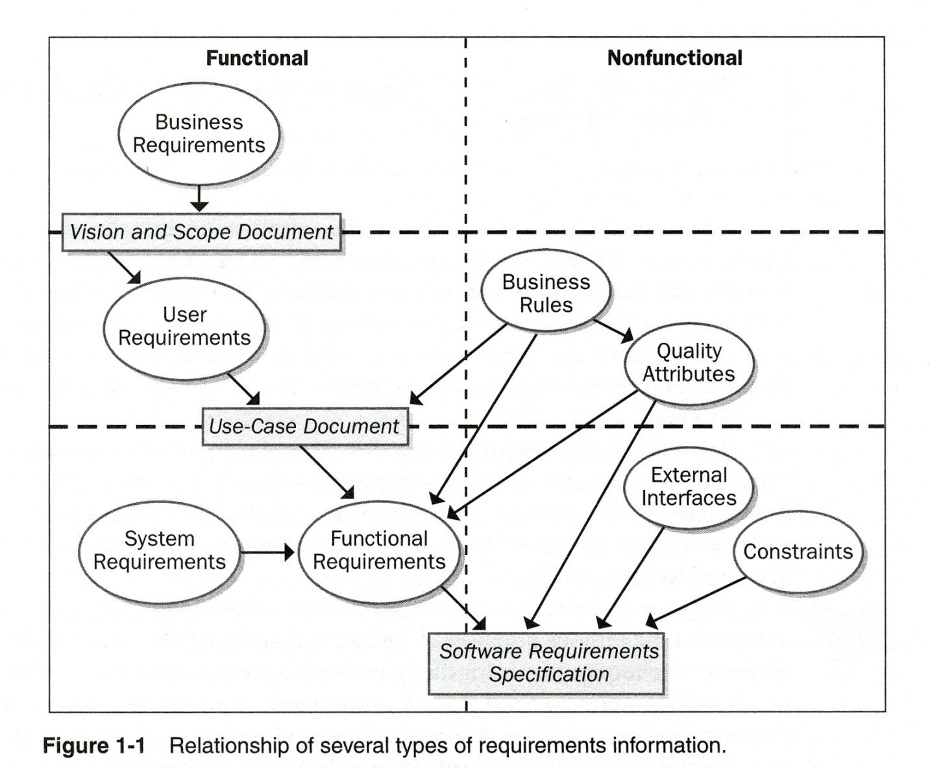
RE activities and documents (Wiegers)

Slide 9
Notes on previous slide
There needs to be an arrow from User requirements to System requirements. (The system has to be able to perform certain use cases. The same use cases must be supported by the software, therefore become Software requirements.)
Business rules (including standards and regulations) are not only non-functional, they also include functional aspects (as shown by the arrows in the diagram).

Slide 10
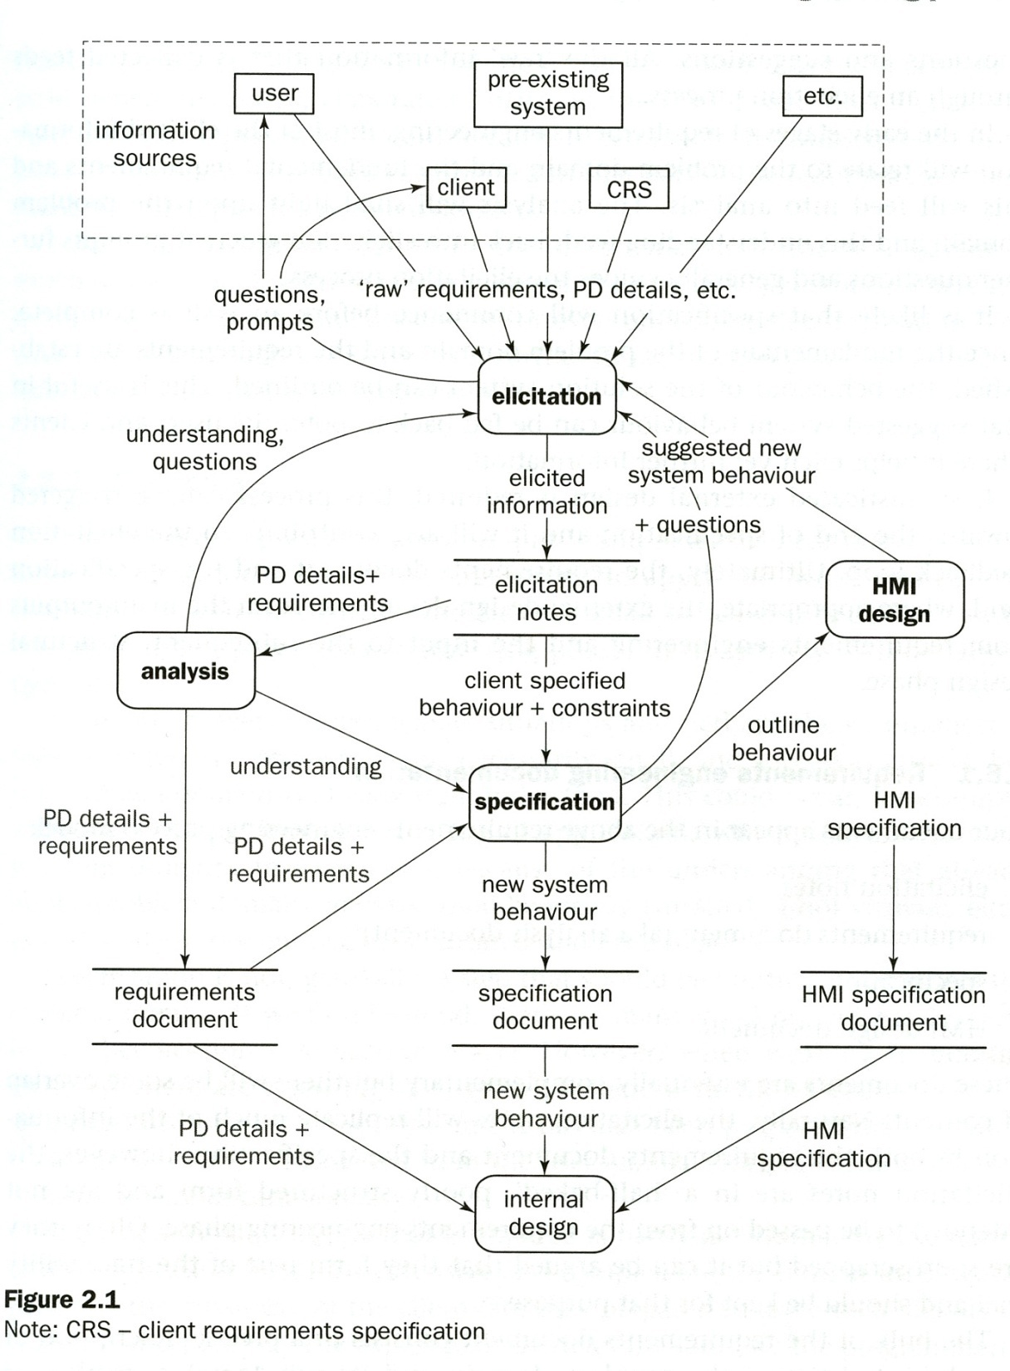
RE process model
(suggested by Bray)
Again, this diagram shows
RE activities (elicitation, analysis, specification, HMI design)
subsequent design activity (internal design)
RE documents (elicitation notes, requirements, specification, HMI specification)
Important point:
Distinction between
Problem domain (described by requ. doc.)
System (to be built) (described by spec. doc.)
Note: One has to distinguish between current (problematic) version of the problem domain, and the projected future version which includes the system to be built.

Slide 11
Typical Layered Approach (V-shaped)

Slide 12
Notes on previous slide
This looks like the waterfall process model, but this diagram describes a quite different situation.
The layers correspond to step-wise refinement in terms of component decomposition.
For instance, the transition from the first to the second layer is the typical RE process: one starts with the information from elicitation (shown in the first layer), that is, the problematic domain model, and one ends up with a proposal for a new system to be built (which is a component within the projected new domain model).
Important note: The process of identification of the system to be built and defining its relationship with the new domain model (note that the environment of the system to be built may also be re-organized within the new domain model) is a kind of “design process” that requires creativity.
The transitions to the lower layers in the diagram are similar processes (you may call them RE at a more detailed level or design processes)

Slide 13
Difference between RE and design ??
Much research towards automated SE
  Compilers automatically generate machine code (correct in respect to program source code)
  CASE tools automatically generate implementations of UML State Machine models (correct in respect to the given model)
  CASE tools automatically generate state machine models from a set of use case scenarios
    E.g. PhD work of Dr. Somé
    Tool for Live Sequence Charts by Dave - described in the book ”Come, Let's Play: Scenario-Based Programming Using LSCs and the Play-Engine”

Slide 14
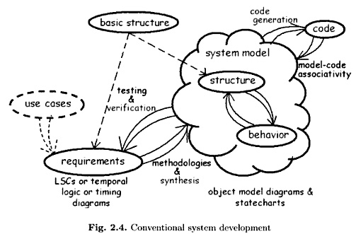
Harel’s “scenario-based programming” (1)
Scenarios (use cases) are played into the tool, and may be played out for testing the recorded behavior model.

Slide 15
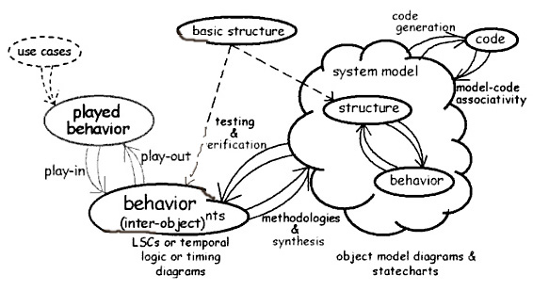
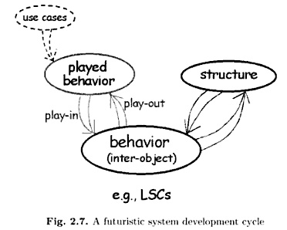
Harel’s “scenario-based programming” (2)
Main idea:
eliminate the design and implemention activities by providing efficient execution of behavior directly defined by the requirements.

Slide 16
Requirements and Modeling go together
The systems engineering sandwich!

Slide 17
Comments on previous slide
Why combining RE with modeling ?
For analysis – models help to understand the problem domain
For documentation – models can be used for describing requirements (instead of solely using natural language)
We will come back to various modeling approaches later in this course.

Slide 18
Back to the Sandwich – consider different levels of details

Slide 19
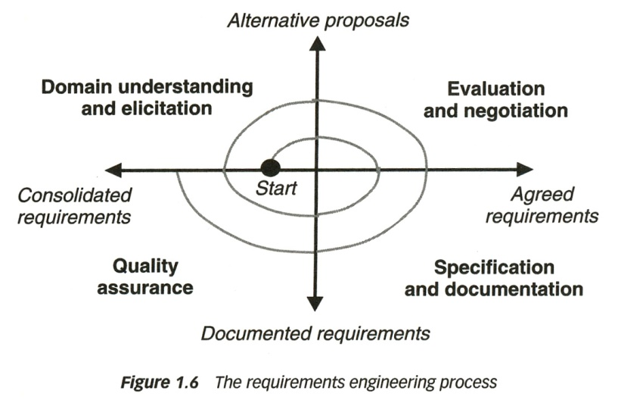
Benefits of Requirement Levels (Sandwich)
Principle of step-wise refinement:
Focus the attention on the big picture before addressing the details
Reduce the number of changes by specifying at a lower level the requirements that will not affect the requirements at a higher level
Promote the division of work
This diagram [Lamsweerde] is another way to present this kind of (spiral) process

Slide 20
RE Process and Related Activities
Why?
What?
How?
Who?
When?
If-Then
Does It?
Where?
Identify Business Needs and Goals
Derive User & Functional Requirements
Design Solutions
TIME
Project Management Process
Risk Management Process
Quality Management Process
Component & Configuration Management Process

Slide 21
Requirements Engineering
Requirements engineering is a set of activities but not necessarily a separate phase
Source: Donald C. Gause, Risk Focused Requirements Management, Tutorial at RE’09, September 2009

Slide 22
The Problem Domain and the System/Software-to-be

Slide 23
Problem Domain
The problem domain is the context for requirements
  Part of the world within which the problem exists
  Needs to be understood for effective requirements engineering
Domain model
  Set of properties assumed / believed to be true about the environment
  Properties relevant to the problem
  Problem domain requirements should hold in the proposed new version of the domain.
Define the system requirements such that:
  If the system that is built satisfies the system requirements and the environment satisfies the properties assumed for the environment, then the problem domain requirements will be satisfied.
  In simple words: The system will behave as required if the assumptions hold.

Slide 24
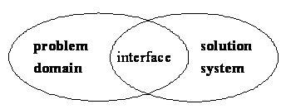
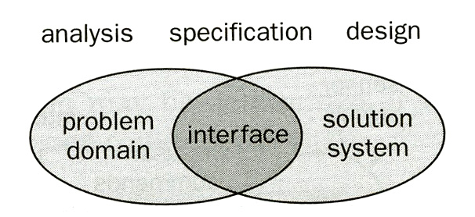
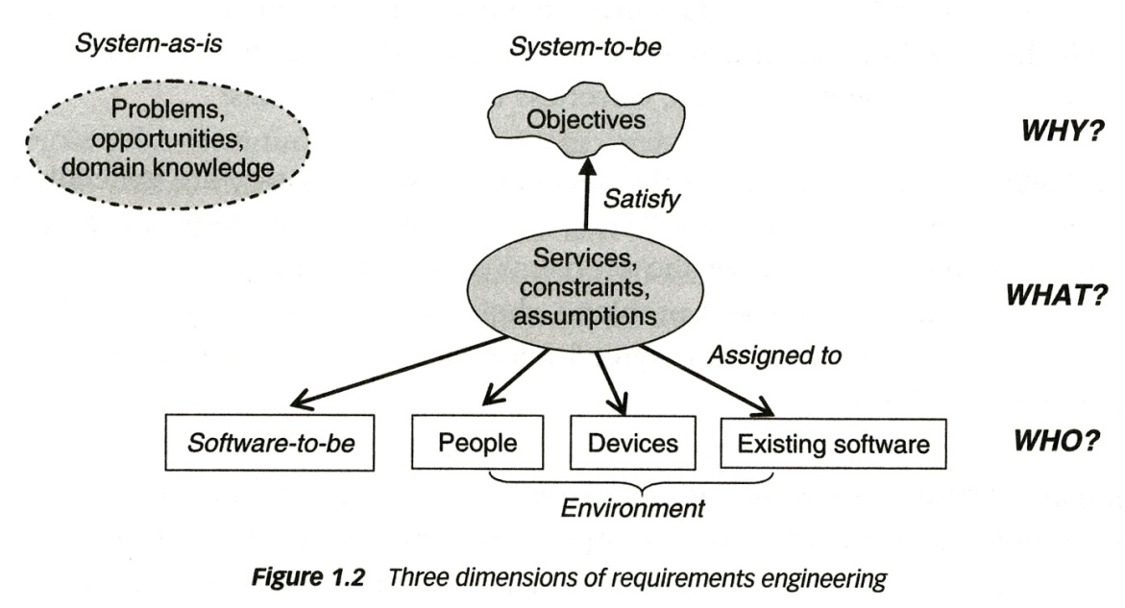
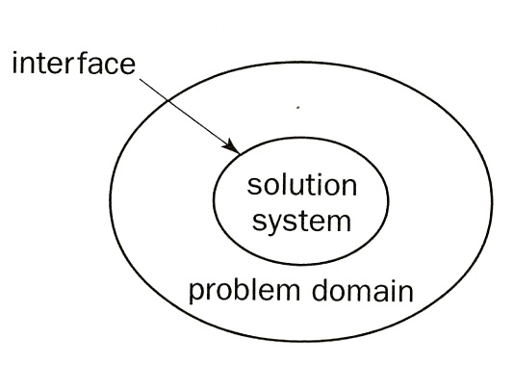
Problem Domain and System-to-be
A domain model should be reusable
(Michael Jackson, 1995)
better: problem domain (as-is and to-be)
Diagram also showing activities [Bray]
Diagram showing existing and future situation [Lamsweerde]
Problem domain with system-to-be [Bray]

Slide 25
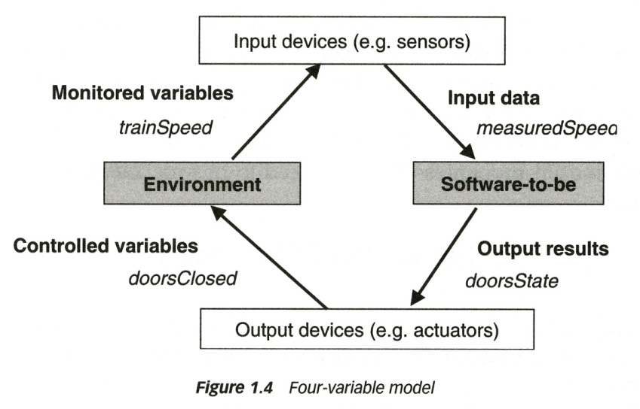
System interface and software interface
Generic architecture of a control system including embedded software [Lamsweerde]
System and software interface for a control system with embedded software:
  Software interface: through input and output variables, for instance measuredSpeed (is read by program) and doorState (is set by program)
  The system includes the software and I/O devices. Therefore the interface of the system with the environment are the monitored and controlled variables of the real world, for instance trainSpeed and doorsClosed.

Slide 26
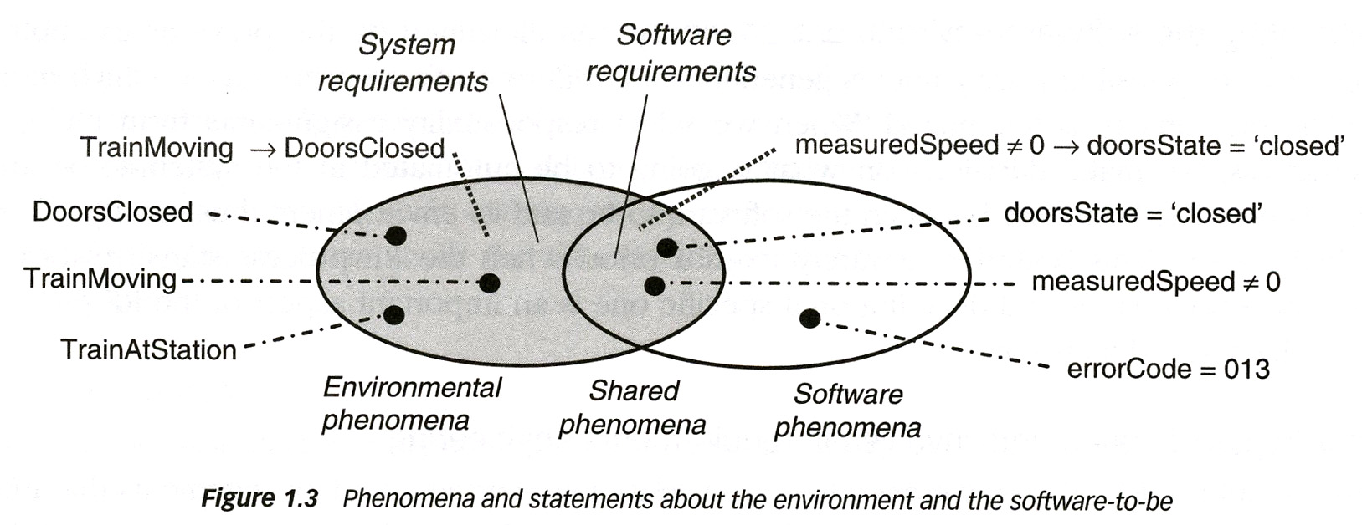
Software objects representing real objects
The software (model) normally contains objects that represent objects in the system environment (e.g. the doorState variable represents the state of the doors in the train)
Whether they represent the situation in the environment correctly, is another question (for the doorState variable, this may depend on the correct functioning of the door state sensing device).
better: Problem domain requirements (if one considers the train to be the environment of the control system)

Slide 28
Main Requirements Activities

Slide 29
Requirements Inception
Start the process
  Identification of business need
  New market opportunity
  Great idea
Involves
  Building a business case
  Preliminary feasibility assessment
  Preliminary definition of project scope
Stakeholders
  Business managers, marketing people, product managers...
Examples of techniques
  Brainstorming, Joint Application Development (JAD) meeting…

Slide 30
Requirements Elicitation (1)
Gathering of information
  About problem domain
  About problems requiring a solution
  About constraints related to the problem or solution
Questions that need to be answered
  What is the system?
  What are the goals of the system?
  How is the work done now?
  What are the problems?
  How will the system solve these problems?
  How will the system be used on a day-to-day basis?
  Will performance issues or other constraints affect the way the solution is approached?

Slide 31
Requirements Elicitation (2)
Overview of different sources
  Customers and other stakeholders
  Existing systems
  Documentation
  Domain experts
  More ...
Overview of different techniques
  Brainstorming
  Interviews
  Task observations
  Use cases / scenarios
  Prototyping
  More ...

Slide 32
Requirements Analysis
The process of studying and analyzing the needs of stakeholders (e.g., customer, user) in view of coming up with a “solution”. Such a solution may involve:
  A new organization of the workflow in the company.
  A new system (system-to-be, also called solution domain) which will be used in the existing or modified workflow.
  A new software to be developed which is to run within the existing computer system or involving modified and/or additional hardware.
Objectives
  Detect and resolve conflicts between requirements (e.g., through negotiation)
  Discover the boundaries of the system / software and how it must interact with its environment
  Elaborate system requirements to derive software requirements

Slide 33
Requirements Specification
The invention and definition of the behavior of a new system (solution domain) such that it will produce the required effects in the problem domain
Requirements Analysis has defined the problem domain and the required effects
Specification Document
  A document that clearly and precisely describes, each of the essential requirements (functions, performance, design constraints, and quality attributes) of the software and the external interfaces
  Each requirement being defined in such a way that its achievement is capable of being objectively verified by a prescribed method (e.g., inspection, demonstration, analysis, or test)
  Different guidelines and templates exist for requirements specification

Slide 34
Requirements Verification and Validation
Validation and verification
  Both help ensure delivery of what the client wants
  Need to be performed at every stage during the process
Validation: checks that the right product is being built (refers back to stakeholders – main concern during RE)
Verification: checks that the product is being built right
  During design phase: refers back to the specification of the system or software requirements
  During RE: mainly checking consistency between different requirements, detecting conflicts
Techniques used during RE
  Simple checks
  Formal Review
  Logical analysis
  Prototypes and enactments
  Design of functional tests
  Development of user manual

Slide 35
Requirements Management
Necessary to cope with changes to requirements
Requirements change is caused by:
  Business process changes
  Technology changes
  Better understanding of the problem
Traceability is very important for effective requirements management
Elicitation notes
Goals

Slide 36
Requirements Documents
Vision and Scope Document
Elicitation notes: (Raw) requirements obtained through elicitation; often unstructured, incomplete, and inconsistent
(Problem domain) Requirements document
System requirements document
Software requirements document
  The software is normally part of a system that includes hardware and software. Therefore the software requirements are normally part of the system requirements.
Note: System and Software requirements may exist in several versions with different levels of details, such as
  User (customer) requirements: Statements in natural language plus diagrams of the services the system provides and its operational constraints; written for customers
  Detailed requirements: A structured document setting out detailed descriptions of the system services; often used as a contract between client and contractor. This description can serve as a basis for a design or implementation; used by developers.

Slide 37
Types of Requirements Documents
Two extremes:
An informal outline of the requirements using a few paragraphs or simple diagrams
  This is called the requirements definition
A long list of specifications that contain
thousands of pages of intricate
requirements describing the
system in detail
  This is called the requirements
  specification
Requirements documents for
large systems are normally
arranged in a hierarchy
Requirements
xxxx
xxxxxxx
xxx
xxxxxxxxxxx
xxxxx
xxxxxxxxxxxxx
xxxxxxx
xxx
xxxxxxxxxxxxxxx
subsystem 1
subsystem 2
Requirements
Requirements
xxxx
Definition
xxxxxxx
xxxx
xxx
xxxxxxx
Requirements
xxxxxxxxxxx
xxx
xxxxx
xxxxxxxxxxx
Specification
xxxxxxxxxxxxx
xxxxx
xxxxxxx
xxxx
xxx
xxxxxxxxxxxxx
xxxxxxxxxxxxxxx
xxxxxxx
xxxxxxx
xxx
xxx
xxxxxxxxxxx
xxxxxxxxxxxxxxx
xxxxx
xxxxxxxxxxxxx
sub-subsystems
xxxxxxx
xxx
Requirements
Requirements
Requirements
Requirements
xxxxxxxxxxxxxxx
Definition
Definition
Definition
Definition
xxxx
xxxx
xxxx
sub-subsystems
xxxx
xxxxxxx
xxxxxxx
xxxxxxx
Requirements
xxxxxxx
xxx
Requirements
xxx
Requirements
xxx
xxx
Requirements
xxxxxxxxxxx
xxxxxxxxxxx
xxxxxxxxxxx
Specification
xxxxxxxxxxx
Specification
xxxxx
Specification
xxxxx
Specification
xxxxx
xxxx
xxxxx
xxxxxxxxxxxxx
xxxxxxxxxxxxx
Requirements
xxxx
xxxx
xxxxxxx
Requirements
xxxxxxxxxxxxx
xxxxxxxxxxxxx
xxxxxxx
Requirements
xxxxxxx
xxxx
xxxxxxx
xxxxxxx
xxxxxxx
xxxxxxx
xxx
xxx
Requirements
Definition
Definition
xxxxxxx
xxx
xxx
xxx
xxx
xxxxxxxxxxx
Definition
xxx
xxx
xxxxxxxxxxxxxxx
xxxxxxxxxxxxxxx
Definition
xxxx
xxxxxxxxxxx
xxxxxxxxxxx
xxxxx
xxxx
xxxxxxxxxxxxxxx
xxxxxxxxxxxxxxx
xxxx
xxxxxxx
xxxxxxxxxxx
xxxxx
xxxxx
xxxxxxxxxxxxx
xxxx
xxxxxxx
xxxxxxx
xxx
Requirements
xxxxx
xxxxxxxxxxxxx
xxxxxxxxxxxxx
xxxxxxx
xxxxxxx
xxx
Requirements
xxx
Requirements
xxxxxxxxxxx
xxxxxxxxxxxxx
xxxxxxx
xxxxxxx
xxx
xxx
Requirements
xxxxxxxxxxx
xxxxxxxxxxx
Specification
xxxxx
Specification
xxxxxxx
xxx
xxx
xxxxxxxxxxxxxxx
xxxxxxxxxxx
xxxxx
Specification
xxxxx
xxxx
xxx
xxxxxxxxxxxxxxx
xxxxx
Specification
xxxxxxxxxxxxx
xxxxxxxxxxxxx
xxxxxxxxxxxxxxx
xxxx
xxxx
xxxxxxx
xxxxxxxxxxxxxxx
xxxxxxxxxxxxx
xxxxxxxxxxxxx
xxxxxxx
xxxxxxx
xxxx
xxxxxxx
xxxxxxx
xxxxxxx
xxxxxxx
xxx
xxx
xxxxxxx
xxx
xxx
xxx
xxx
xxxxxxxxxxx
xxx
xxx
xxxxxxxxxxxxxxx
xxxxxxxxxxxxxxx
xxxxxxxxxxx
xxxxxxxxxxx
xxxxx
xxxxxxxxxxxxxxx
xxxxxxxxxxxxxxx
xxxxxxxxxxx
xxxxx
xxxxx
xxxxxxxxxxxxx
xxxxx
xxxxxxxxxxxxx
xxxxxxxxxxxxx
xxxxxxx
xxxxxxxxxxxxx
xxxxxxx
xxxxxxx
xxx
xxxxxxx
xxx
xxx
xxxxxxxxxxxxxxx
xxx
xxxxxxxxxxxxxxx
xxxxxxxxxxxxxxx
xxxxxxxxxxxxxxx

Slide 38
The Requirements Analyst¹
Plays an essential communication role
  Talks to users: application domain
  Talks to developers: technical domain
  Translates user requirements into functional requirements and quality goals
Needs many capabilities
  Interviewing and listening skills
  Facilitation and interpersonal skills
  Writing and modeling skills
  Organizational ability
RE is more than just modeling…
This is a social activity!

Slide 39
For More Information
B. A. Nuseibeh and S. M. Easterbrook, Requirements Engineering: A Roadmap. In A. C. W. Finkelstein (ed) The Future of Software Engineering, ACM Press, 2000
http://www.cs.toronto.edu/~sme/papers/2000/ICSE2000.pdf
Simson Garfinkel, History's Worst Software Bugs, Wired News, 2005
http://www.wired.com/news/technology/bugs/0,2924,69355,00.html
INCOSE Requirements Working Group
http://www.incose.org/practice/techactivities/wg/rqmts/
Tools Survey: Requirements Management (RM) Tools
http://www.incose.org/productspubs/products/rmsurvey.aspx
http://www.volere.co.uk/tools.htm
IEEE (1993) Recommended Practice for Software Requirements Specifications. IEEE Std 830-1993, NY, USA.
IEEE (1995) Guide for Developing System Requirements Specifications. IEEE Std P1233/D3, NY, USA.
Requirements Engineering Conference
http://www.requirements-engineering.org/

Slide 40
Main References
Jeremy Dick, Elizabeth Hull, Ken Jackson: Requirements Engineering, Springer-Verlag, 2004
Soren Lauesen: Software Requirements - Styles and Techniques, Addison Wesley, 2002
Ian K. Bray: An Introduction to Requirements Engineering, Addison Wesley,
2002
Karl E. Wiegers: Software Requirements, Microsoft Press,
2003
Gerald Kotonya, Ian Sommerville: Requirements Engineering – Processes and Techniques, Wiley, 1998
Roger S. Pressman: Software Engineering – A Practitioner's Approach, McGraw-Hill, 2005
Tim Lethbridge, Robert Laganière: Object Oriented Software Engineering: Practical Software Developement using UML and Java, 2nd edition, McGraw-Hill, 2005
Ivy F. Hooks, Kristin A. Farry: Customer-Centered Products – Creating Successful Products Through Smart Requirements Management, Amacom, 2001
CHAOS Report, Standish Group

Slide 41
Thank you

