Slide 1
RE BASICS : THE REQUIREMENTS INCEPTION
PERTEMUAN 9
AGUNG MULYO WIDODO
TEKNIK INFORMATIKA

Slide 2
KEMAMPUAN AKHIR YANG DIHARAPKAN
Problem Analysis
Business Requirements
Five Steps for Problem Analysis
Gain Agreement on the Problem Definition
Understand the Root Causes
Identify the Stakeholders
Product Vision and Project Scope
Identify the Constraints
Vision and Scope Document
The important thing is not to stop questioning. Curiosity has its own reason for existing.¹
Notes:
a

Slide 3
BUKU PEMBELAJARAN
Jeremy Dick, Elizabeth Hull, Ken Jackson, Requirements Engineering, Springer-Verlag, 2004
Soren Lauesen Software Requirements - Styles and Techniques, Addison Wesley, 2002
Ian K. Bray , An Introduction to Requirements Engineering, Addison Wesley, 2002
Colin Hood, Simon Wiedemann , Stefan FichtingerUrte Pautz ,Requirements Management, Springer-Verlag, 2008

Slide 4
REFERENSI
B. A. Nuseibeh and S. M. Easterbrook, Requirements Engineering: A Roadmap. In A. C. W. Finkelstein (ed) The Future of Software Engineering, ACM Press, 2000 http://www.cs.toronto.edu/~sme/papers/2000/ICSE2000.pdf
Simson Garfinkel, History's Worst Software Bugs, Wired News, 2005 http://www.wired.com/news/technology/bugs/0,2924,69355,00.html
INCOSE Requirements Working Group http://www.incose.org/practice/techactivities/wg/rqmts/
Tools Survey: Requirements Management (RM) Tools http://www.incose.org/productspubs/products/rmsurvey.aspx http://www.volere.co.uk/tools.htm
IEEE (1993) Recommended Practice for Software Requirements Specifications. IEEE Std 830-1993, NY, USA.
IEEE (1995) Guide for Developing System Requirements Specifications. IEEE Std P1233/D3, NY, USA.
Requirements Engineering Conference http://www.requirements-engineering.org/

Slide 5
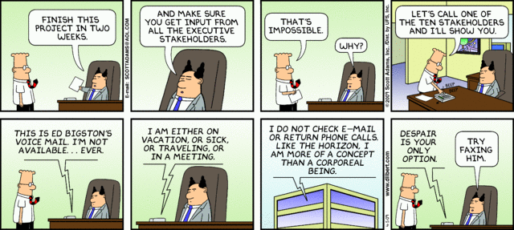

Slide 6
Problem Analysis
Goal: gain a better understanding of the problem being solved before development begins
Identify root cause
Identify stakeholders and their needs (or problems)
Identify solution boundary
Uses business requirements obtained from stakeholders
Results in Product Vision and Project Scope

Slide 7
Business Requirements (1)
Business Opportunity
Description of market opportunity, competing market, business problem being solved or improved, advantage of proposed solution, problems that will be solved...
Business Objective and Success Criteria
Important business benefits the product will provide in a quantitative and measurable way, how success will be measured, factors that have great impact on success...
Customer or Market Needs
Problems that customers currently encounter that will be addressed
Business Risks
Major risks associated with developing or not developing the product (marketplace competition, timing, user acceptance, implementation issues...)

Slide 8
Business Requirements – Example
Business Opportunity
Exploit the poor security record of a competing product
Business Objective and Success Criteria
Capture a market share of 80 percent by being recognized as the most secure product in the market through trade journal reviews and consumer surveys
Achieve positive cash flow on the product within 6 months

Slide 9
Business Requirements (2)
Important for:
Ensuring that all project participants work for the same reasons
Getting stakeholders agreement on requirements
User and software requirements must align with the context and objective defined by business requirements
Requirements that do not help achieve business objective should not be included

Slide 10
Problem Analysis – Five Steps
Leffingwell and Widrig propose five steps for problem analysis
Gain agreement on the problem definition
Understand the root causes – the problem behind the problem
Identify the stakeholders
Define the solution system vision and boundary
Identify the constraints to be imposed on the solution

Slide 11
Problem Analysis – Gain Agreement
Document the problem and seek agreement
Ask stakeholders to write a problem statement in an agreed format
Statement should include
What the problem is
Who is affected by it?
What is the impact?
Is there a proposed solution?
What are key benefits?

Slide 12
Problem Analysis – Understand Root Causes (1)
There is often a problem behind the problem
Root cause analysis consists of finding underlying causes that may not be immediately apparent
Example: Our e­commerce site is not profitable
Why is it not profitable?
Poor site design?
Bad pricing?
Poor customer management after the sale?
Some or all of the above?

Slide 13
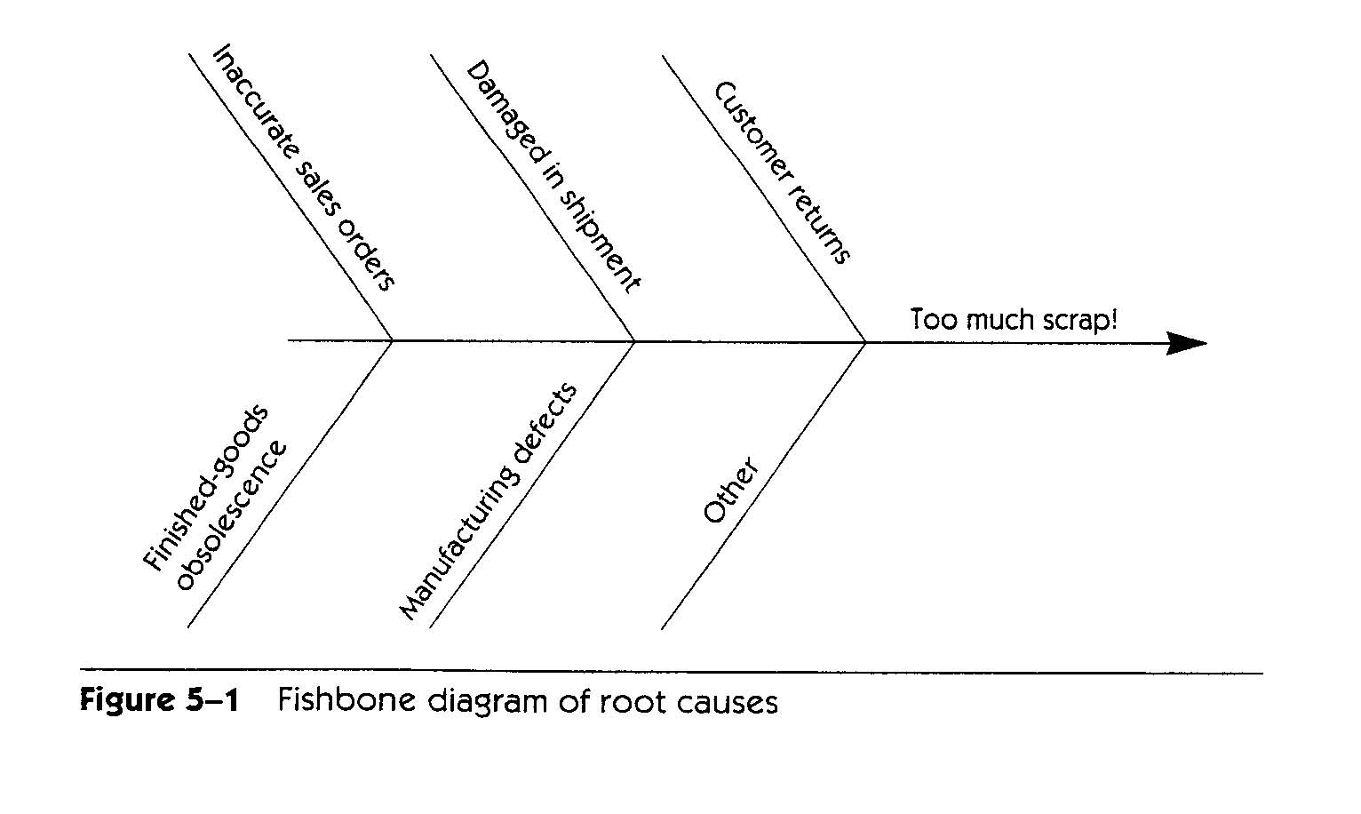
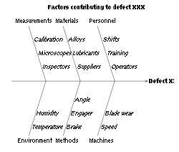
Problem Analysis – Understand Root Causes (2)
Root cause analysis can be used to understand root causes
Determine what factors contribute to the problem (sub­problems)
Recursively determine what factors contribute to these problems
Decompose until causes are understood (possible solution clear)
Decomposition can be represented using a Fishbone diagram, an itemized list...

Slide 14
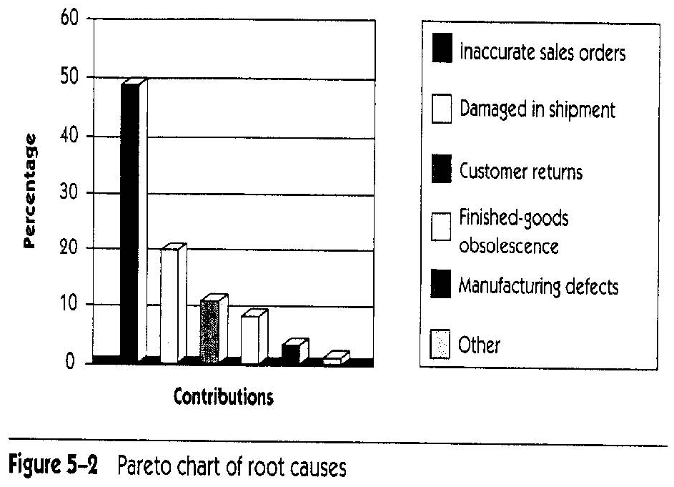
Problem Analysis – Understand Root Causes (3)
Address Root Causes
Root causes do not all have same impact
Some may not be worth fixing, at least not now
Estimate relative impact of root causes (e.g., with the help of a Pareto (bar) chart)
Create problem statement for root cause problem identified as worth solving (and with computer solution)

Slide 15
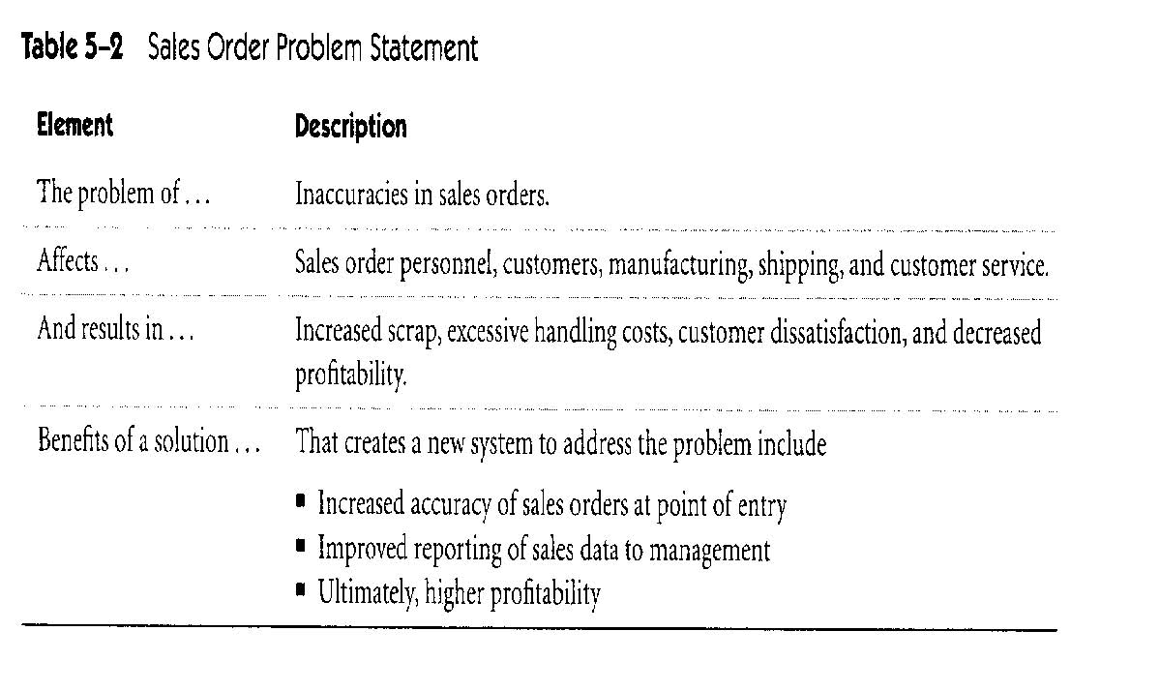
Problem Statement

Slide 16
Problem Analysis – Stakeholder Profiles (1)
Stakeholder Profiles
Stakeholders are individuals, groups, organizations who are actively involved in the project, are affected by its outcome or are able to influence its outcome
Profile should include:
Major value or benefit that stakeholder will receive from product (e.g., improved productivity, reduced rework, cost saving, ability to perform new tasks...)
Likely attitude toward the product
Major features and characteristics of interest
Any known constraints that must be accommodated

Slide 17
Problem Analysis – Stakeholder Profiles (2)
How to identify Stakeholders?
Elicitation would ask questions such as
Who uses the system?
Who is the customer?
Who is affected by outputs?
Who evaluates/approves system?
Other external/internal users?
Who maintains the system?
Anyone who cares? (e.g., legal/regulatory, etc.)

Slide 18
Problem Analysis – Product Vision and Project Scope
Product Vision: describes what the product is about and what it could eventually become
Aligns all stakeholders in a common direction
Project Scope: identifies what portion of the ultimate long-term product vision the current project will address
Draws boundary between what is in and what is out
Product Vision
Project Scope for release 1.0
Project Scope for release 1.1
…..
Project Scope for release n

Slide 19
Vision Statement (1)
Vision Statement template (according to Moore)
For [target customer]
Who [statement of the need or opportunity]
The [product name]
Is [a product category]
That [key benefit, compelling reason to buy or use]
Unlike [primary competitive alternative, current system, or current business process],
Our product [statement of primary differentiation and advantages of new product]

Slide 20
Vision Statement (2)
Example
For scientists who need to request containers of chemicals, the Chemical Tracking System is an information system that will provide a single point of access to the chemical stockroom and vendors. The system will store the location of every chemical container within the company, the quantity of material remaining in it and the complete history of each container's location and usage. This system will save the company 25% on chemical costs in the first year of use by allowing the company to fully exploit chemicals that are already available within the company, dispose of fewer partially used or expired containers and use a single standard chemical purchasing process. Unlike the current manual ordering processes, our product will generate all reports required to comply with government regulations that require the reporting of chemical usage, storage, and disposal.

Slide 21
Problem Analysis – Definition of Scope (1)
Definition of solution system boundaries
Requirements baseline is defined according to the release scope
New requirements during development are evaluated according to the scope
New in­scope requirements can be incorporated if they are of high priority relative to the other requirements in the baseline
Usually implies deferring or canceling other requirements or negotiating a new schedule
Out­of­scope requirements should be deferred to a following release

Slide 22
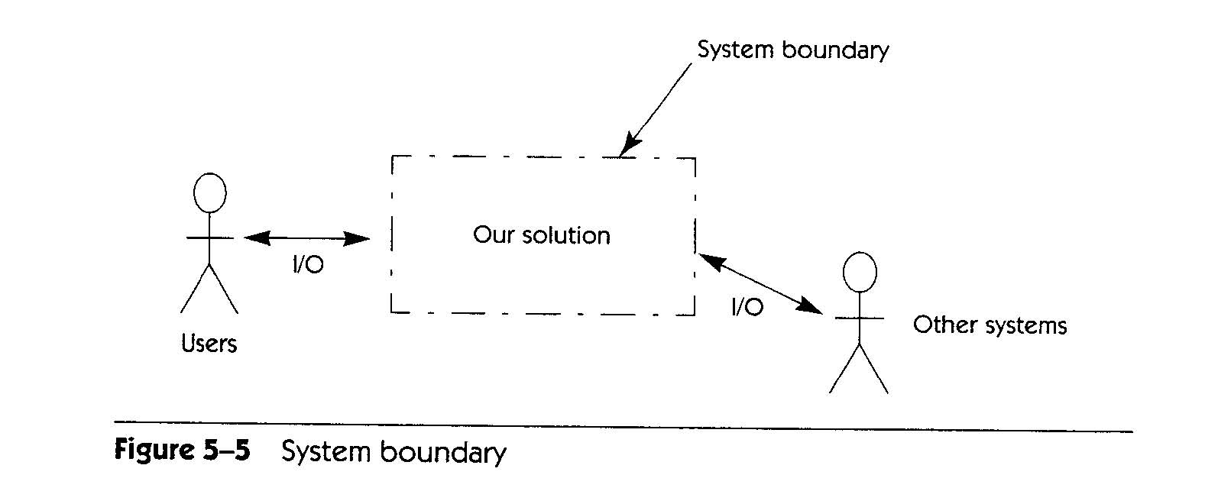
Problem Analysis – Definition of Scope (2)
Context Diagram
Top­level view of a system that shows the system’s boundaries and scope
Identifies terminators outside the system
Data, control, and material flow between terminators and the system

Slide 23
Problem Analysis – Identify Constraints
Restrictions on the solution space
Put limitations on the ability to deliver a solution as envisioned
Usually non-functional requirements that impose major restrictions on the system
Sources of constraints include:
Economics (e.g., costs, licensing issues)
Politics (e.g., internal or external, interdepartmental issues)
Technology (e.g., choice of technology/platform)
Systems (e.g., existing system, compatibility issues)
Environment (e.g., legal/environmental/security/standards)
Schedule and resources (e.g., fixed schedule, team)

Slide 24
Vision and Scope Document (1)
Contents:
Business requirements
Vision of the solution
Vision statement
Major features (numbered list of major features or user capabilities unique to the new product)
Assumptions (made while developing vision and scope)
Major dependencies to external factors outside of the project’s control (e.g., pending industry standards, government regulations, other projects, third party suppliers, development partners)
Scope and limitation (for initial and subsequent releases)
Business context

Slide 25
Vision and Scope Document (2)
Contents – Scope and limitations:
Concept and range of proposed solution
What the system is
Limitations
Capabilities that the product won't include (what the system is not)
Record rejected requirements with the reason for rejecting them
Scope of initial release
Major features planned for initial release
Acceptable quality characteristics of initial release
Scope of subsequent releases

Slide 26
Vision and Scope Document (3)
Contents – Business context:
Project Priorities
Stakeholders must agree on the project priorities
Help effective decision making
Operating Environment
Environment in which system will be used (e.g., distributed environment)
Vital availability, reliability, performance and integrity requirements linked to operating environment

Slide 27
Thank you

