Slide 1
Architecture
Munawar, PhD

Slide 2
Architectural Styles (1)
Important styles of architecture for distributed systems
Layered architectures
Object-based architectures
Data-centered architectures
Event-based architectures

Slide 3
Architectural Styles (2)
Figure 2-1. The (a) layered architectural style and …

Slide 4
Architectural Styles (3)
Figure 2-1. (b) The object-based architectural style.

Slide 5
Architectural Styles (4)
Figure 2-2. (a) The event-based architectural style and …

Slide 6
Architectural Styles (5)
Figure 2-2. (b) The shared data-space architectural style.

Slide 7
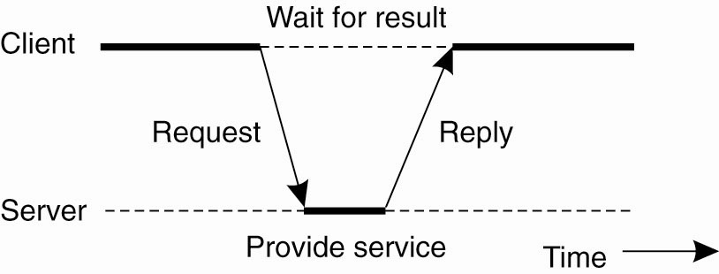
Centralized Architectures
Figure 2-3. General interaction between a client and a server.

Slide 8
Application Layering (1)
Recall previously mentioned layers of architectural style
The user-interface level
The processing level
The data level

Slide 9
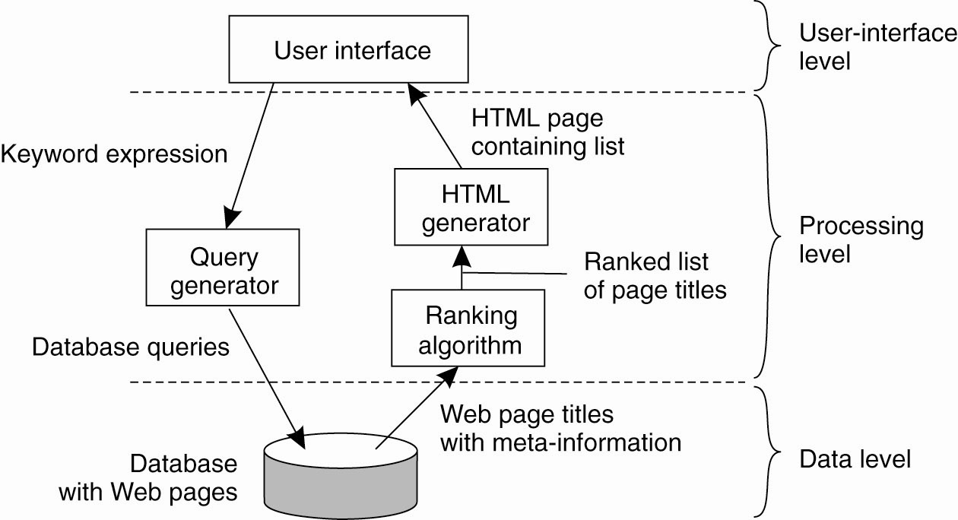
Application Layering (2)
Figure 2-4. The simplified organization of an Internet search engine into three different layers.

Slide 10
Multitiered Architectures (1)
The simplest organization is to have only two types of machines:
A client machine containing only the programs implementing (part of) the user-interface level
A server machine containing the rest,
the programs implementing the processing and data level

Slide 11
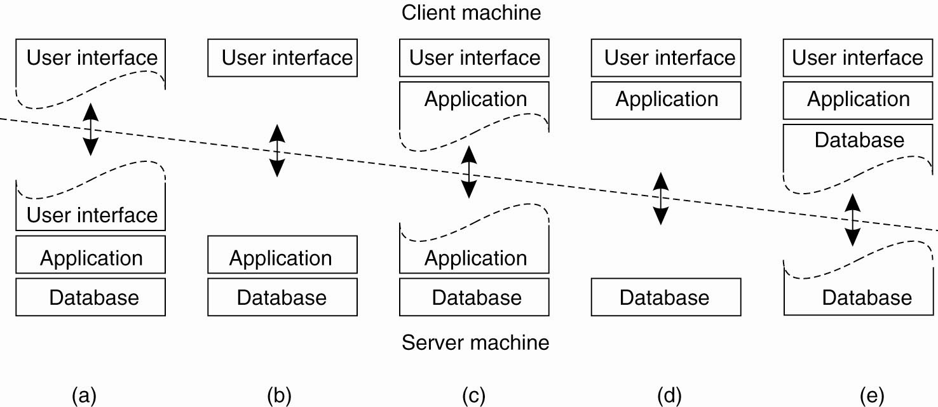
Multitiered Architectures (2)
Figure 2-5. Alternative client-server organizations (a)–(e).

Slide 12
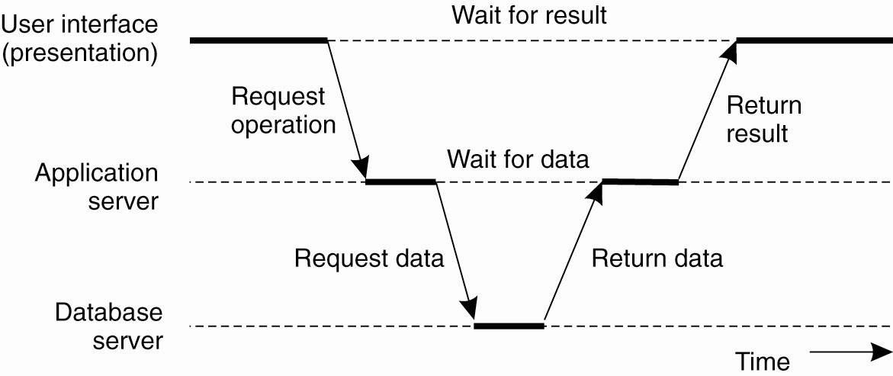
Multitiered Architectures (3)
Figure 2-6. An example of a server acting as client.

Slide 13
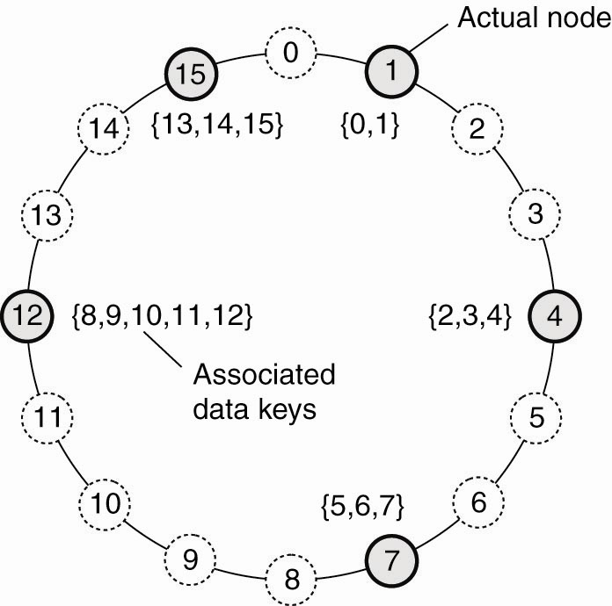
Structured Peer-to-Peer Architectures (1)
Figure 2-7. The mapping of data items onto nodes in Chord.

Slide 14
Structured Peer-to-Peer Architectures (2)
Figure 2-8. (a) The mapping of data items onto nodes in CAN.

Slide 15
Structured Peer-to-Peer Architectures (3)
Figure 2-8. (b) Splitting a region when a node joins.

Slide 16
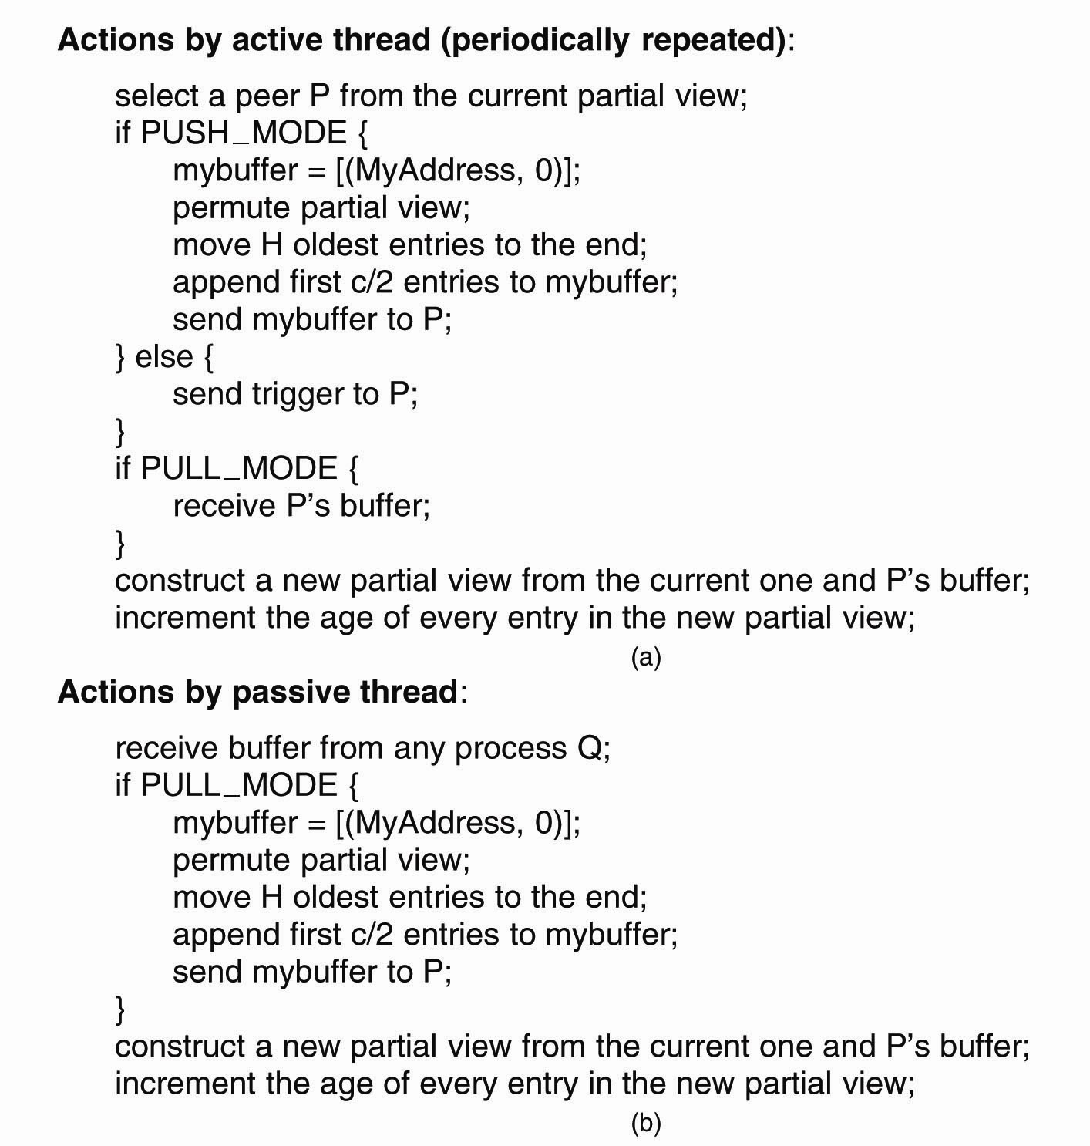
Unstructured Peer-to-Peer Architectures (1)
Figure 2-9. (a) The steps taken by the active thread.

Slide 17
Unstructured Peer-to-Peer Architectures (2)
Figure 2-9. (b) The steps take by the passive thread

Slide 18
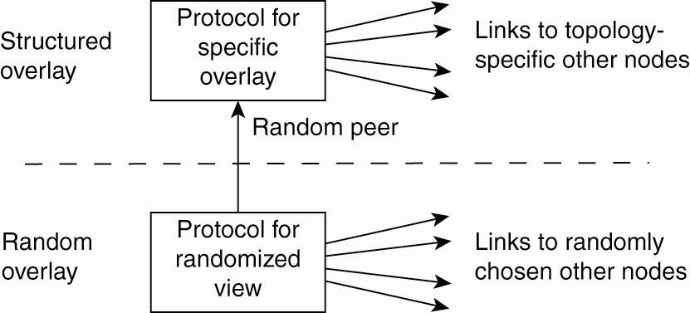
Topology Management of Overlay Networks (1)
Figure 2-10. A two-layered approach for constructing and maintaining specific overlay topologies using techniques from unstructured peer-to-peer systems.

Slide 19
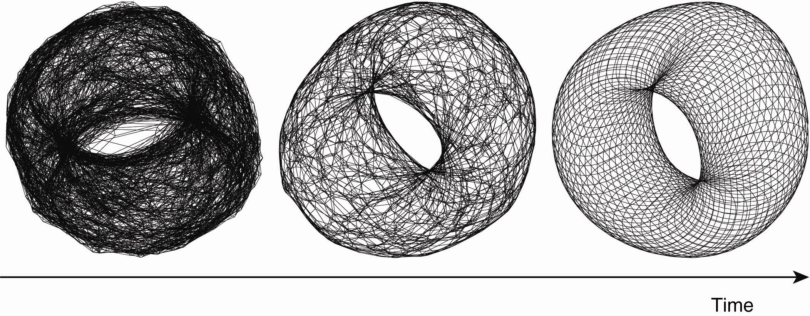
Topology Management of Overlay Networks (2)
Figure 2-11. Generating a specific overlay network using a two-layered unstructured peer-to-peer system [adapted with permission from Jelasity and Babaoglu (2005)].

Slide 20
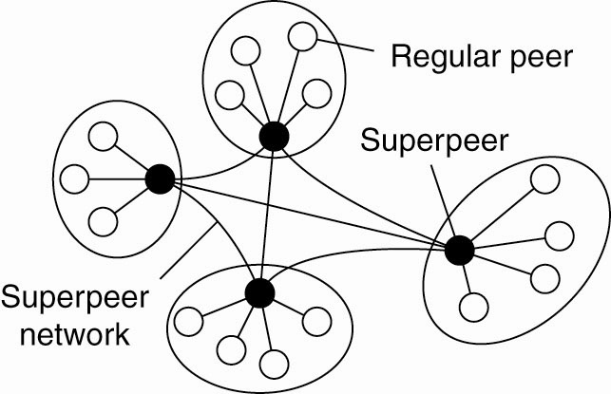
Superpeers
Figure 2-12. A hierarchical organization of nodes into a superpeer network.

Slide 21
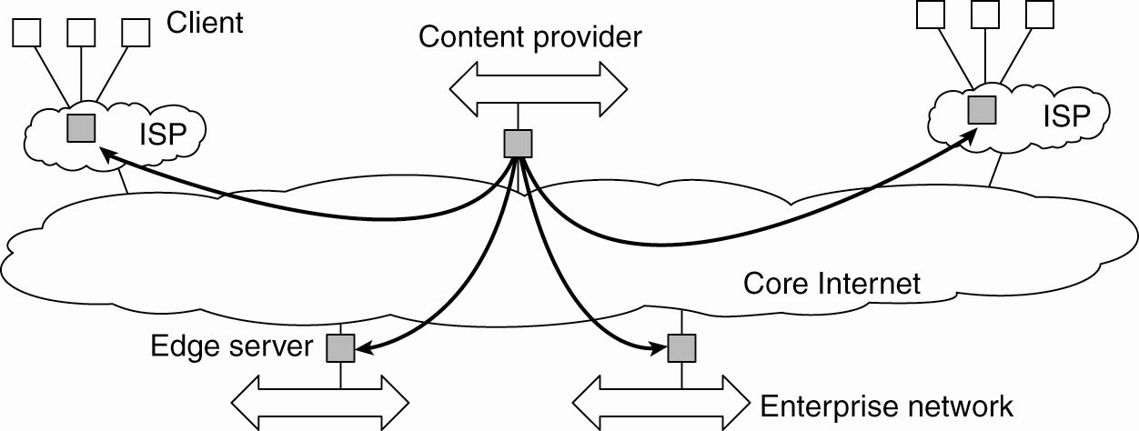
Edge-Server Systems
Figure 2-13. Viewing the Internet as consisting of a collection of edge servers.

Slide 22
Collaborative Distributed Systems (1)
Figure 2-14. The principal working of BitTorrent [adapted with permission from Pouwelse et al. (2004)].

Slide 23
Collaborative Distributed Systems (2)
Components of Globule collaborative content distribution network:
A component that can redirect client requests to other servers.
A component for analyzing access patterns.
A component for managing the replication of Web pages.

Slide 24
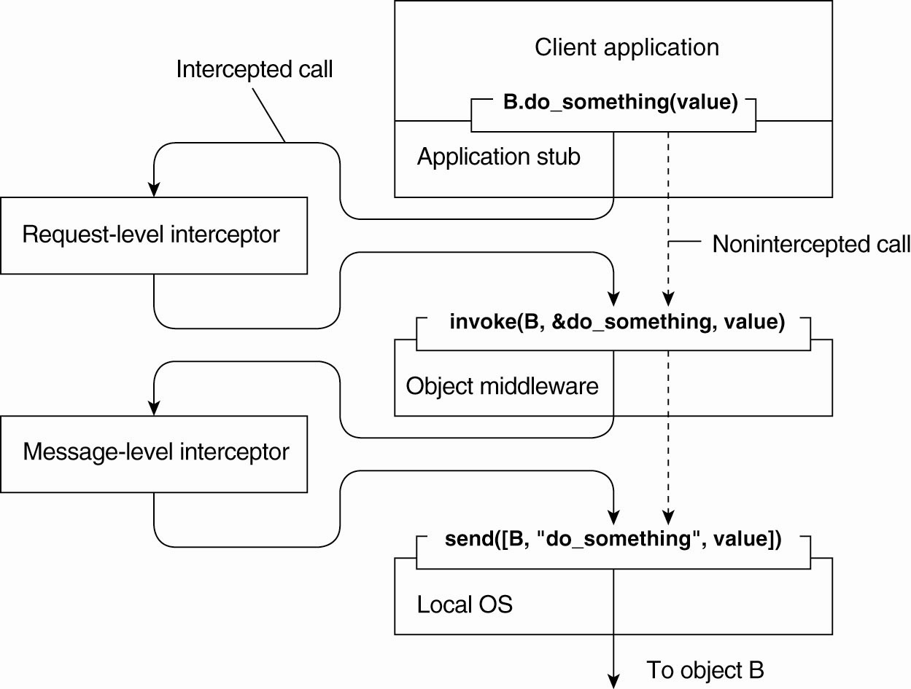
Interceptors
Figure 2-15. Using interceptors to handle remote-object invocations.

Slide 25
General Approaches to Adaptive Software
Three basic approaches to adaptive software:
Separation of concerns
Computational reflection
Component-based design

Slide 26
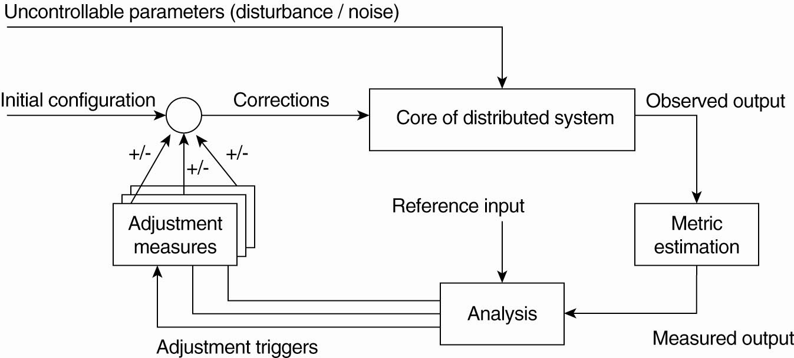
The Feedback Control Model
Figure 2-16. The logical organization of a feedback control system.

Slide 27
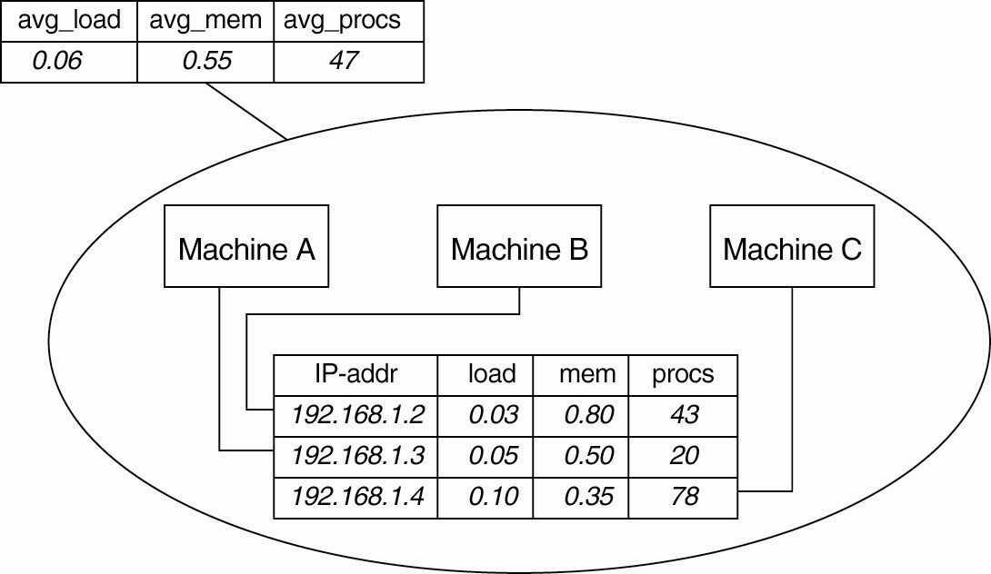
Example: Systems Monitoring with Astrolabe
Figure 2-17. Data collection and information aggregation in Astrolabe.

Slide 28
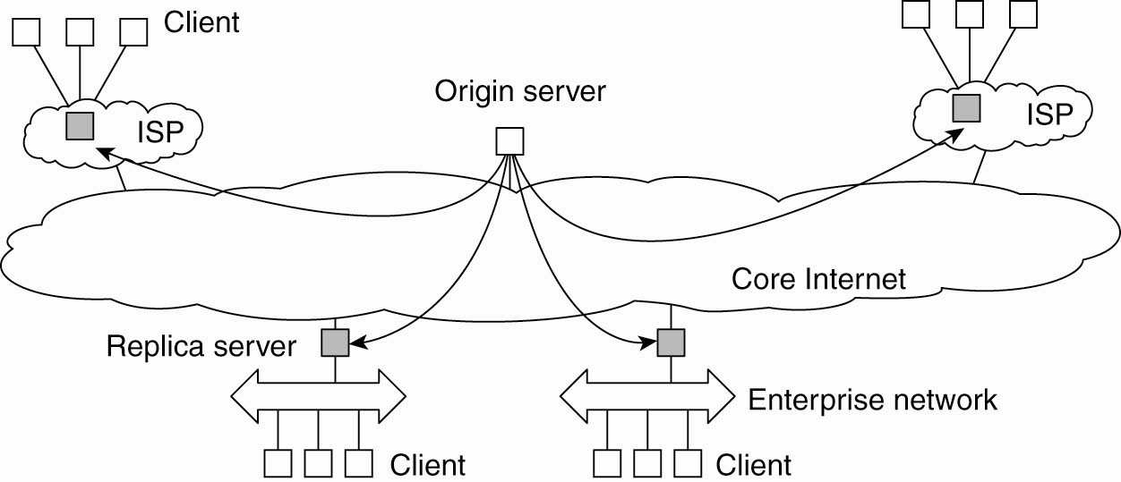
Example: Differentiating Replication Strategies in Globule (1)
Figure 2-18. The edge-server model assumed by Globule.

Slide 29
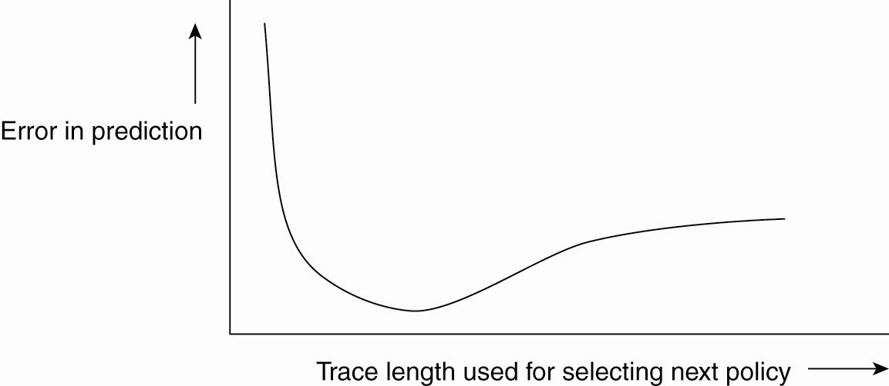
Example: Differentiating Replication Strategies in Globule (2)
Figure 2-19. The dependency between prediction accuracy and trace length.

Slide 30
Example: Automatic Component Repair Management in Jade
Steps required in a repair procedure:
Terminate every binding between a component on a nonfaulty node, and a component on the node that just failed.
Request the node manager to start and add a new node to the domain.
Configure the new node with exactly the same components as those on the crashed node.
Re-establish all the bindings that were previously terminated.

Slide 31
Thank You !

