Slide 1
Processes
Munawar, PhD

Slide 2
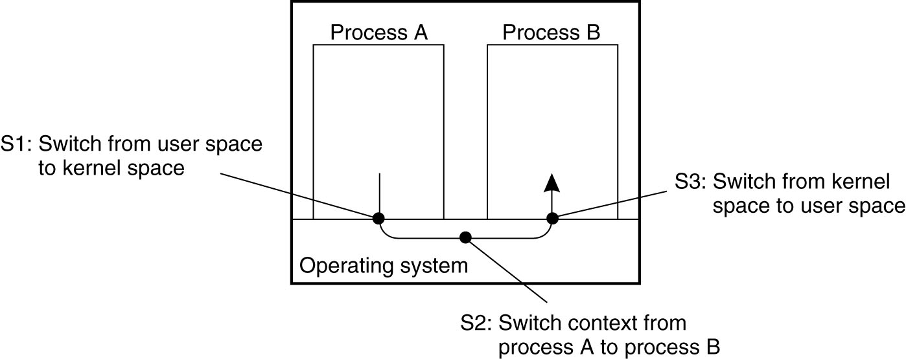
Thread Usage in Non distributed Systems
Figure 3-1. Context switching as the result of IPC.

Slide 3
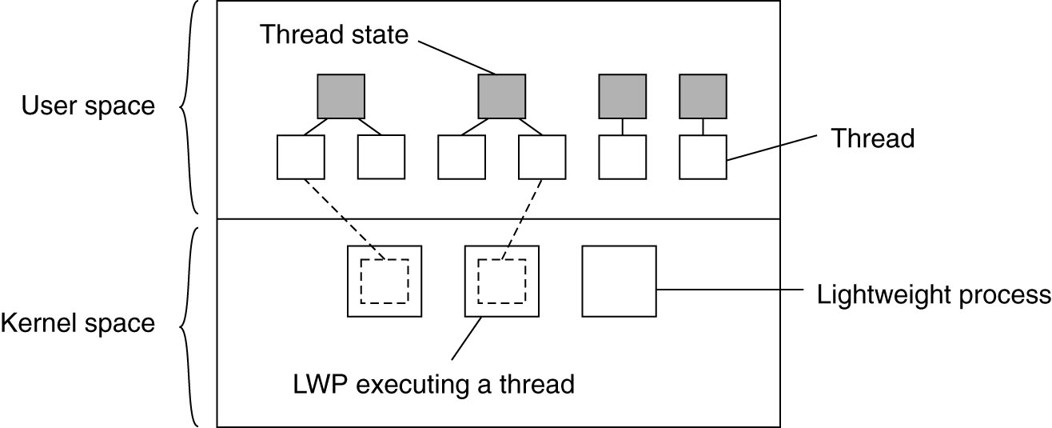
Thread Implementation
Figure 3-2. Combining kernel-level lightweight processes and user-level threads.

Slide 4
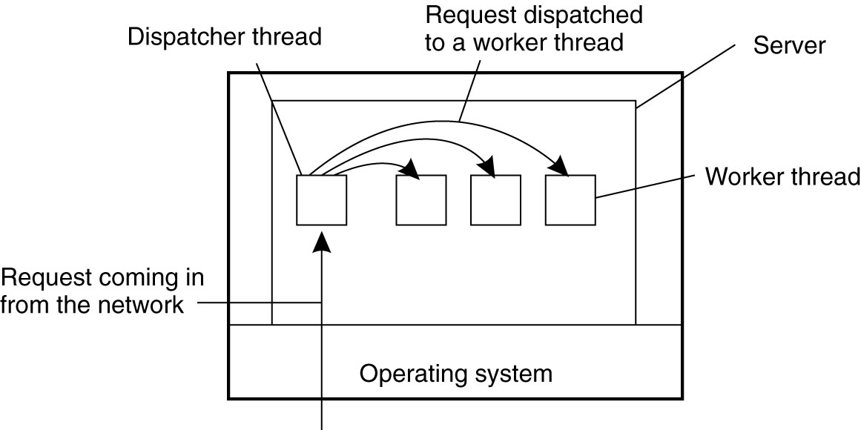
Multithreaded Servers (1)
Figure 3-3. A multithreaded server organized in a dispatcher/worker model.

Slide 5
Multithreaded Servers (2)
Figure 3-4. Three ways to construct a server.

Slide 6
The Role of Virtualization in Distributed Systems
Figure 3-5. (a) General organization between a program, interface, and system. (b) General organization of virtualizing system A on top of system B.

Slide 7
Architectures of Virtual Machines (1)
Interfaces at different levels
An interface between the hardware and software consisting of machine instructions
that can be invoked by any program.
An interface between the hardware and software, consisting of machine instructions
that can be invoked only by privileged programs, such as an operating system.

Slide 8
Architectures of Virtual Machines (2)
Interfaces at different levels
An interface consisting of system calls as offered by an operating system.
An interface consisting of library calls
generally forming what is known as an application programming interface (API).
In many cases, the aforementioned system calls are hidden by an API.

Slide 9
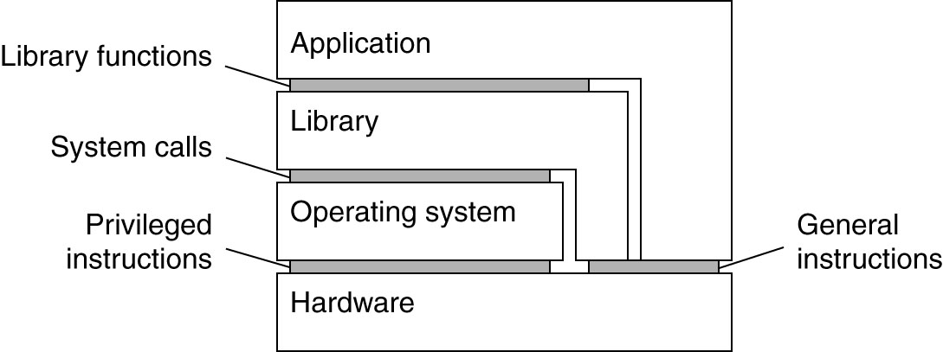
Architectures of Virtual Machines (3)
Figure 3-6. Various interfaces offered by computer systems.

Slide 10
Architectures of Virtual Machines (4)
Figure 3-7. (a) A process virtual machine, with multiple instances of (application, runtime) combinations.

Slide 11
Architectures of Virtual Machines (5)
Figure 3-7. (b) A virtual machine monitor, with multiple instances of (applications, operating system) combinations.

Slide 12
Networked User Interfaces (1)
Figure 3-8. (a) A networked application with its own protocol.

Slide 13
Networked User Interfaces (2)
Figure 3-8. (b) A general solution to allow access to remote applications.

Slide 14
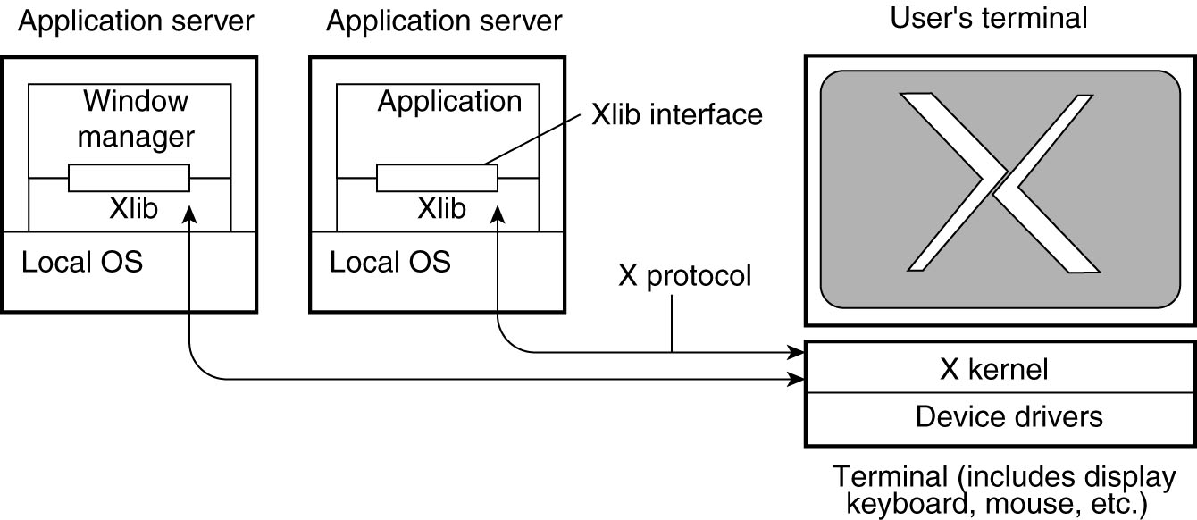
Example: The XWindow System
Figure 3-9. The basic organization of theXWindow System.

Slide 15
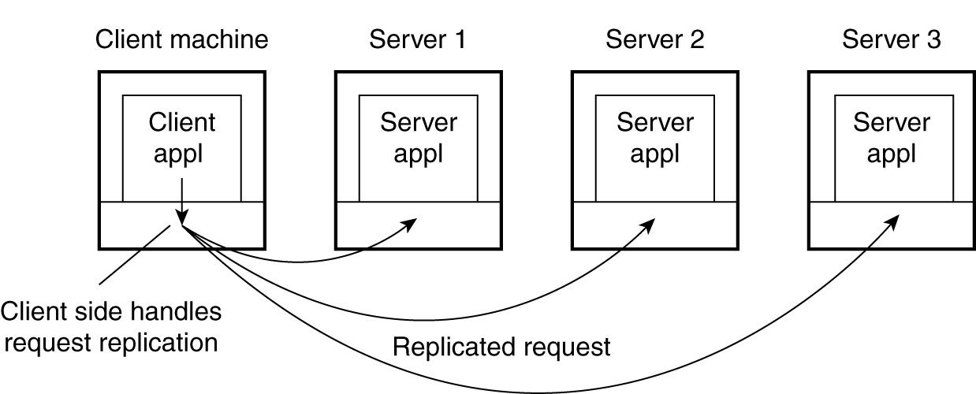
Client-Side Software for Distribution Transparency
Figure 3-10. Transparent replication of a server using a client-side solution.

Slide 16
General Design Issues (1)
Figure 3-11. (a) Client-to-server binding using a daemon.

Slide 17
General Design Issues (2)
Figure 3-11. (b) Client-to-server binding using a superserver.

Slide 18
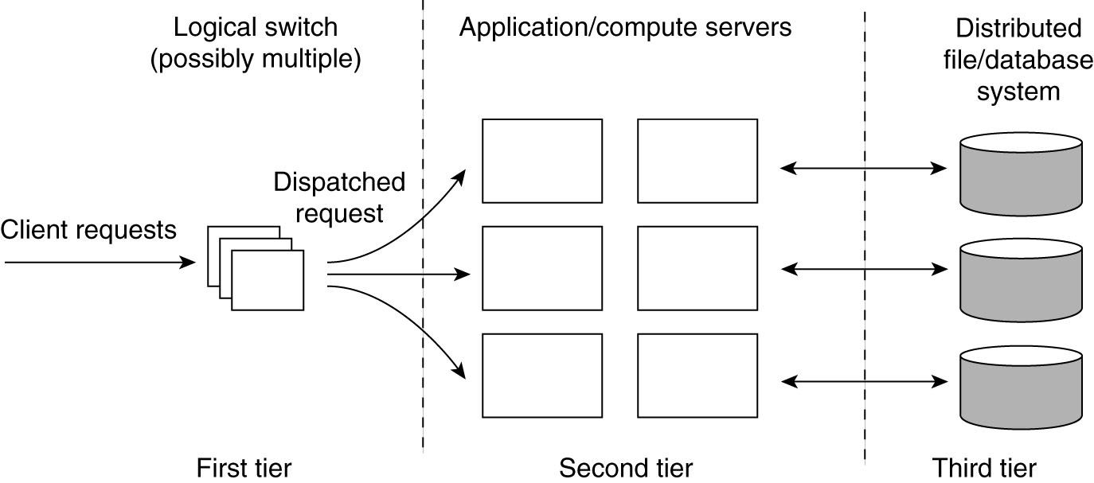
Server Clusters (1)
Figure 3-12. The general organization of a three-tiered server cluster.

Slide 19
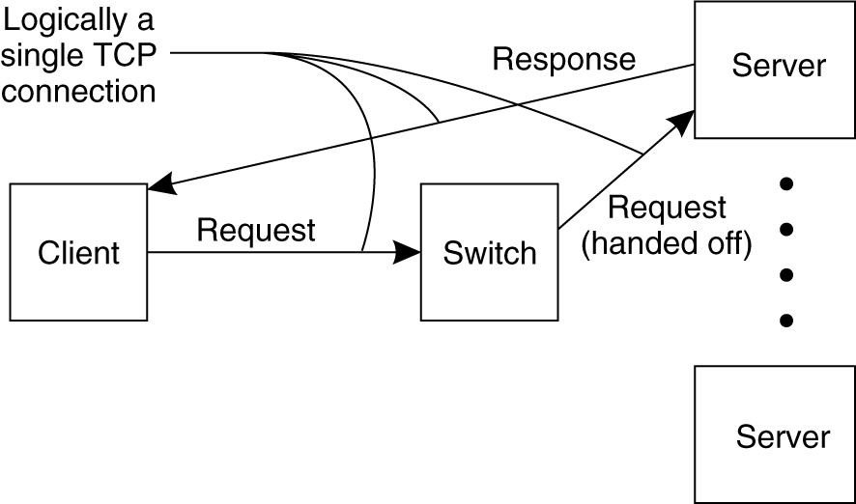
Server Clusters (2)
Figure 3-13. The principle of TCP handoff.

Slide 20
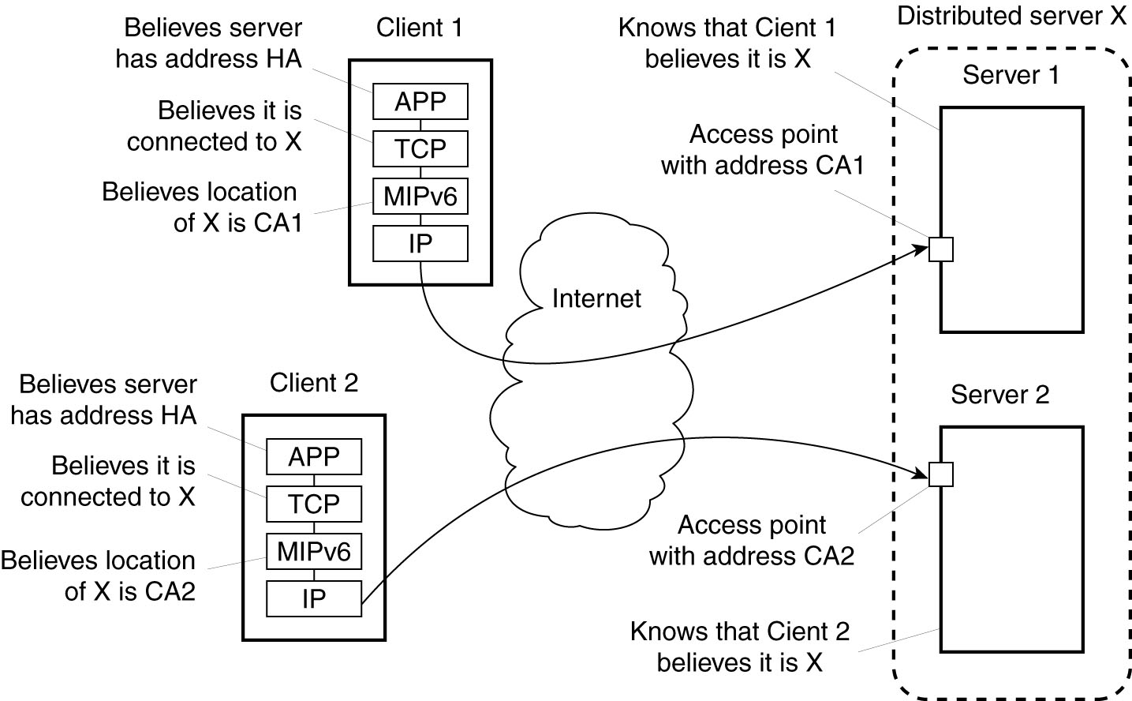
Distributed Servers
Figure 3-14. Route optimization in a distributed server.

Slide 21
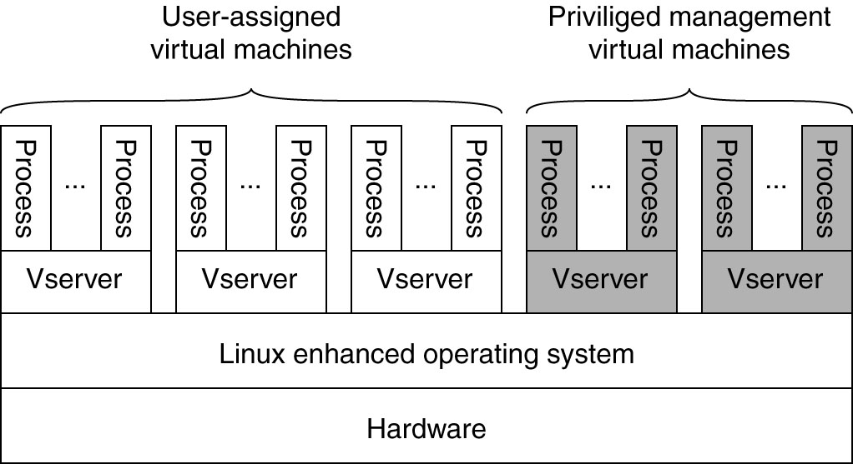
Managing Server Clusters
Figure 3-15. The basic organization of a PlanetLab node.

Slide 22
PlanetLab (1)
PlanetLab management issues:
Nodes belong to different organizations.
Each organization should be allowed to specify who is allowed to run applications on their nodes,
And restrict resource usage appropriately.
Monitoring tools available assume a very specific combination of hardware and software.
All tailored to be used within a single organization.
Programs from different slices but running on the same node should not interfere with each other.

Slide 23
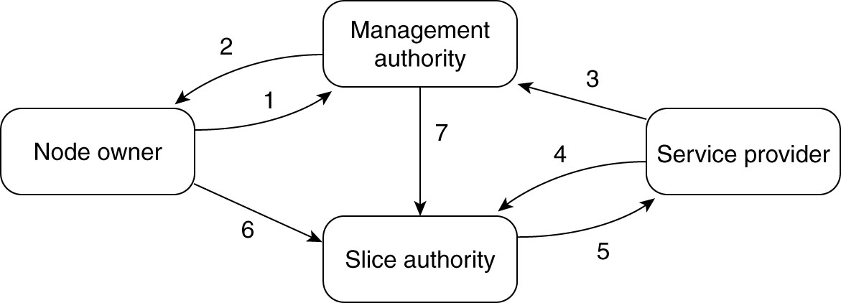
PlanetLab (2)
Figure 3-16. The management relationships between various PlanetLab entities.

Slide 24
PlanetLab (3)
Relationships between PlanetLab entities:
A node owner puts its node under the regime of a management authority, possibly restricting usage where appropriate.
A management authority provides the necessary software to add a node to PlanetLab.
A service provider registers itself with a management authority, trusting it to provide well-behaving nodes.

Slide 25
PlanetLab (4)
Relationships between PlanetLab entities:
A service provider contacts a slice authority to create a slice on a collection of nodes.
The slice authority needs to authenticate the service provider.
A node owner provides a slice creation service for a slice authority to create slices. It essentially delegates resource management to the slice authority.
A management authority delegates the creation of slices to a slice authority.

Slide 26
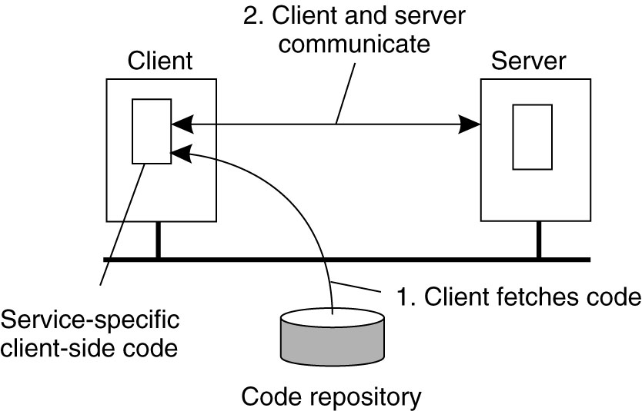
Reasons for Migrating Code
Figure 3-17. The principle of dynamically configuring a client to communicate to a server. The client first fetches the necessary software, and then invokes the server.

Slide 27
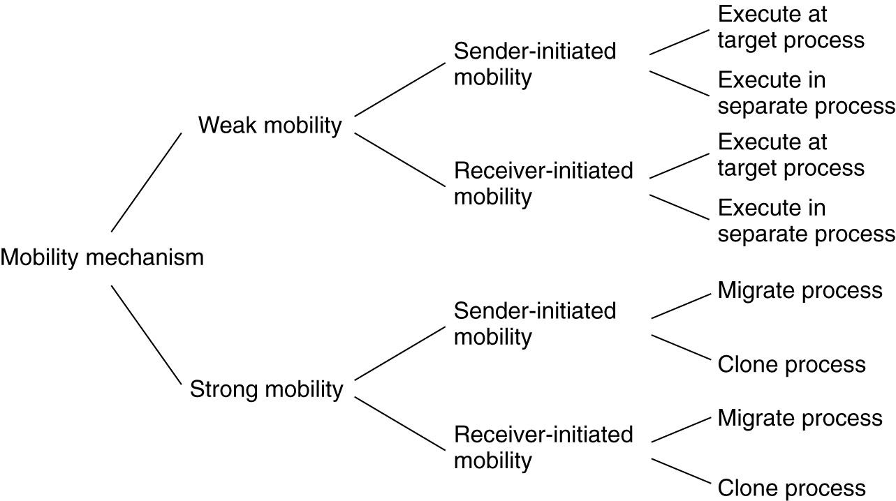
Models for Code Migration
Figure 3-18. Alternatives for code migration.

Slide 28
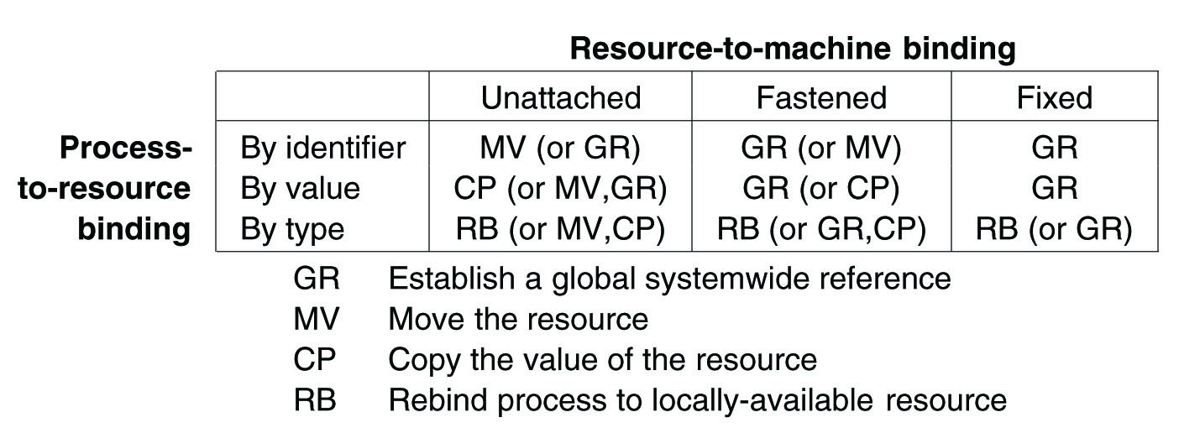
Migration and Local Resources
Figure 3-19. Actions to be taken with respect to the references to local resources when migrating code to another machine.

Slide 29
Migration in Heterogeneous Systems
Three ways to handle migration (which can be combined)
Pushing memory pages to the new machine and resending the ones that are later modified during the migration process.
Stopping the current virtual machine; migrate memory, and start the new virtual machine.
Letting the new virtual machine pull in new pages as needed, that is, let processes start on the new virtual machine immediately and copy memory pages on demand.

Slide 30
Thank You !

