Slide 1
Naming
Munawar, PhD

Slide 2
Names, Identifiers, And Addresses
Properties of a true identifier:
An identifier refers to at most one entity.
Each entity is referred to by at most one identifier.
An identifier always refers to the same entity

Slide 3
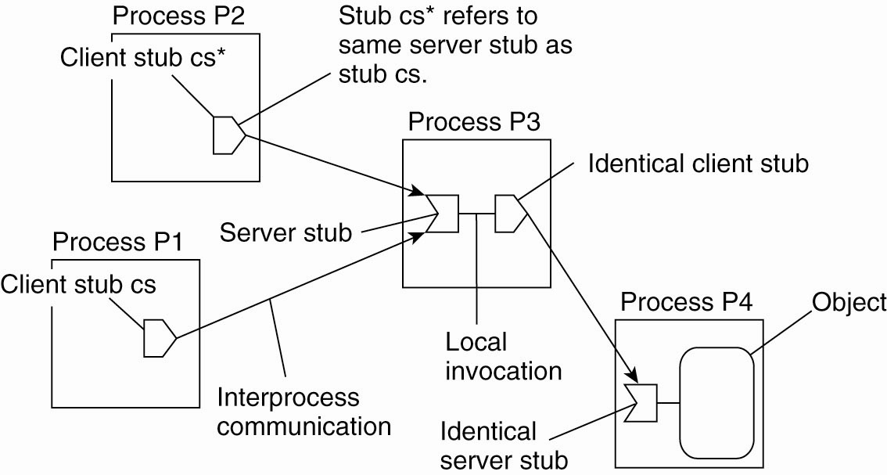
Forwarding Pointers (1)
Figure 5-1. The principle of forwarding pointers
using (client stub, server stub) pairs.

Slide 4
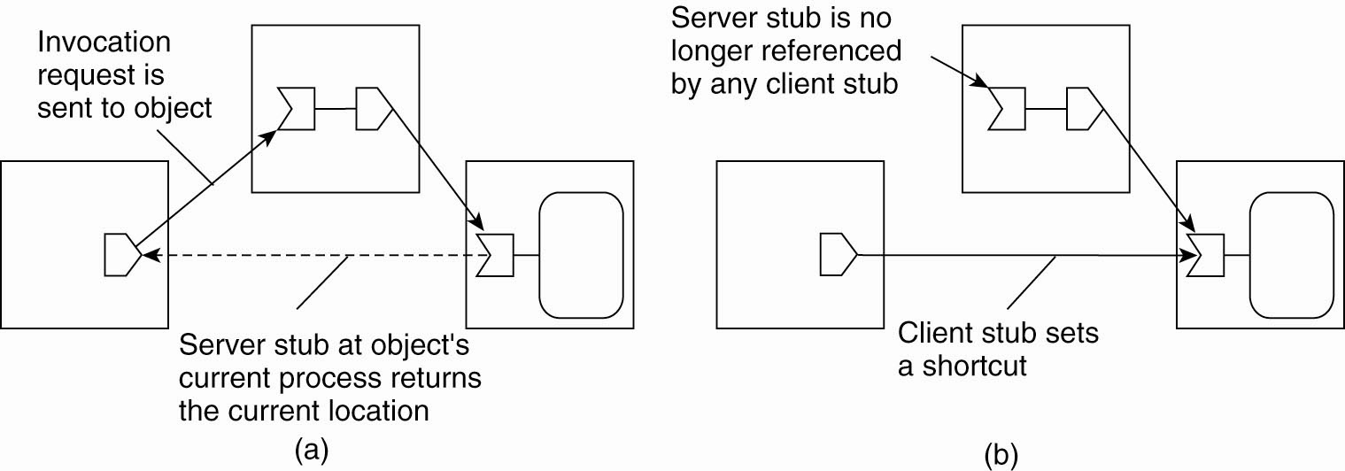
Forwarding Pointers (2)
Figure 5-2. Redirecting a forwarding pointer by
storing a shortcut in a client stub.

Slide 5
Forwarding Pointers (3)
Figure 5-2. Redirecting a forwarding pointer by
storing a shortcut in a client stub.

Slide 6
Home-Based Approaches
Figure 5-3. The principle of Mobile IP.

Slide 7
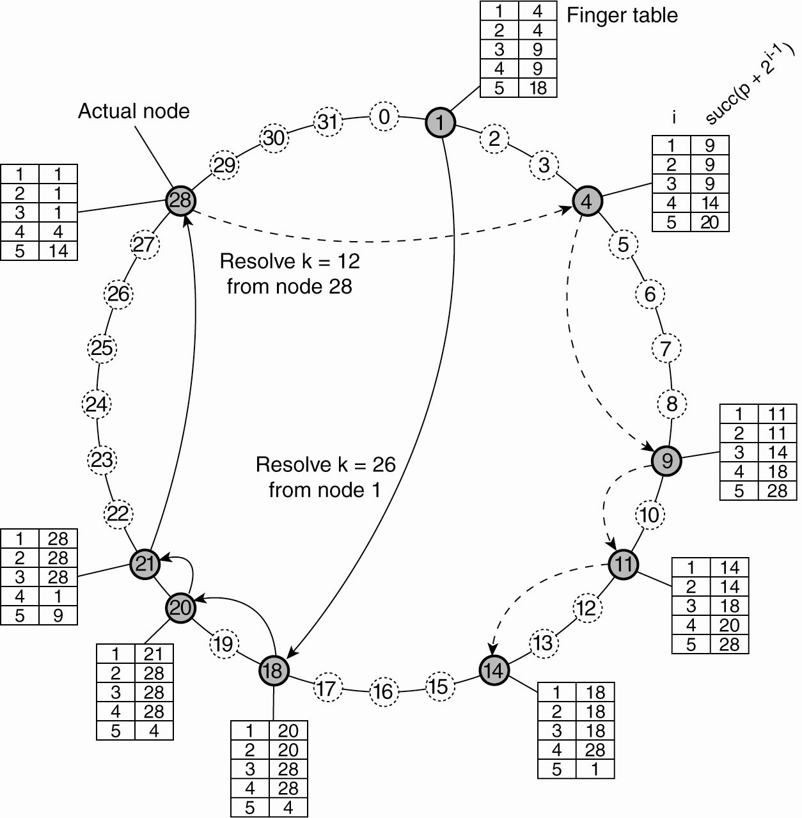
Distributed Hash Tables General Mechanism
Figure 5-4. Resolving key 26 from node 1 and key 12 from node 28 in a Chord system.

Slide 8
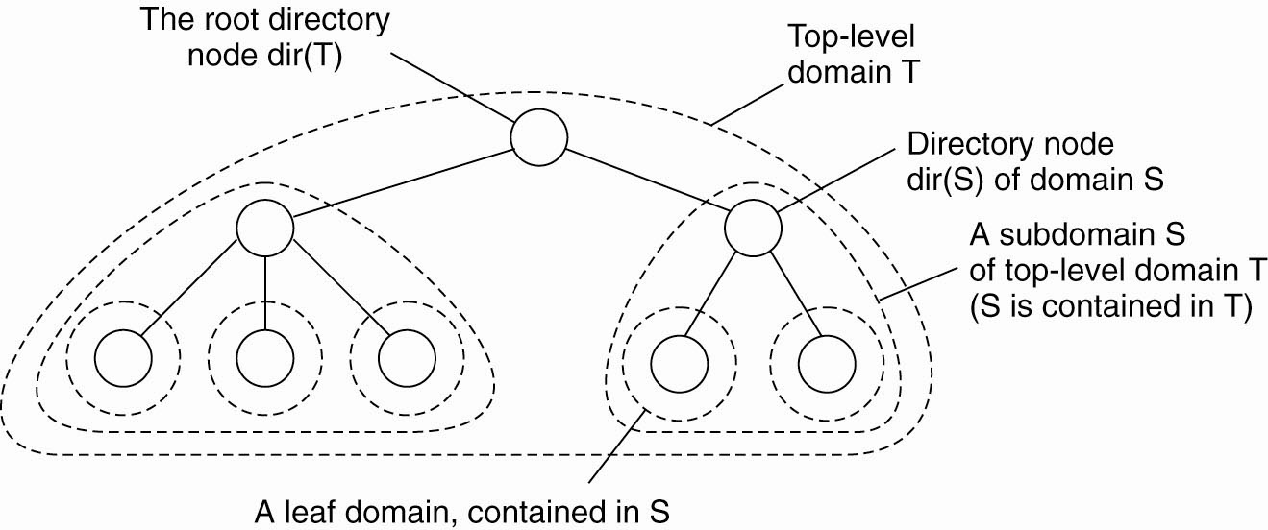
Hierarchical Approaches (1)
Figure 5-5. Hierarchical organization of a location service into domains, each having an associated directory node.

Slide 9
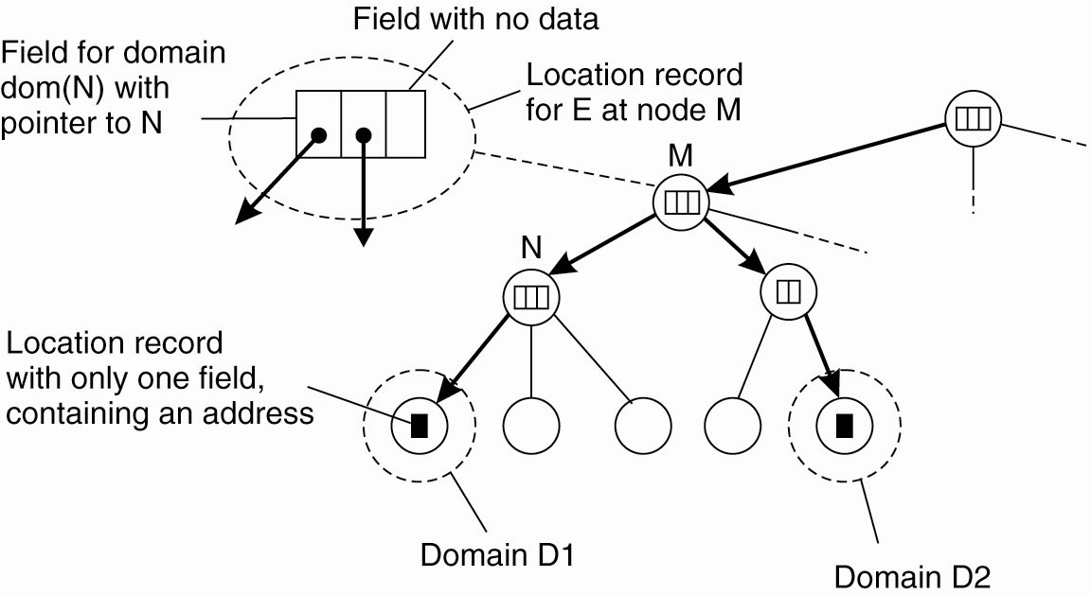
Hierarchical Approaches (2)
Figure 5-6. An example of storing information of an entity
having two addresses in different leaf domains.

Slide 10
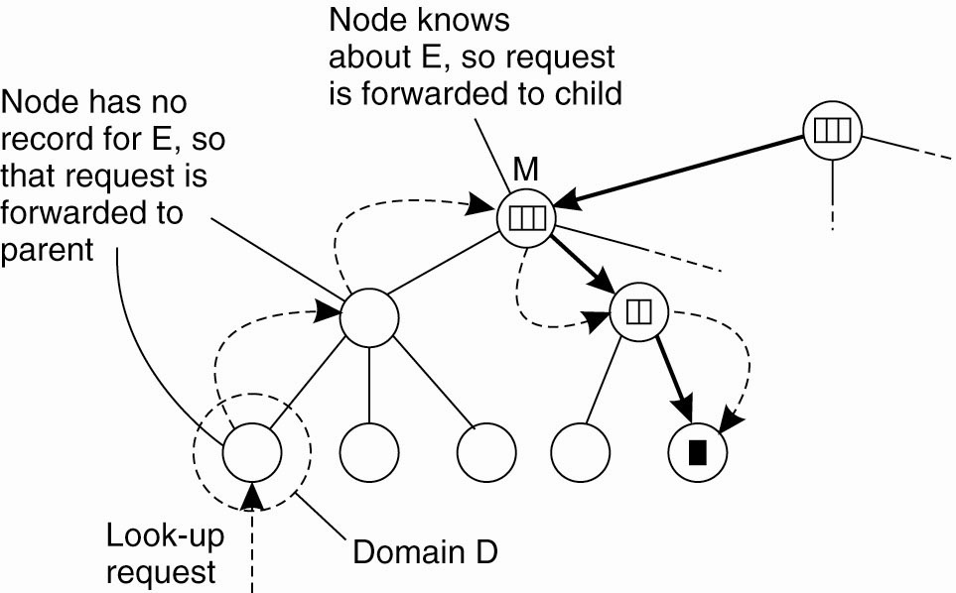
Hierarchical Approaches (3)
Figure 5-7. Looking up a location in a hierarchically
organized location service.

Slide 11
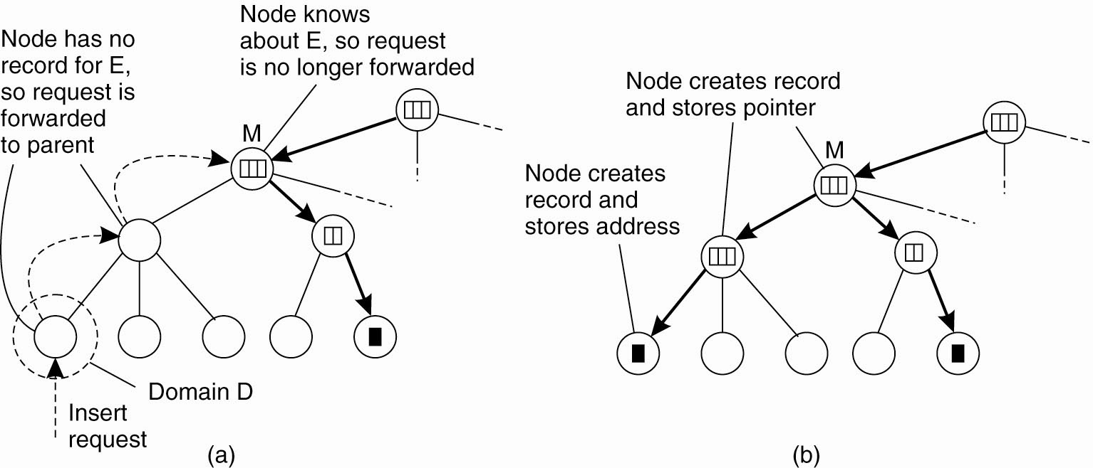
Hierarchical Approaches (4)
Figure 5-8. (a) An insert request is forwarded to the
first node that knows about entity E.

Slide 12
Hierarchical Approaches (5)
Figure 5-8. (b) A chain of forwarding pointers
to the leaf node is created.

Slide 13
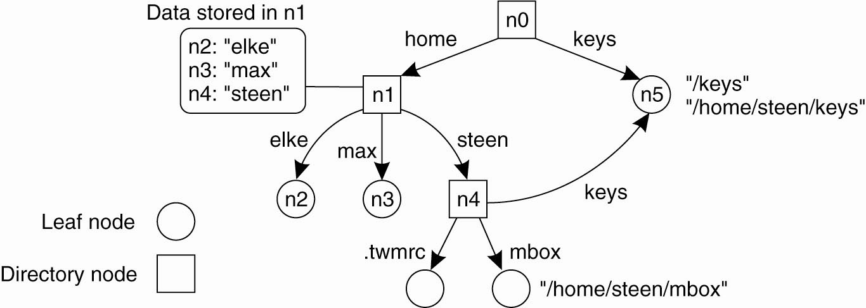
Name Spaces (1)
Figure 5-9. A general naming graph with a single root node.

Slide 14
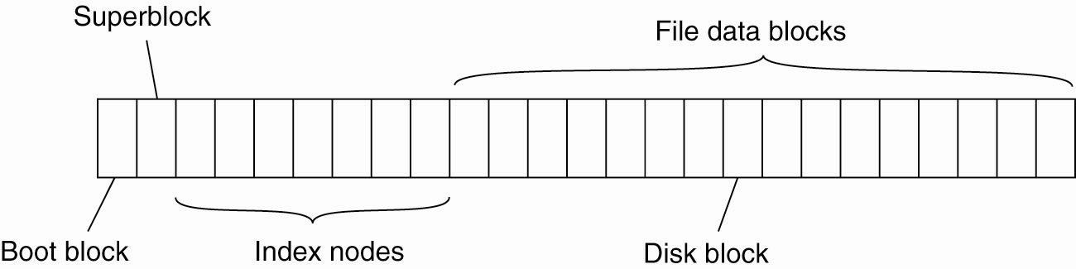
Name Spaces (2)
Figure 5-10. The general organization of the UNIX file system implementation on a logical disk of contiguous disk blocks.

Slide 15
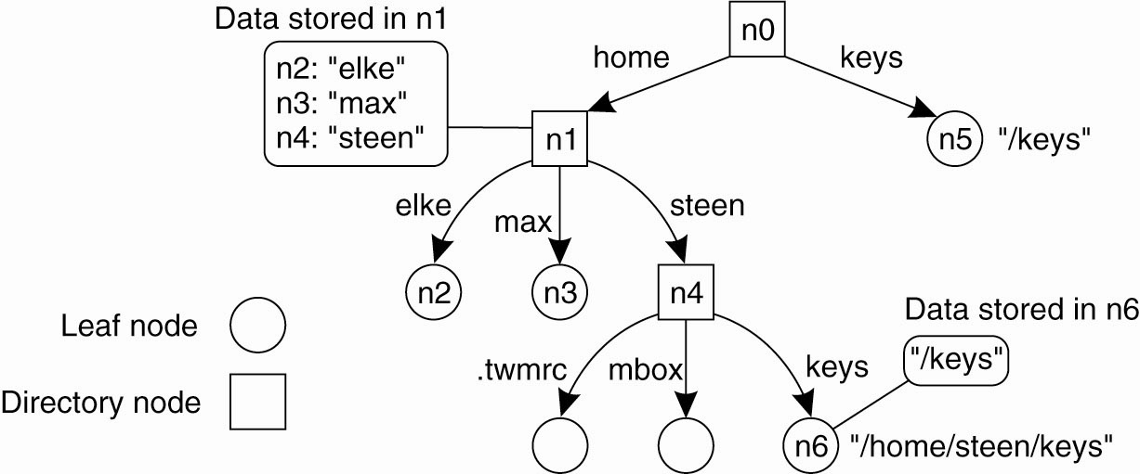
Linking and Mounting (1)
Figure 5-11. The concept of a symbolic link
explained in a naming graph.

Slide 16
Linking and Mounting (2)
Information required to mount a foreign name space in a distributed system
The name of an access protocol.
The name of the server.
The name of the mounting point in the foreign name space.

Slide 17
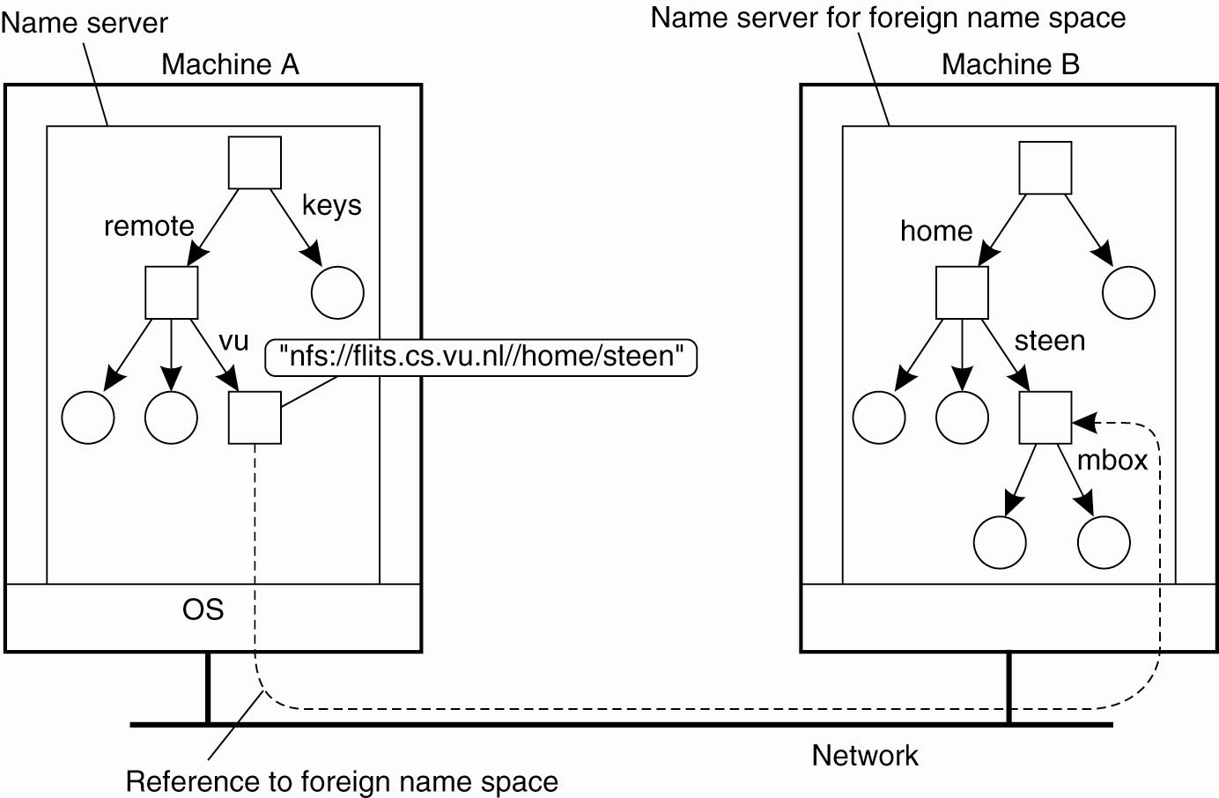
Linking and Mounting (3)
Figure 5-12. Mounting remote name spaces
through a specific access protocol.

Slide 18
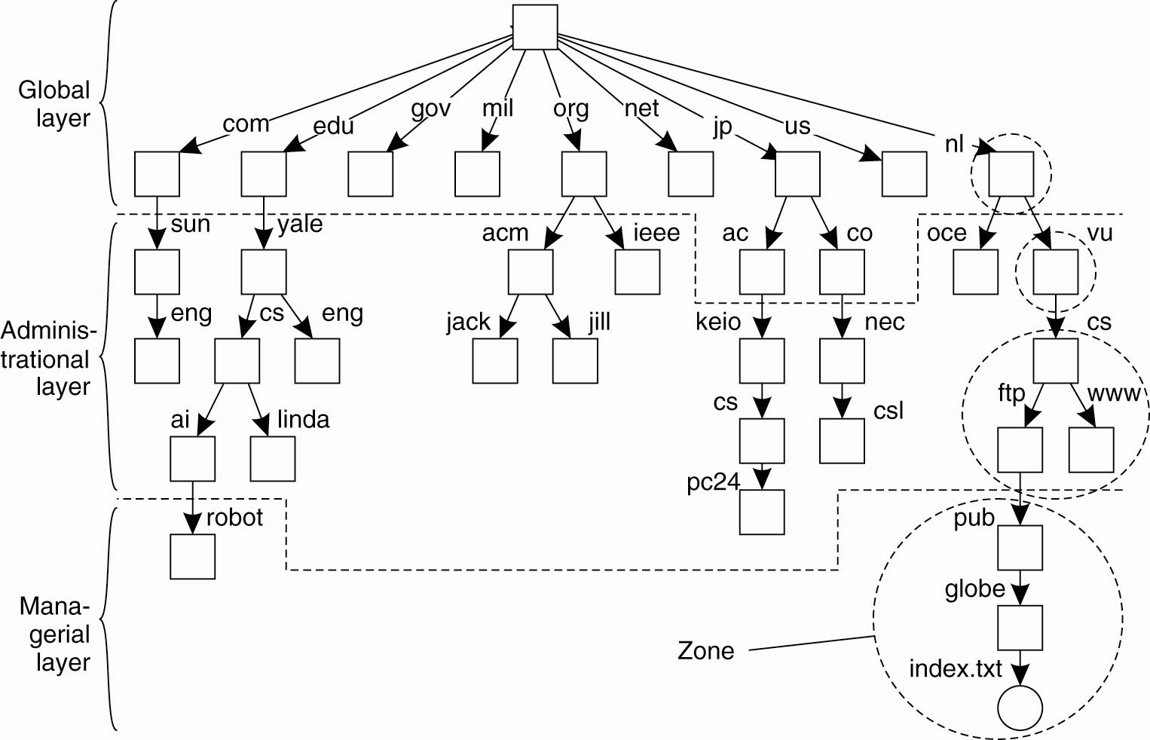
Name Space Distribution (1)
Figure 5-13. An example partitioning of the DNS name space, including Internet-accessible files, into three layers.

Slide 19
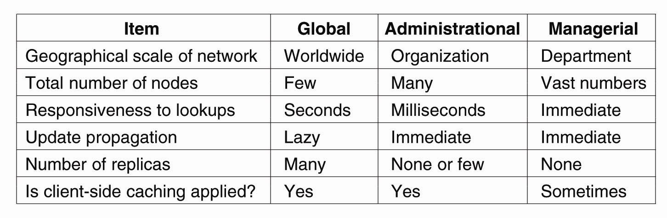
Name Space Distribution (2)
Figure 5-14. A comparison between name servers for implementing nodes from a large-scale name space partitioned into a global layer, an administrational
layer, and a managerial layer.

Slide 20
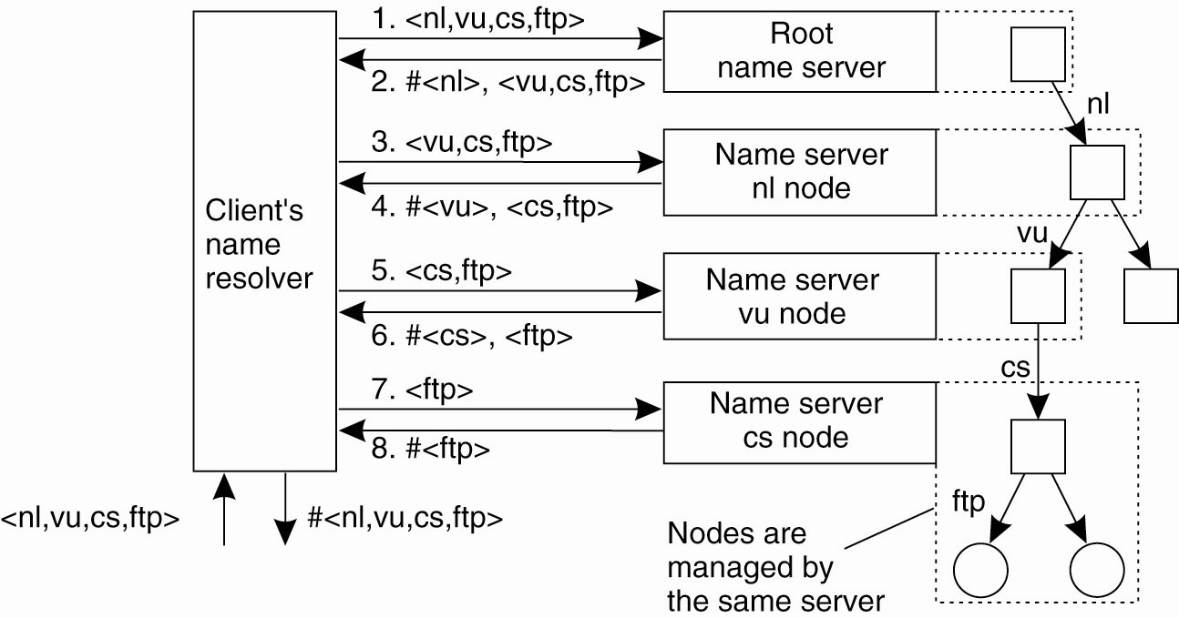
Implementation of Name Resolution (1)
Figure 5-15. The principle of iterative name resolution.

Slide 21
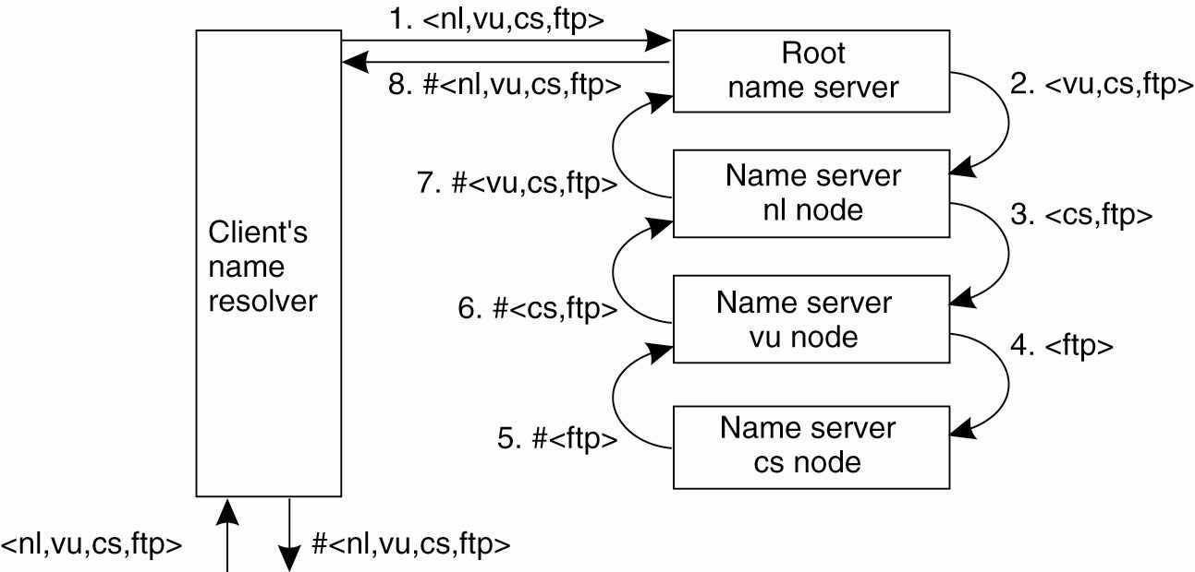
Implementation of Name Resolution (2)
Figure 5-16. The principle of recursive name resolution.

Slide 22
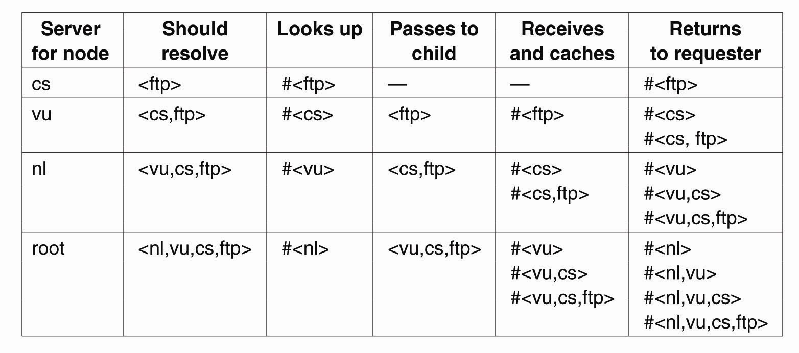
Implementation of Name Resolution (3)
Figure 5-17. Recursive name resolution of <nl, vu, cs, ftp>. Name servers cache intermediate results for subsequent lookups.

Slide 23
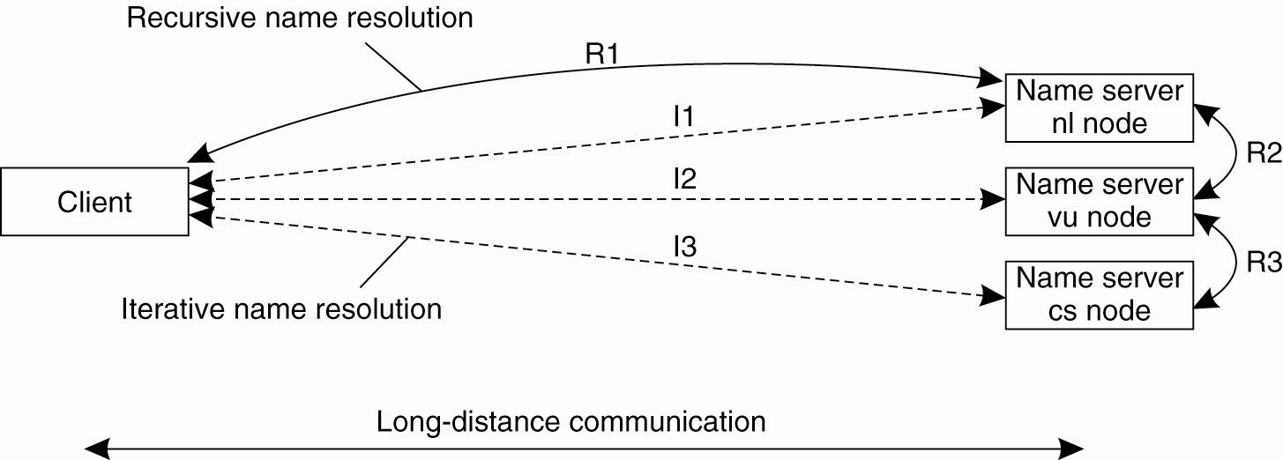
Example: The Domain Name System
Figure 5-18. The comparison between recursive and iterative name resolution with respect to communication costs.

Slide 24
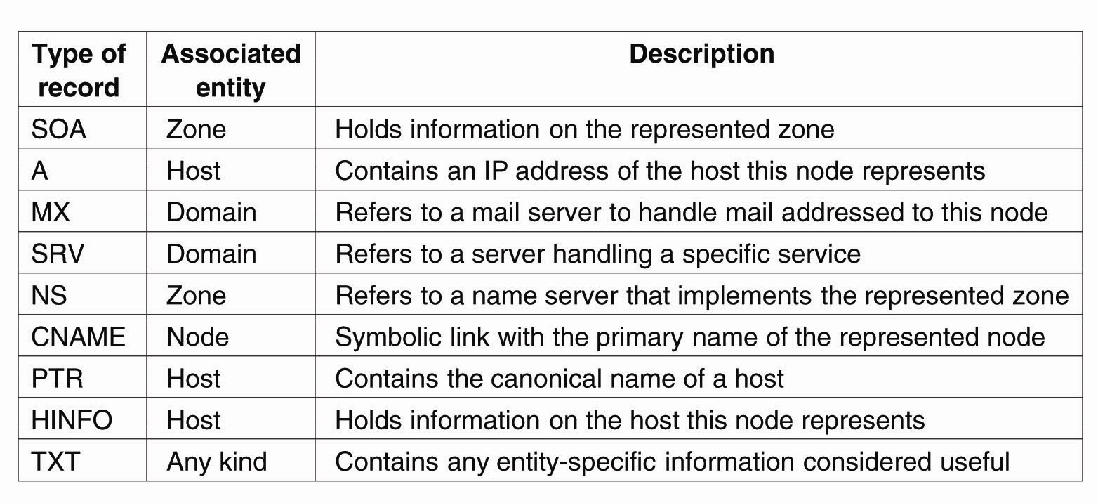
The DNS Name Space
Figure 5-19. The most important types of resource records forming the contents of nodes in the DNS name space.

Slide 25
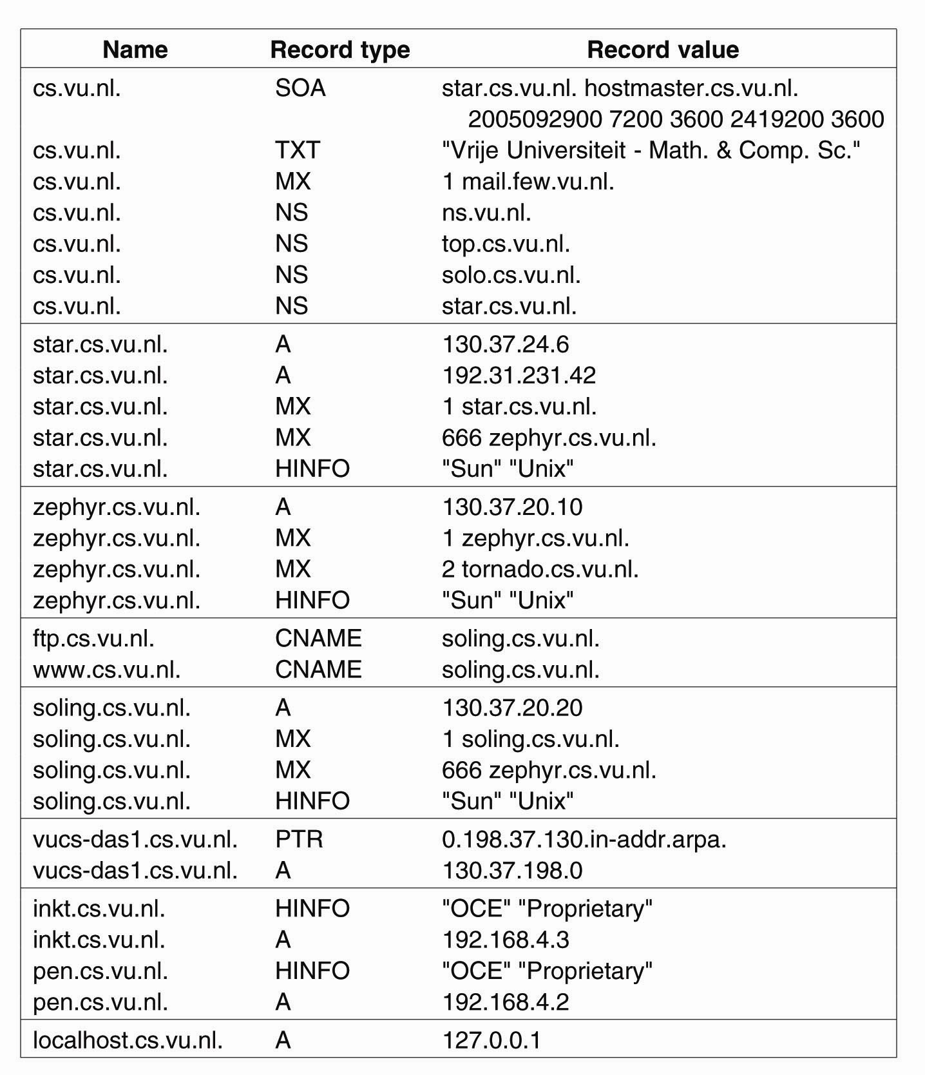
DNS Implementation (1)
Figure 5-20. An excerpt from the DNS database for the zone cs.vu.nl.

Slide 26
DNS Implementation (2)
Figure 5-20. An excerpt from the DNS
database for the zone cs.vu.nl.

Slide 27
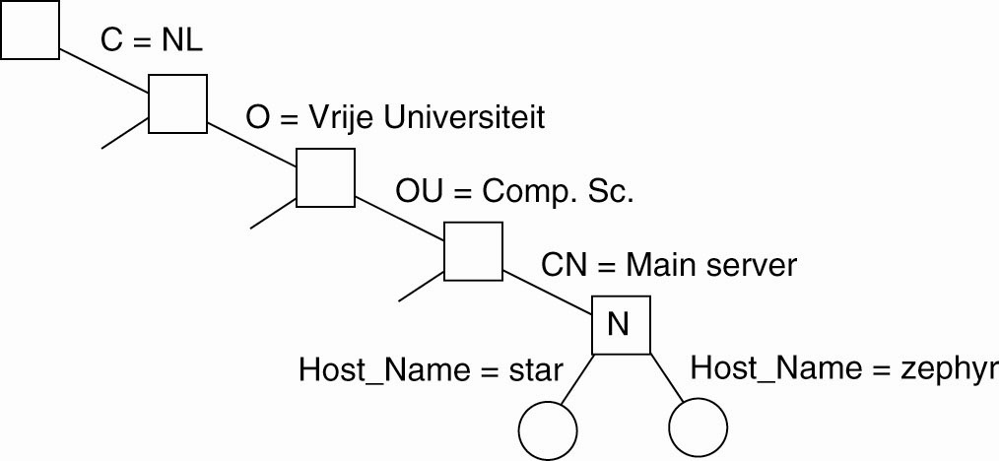
DNS Implementation (3)
Figure 5-21. Part of the description for the vu.nl
domain which contains the cs.vu.nl domain.

Slide 28
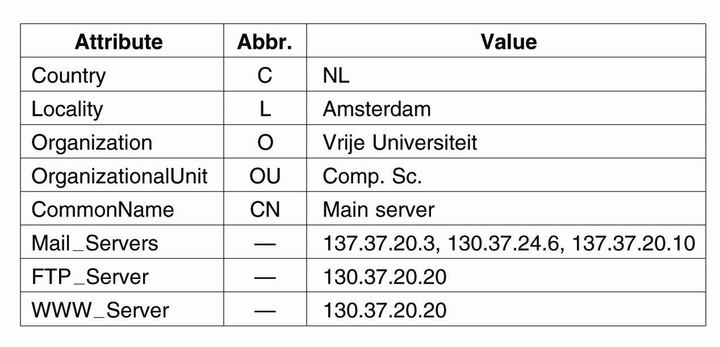
Hierarchical Implementations: LDAP (1)
Figure 5-22. A simple example of an LDAP
directory entry using LDAP naming conventions.

Slide 29
Hierarchical Implementations: LDAP (2)
Figure 5-23. (a) Part of a directory information tree.

Slide 30
Hierarchical Implementations: LDAP (3)
Figure 5-23. (b) Two directory entries
having Host_Name as RDN.

Slide 31
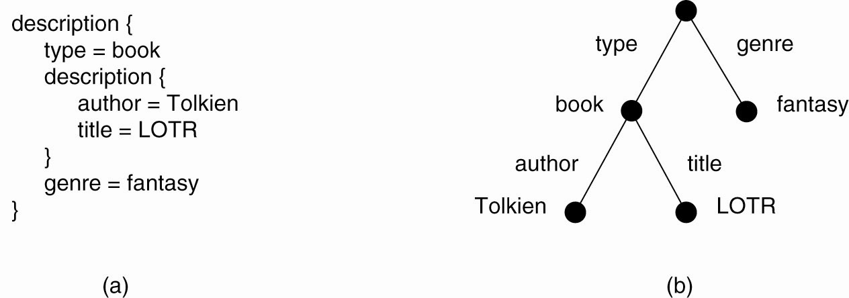
Mapping to Distributed Hash Tables (1)
Figure 5-24. (a) A general description of a resource.
(b) Its representation as an AVTree.

Slide 32
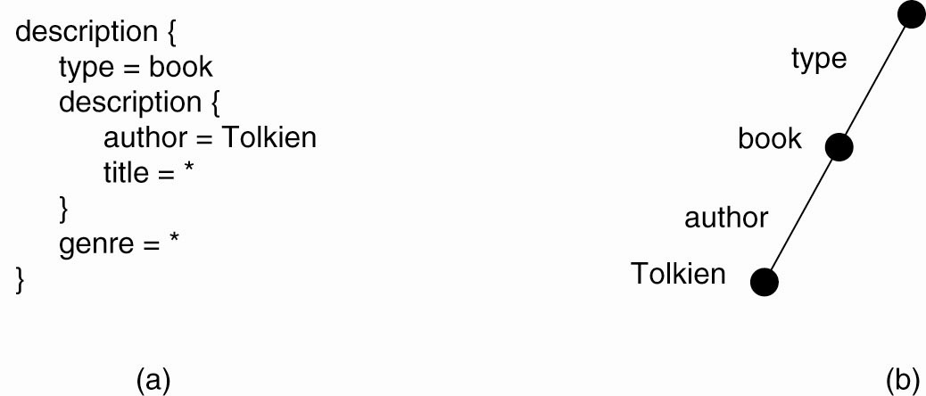
Mapping to Distributed Hash Tables (2)
Figure 5-25. (a) The resource description of a query.
(b) Its representation as an AVTree.

Slide 33
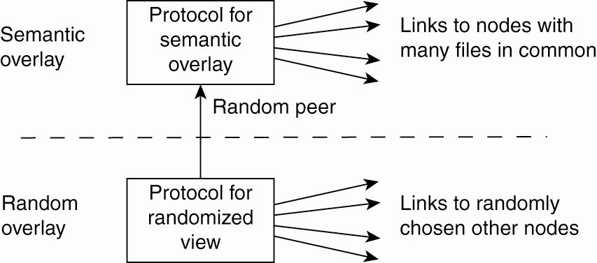
Semantic Overlay Networks
Figure 5-26. Maintaining a semantic overlay through gossiping.

Slide 34
Thank You !

