Slide 1
Synchronization
Munawar, PhD

Slide 2
Clock Synchronization
Figure 6-1. When each machine has its own clock, an event that occurred after another event may nevertheless be assigned an earlier time.

Slide 3
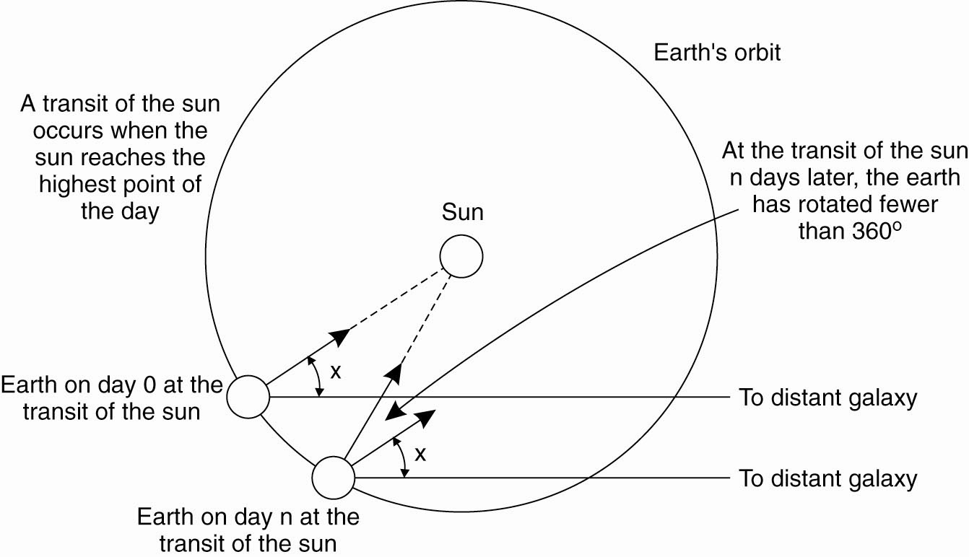
Physical Clocks (1)
Figure 6-2. Computation of the mean solar day.

Slide 4
Physical Clocks (2)
Figure 6-3. TAI seconds are of constant length, unlike solar seconds. Leap seconds are introduced when necessary to keep in phase with the sun.

Slide 5
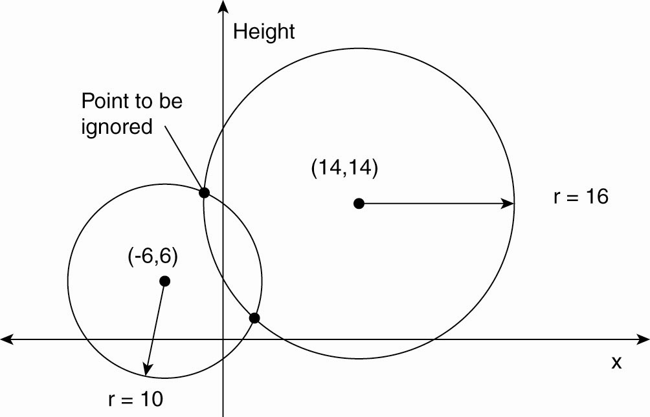
Global Positioning System (1)
Figure 6-4. Computing a position in a two-dimensional space.

Slide 6
Global Positioning System (2)
Real world facts that complicate GPS
It takes a while before data on a satellite’s position reaches the receiver.
The receiver’s clock is generally not in synch with that of a satellite.

Slide 7
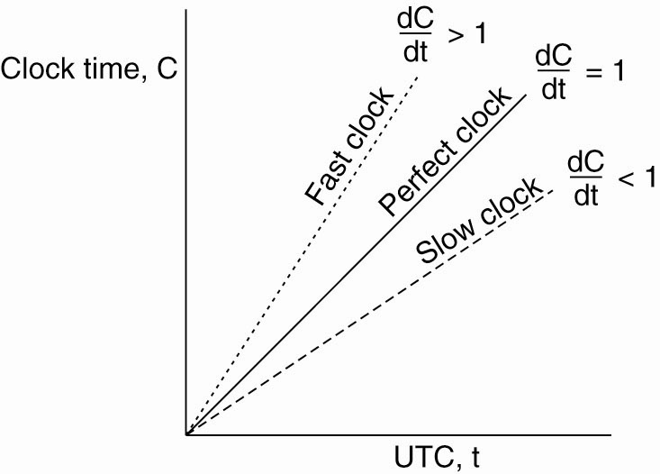
Clock Synchronization Algorithms
Figure 6-5. The relation between clock time and UTC when clocks tick at different rates.

Slide 8
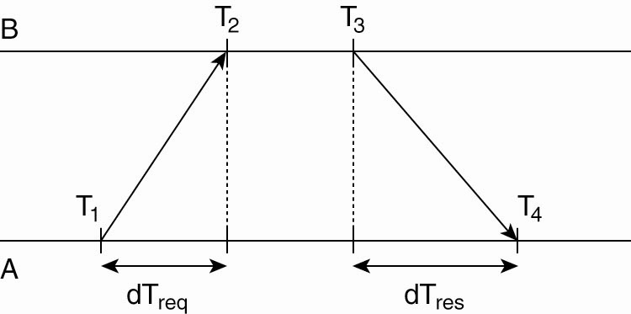
Network Time Protocol
Figure 6-6. Getting the current time from a time server.

Slide 9
The Berkeley Algorithm (1)
Figure 6-7. (a) The time daemon asks all the other machines for their clock values.

Slide 10
The Berkeley Algorithm (2)
Figure 6-7. (b) The machines answer.

Slide 11
The Berkeley Algorithm (3)
Figure 6-7. (c) The time daemon tells everyone how to adjust their clock.

Slide 12
Clock Synchronization in Wireless Networks (1)
Figure 6-8. (a) The usual critical path in determining network delays.

Slide 13
Clock Synchronization in Wireless Networks (2)
Figure 6-8. (b) The
critical path in the
case of RBS.

Slide 14
Lamport’s Logical Clocks (1)
The "happens-before" relation → can be observed directly in two situations:
If a and b are events in the same process, and a occurs before b, then a → b is true.
If a is the event of a message being sent by one process, and b is the event of the message being received by another process, then a → b

Slide 15
Lamport’s Logical Clocks (2)
Figure 6-9. (a) Three processes, each with its own clock. The clocks run at different rates.

Slide 16
Lamport’s Logical Clocks (3)
Figure 6-9. (b) Lamport’s algorithm corrects the clocks.

Slide 17
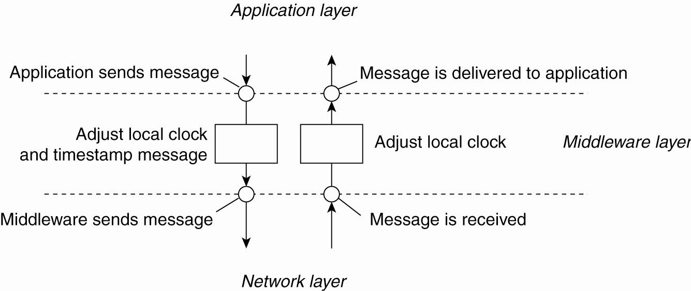
Lamport’s Logical Clocks (4)
Figure 6-10. The positioning of Lamport’s logical clocks in distributed systems.

Slide 18
Lamport’s Logical Clocks (5)
Updating counter C_{i} for process P_{i}
Before executing an event P_{i} executes C_{i} ← C_{i} + 1.
When process P_{i} sends a message m to P_{j}, it sets m’s timestamp ts (m) equal to C_{i} after having executed the previous step.
Upon the receipt of a message m, process P_{j} adjusts its own local counter as C_{j} ← max{C_{j} , ts (m)}, after which it then executes the first step and delivers the message to the application.

Slide 19
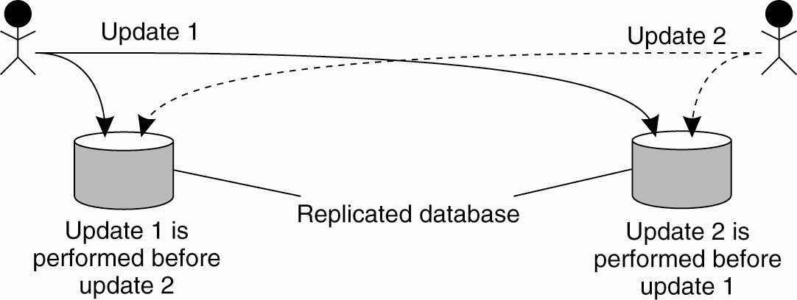
Example: Totally Ordered Multicasting
Figure 6-11. Updating a replicated database and leaving it in an inconsistent state.

Slide 20
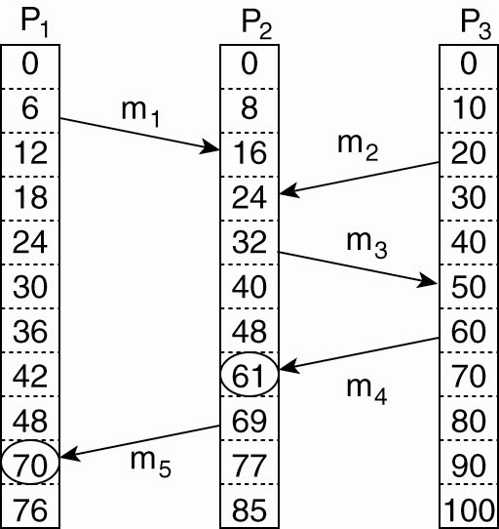
Vector Clocks (1)
Figure 6-12. Concurrent message transmission using logical clocks.

Slide 21
Vector Clocks (2)
Vector clocks are constructed by letting each process P_{i} maintain a vector VC_{i} with the following two properties:
VC_{i} [ i ] is the number of events that have occurred so far at P_{i}. In other words, VC_{i} [ i ] is the local logical clock at process P_{i} .
If VC_{i} [ j ] = k then P_{i} knows that k events have occurred at P_{j}. It is thus P_{i}’s knowledge of the local time at P_{j} .

Slide 22
Vector Clocks (3)
Steps carried out to accomplish property 2 of previous slide:
Before executing an event P_{i} executes VC_{i} [ i ] ← VC_{i} [i ] + 1.
When process P_{i} sends a message m to P_{j}, it sets m’s (vector) timestamp ts (m) equal to VC_{i} after having executed the previous step.
Upon the receipt of a message m, process P_{j} adjusts its own vector by setting VC_{j} [k ] ← max{VC_{j} [k ], ts (m)[k ]} for each k, after which it executes the first step and delivers the message to the application.

Slide 23
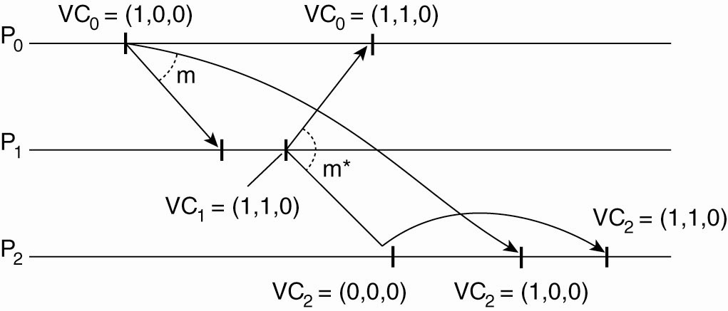
Enforcing Causal Communication
Figure 6-13. Enforcing causal communication.

Slide 24
Mutual Exclusion A Centralized Algorithm (1)
Figure 6-14. (a) Process 1 asks the coordinator for permission to access a hared resource. Permission is granted.

Slide 25
Mutual Exclusion A Centralized Algorithm (2)
Figure 6-14. (b) Process 2 then asks permission to access the same resource. The coordinator does not reply.

Slide 26
Mutual Exclusion A Centralized Algorithm (3)
Figure 6-14. (c) When process 1 releases the resource, it tells the coordinator, which then replies to 2.

Slide 27
A Distributed Algorithm (1)
Three different cases:
If the receiver is not accessing the resource and does not want to access it, it sends back an OK message to the sender.
If the receiver already has access to the resource, it simply does not reply. Instead, it queues the request.
If the receiver wants to access the resource as well but has not yet done so, it compares the timestamp of the incoming message with the one contained in the message that it has sent everyone. The lowest one wins.

Slide 28
A Distributed Algorithm (2)
Figure 6-15. (a) Two processes want to access a shared resource at the same moment.

Slide 29
A Distributed Algorithm (3)
Figure 6-15. (b) Process 0 has the lowest timestamp, so it wins.

Slide 30
A Distributed Algorithm (4)
Figure 6-15. (c) When process 0 is done, it sends an OK also, so 2 can now go ahead.

Slide 31
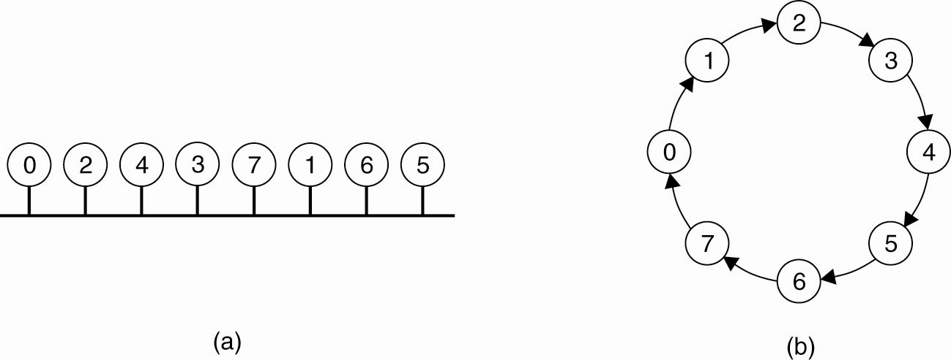
A Token Ring Algorithm
Figure 6-16. (a) An unordered group of processes on a network. (b) A logical ring constructed in software.

Slide 32
A Comparison of the Four Algorithms
Figure 6-17. A comparison of three mutual exclusion algorithms.

Slide 33
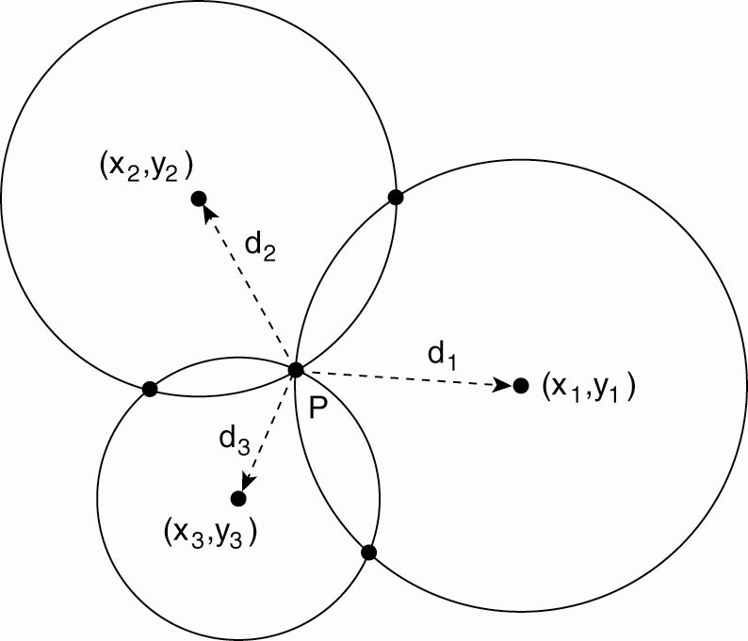
Global Positioning Of Nodes (1)
Figure 6-18. Computing a node’s position in a two-dimensional space.

Slide 34
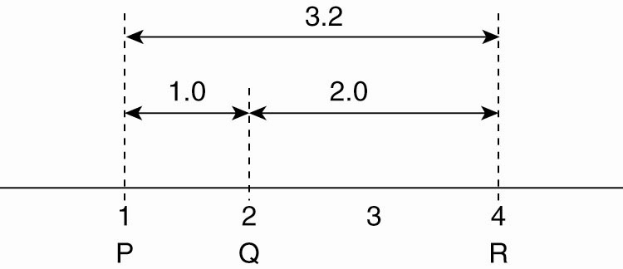
Global Positioning Of Nodes (2)
Figure 6-19. Inconsistent distance measurements in a one-dimensional space.

Slide 35
Election Algorithms
The Bully Algorithm
P sends an ELECTION message to all processes with higher numbers.
If no one responds, P wins the election and becomes coordinator.
If one of the higher-ups answers, it takes over. P’s job is done.

Slide 36
The Bully Algorithm (1)
Figure 6-20. The bully election algorithm. (a) Process 4 holds an election. (b) Processes 5 and 6 respond, telling 4 to stop. (c) Now 5 and 6 each hold an election.

Slide 37
The Bully Algorithm (2)
Figure 6-20. The bully election algorithm. (d) Process 6 tells 5 to stop. (e) Process 6 wins and tells everyone.

Slide 38
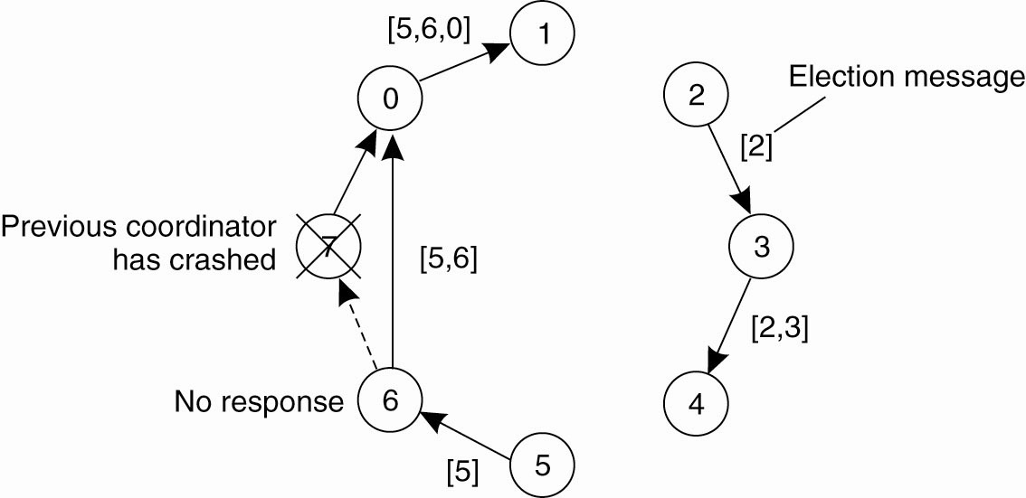
A Ring Algorithm
Figure 6-21. Election algorithm using a ring.

Slide 39
Elections in Wireless Environments (1)
Figure 6-22. Election algorithm in a wireless network, with node a as the source. (a) Initial network. (b)–(e) The build-tree phase

Slide 40
Elections in Wireless Environments (2)
Figure 6-22. Election algorithm in a wireless network, with node a as the source. (a) Initial network. (b)–(e) The build-tree phase

Slide 41
Elections in Wireless Environments (3)
Figure 6-22. (e) The build-tree phase. (f) Reporting of best node to source.

Slide 42
Elections in Large-Scale Systems (1)
Requirements for superpeer selection:
Normal nodes should have low-latency access to superpeers.
Superpeers should be evenly distributed across the overlay network.
There should be a predefined portion of superpeers relative to the total number of nodes in the overlay network.
Each superpeer should not need to serve more than a fixed number of normal nodes.

Slide 43
Elections in Large-Scale Systems (2)
Figure 6-23. Moving tokens in a two-dimensional space using repulsion forces.

Slide 44
Thank You !

