Slide 1
Concistency and Replication
Munawar, PhD

Slide 2
Reasons for Replication
Data are replicated to increase the reliability of a system.
Replication for performance
Scaling in numbers
Scaling in geographical area
Caveat
Gain in performance
Cost of increased bandwidth for maintaining replication

Slide 3
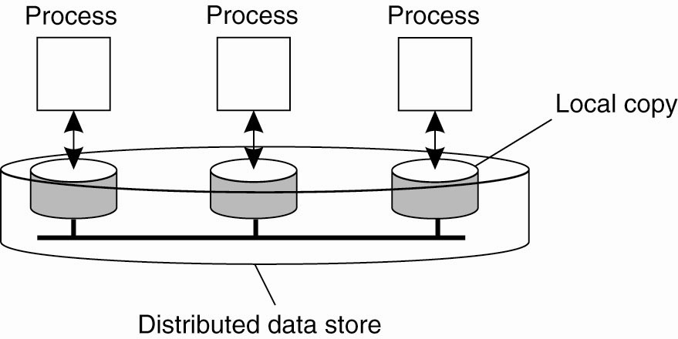
Data-centric Consistency Models
Figure 7-1. The general organization of a logical data store, physically distributed and replicated across multiple processes.

Slide 4
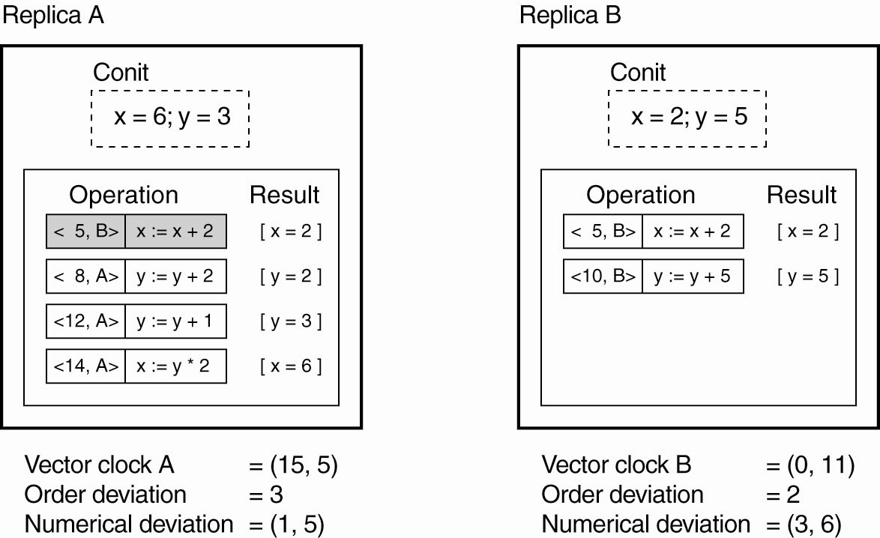
Continuous Consistency (1)
Figure 7-2. An example of keeping track of consistency deviations [adapted from (Yu and Vahdat, 2002)].

Slide 5
Continuous Consistency (2)
Figure 7-3. Choosing the appropriate granularity for a conit. (a) Two updates lead to update propagation.

Slide 6
Continuous Consistency (3)
Figure 7-3. Choosing the appropriate granularity for a conit. (b) No update propagation is needed (yet).

Slide 7
Sequential Consistency (1)
Figure 7-4. Behavior of two processes operating on the same data item. The horizontal axis is time.

Slide 8
Sequential Consistency (2)
A data store is sequentially consistent when:
The result of any execution is the same as if the (read and write) operations by all processes on the data store …
were executed in some sequential order and …
the operations of each individual process appear …
in this sequence
in the order specified by its program.

Slide 9
Sequential Consistency (3)
Figure 7-5. (a) A sequentially consistent data store. (b) A data store that is not sequentially consistent.

Slide 10
Sequential Consistency (4)
Figure 7-6. Three concurrently-executing processes.

Slide 11
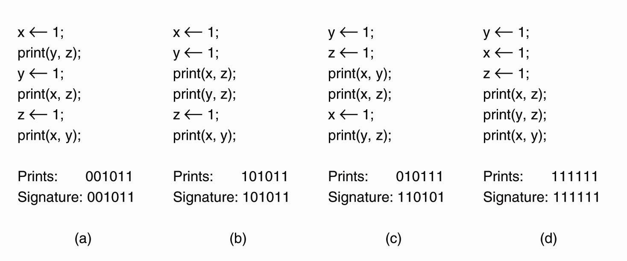
Sequential Consistency (5)
Figure 7-7. Four valid execution sequences for the processes of Fig. 7-6. The vertical axis is time.

Slide 12
Causal Consistency (1)
For a data store to be considered causally consistent, it is necessary that the store obeys the following condition:
Writes that are potentially causally related …
must be seen by all processes
in the same order.
Concurrent writes …
may be seen in a different order
on different machines.

Slide 13
Causal Consistency (2)
Figure 7-8. This sequence is allowed with a causally-consistent store, but not with a sequentially consistent store.

Slide 14
Causal Consistency (3)
Figure 7-9. (a) A violation of a causally-consistent store.

Slide 15
Causal Consistency (4)
Figure 7-9. (b) A correct sequence of events in a causally-consistent store.

Slide 16
Grouping Operations (1)
Necessary criteria for correct synchronization:
An acquire access of a synchronization variable, not allowed to perform until all updates to guarded shared data have been performed with respect to that process.
Before exclusive mode access to synchronization variable by process is allowed to perform with respect to that process, no other process may hold synchronization variable, not even in nonexclusive mode.
After exclusive mode access to synchronization variable has been performed, any other process’ next nonexclusive mode access to that synchronization variable may not be performed until it has performed with respect to that variable’s owner.

Slide 17
Grouping Operations (2)
Figure 7-10. A valid event sequence for entry consistency.

Slide 18
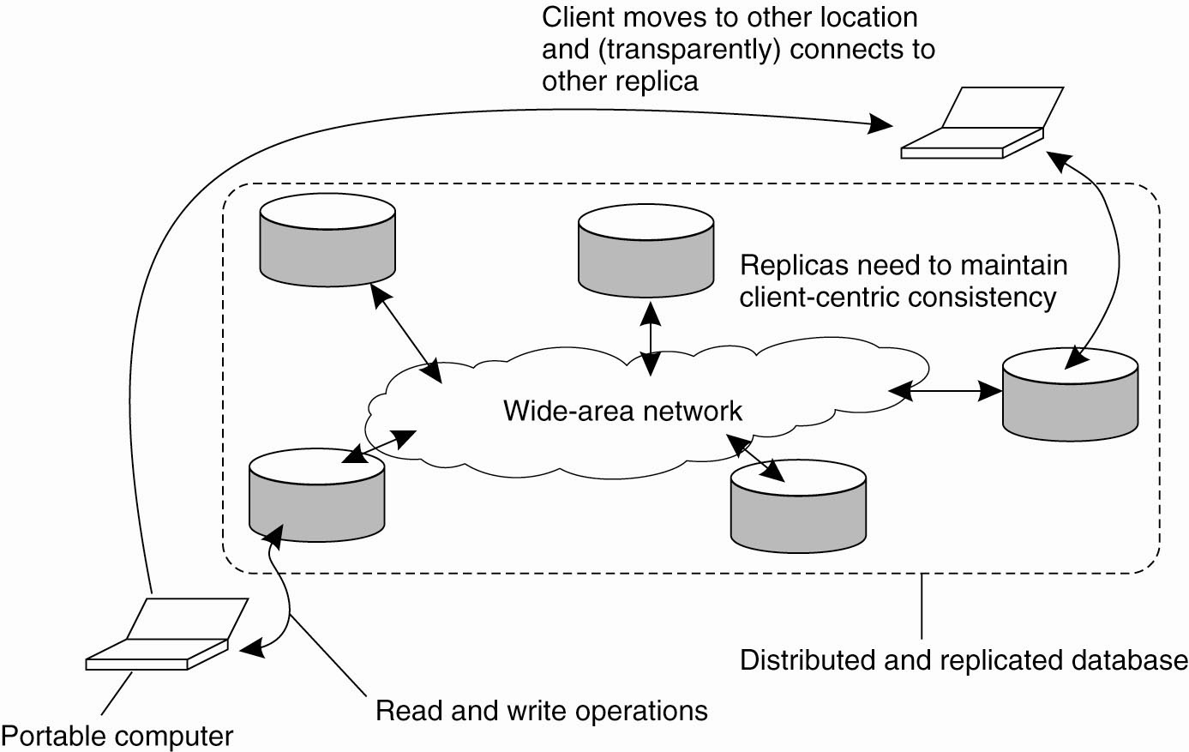
Eventual Consistency
Figure 7-11. The principle of a mobile user accessing different replicas of a distributed database.

Slide 19
Monotonic Reads (1)
A data store is said to provide monotonic-read consistency if the following condition holds:
If a process reads the value of a data item x …
any successive read operation on x by that process
will always return that same value
or a more recent value.

Slide 20
Monotonic Reads (2)
Figure 7-12. The read operations performed by a single process P at two different local copies of the same data store. (a) A monotonic-read consistent data store.

Slide 21
Monotonic Reads (3)
Figure 7-12. The read operations performed by a single process P at two different local copies of the same data store. (b) A data store that does not provide monotonic reads.

Slide 22
Monotonic Writes (1)
In a monotonic-write consistent store, the following
condition holds:
A write operation by a process on a data item x …
is completed before any successive write operation on x
by the same process.

Slide 23
Monotonic Writes (2)
Figure 7-13. The write operations performed by a single process P at two different local copies of the same data store. (a) A monotonic-write consistent data store.

Slide 24
Monotonic Writes (3)
Figure 7-13. The write operations performed by a single process P at two different local copies of the same data store. (b) A data store that does not provide monotonic-write consistency.

Slide 25
Read Your Writes (1)
A data store is said to provide read-your-writes consistency, if the following condition holds:
The effect of a write operation by a process on data item x …
will always be seen by a successive read operation on x
by the same process.

Slide 26
Read Your Writes (2)
Figure 7-14. (a) A data store that provides read-your-writes consistency.

Slide 27
Read Your Writes (3)
Figure 7-14. (b) A data store that does not.

Slide 28
Writes Follow Reads (1)
A data store is said to provide writes-follow-reads consistency, if the following holds:
A write operation by a process …
on a data item x following a previous read operation on x by the same process …
is guaranteed to take place on the same or a more recent value of x that was read.

Slide 29
Writes Follow Reads (2)
Figure 7-15. (a) A writes-follow-reads consistent data store.

Slide 30
Writes Follow Reads (3)
Figure 7-15. (b) A data store that does not provide writes-follow-reads consistency.

Slide 31
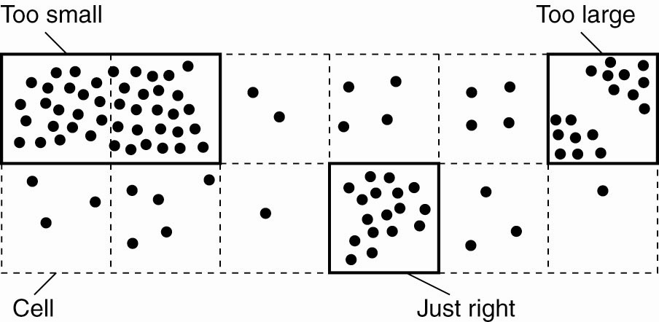
Replica-Server Placement
Figure 7-16. Choosing a proper cell size for server placement.

Slide 32
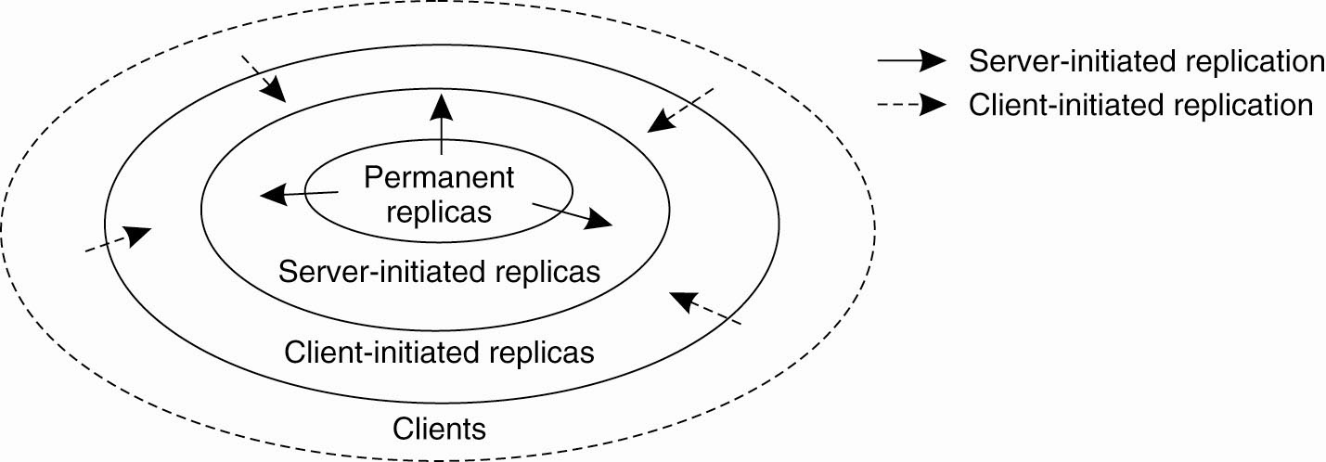
Content Replication and Placement
Figure 7-17. The logical organization of different kinds of copies of a data store into three concentric rings.

Slide 33
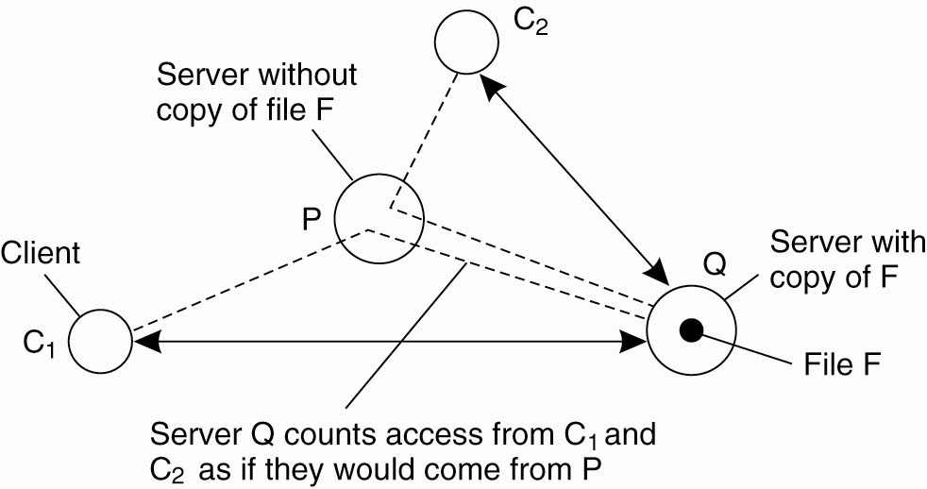
Server-Initiated Replicas
Figure 7-18. Counting access requests from different clients.

Slide 34
State versus Operations
Possibilities for what is to be propagated:
Propagate only a notification of an update.
Transfer data from one copy to another.
Propagate the update operation to other copies.

Slide 35
Pull versus Push Protocols
Figure 7-19. A comparison between push-based and pull-based protocols in the case of multiple-client, single-server systems.

Slide 36
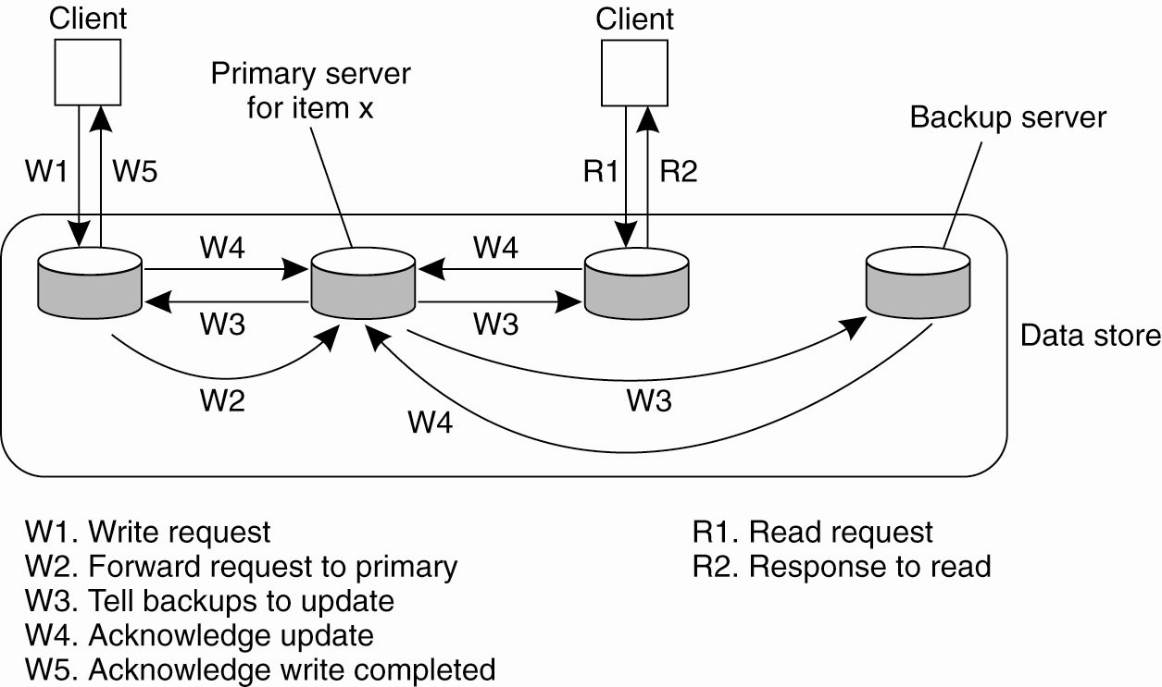
Remote-Write Protocols
Figure 7-20. The principle of a primary-backup protocol.

Slide 37
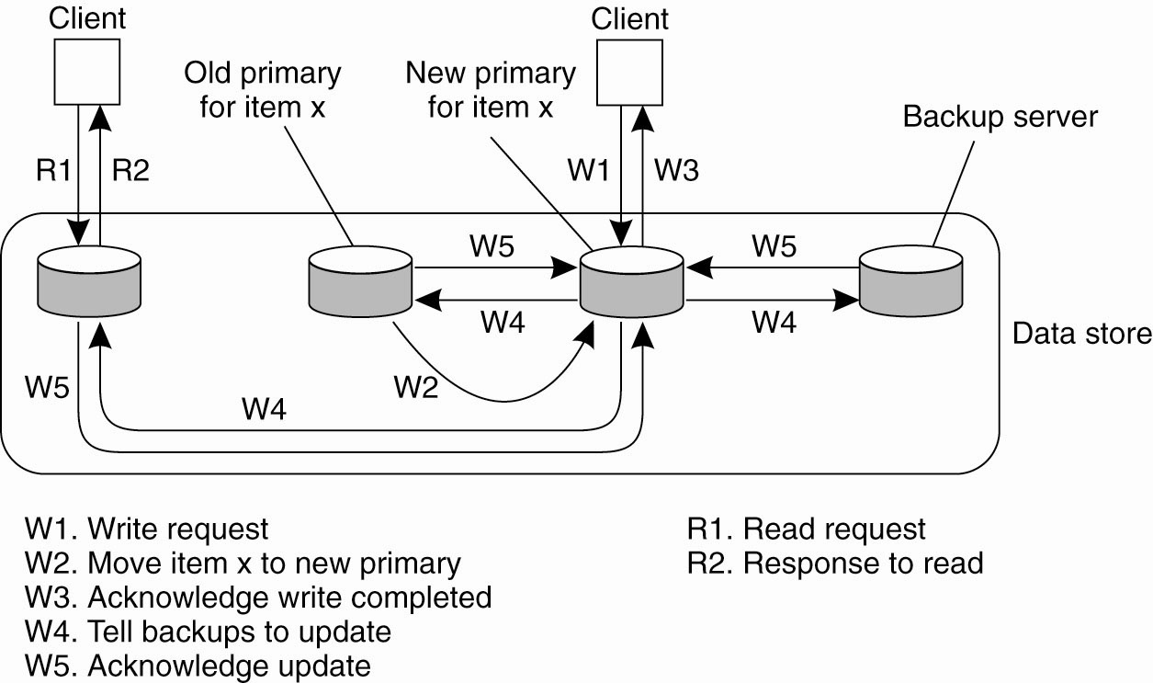
Local-Write Protocols
Figure 7-21. Primary-backup protocol in which the primary migrates to the process wanting to perform an update.

Slide 38
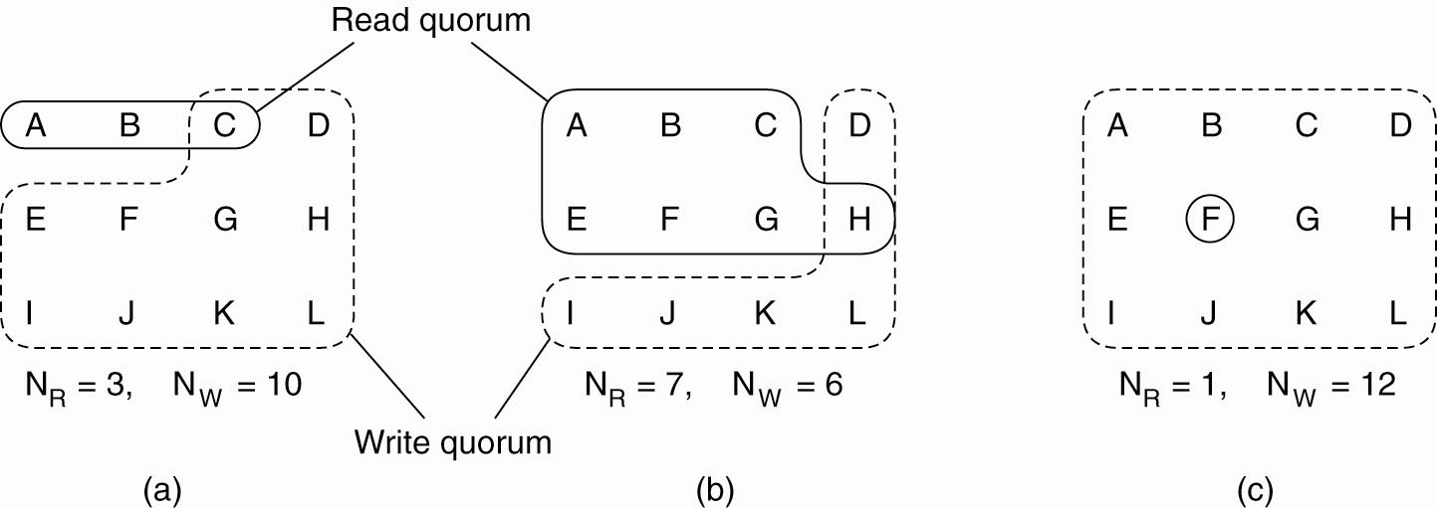
Quorum-Based Protocols
Figure 7-22. Three examples of the voting algorithm. (a) A correct choice of read and write set. (b) A choice that may lead to write-write conflicts. (c) A correct choice, known as ROWA (read one, write all).

Slide 39
Thank You !

