Slide 1
Distributed Object Based System
Munawar, PhD

Slide 2
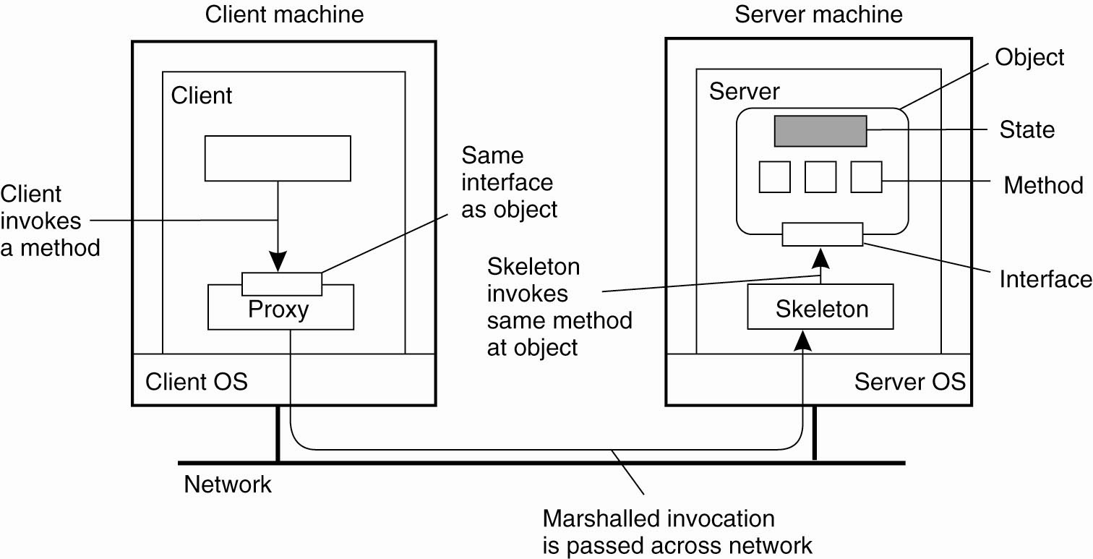
Distributed Objects
Figure 10-1. Common organization of a remote object with client-side proxy.

Slide 3
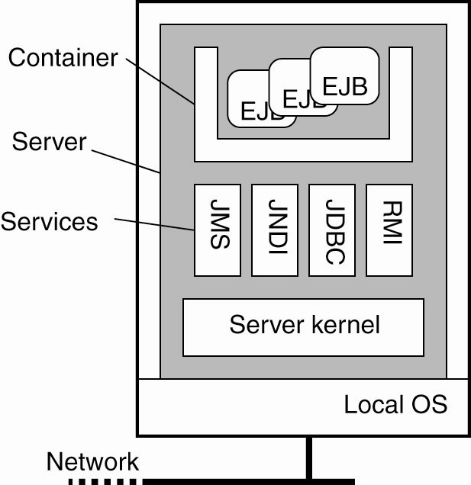
Example: Enterprise Java Beans
Figure 10-2. General architecture of an EJB server.

Slide 4
Four Types of EJBs
Stateless session beans
Stateful session beans
Entity beans
Message-driven beans

Slide 5
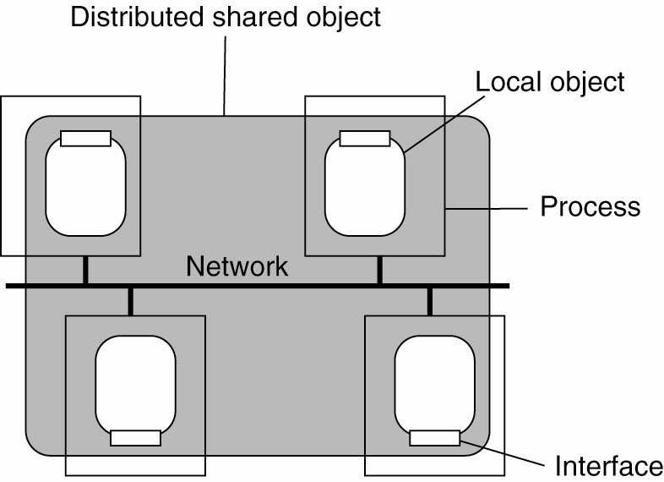
Globe Distributed Shared Objects (1)
Figure 10-3. The organization of a Globe distributed shared object.

Slide 6
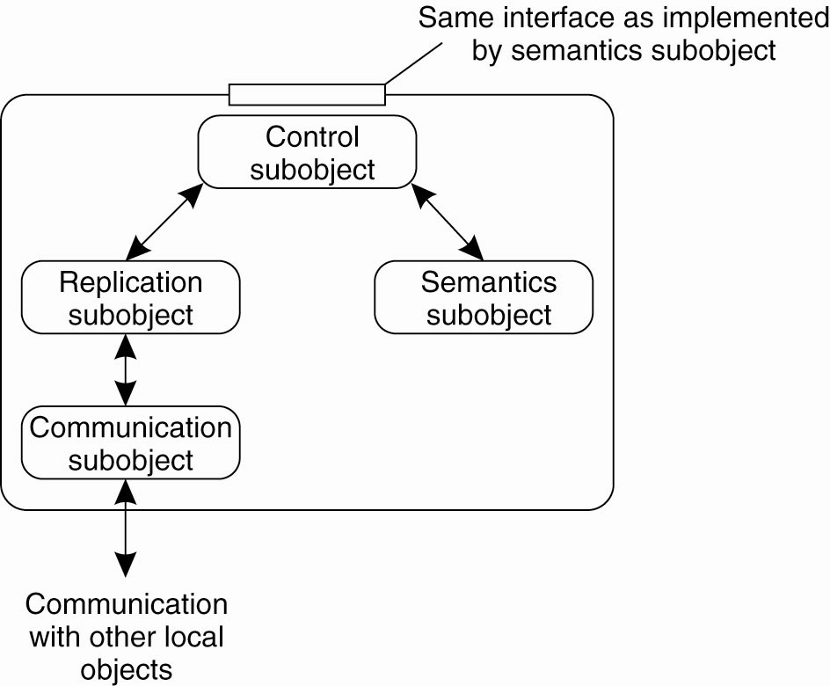
Globe Distributed Shared Objects (2)
Figure 10-4. The general organization of a local object for distributed shared objects in Globe.

Slide 7
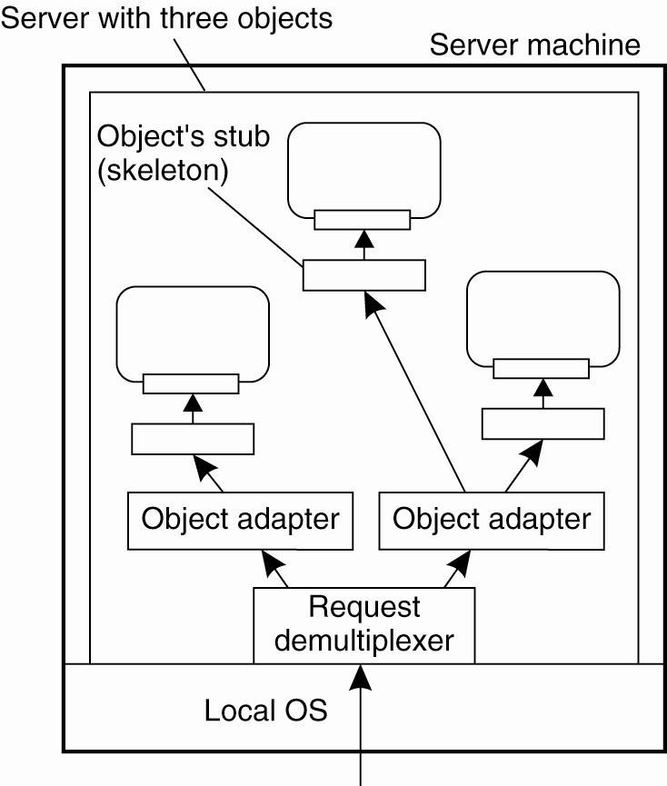
Object Adapter
Figure 10-5. Organization of an object server supporting different activation policies.

Slide 8
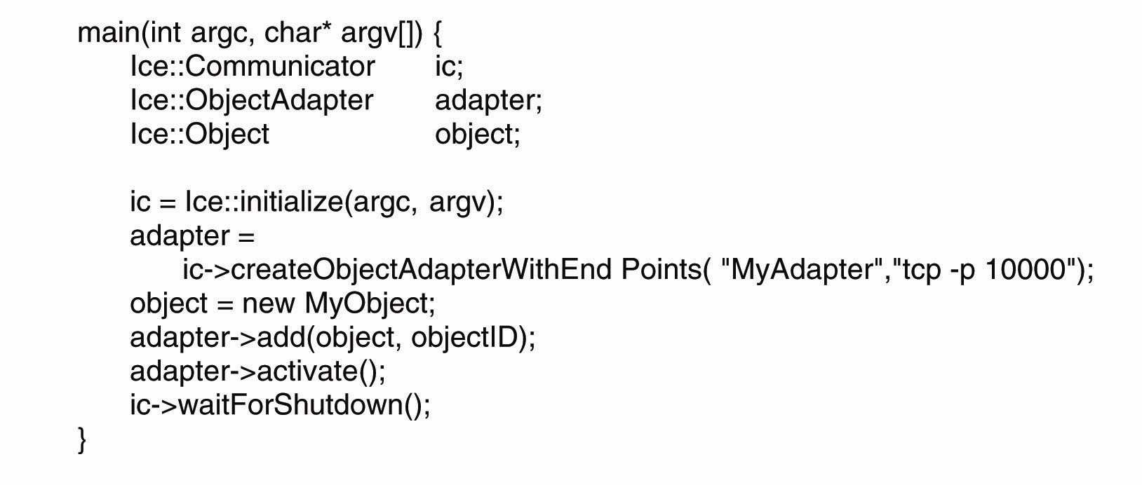
Example: The Ice Runtime System
Figure 10-6. Example of creating an object server in Ice.

Slide 9
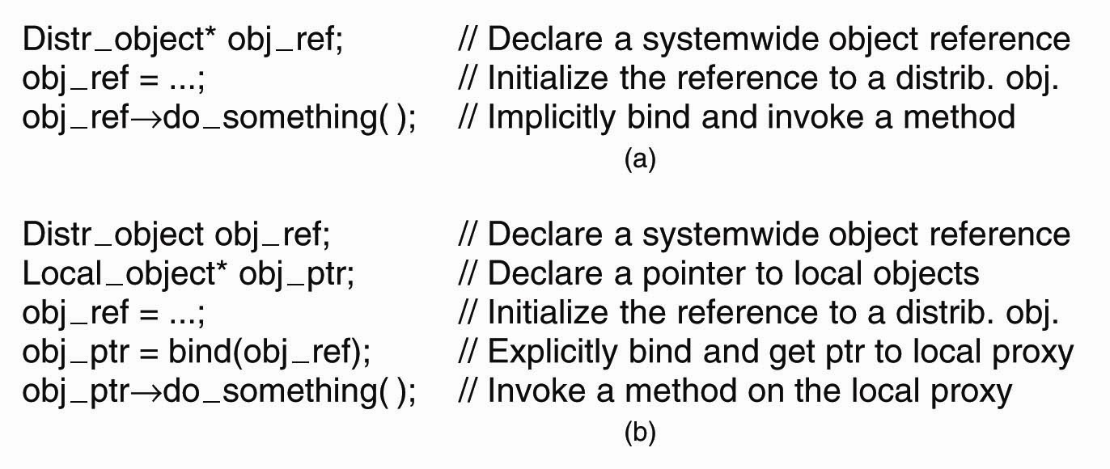
Binding a Client to an Object
Figure 10-7. (a) An example with implicit binding using only global references. (b) An example with explicit binding using global and local references.

Slide 10
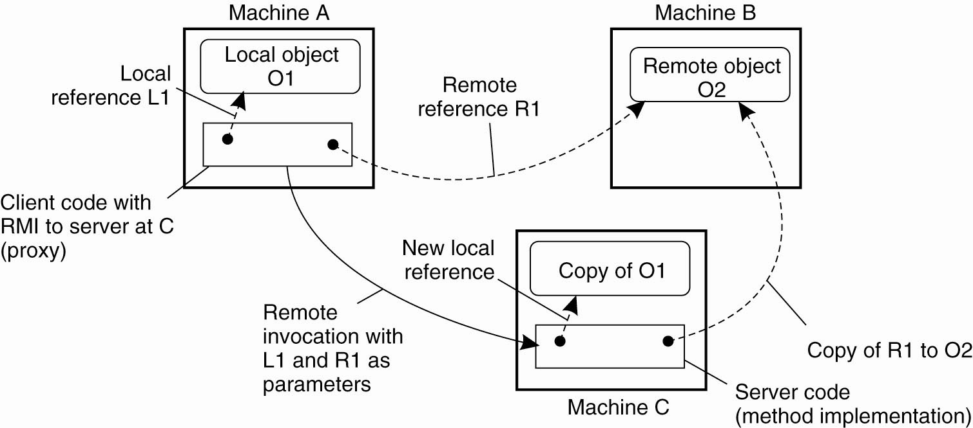
Parameter Passing
Figure 10-8. The situation when passing an object by reference or by value.

Slide 11
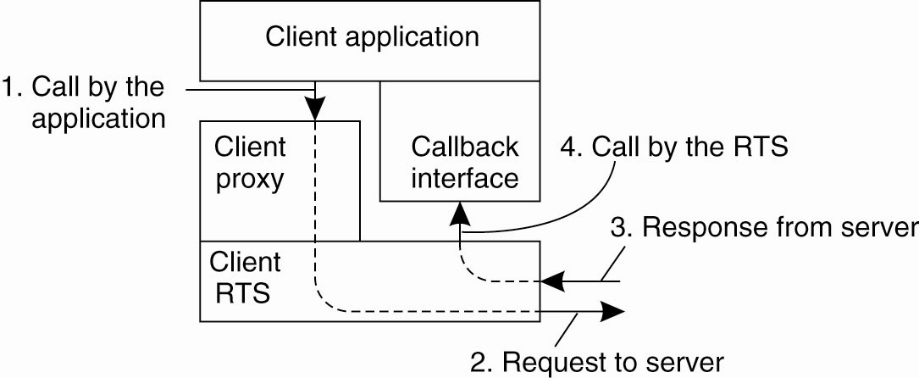
Object-Based Messaging (1)
Figure 10-9. CORBA’s callback model for asynchronous method invocation.

Slide 12
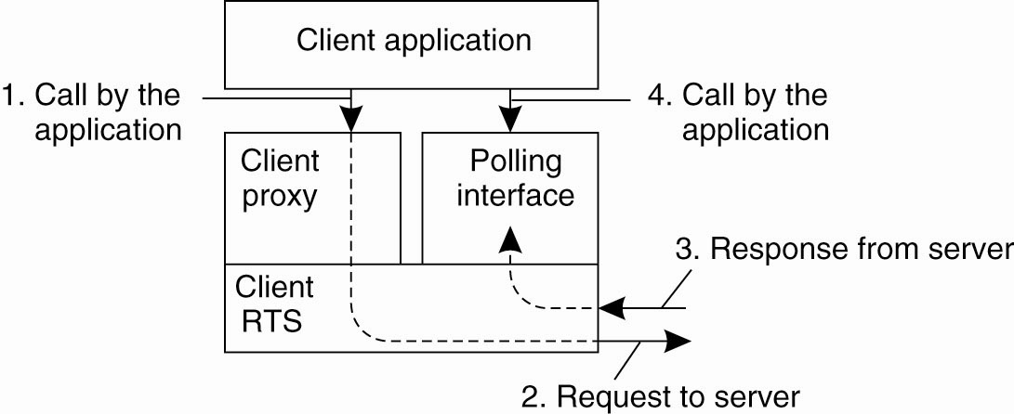
Object-Based Messaging (2)
Figure 10-10. CORBA’s polling model for asynchronous method invocation.

Slide 13
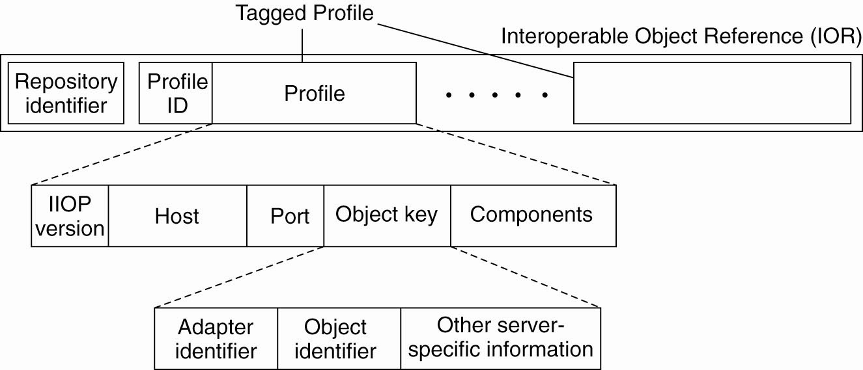
CORBA Object References
Figure 10-11. The organization of an IOR with specific information for IIOP.

Slide 14
Globe Object References (1)
Figure 10-12. The representation of a protocol layer in a stacked contact address.

Slide 15
Globe Object References (2)
Figure 10-13. The representation of an instance contact address.

Slide 16
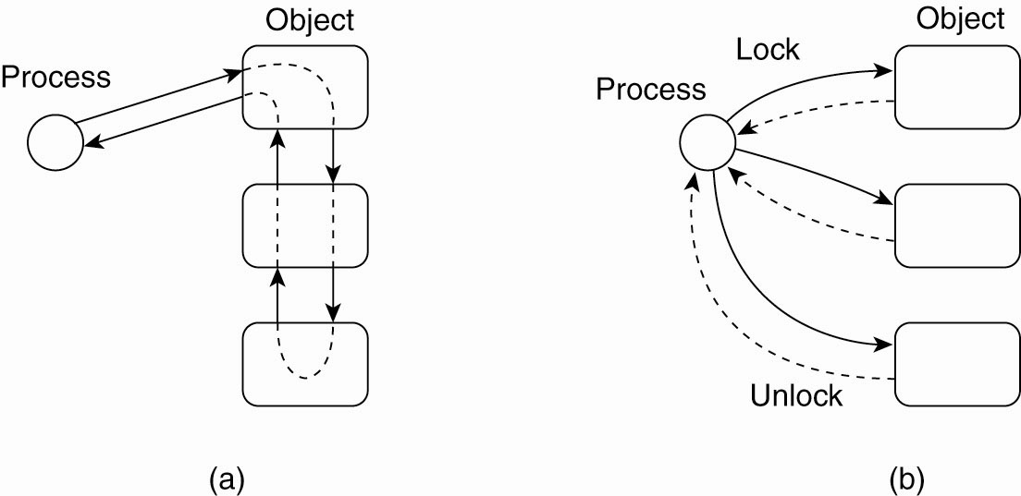
Synchronization
Figure 10-14. Differences in control flow for locking objects

Slide 17
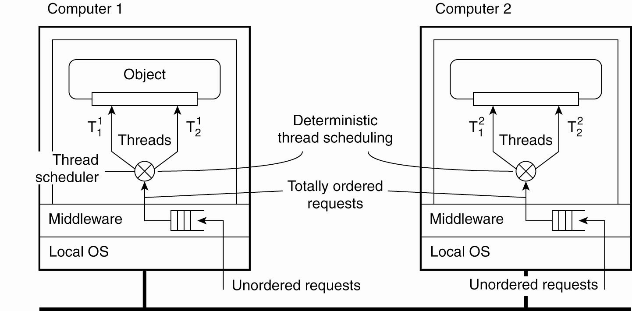
Entry Consistency
Figure 10-15. Deterministic thread scheduling for replicated object servers.

Slide 18
Replication Frameworks (1)
Invocations to objects are intercepted at three different points:
At the client side just before the invocation is passed to the stub.
Inside the client’s stub, where the interception forms part of the replication algorithm.
At the server side, just before the object is about to be invoked.

Slide 19
Replication Frameworks (2)
Figure 10-16. A general framework for separating replication algorithms from objects in an EJB environment.

Slide 20
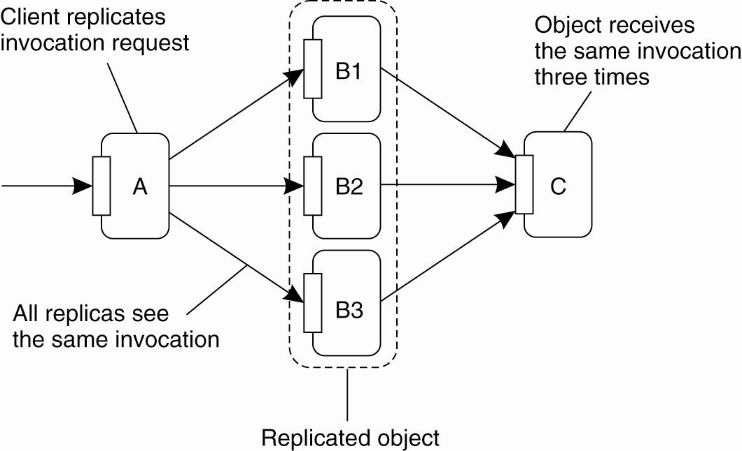
Replicated Invocations (1)
Figure 10-17. The problem of replicated method invocations.

Slide 21
Replicated Invocations (2)
Figure 10-18. (a) Forwarding an invocation request from a replicated object to another replicated object.

Slide 22
Replicated Invocations (3)
Figure 10-18. (b) Returning a reply from one replicated object to another.

Slide 23
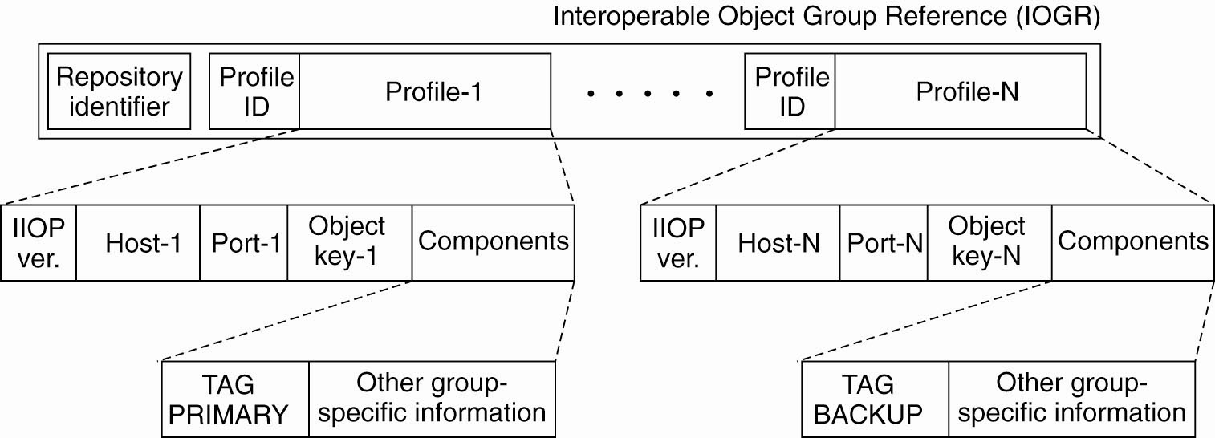
Example: Fault-Tolerant CORBA
Figure 10-19. A possible organization of an IOGR for an object group having a primary and backups.

Slide 24
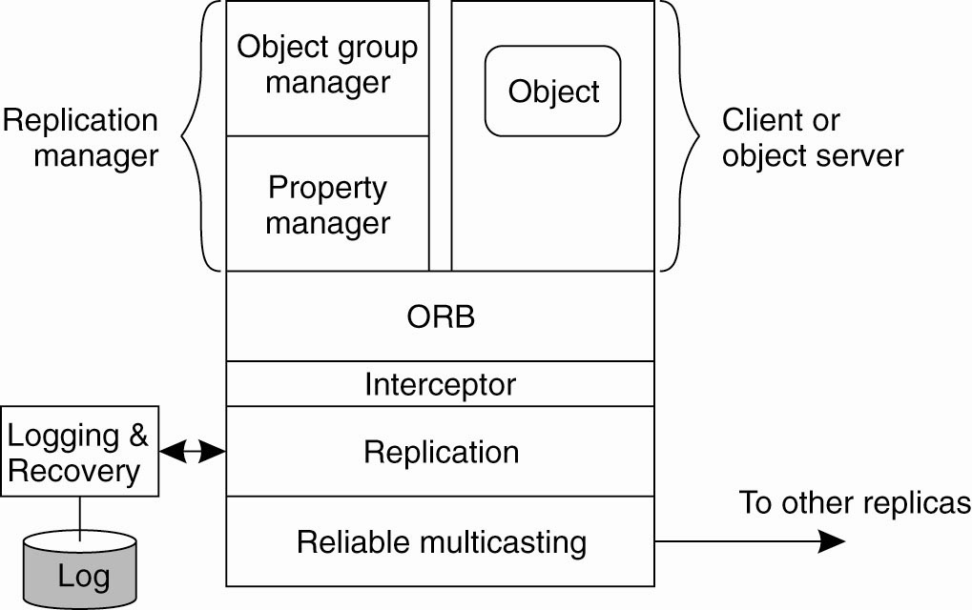
An Example Architecture
Figure 10-20. An example architecture of a fault-tolerant CORBA system.

Slide 25
Example: Fault-Tolerant Java
Causes for nondeterministic behavior:
JVM can execute native code, that is, code that is external to the JVM and provided to the latter through an interface.
Input data may be subject to nondeterminism.
In the presence of failures, different JVMs will produce different output revealing that the machines have been replicated.

Slide 26
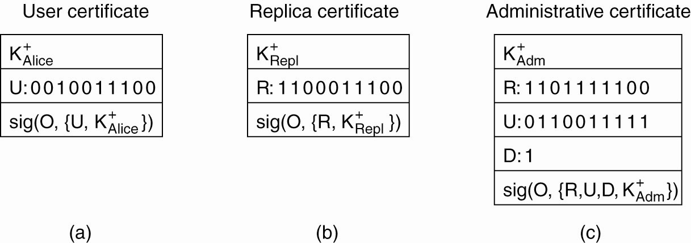
Overview of Globe Security
Figure 10-21. Certificates in Globe: (a) a user certificate, (b) a replica certificate, (c) an administrative certificate.

Slide 27
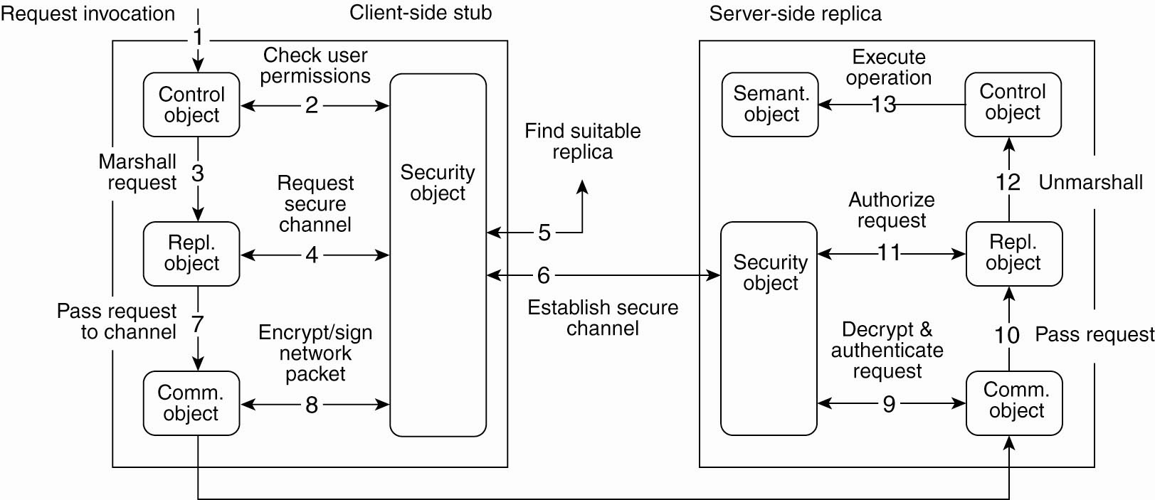
Secure Method Invocation (1)
Figure 10-22. Secure method invocation in Globe.

Slide 28
Secure Method Invocation (2)
Steps for securely invoking a method of a Globe object:
Application issues a invocation request by locally calling the associated method
Control subobject checks the user permissions with the information stored in the local security object.
Request is marshaled and passed on.
Replication subobject requests the middleware to set up a secure channel to a suitable replica.

Slide 29
Secure Method Invocation (3)
Security object first initiates a replica lookup.
Once a suitable replica has been found, security subobject can set up a secure channel with its peer, after which control is returned to the replication subobject.
Request is now passed on to the communication subobject.
Subobject encrypts and signs the request so that it can pass through the channel.

Slide 30
Secure Method Invocation (4)
After its receipt, the request is decrypted and authenticated.
Request then passed on to the server-side replication subobject.
Authorization takes place:
Request is then unmarshaled.
Finally, the operation can be executed.

Slide 31
Thank You !

