Slide 1
Distributed File System
Munawar, PhD

Slide 2
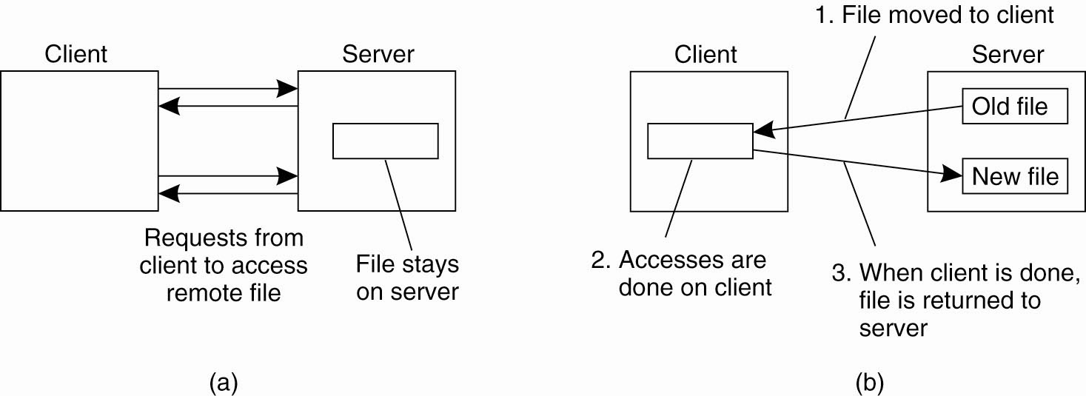
Client-Server Architectures (1)
Figure 11-1. (a) The remote access model. (b) The upload/download model.

Slide 3
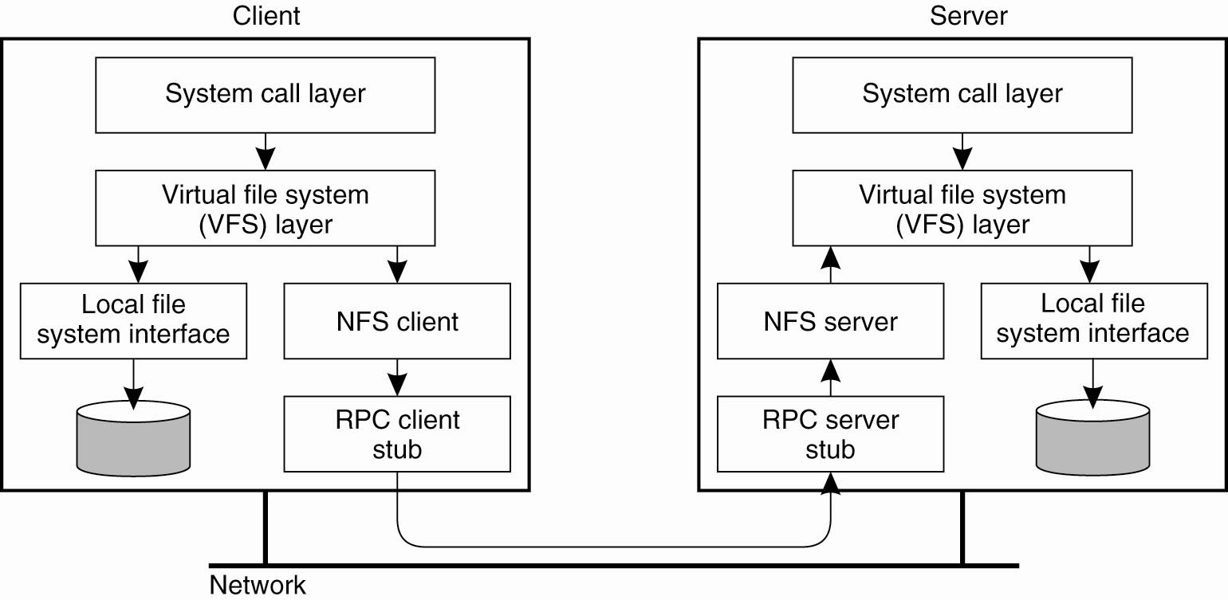
Client-Server Architectures (2)
Figure 11-2. The basic NFS architecture for UNIX systems.

Slide 4
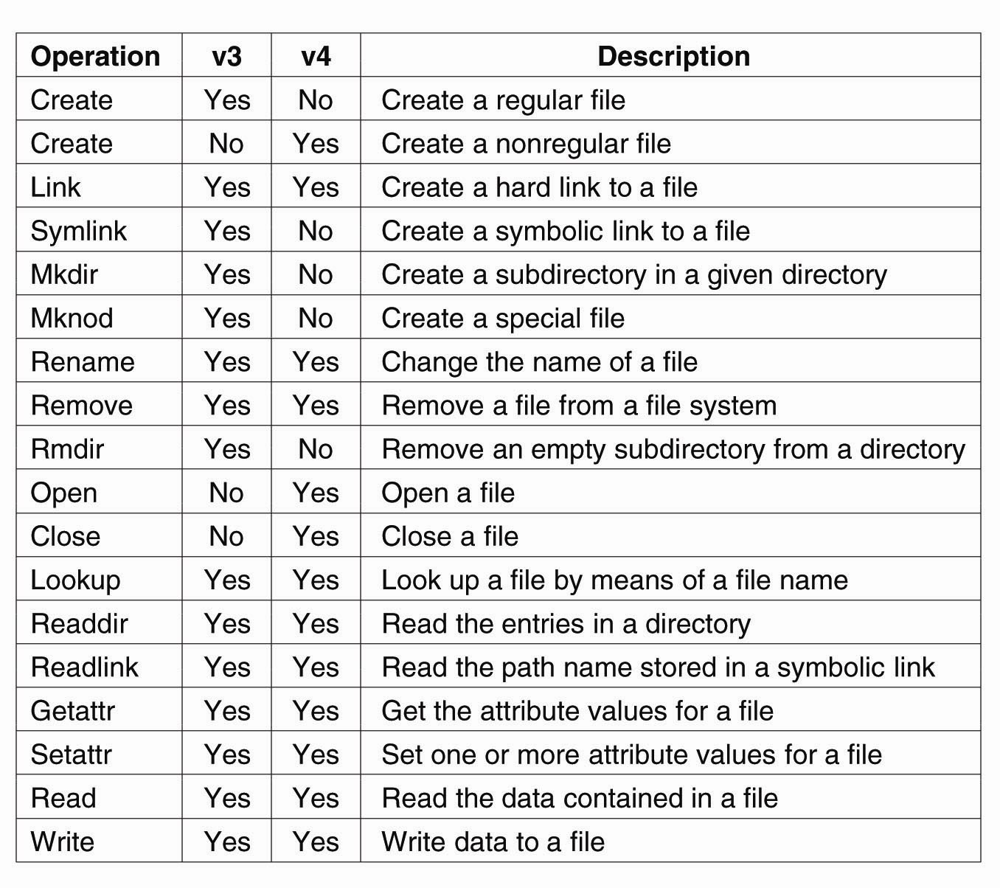
File System Model (1)
Figure 11-3. An incomplete list of file system operations supported by NFS.

Slide 5
File System Model (2)
Figure 11-3. An incomplete list of file system operations supported by NFS.

Slide 6
Cluster-Based Distributed File Systems (1)
Figure 11-4. The difference between (a) distributing whole files across several servers and (b) striping files for parallel access.

Slide 7
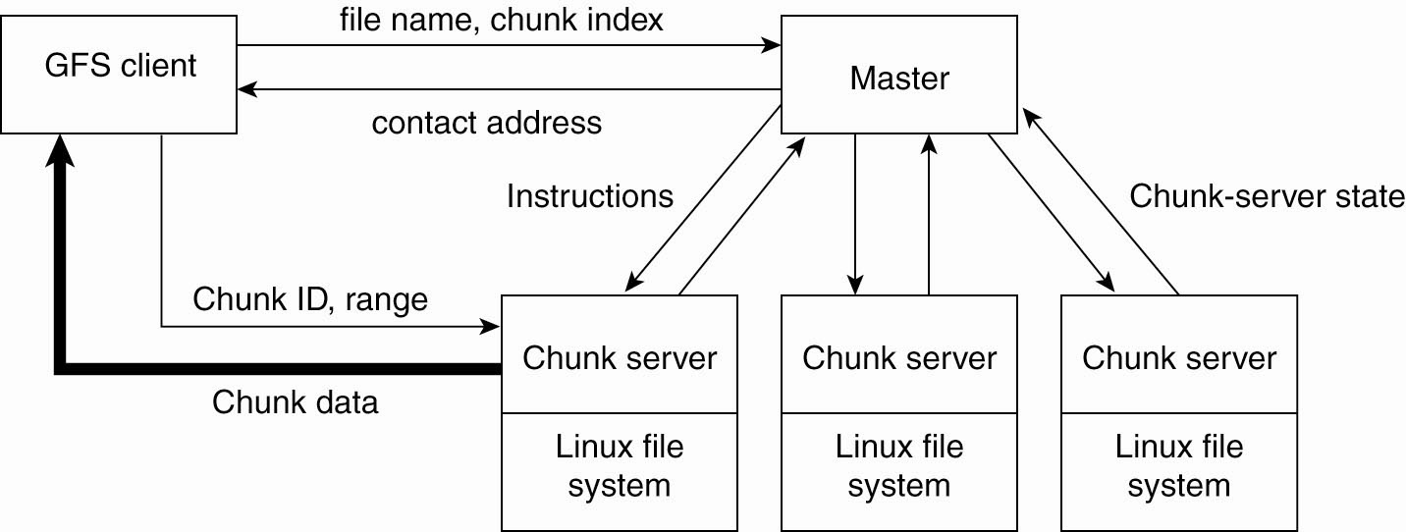
Cluster-Based Distributed File Systems (2)
Figure 11-5. The organization of a Google cluster of servers.

Slide 8
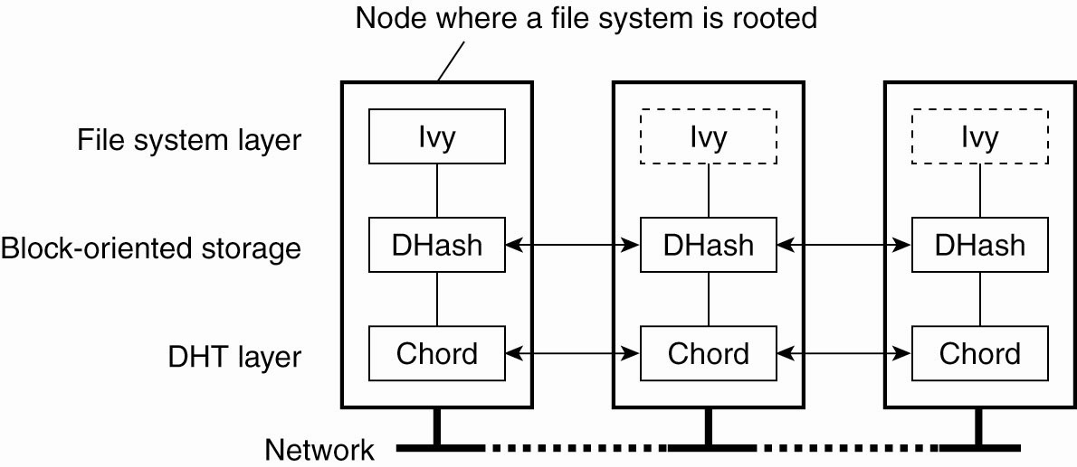
Symmetric Architectures
Figure 11-6. The organization of the Ivy distributed file system.

Slide 9
Remote Procedure Calls in NFS
Figure 11-7. (a) Reading data from a file in NFS version 3. (b) Reading data using a compound procedure in version 4.

Slide 10
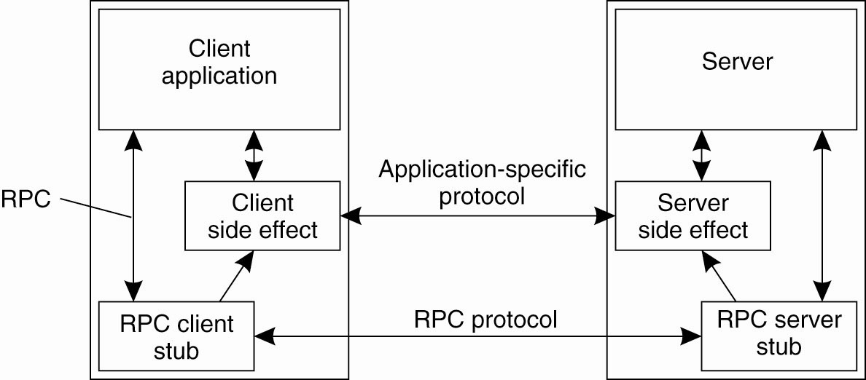
The RPC2 Subsystem (1)
Figure 11-8. Side effects in Coda’s RPC2 system.

Slide 11
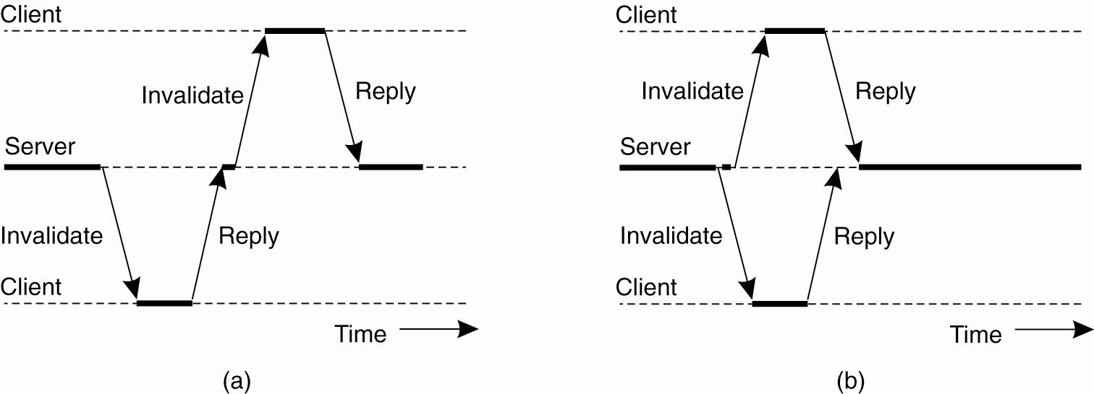
The RPC2 Subsystem (2)
Figure 11-9. (a) Sending an invalidation message one at a time. (b) Sending invalidation messages in parallel.

Slide 12
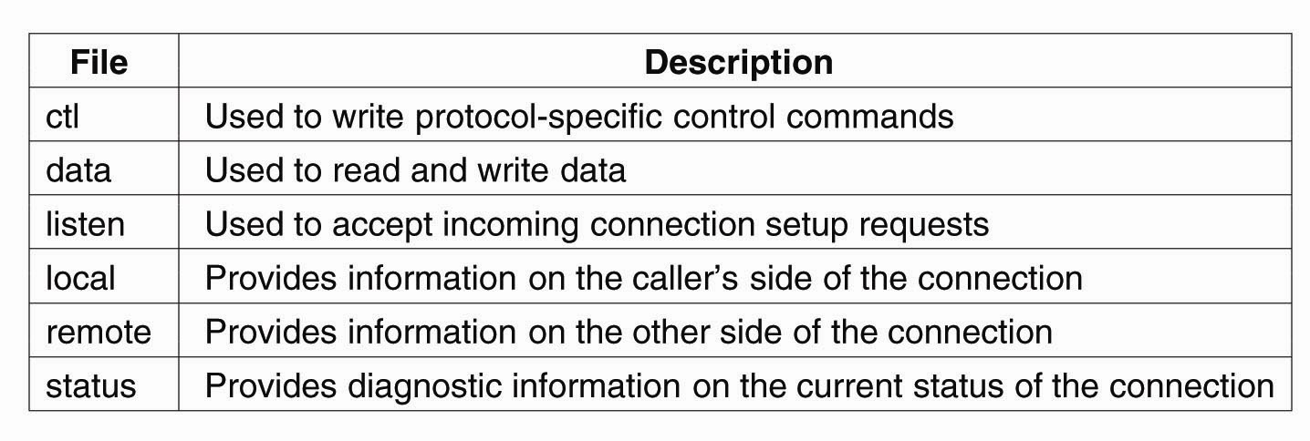
File-Oriented Communication in Plan 9
Figure 11-10. Files associated with a single TCP connection in Plan 9.

Slide 13
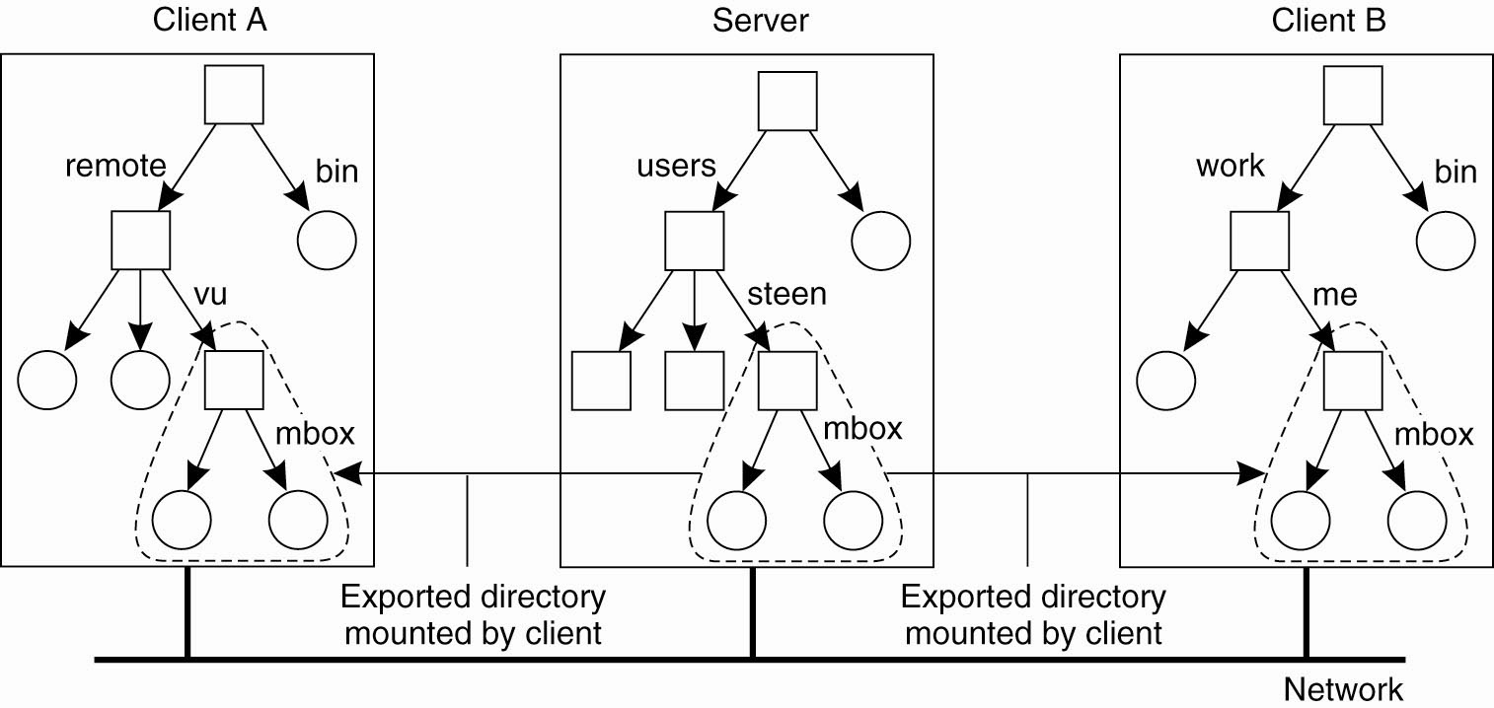
Naming in NFS (1)
Figure 11-11. Mounting (part of) a remote file system in NFS.

Slide 14
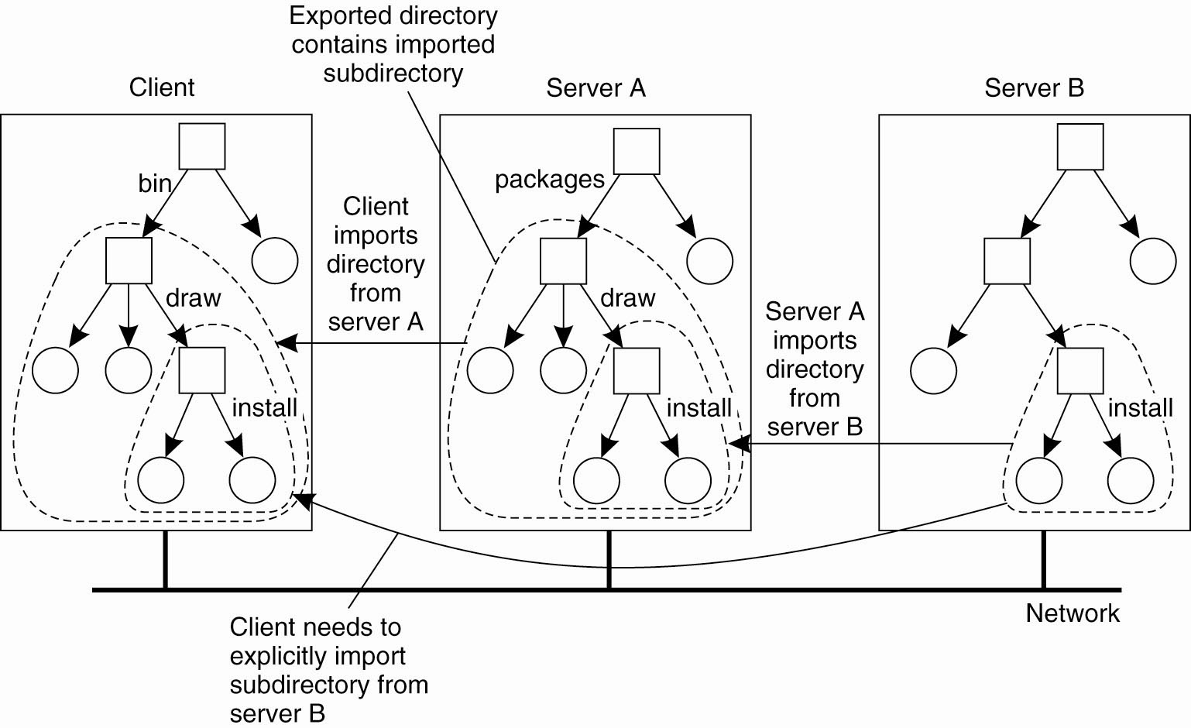
Naming in NFS (2)
Figure 11-12. Mounting nested directories from multiple servers in NFS.

Slide 15
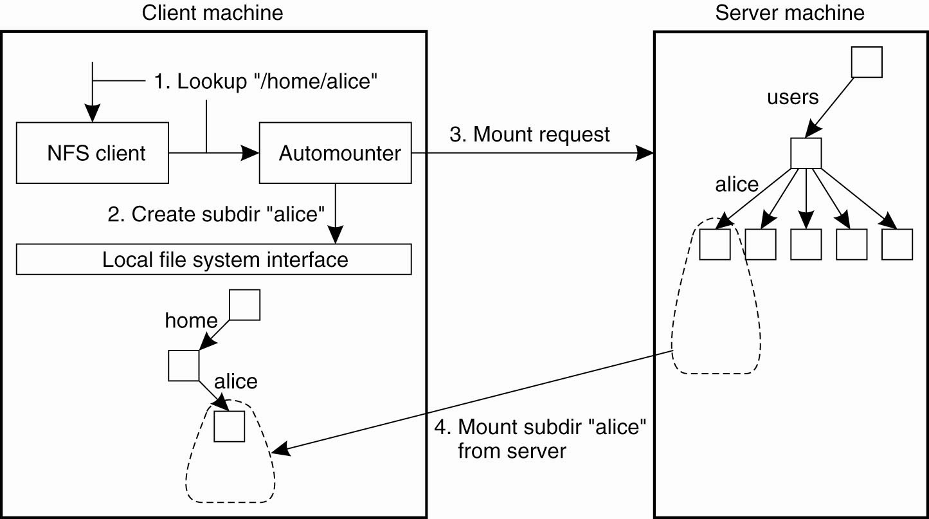
Automounting (1)
Figure 11-13. A simple automounter for NFS.

Slide 16
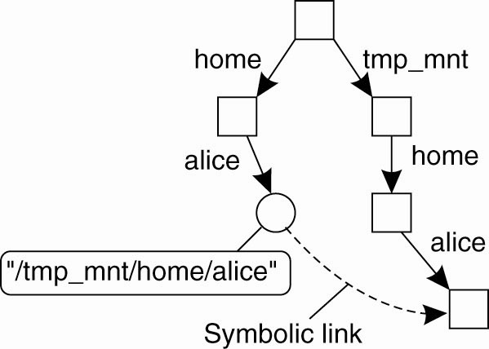
Automounting (2)
Figure 11-14. Using symbolic links with automounting.

Slide 17
Constructing a Global Name Space
Figure 11-15. Junctions in GNS.

Slide 18
Semantics of File Sharing (1)
Figure 11-16. (a) On a single processor, when a read follows a write, the value returned by the read is the value just written.

Slide 19
Semantics of File Sharing (2)
Figure 11-16. (b) In a distributed system with caching, obsolete values may be returned.

Slide 20
Semantics of File Sharing (3)
Figure 11-17. Four ways of dealing with the shared files in a distributed system.

Slide 21
File Locking (1)
Figure 11-18. NFSv4 operations related to file locking.

Slide 22
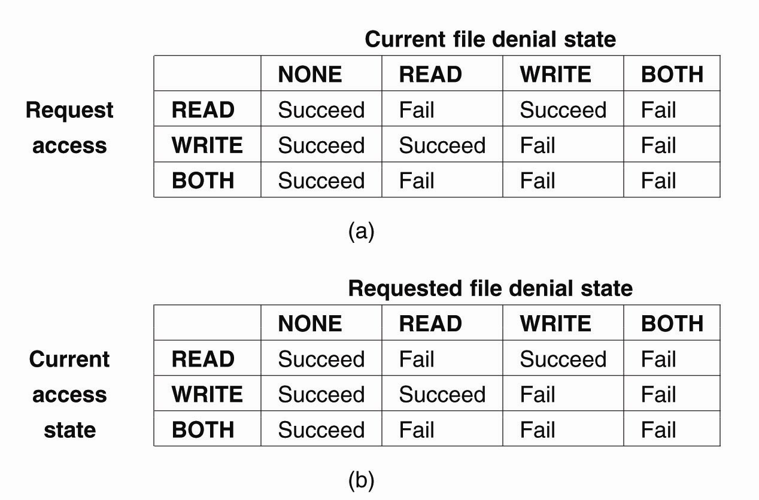
File Locking (2)
Figure 11-19. The result of an open operation with share reservations in NFS. (a) When the client requests shared access given the current denial state.

Slide 23
File Locking (3)
Figure 11-19. The result of an open operation with share reservations in NFS. (b) When the client requests a denial state given the current file access state.

Slide 24
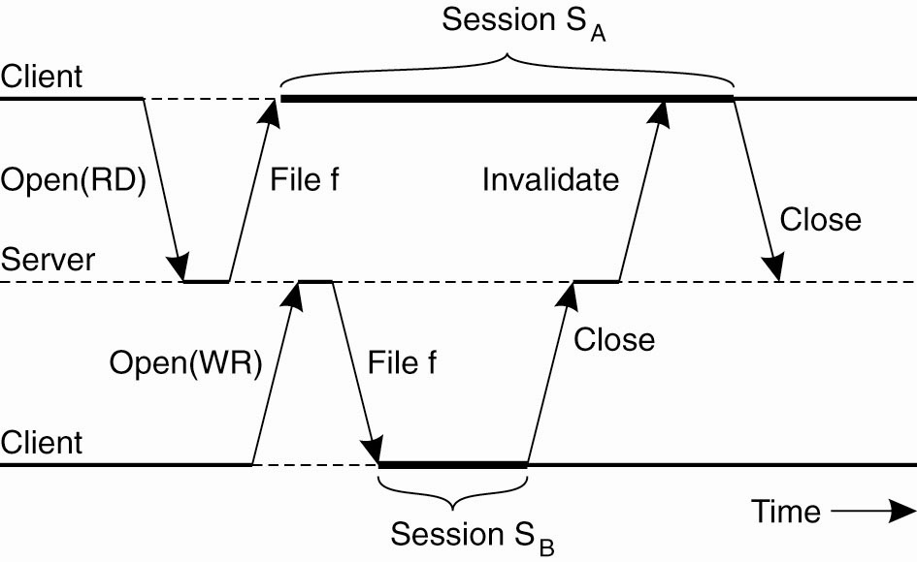
Sharing Files in Coda
Figure 11-20. The transactional behavior in sharing files in Coda.

Slide 25
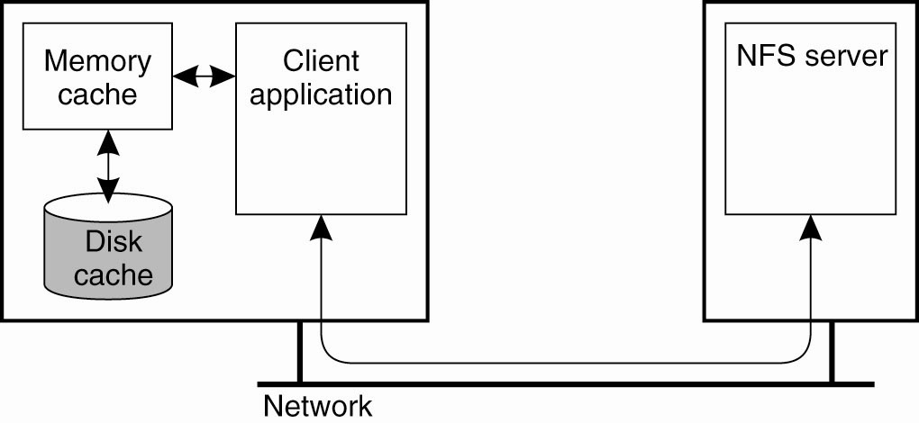
Client-Side Caching (1)
Figure 11-21. Client-side caching in NFS.

Slide 26
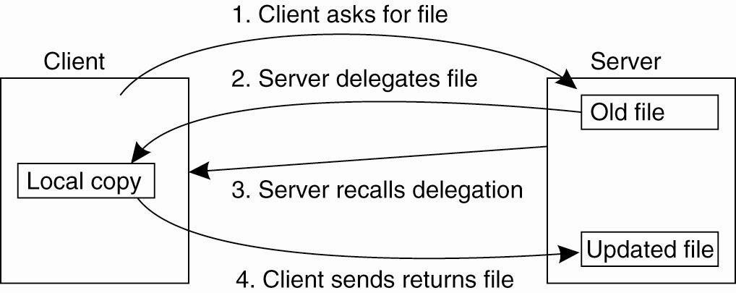
Client-Side Caching (2)
Figure 11-22. Using the NFSv4 callback mechanism to recall file delegation.

Slide 27
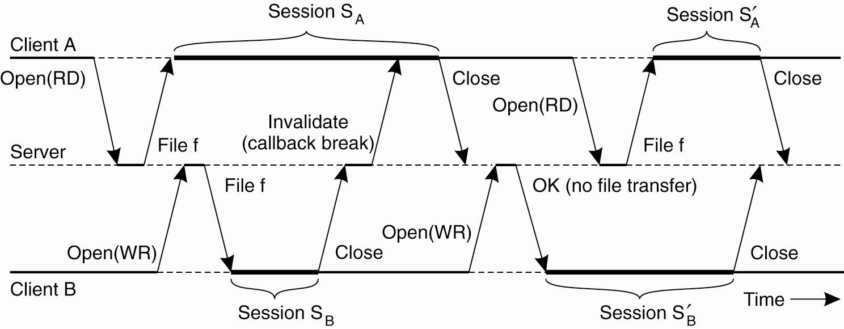
Client-Side Caching in Coda
Figure 11-23. The use of local copies when opening a session in Coda.

Slide 28
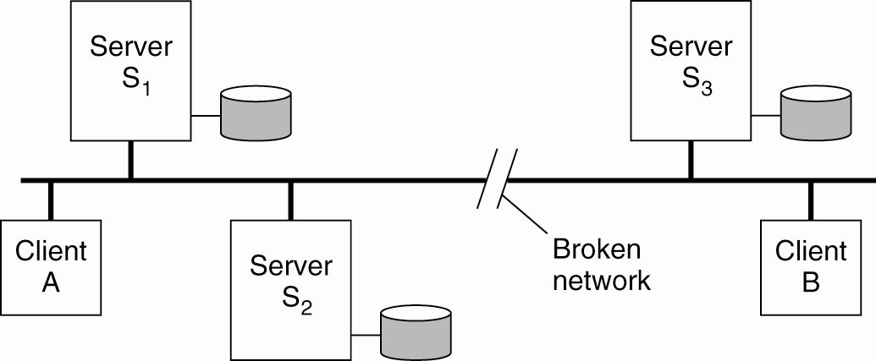
Server Replication in Coda
Figure 11-24. Two clients with a different AVSG for the same replicated file.

Slide 29
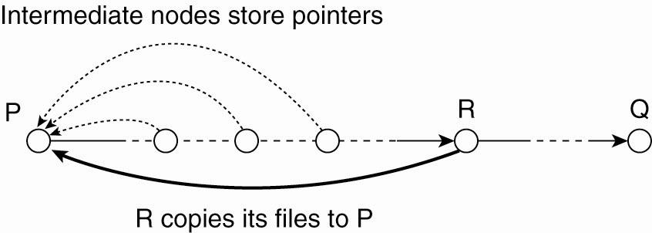
Structured Peer-to-Peer Systems
Figure 11-25. Balancing load in a peer-to-peer system by replication.

Slide 30
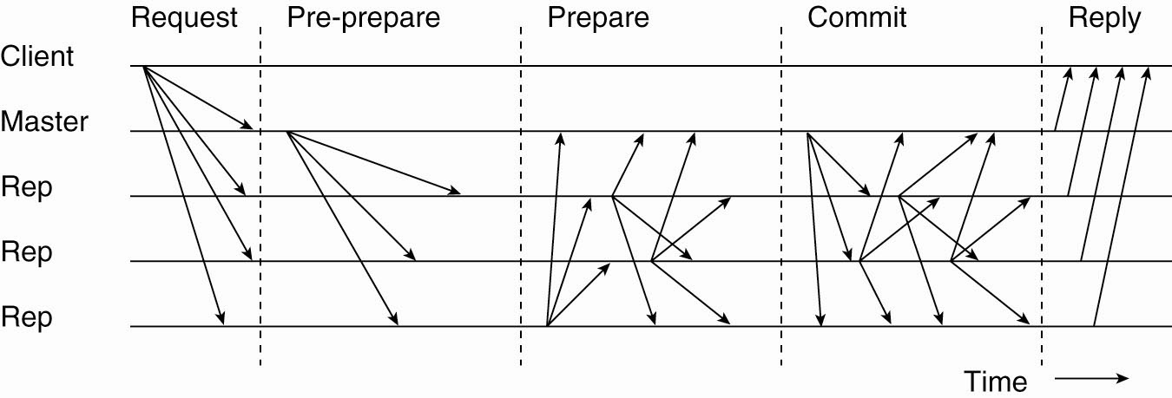
Handling Byzantine Failures
Figure 11-26. The different phases in Byzantine fault tolerance.

Slide 31
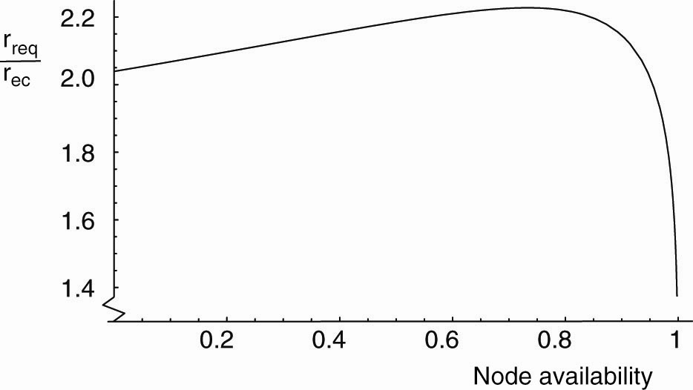
High Availability in Peer-to-Peer Systems
Figure 11-27. The ratio r_{rep} /r_{ec} as a function of node availability a.

Slide 32
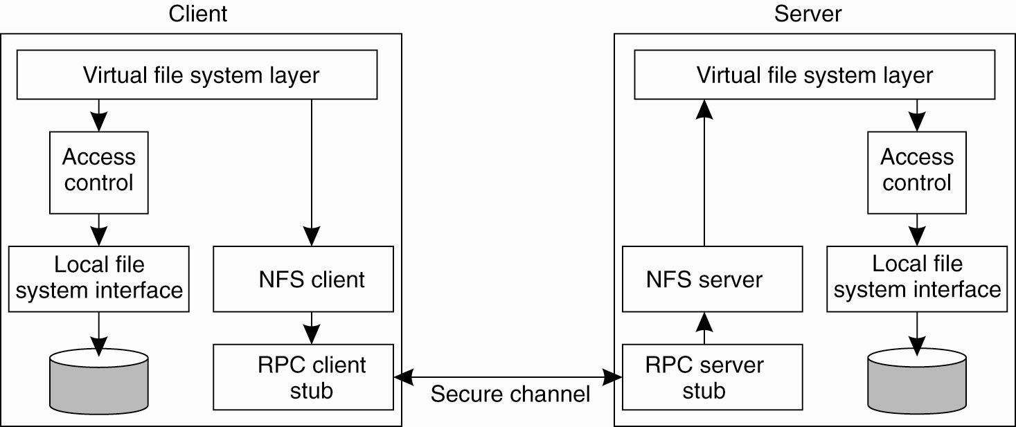
Security in NFS
Figure 11-28. The NFS security architecture.

Slide 33
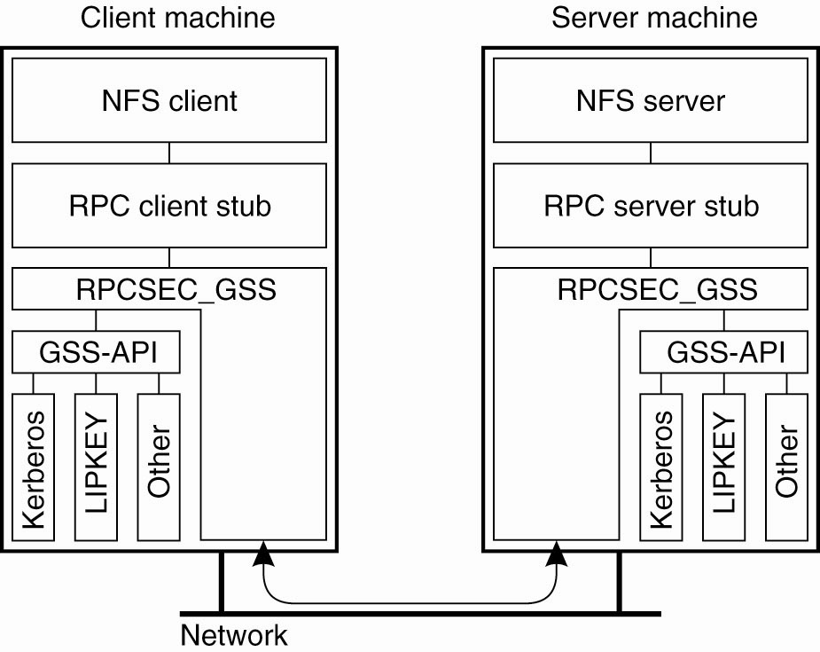
Secure RPCs
Figure 11-29. Secure RPC in NFSv4.

Slide 34
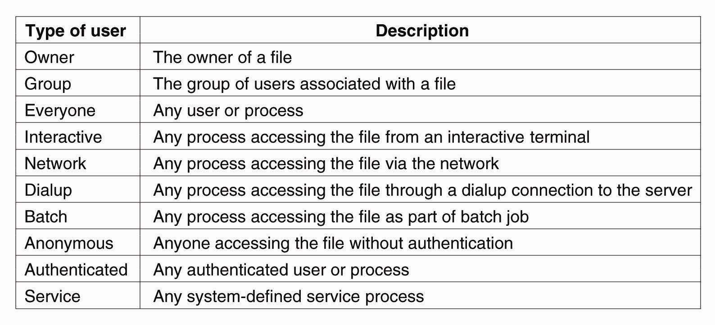
Access Control
Figure 11-30. The various kinds of users and processes distinguished by NFS with respect to access control.

Slide 35
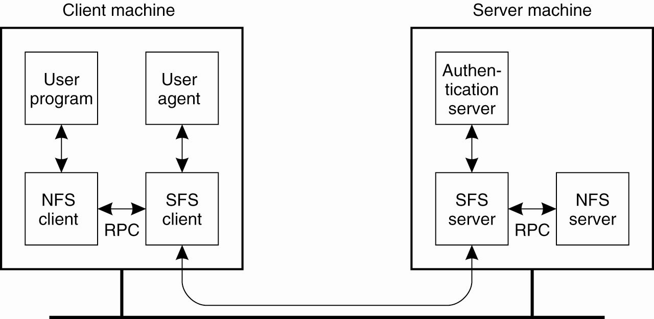
Decentralized Authentication (1)
Figure 11-31. The organization of SFS.

Slide 36
Decentralized Authentication (2)
Figure 11-32. A self-certifying pathname in SFS.

Slide 37
Secure Lookups in DHT-Based Systems
Secure routing requires that three issues are dealt with:
Nodes are assigned identifiers in a secure way.
Routing tables are securely maintained.
Lookup requests are securely forwarded between nodes.

Slide 38
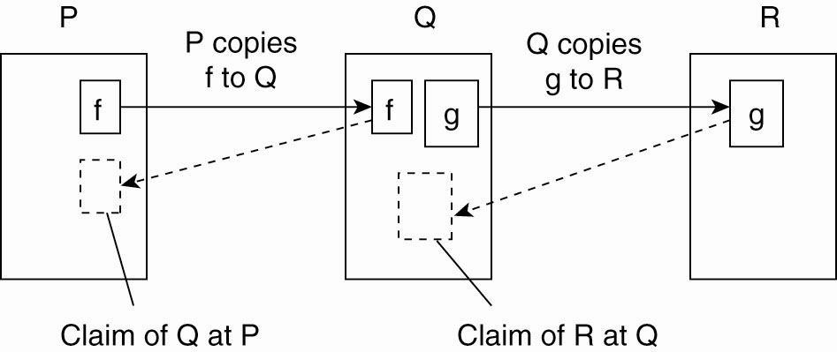
Secure Collaborative Storage
Figure 11-33. The principle of storage claims in the Samsara peer-to-peer system.

Slide 39
Thank You !

