Slide 1
Distributed Web Based System
Munawar, PhD

Slide 2
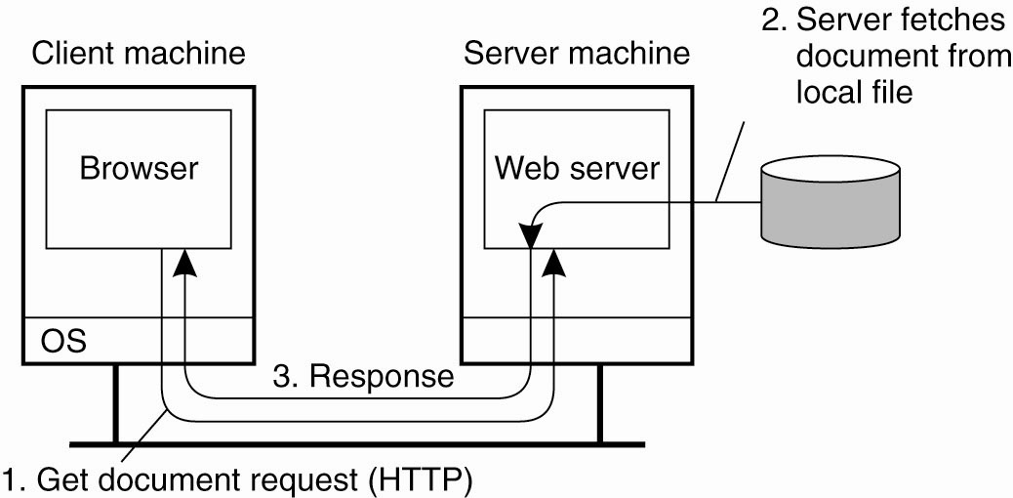
Traditional Web-Based Systems
Figure 12-1. The overall organization of a traditional Web site.

Slide 3
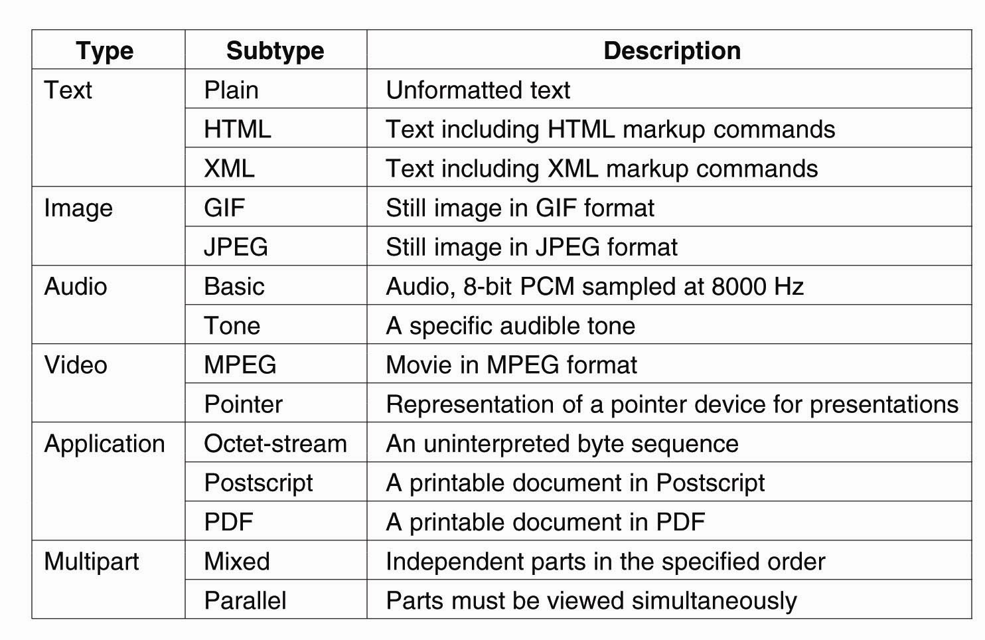
Web Documents
Figure 12-2. Six top-level MIME types and some common subtypes.

Slide 4
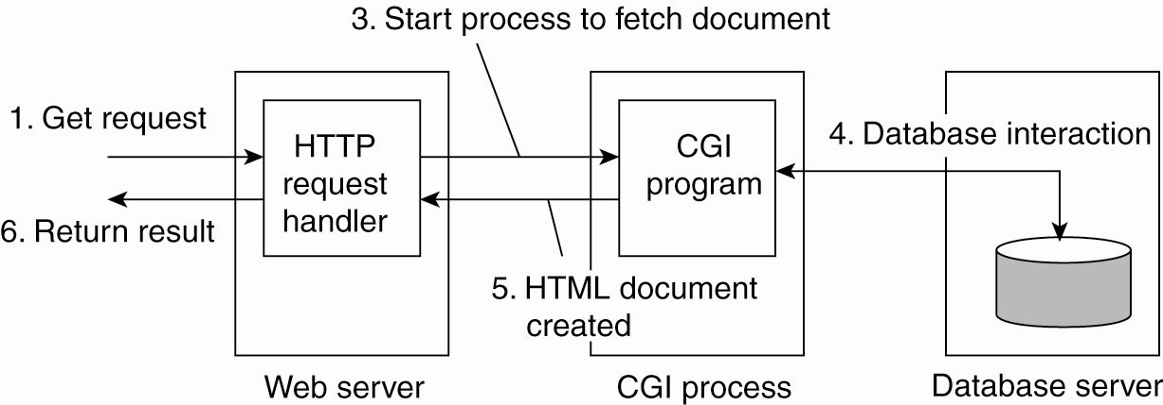
Multitiered Architectures
Figure 12-3. The principle of using server-side CGI programs.

Slide 5
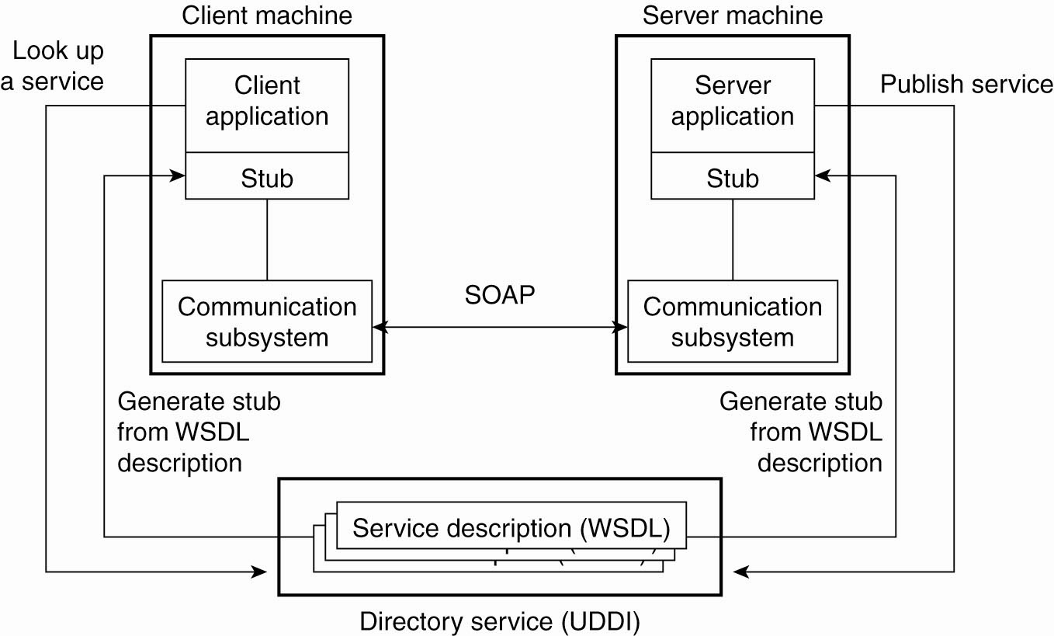
Web Services Fundamentals
Figure 12-4. The principle of a Web service.

Slide 6
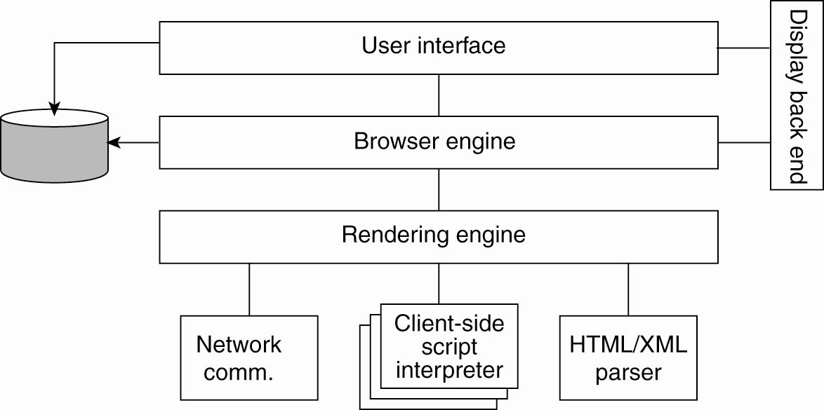
Processes – Clients (1)
Figure 12-5. The logical components of a Web browser.

Slide 7
Processes – Clients (2)
Figure 12-6. Using a Web proxy when the browser does not speak FTP.

Slide 8
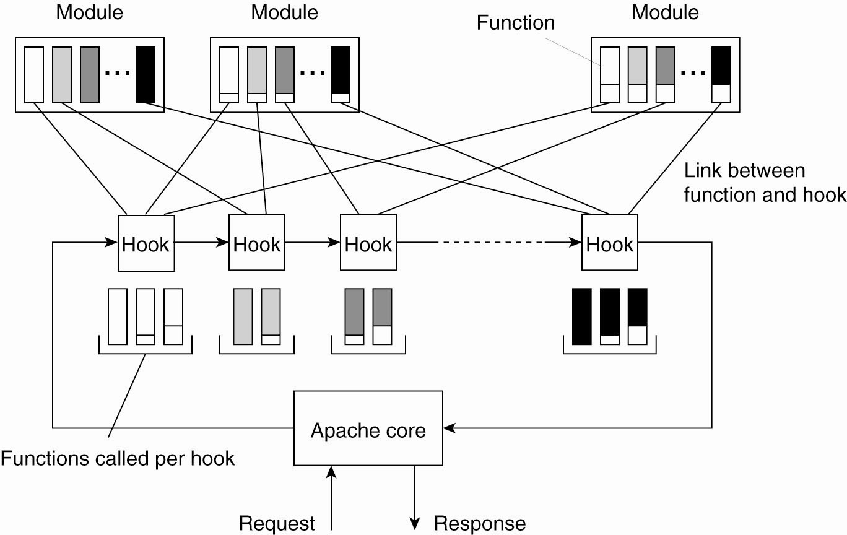
The Apache Web Server
Figure 12-7. The general organization of the Apache Web server.

Slide 9
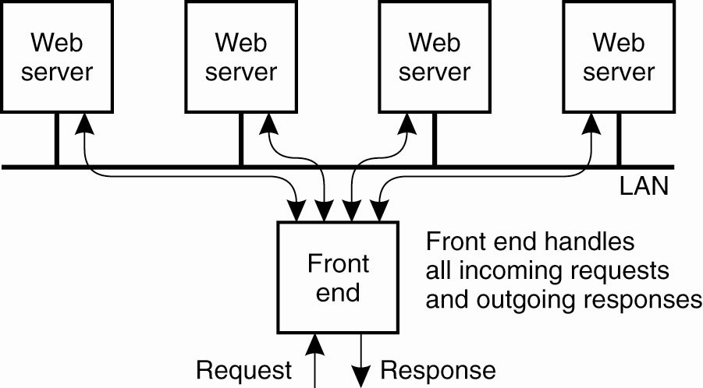
Web Server Clusters (1)
Figure 12-8. The principle of using a server cluster in combination with a front end to implement a Web service.

Slide 10
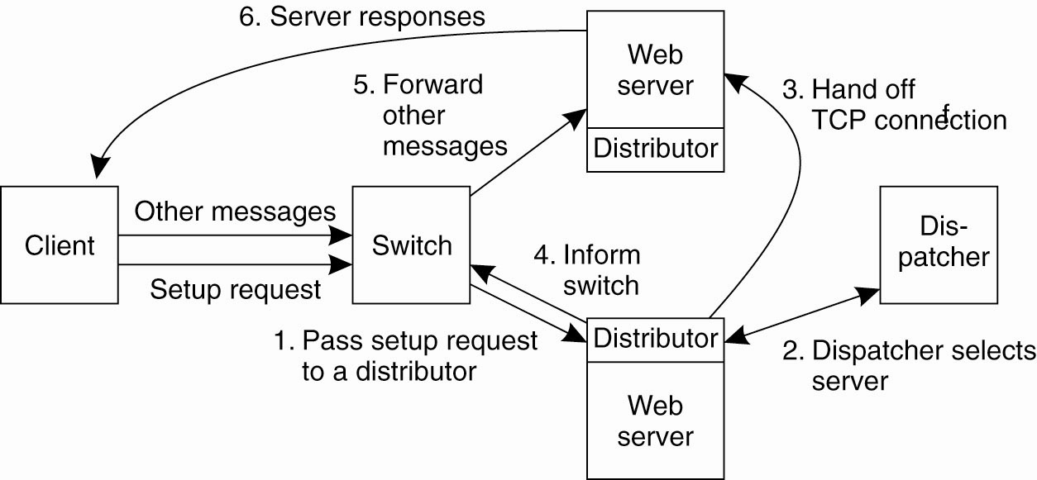
Web Server Clusters (2)
Figure 12-9. A scalable content-aware cluster of Web servers.

Slide 11
HTTP Connections (1)
Figure 12-10. (a) Using nonpersistent connections.

Slide 12
HTTP Connections (2)
Figure 12-10. (b) Using persistent connections.

Slide 13
HTTP Methods
Figure 12-11. Operations supported by HTTP.

Slide 14
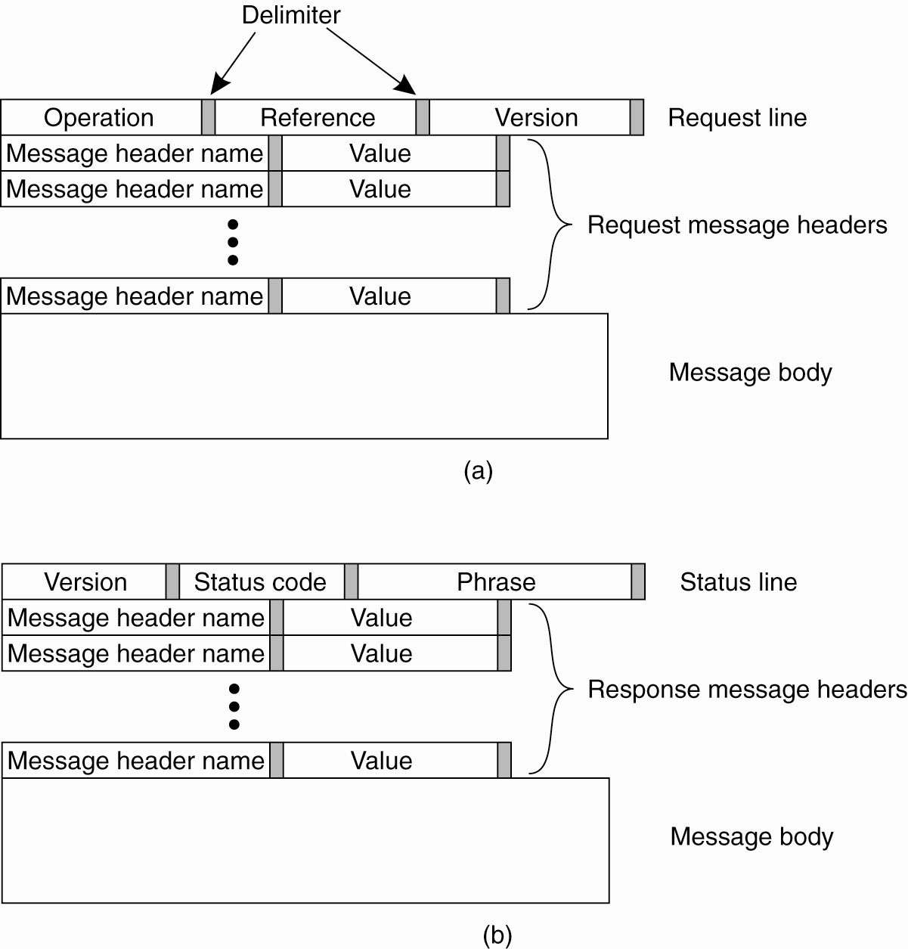
HTTP Messages (1)
Figure 12-12. (a) HTTP request message.

Slide 15
HTTP Messages (2)
Figure 12-12. (b) HTTP response message.

Slide 16
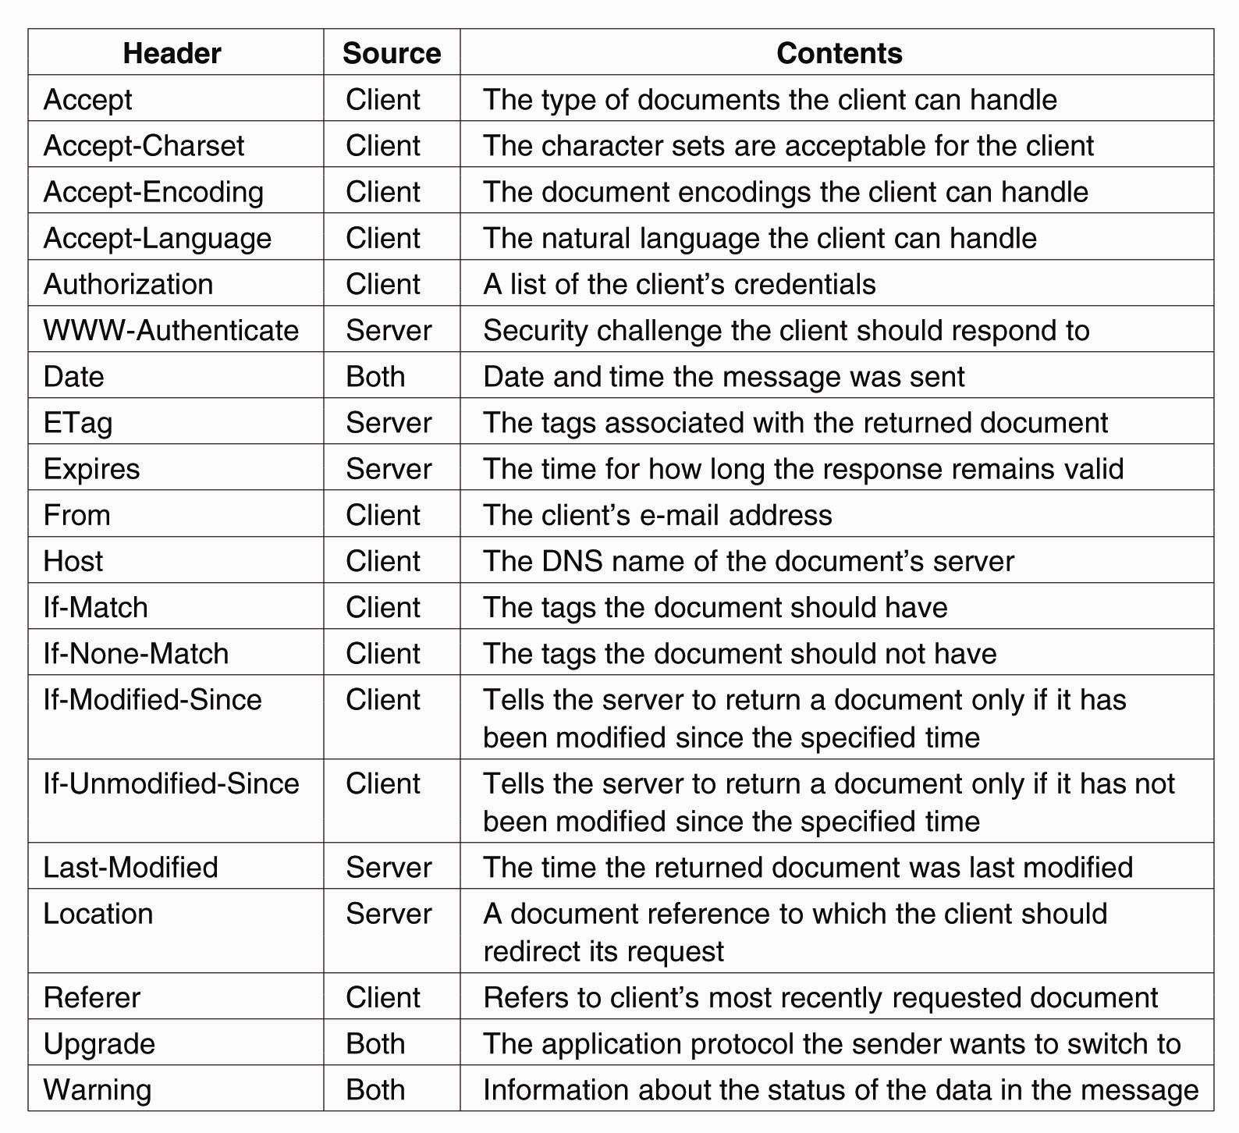
HTTP Messages (3)
Figure 12-13. Some HTTP message headers.

Slide 17
HTTP Messages (4)
Figure 12-13. Some HTTP message headers.

Slide 18
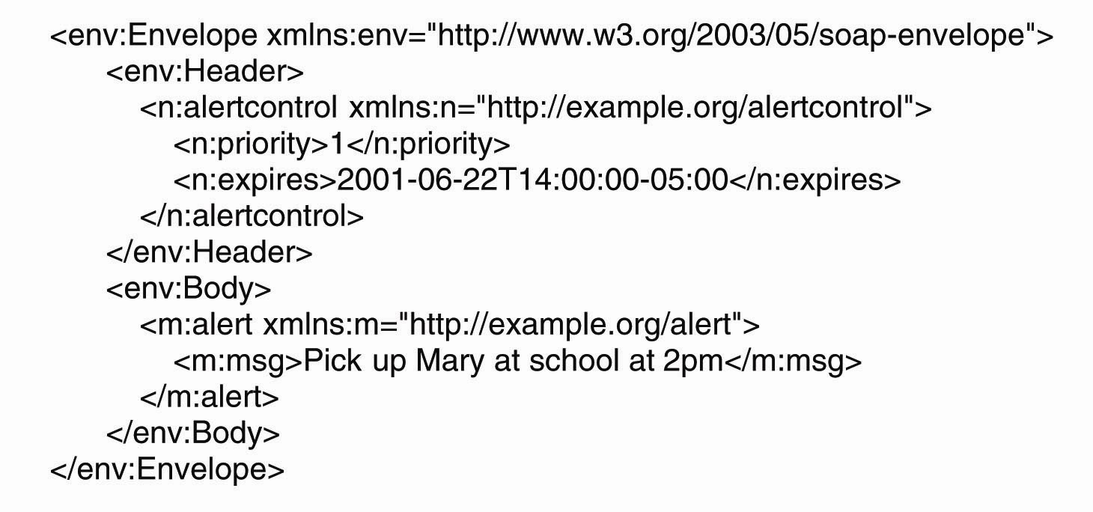
Simple Object Access Protocol
Figure 12-14. An example of an XML-based SOAP message.

Slide 19
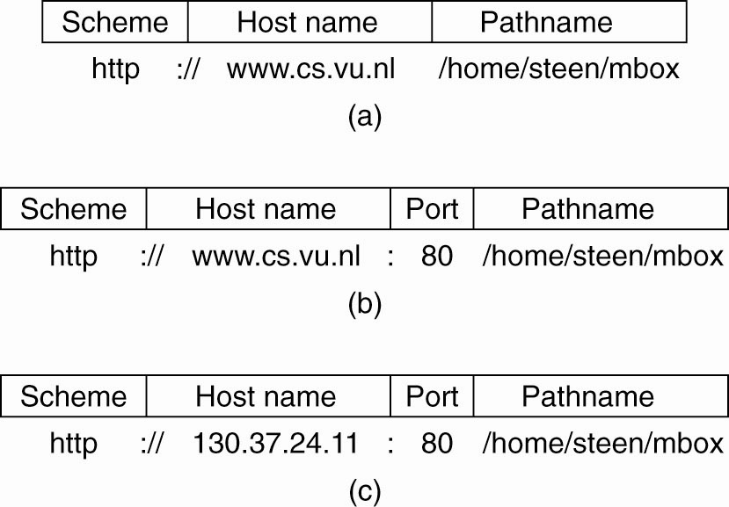
Naming (1)
Figure 12-15. Often-used structures for URLs. (a) Using only a DNS name. (b) Combining a DNS name with a port number. (c) Combining an IP address with a port number.

Slide 20
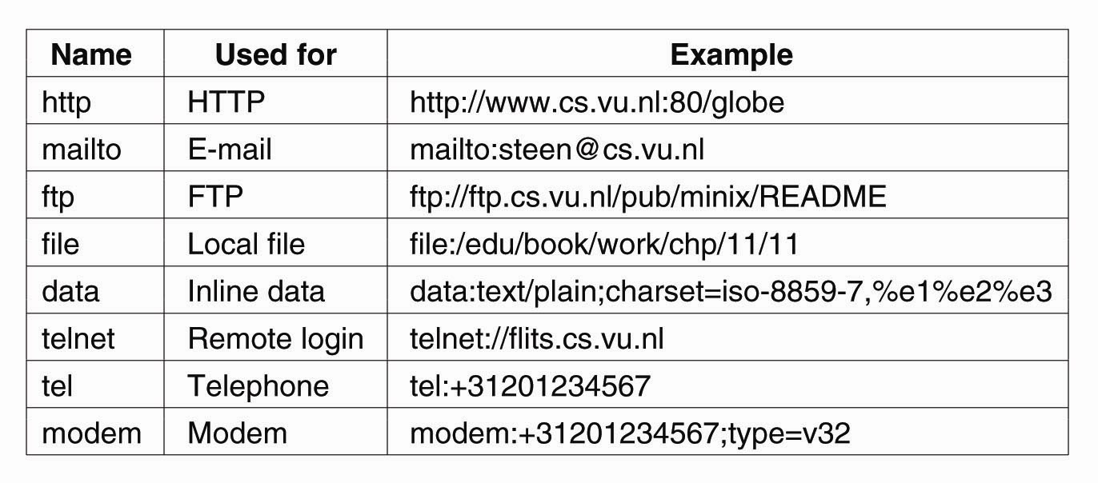
Naming (2)
Figure 12-16. Examples of URIs.

Slide 21
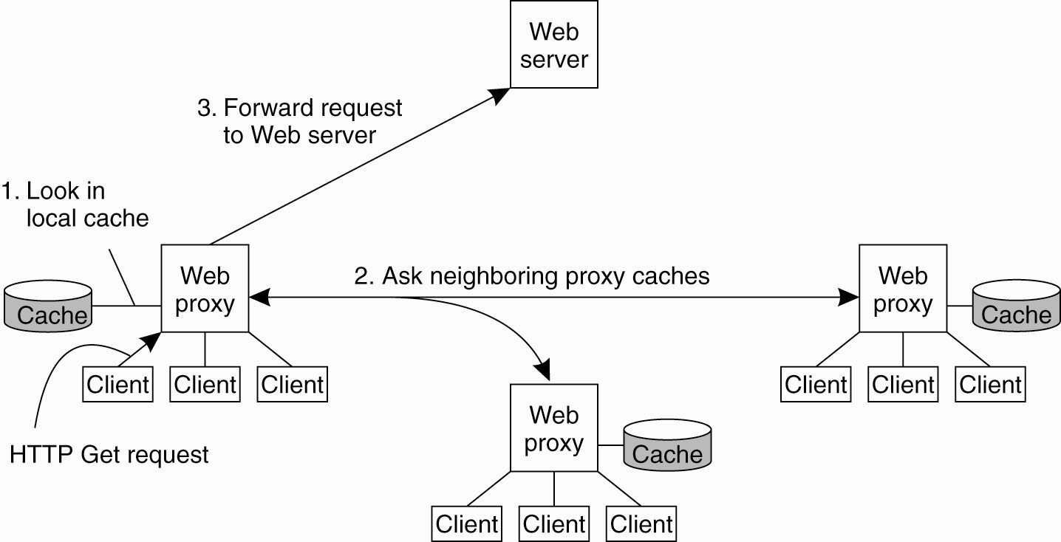
Web Proxy Caching
Figure 12-17. The principle of cooperative caching.

Slide 22
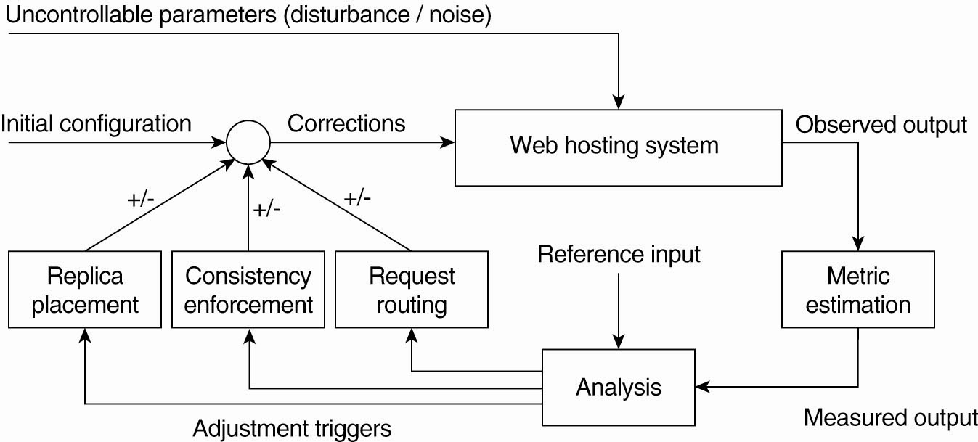
Replication for Web Hosting Systems
Figure 12-18. The general organization of a CDN as a feedback-control system (adapted from Sivasubramanian et al., 2004b).

Slide 23
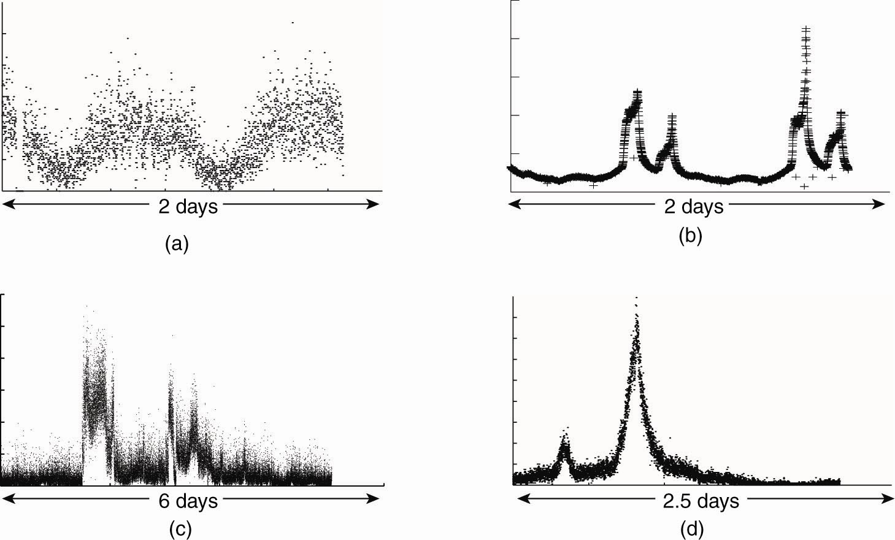
Adaptation Triggering
Figure 12-19. One normal and three different access patterns reflecting flashcrowd behavior (adapted from Baryshnikov et al., 2005).

Slide 24
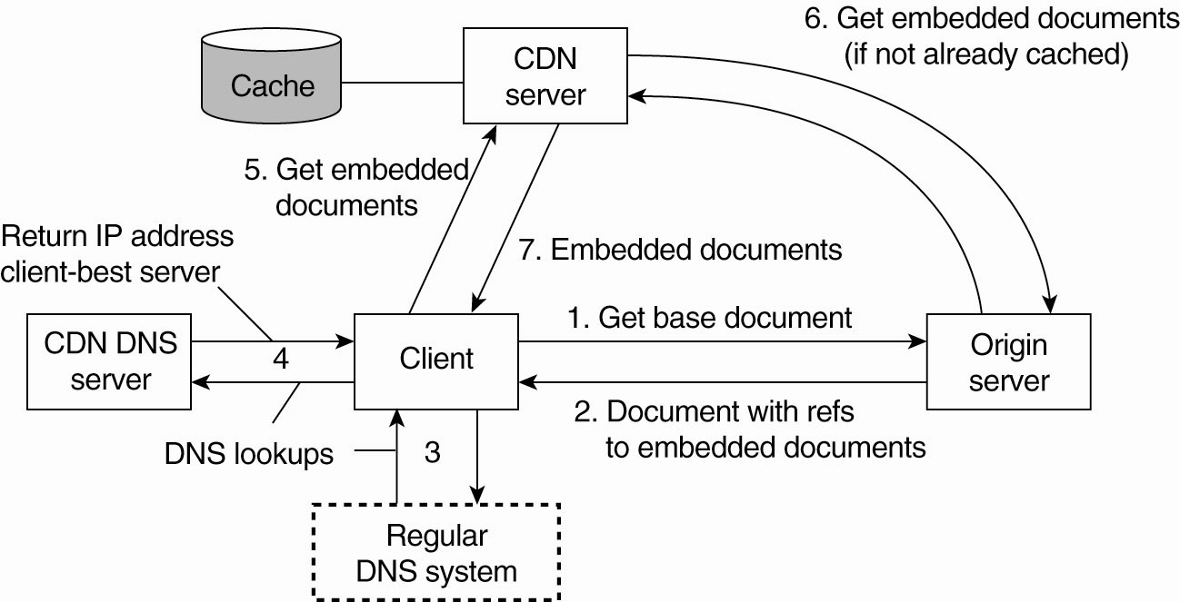
Adjustment Measures
Figure 12-20. The principal working of the Akamai CDN.

Slide 25
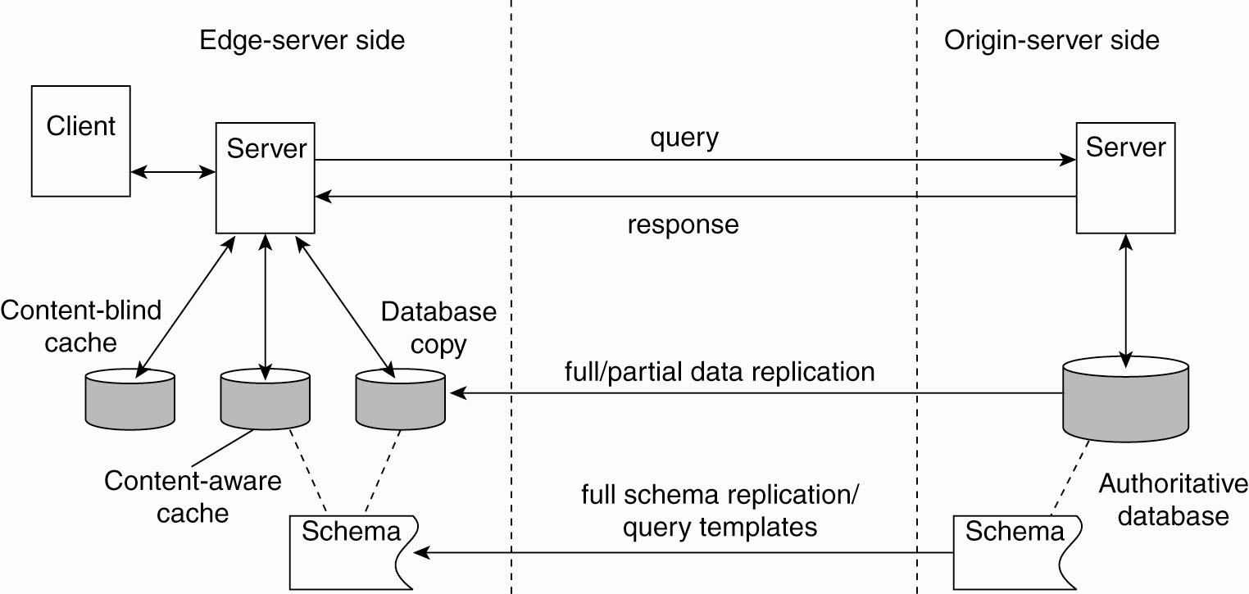
Replication of Web Applications
Figure 12-21. Alternatives for caching and replication with Web applications.

Slide 26
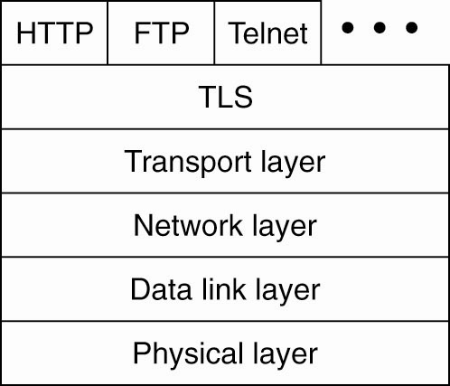
Security (1)
Figure 12-22. The position of TLS in the Internet protocol stack.

Slide 27
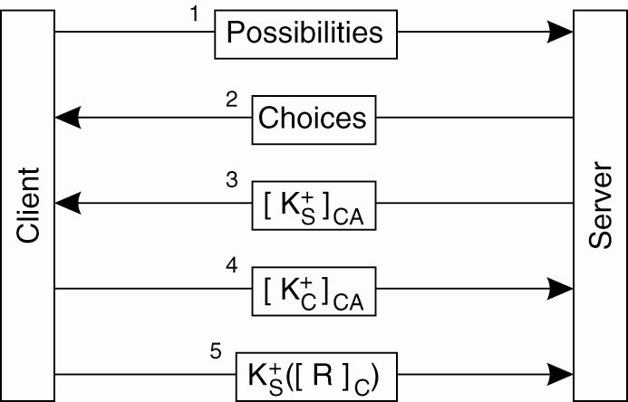
Security (2)
Figure 12-23. TLS with mutual authentication.

Slide 28
Thank You !

