Slide 1
Distributed Coordinator Based System
Munawar, PhD

Slide 2
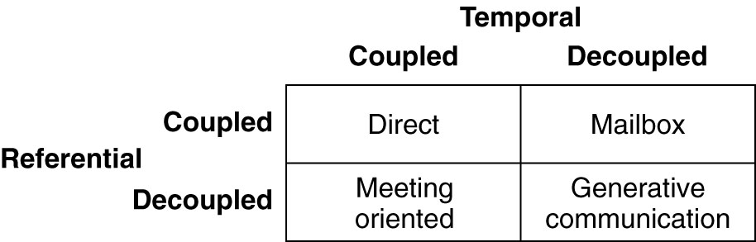
Introduction To Coordination Models
Figure 13-1. A taxonomy of coordination models (adapted from Cabri et al., 2000).

Slide 3
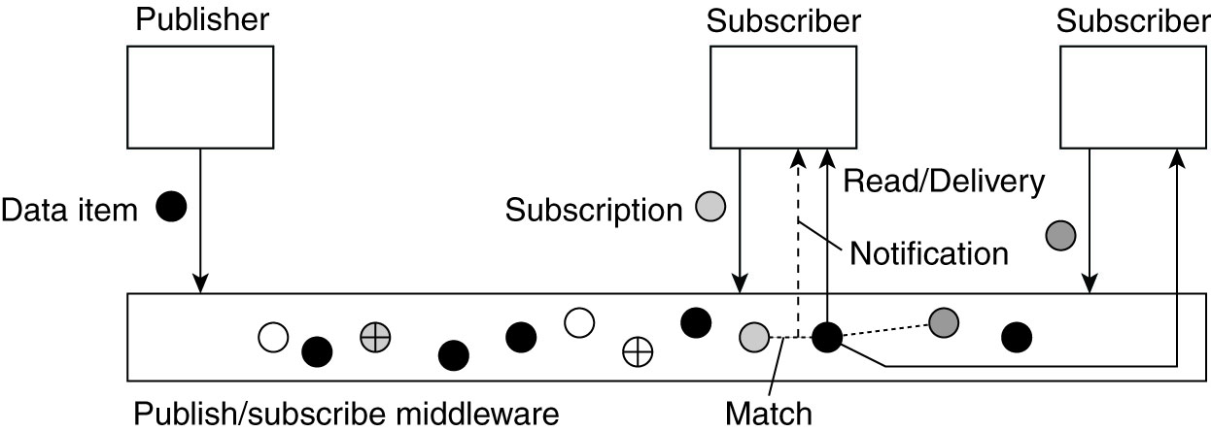
Overall Approach
Figure 13-2. The principle of exchanging data items between publishers and subscribers.

Slide 4
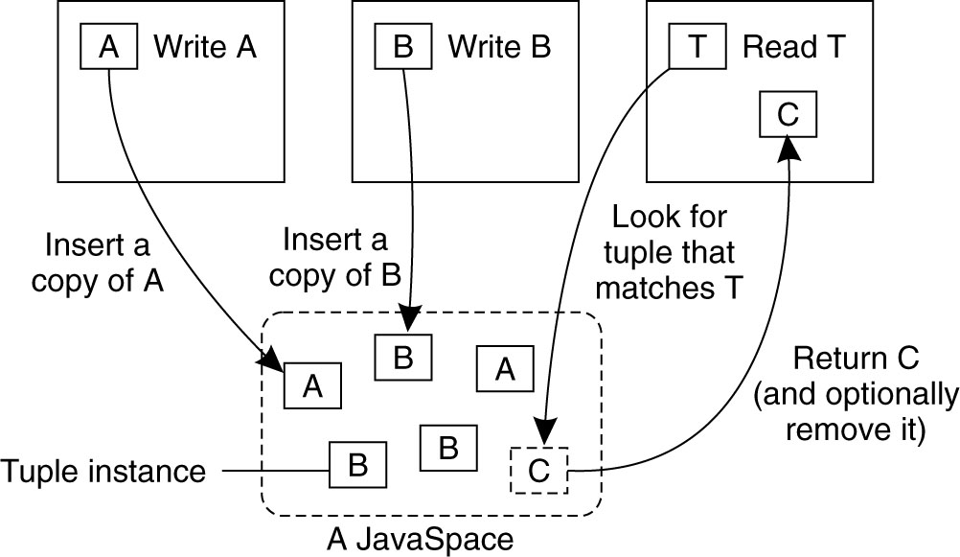
Example: Jini and JavaSpaces
Figure 13-3. The general organization of a JavaSpace in Jini.

Slide 5
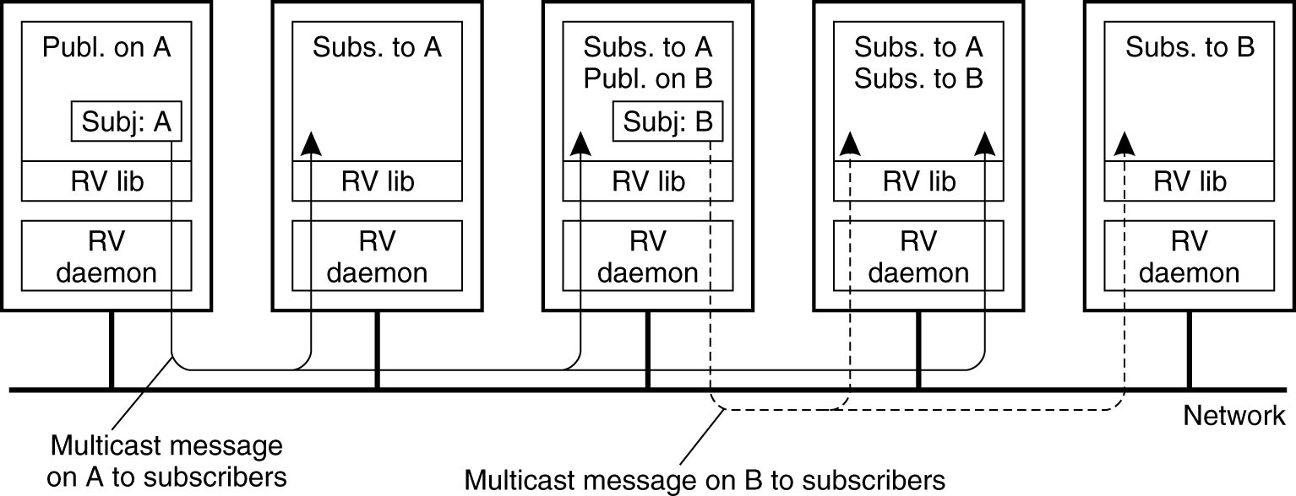
Example: TIB/Rendezvous
Figure 13-4. The principle of a publish/subscribe system
as implemented in TIB/Rendezvous.

Slide 6
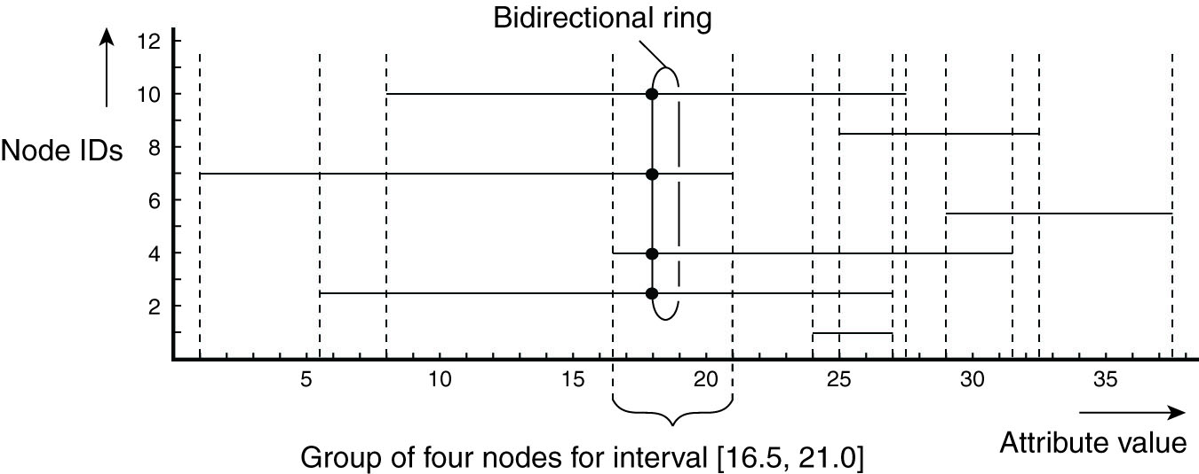
Example: A Gossip-Based Publish/Subscribe System
Figure 13-5. Grouping nodes for supporting range queries in a peer-to-peer publish/subscribe system.

Slide 7
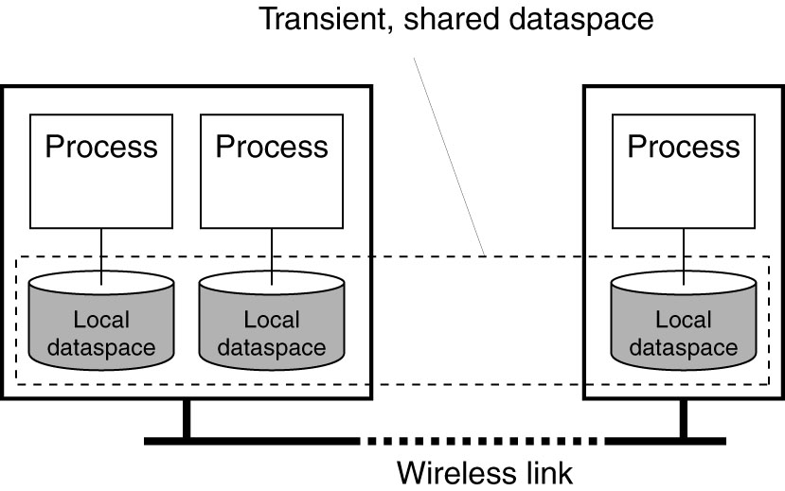
Example: Lime
Figure 13-6. Transient sharing of local dataspaces in Lime.

Slide 8
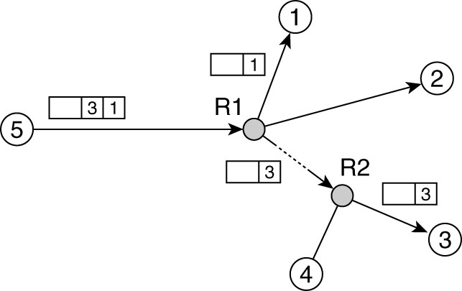
Content-Based Routing (1)
Figure 13-7. Naive content-based routing.

Slide 9
Content-Based Routing (1)
Figure 13-8. A partially filled routing table.

Slide 10
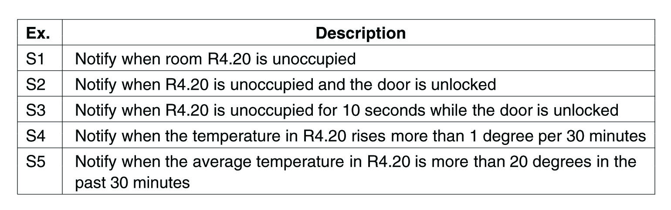
Describing Composite Events (1)
Figure 13-9. Examples of events in a distributed system.

Slide 11
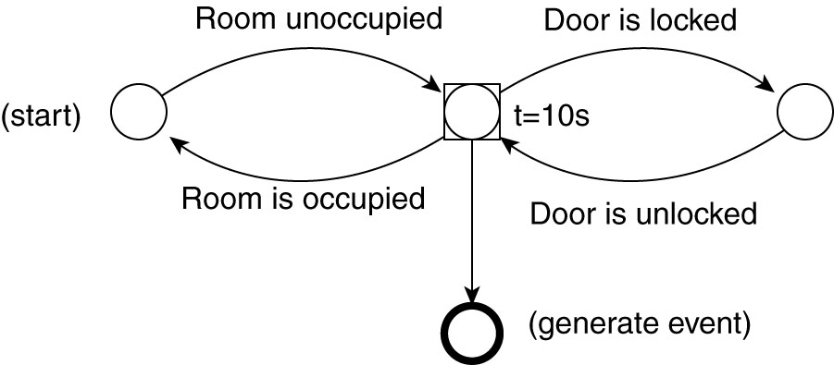
Describing Composite Events (2)
Figure 13-10. The finite state machine for
subscription S3 from Fig. 13-9.

Slide 12
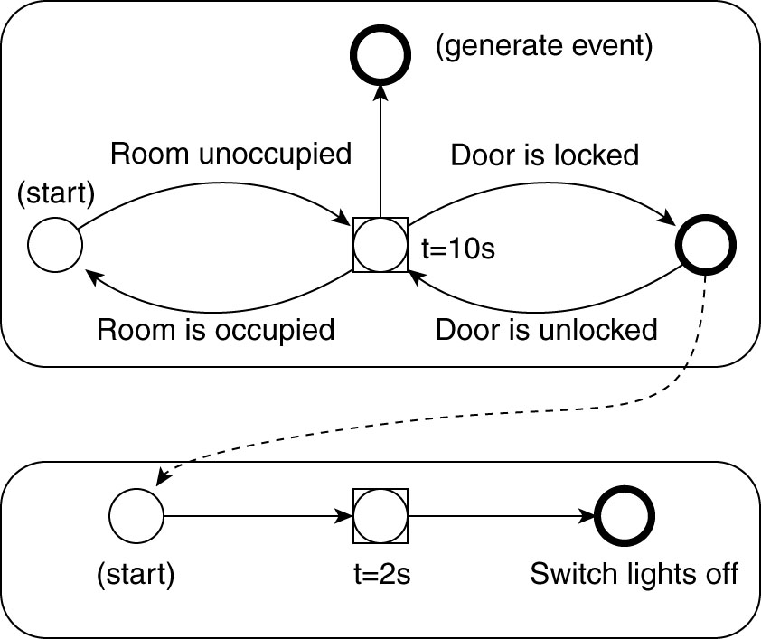
Describing Composite Events (3)
Figure 13-11. Two coupled FSMs.

Slide 13
General Considerations to Static Approaches (1)
An efficient distributed implementation of a JavaSpace has to solve two problems:
How to simulate associative addressing without massive searching.
How to distribute tuple instances among machines and locate them later.

Slide 14
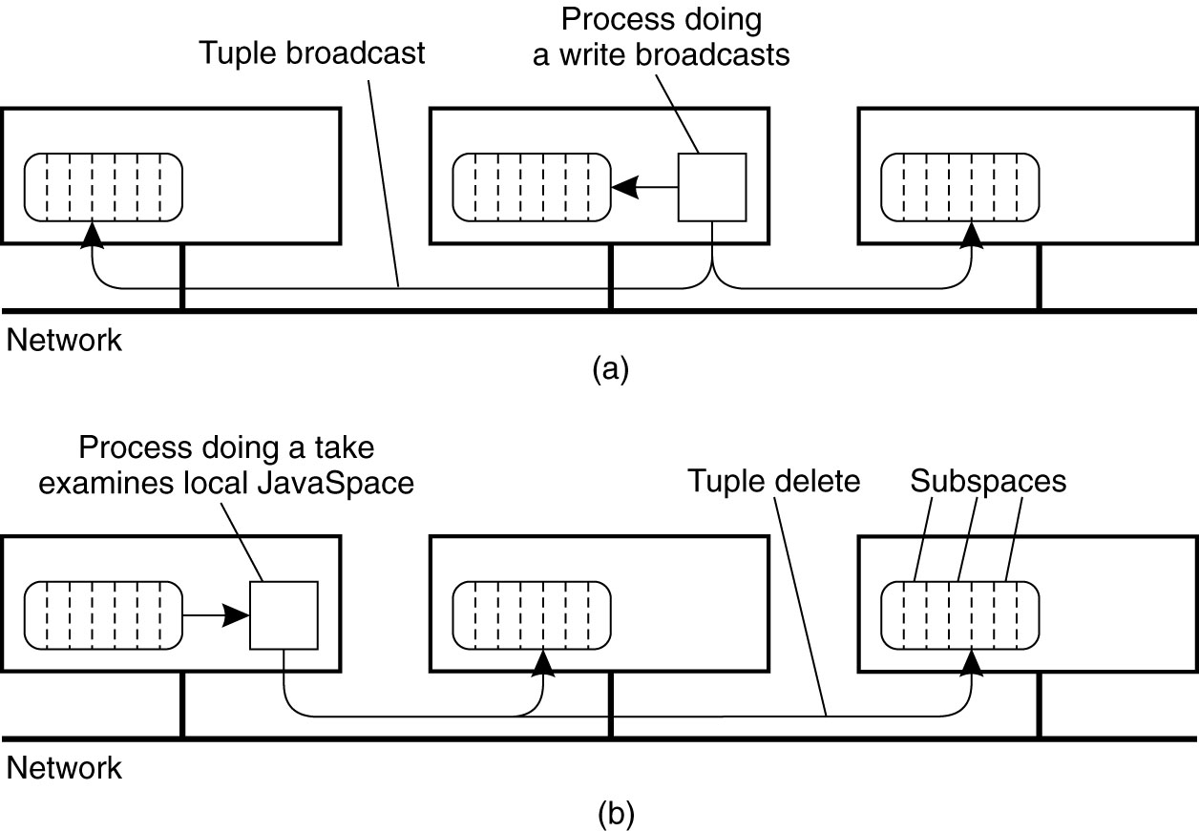
General Considerations to Static Approaches (2)
Figure 13-12. A JavaSpace can be replicated on all machines. The dotted lines show the partitioning of the JavaSpace into subspaces. (a) Tuples are broadcast on write.

Slide 15
General Considerations to Static Approaches (3)
Figure 13-12. A JavaSpace can be replicated on all machines. The dotted lines show the partitioning of the JavaSpace into subspaces. (b) reads are local, but the removing an instance when calling take must be broadcast.

Slide 16
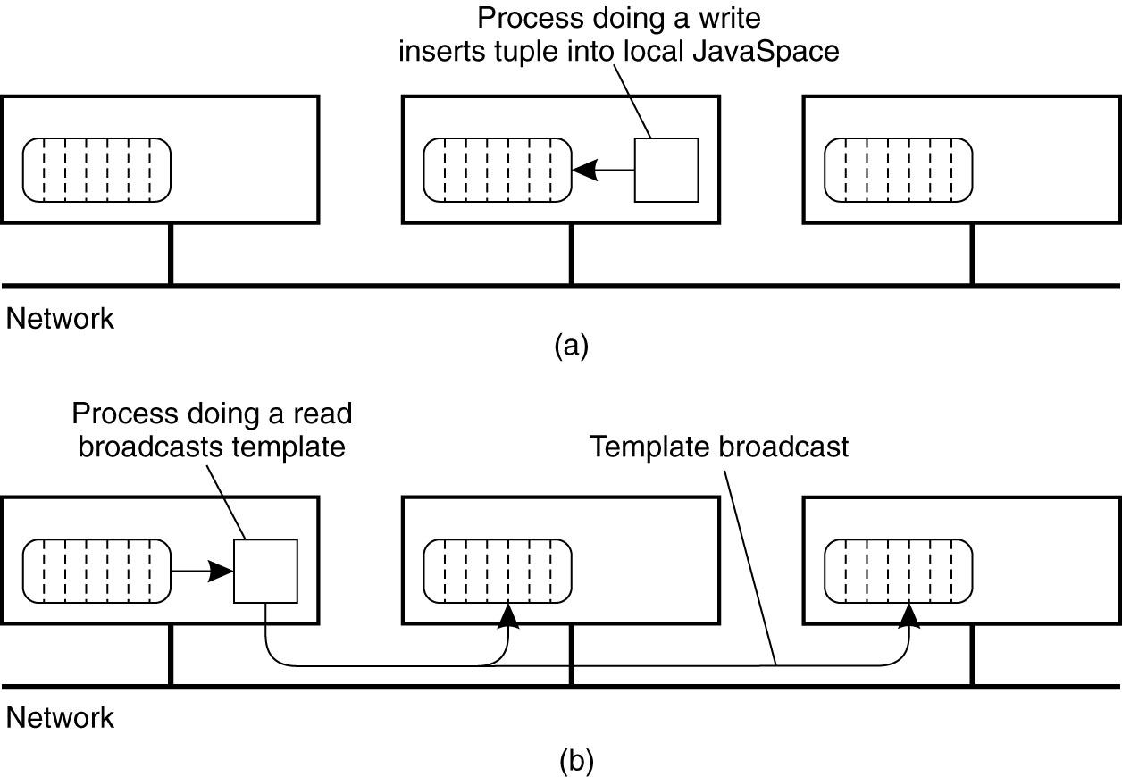
General Considerations to Static Approaches (4)
Figure 13-13. Nonreplicated JavaSpace.
(a) A write is done locally.

Slide 17
General Considerations to Static Approaches (5)
Figure 13-13. Nonreplicated JavaSpace. (b) A read or
take requires the template tuple to be broadcast
in order to find a tuple instance.

Slide 18
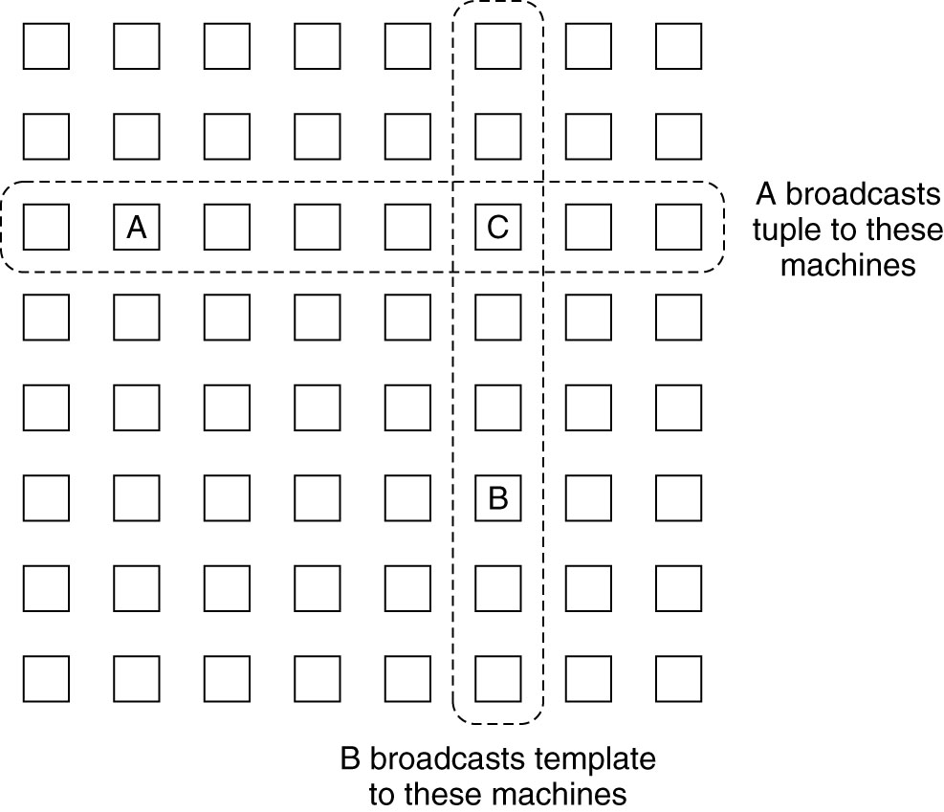
General Considerations to Static Approaches (6)
Figure 13-14. Partial broadcasting of tuples and template tuples.

Slide 19
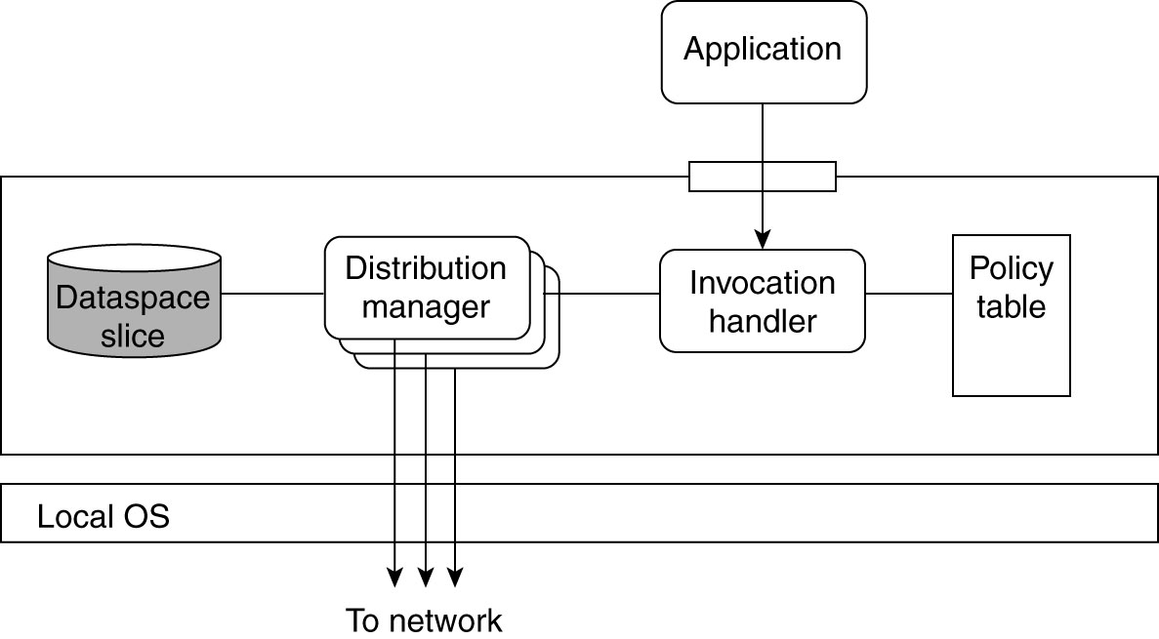
GSpace Overview
Figure 13-15. Internal organization of a GSpace kernel.

Slide 20
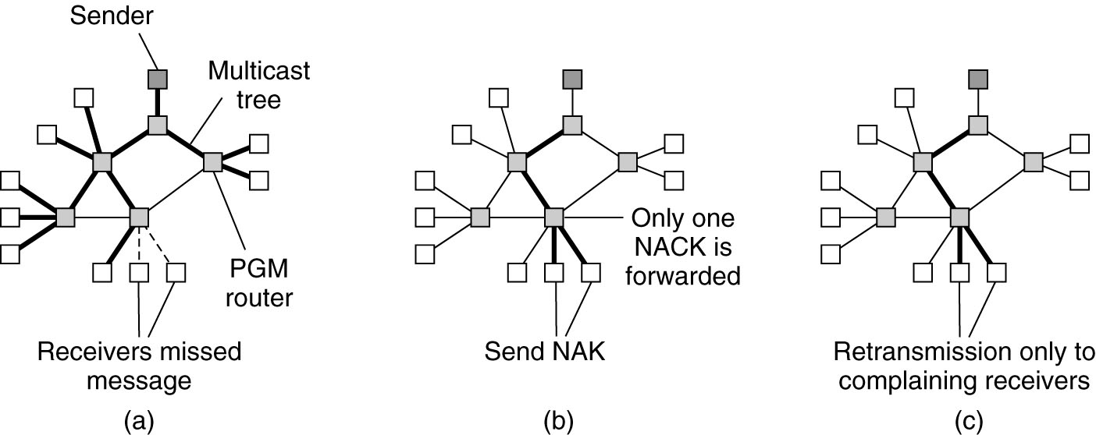
Example: Fault Tolerance in TIB/Rendezvous (1)
Figure 13-16. The principle of PGM.
(a) A message is sent along a multicast tree.

Slide 21
Example: Fault Tolerance in TIB/Rendezvous (2)
Figure 13-16. The principle of PGM. (b) A router
will pass only a single NAK for each message.

Slide 22
Example: Fault Tolerance in TIB/Rendezvous (3)
Figure 13-16. The principle of PGM. (c) A message is retransmitted only to receivers that have asked for it.

Slide 23
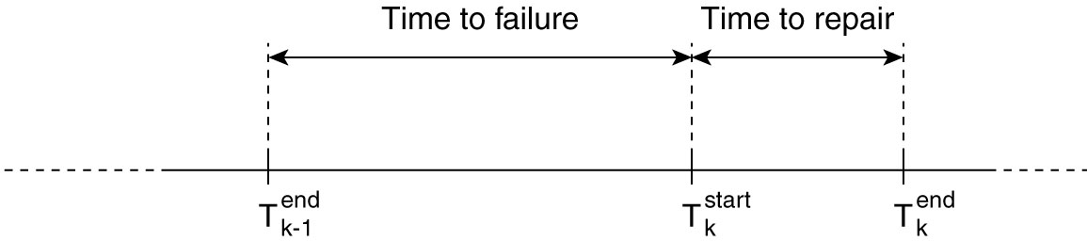
Fault Tolerance in Shared Dataspaces
Figure 13-17. The time line of a node experiencing failures.

Slide 24
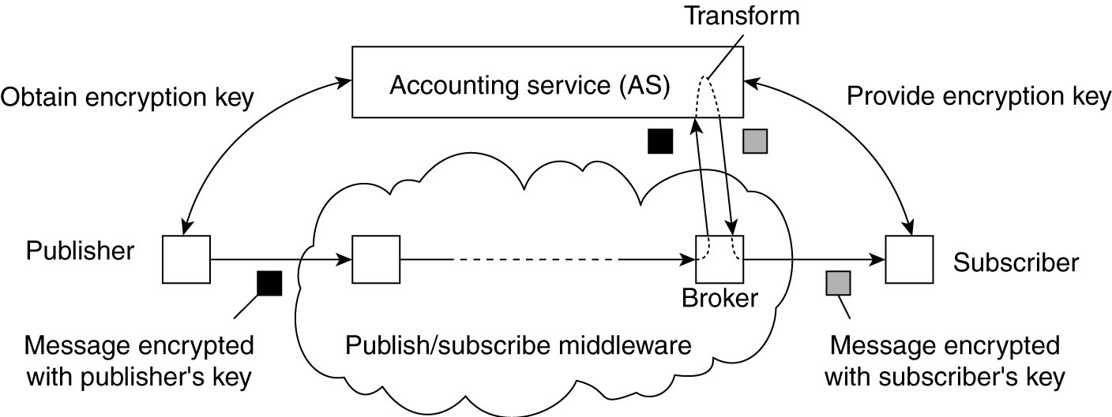
Decoupling Publishers from Subscribers
Figure 13-18. Decoupling publishers from subscribers
using an additional trusted service.

Slide 25
Thank You !

