Slide 1
Pemrosesan Data Tersebar
Pertemuan 1 . Introduction Dosen Pengampu: Hendry Gunawan S.Kom, MM
Prodi Teknik Informatika - Fakultas Ilmu Komputer

Slide 2
Materi Sebelum UTS
Introduction
Digital Data Communication Techniques
Ad-hoc & Sensor Network
Quality of Service
Congestion control and QoS
Multiplexing and Spreading
Signal encoding technique

Slide 3
Materi Setelah UTS
Congestion Control in Data Networks
Error Detection and Correction
Multiple Access
Multimedia on Network
Publish/Subcribe Internet Architecture
Cache-and-forward Network Archtecture for mobile contennt
Fault Tolerant Network Architecture

Slide 4
Learning Outcomes
Pemahaman topik-topik kehandalan pengiriman data dalam konteks aplikasi pervasive computing

Slide 5
PERVASIVE COMPUTING
Pervasive Computing is the study of a computing technology that pervades the users’ environment by making use of seamless connectivity of multiple independent information devices embedded in the environment of the users.
The most profound technologies are those that disappear. They weave themselves into the fabric of everyday life until they are indistinguishable from it. --------Mark Weiser

Slide 6
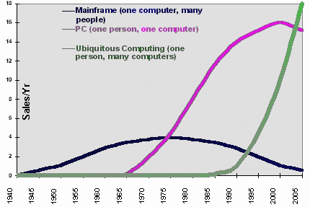
PERVASIVE COMPUTING
"Ubiquitous computing names the third wave in computing, just now beginning. First were mainframes, each shared by lots of people. Now we are in the personal computing era, person and machine staring uneasily at each other across the desktop. Next comes ubiquitous computing, or the age of calm technology, when technology recedes into the background of our lives."

Slide 7
PERVASIVE COMPUTING
This is done by:
Making use of multiple independent information devices (fixed or mobile, homogeneous or heterogeneous)
Interconnecting these devices seamlessly through wireless or wired computer communication networks
Providing a class of computing / sensory / communication services to a class of users, preferably transparently and can provide personalized services while ensuring a fair degree of privacy / non-intrusiveness.
Pervasive Computing is also called Ubiquitous Computing or Invisible Computing.

Slide 8
PERVASIVE COMPUTING
Promoters of this idea hope that embedding computation into the environment and everyday objects would enable people to interact with information-processing devices more naturally and casually than they currently do, and in ways that suit whatever location or context they find themselves in.

Slide 9
Principles of Pervasive Computing
Pervasive computing integrates computation into the environment, rather than having computers which are distinct objects.
Other terms for pervasive computing:
Ubiquitous computing
Calm technology
Things that think
Everyware
Pervasive internet
Ambient intelligence
Proactive computing
Augmented reality

Slide 10
Principles of Pervasive Computing
Central aim of pervasive computing: invisibility
One does not need to continually rationalize one's use of a pervasive computing system.
Having learnt about its use sufficiently well, one ceases to be aware of it.
It is "literally visible, effectively invisible" in the same way that a skilled carpenter engaged in his work might use a hammer without consciously planning each swing.
Similarly, when you look at a street sign, you absorb its information without consciously performing the act of reading.

Slide 11
Evolution & Related Fields
Pervasive computing represents a major evolutionary step in a line of work dating back to the mid-1970s.
Two distinct earlier steps in this evolution:
Distributed systems
Mobile computing

Slide 12
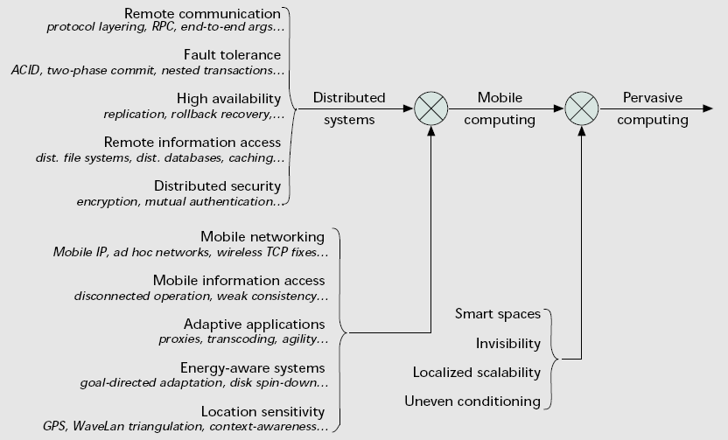
Evolution & Related Fields
Taxonomy of computer systems research problems in pervasive computing.

Slide 13
Evolution & Related Fields
Distributed systems
Arose at the intersection of personal computers and local area networks.
The research that followed from the mid-1970s through the early 1990s created a conceptual framework and algorithmic base that has proven to be of enduring value in all work involving two or more computers connected by a network — whether mobile or static, wired or wireless, sparse or pervasive.
Spans many areas that are foundational to pervasive computing (Figure 2).

Slide 14
Evolution & Related Fields
Mobile computing
The appearance of full-function laptop computers and wireless LANs in the early 1990s led researchers to confront the problems that arise in building a distributed system with mobile clients. The field of mobile computing was thus born.
Many basic principles of distributed system design continued to apply.
Four key constraints of mobility forced the development of specialized techniques:
Unpredictable variation in network quality
Lowered trust and robustness of mobile elements
Limitations on local resources imposed by weight and size constraints
Concern for battery power consumption

Slide 15
Evolution & Related Fields
Other related fields:
Sensor networks
Human-computer interaction
http://www.sigchi.org/
Artificial intelligence

Slide 16
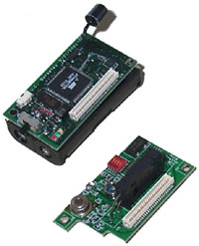
Evolution & Related Fields
Other related fields:
Sensor Networks
A sensor network consist of a large number of tiny autonomous computing devices, each equipped with sensors, a wireless radio, a processor, and a power source.
Sensor networks are envisioned to be deployed unobtrusively in the physical environment in order to monitor a wide range of environmental phenomena (e.g., environmental pollutions, seismic activity, wildlife) with unprecedented quality and scale.

Slide 17
Evolution & Related Fields
Other related fields:
Human Computer Interaction
HCI is the study of interaction between people (users) and computers.
A basic goal of HCI is to improve the interaction between users and computers by making computers more user-friendly and receptive to the user's needs.
A long term goal of HCI is to design systems that minimize the barrier between the human's cognitive model of what they want to accomplish and the computer's understanding of the user's task.

Slide 18
Evolution & Related Fields
Other related fields:
Artificial Intelligence
AI can be defined as intelligence exhibited by an artificial (non-natural, manufactured) entity.
AI is studied in overlapping fields of computer science, psychology and engineering, dealing with intelligent behavior, learning and adaptation in machines, generally assumed to be computers.
Research in AI is concerned with producing machines to automate tasks requiring intelligent behavior.

Slide 19
Problem Space
Pervasive computing incorporates four additional research thrusts:
Effective use of smart spaces
Invisibility
Localized scalability
Masking uneven conditioning

Slide 20
Problem Space
Effective use of smart spaces
By embedding computing infrastructure in building infrastructure, a smart space brings together physical and virtual worlds that have been disjoint until now.
The fusion of these worlds enables sensing and control of one world by the other.
Automatic adjustment of heating, cooling, and lighting levels in a room based on an occupant’s electronic profile.
Notes:
Akıllı alanların etkili kullanımı

Slide 21
Problem Space
Invisibility
The ideal expressed by Weiser is complete disappearance of pervasive computing technology from a user’s consciousness (minimal user distraction).
If a pervasive computing environment continuously meets user expectations and rarely presents him with surprises, it allows him to interact almost at a subconscious level.
Notes:
Görünmezlik

Slide 22
Problem Space
Localized scalability
As smart spaces grow in sophistication, the intensity of interactions between a user’s personal computing space and his/her surroundings increases.
This has severe bandwidth, energy, and distraction implications for a wireless mobile user.
The presence of multiple users will further complicate this problem.
Good system design has to achieve scalability by severely reducing interactions between distant entities.
Notes:
Sınırlandırılmış Ölçeklenirlik

Slide 23
Problem Space
Masking un-even conditioning
Huge differences in the “smartness” of different environments — what is available in a well-equipped conference room, office, or classroom may be more sophisticated than in other locations.
This large dynamic range of “smartness” can be jarring to a user, detracting from the goal of making pervasive computing technology invisible.
One way to reduce the amount of variation seen by a user is to have his/her personal computing space compensate for “dumb” environments.
Notes:
Değişken Durumların Gizlenmesi

Slide 24
Problem Space
Design and implementation problems in pervasive comp.
User intent
Cyber foraging
Adaptation strategy
High-level energy management
Client thickness
Context awareness
Balancing proactivity and transparency
Privacy and trust
Notes:
http://en.wikipedia.org/wiki/Cyber_foraging

Slide 25
Problem Space
User intent
For proactivity to be effective, it is crucial that a pervasive computing system track user intent. Otherwise, it will be almost impossible to determine which system actions will help rather than hinder the user.
For example, suppose a user is viewing video over a network connection whose bandwidth suddenly drops. Should the system:
Reduce the fidelity of the video?
Pause briefly to find another higher-bandwidth connection?
Advise the user that the task can no longer be accomplished?
The correct choice will depend on what the user is trying to accomplish.

Slide 26
Problem Space
Cyber foraging (also called “living off the land”)
The idea is to dynamically augment the computing resources of a wireless mobile computer by exploiting wired hardware infrastructure.
As computing becomes cheaper and more plentiful, it makes economic sense to “waste” computing resources to improve user experience.
In the forseeable future, public spaces such as airport lounges and coffee shops will be equipped with compute servers or data staging servers for the benefit of customers, much as table lamps are today. (Today, many shopping centers and cafeterias offer their customers free wireless internet access.)

Slide 27
Problem Space
Adaptation strategy
Adaptation is necessary when there is a significant mismatch between the supply and demand of a resource (e.g. wireless network bandwidth, energy, computing cycles or memory).
There are three alternative strategies for adaptation in pervasive computing:
A client can guide applications in changing their behavior so that they use less of a scarce resource. This change usually reduces the user-perceived quality, or fidelity, of an application.
A client can ask the environment to guarantee a certain level of a resource (reservation-based QoS systems). From the viewpoint of the client, this effectively increases the supply of a scarce resource to meet the client’s demand.
A client can suggest a corrective action to the user. If the user acts on this suggestion, it is likely (but not certain) that resource supply will become adequate to meet demand.

Slide 28
Problem Space
High-level energy management
Sophisticated capabilities such as proactivity and self-tuning increase the energy demand of software on a mobile computer in one’s personal computing space.
Making such computers lighter and more compact places severe restrictions on battery capacity, requiring advance energy efficient memory management.
One example is energy-aware memory management, where the operating system dynamically controls the amount of physical memory that has to be refreshed.
Another example is energy-aware adaptation, where individual applications switch to modes of operation with lower fidelity and energy demand under operating system control.

Slide 29
Problem Space
Client thickness (hardware capabilities of the client)
For a given application, the minimum acceptable thickness of a client is determined by the worst-case environmental conditions under which the application must run satisfactorily.
A very thin client suffices if one can always count on high-bandwidth low-latency wireless communication to nearby computing infrastructure, and batteries can be recharged or replaced easily.
If there exists even a single location visited by a user where these assumptions do not hold, the client will have to be thick enough to compensate at that location.
This is especially true for interactive applications where crisp response is important.

Slide 30
Problem Space
Context awareness
A pervasive computing system must recognize user’s state and surroundings, and must modify its behavior based on this information.
A user’s context can be quite rich, consisting of attributes such as physical location, physiological state (e.g., body temperature and heart rate), emotional state (e.g., angry, distraught, or calm), personal history, daily behavioral patterns, and so on.
If a human assistant were given such context, he or she would make decisions in a proactive fashion, anticipating user needs.
In making these decisions, the assistant would typically not disturb the user at inopportune moments except in an emergency.
A pervasive computing system should emulate such a human assistant.

Slide 31
Problem Space
Balancing proactivity and transparency
Unless carefully designed, a proactive system can annoy a user and thus defeat the goal of invisibility.
A mobile user’s need and tolerance for proactivity are likely to be closely related to his/her level of expertise on a task and familiarity with his/her environment.
A system that can infer these factors by observing user behavior and context is better positioned to strike the right balance.
For transparency, a user patience model can be implemented to predict whether the user will respond positively to a fetch request. So the user interaction is suppressed and the fetch is handled transparently.

Slide 32
Problem Space
Privacy and trust
As a user becomes more dependent on a pervasive computing system, it becomes more knowledgeable about that user’s movements, behavior patterns and habits.
Exploiting this information is critical to successful proactivity and self-tuning (invisibility), but also may cause serious loss of privacy.
User must trust the infrastructure to a considerable extent and the infrastructure needs to be confident of the user’s identity and authorization level before responding to his/her requests.
It is a difficult challenge to establish this mutual trust in a manner that is minimally intrusive and thus preserves invisibility.

Slide 33
Self-Configuration & its Importance
In order too achieve the pervasive computing system design goals the appliances and the networks comprising of these appliance nodes must be able to:
automatically discover other
Devices,
Services and
Parameters
In addition, they should be able to carry out unattended negotiation amongst themselves if needed.

Slide 34
Elements: Devices
Devices:
Computing Nodes / Sensor-Compute Nodes (miniature to large, single to multi-core)
Display devices (hard and soft surface display devices)
Input devices (voice, video, touchpad, keypad etc.)
Storage devices (short-term to long-term, slow to very fast)
Communication devices (wireless and wireline)

Slide 35
Elements: Power-provisioning
Power-provisioning:
Traditional (Thermal / Hydel / Gas / Atomic / Solar / Tidal / Wind etc.) power provisioning from the regular power systems
Traditional battery based power systems
Miniature flexi-shape, flexible power systems
Self-powering systems like powered by walking, respiration etc.

Slide 36
Elements: Communication Links
Physical Links:
Fixed wireline links
Fixed wireless links
Mobile wireless links
Hybrid multi-links
Logical / Virtual links

Slide 37
Elements: Interfacing technologies
Navigation technologies
Haptic interfacing technologies
On-screen / Touch-panel technologies
Voice interfacing technologies
Video-interfacing technologies
Handwriting-based interfacing technologies
Hybrid interfacing technologies

Slide 38
Elements: Services
Services:
Publication services
Directory services
Discovery services
Authentication services
Computation services
Storage services
Translation services
Certification services
Context-aware services

Slide 39
Elements: Software
Software elements: System / Application, Regular / Embedded
Device drivers
Operating systems
Application software
Software-based service-oriented protocols and architectures
File systems
Power-management modules
Regular / Specialized Languages and corresponding Regular / Cross-compilation-based IDEs

Slide 40
Some Interesting Display Systems
Web-Wall
Ambient Displays
Awareness Displays
Architecture Annotation
Steerable Displays / Activity Displays
Wearable See-through Displays
Non-wearable See-through Still and Movie Displays
Fog, Snow, Water and Ice-based Displays

Slide 43
Sources
http://www.bits-pilani.ac.in/~rahul/ Rahul@bits-pilani.ac.in
http://web.uettaxila.edu.pk/CMS/SP2014/teMPCms Dr. Adeel Akram

