Slide 1
Pemrosesan Data Tersebar
Digital Communication Pertemuan 2 Dosen Pengampu: Hendry Gunawan S.Kom, MM
Prodi Teknik Informatika - Fakultas Ilmu Komputer

Slide 2
Digital Data Communications Techniques
A conversation forms a two-way communication link; there is a measure of symmetry between the two parties, and messages pass to and fro. There is a continual stimulus-response, cyclic action; remarks call up other remarks, and the behavior of the two individuals becomes concerted, co-operative, and directed toward some goal. This is true communication.
—On Human Communication, Colin Cherry
Notes:
This quote from the start of Stallings DCC8e Ch6 points to the process used to exchange data.
The preceding three chapters have been concerned primarily with the attributes of data transmission.
In this chapter, we shift our emphasis from data transmission to data communications.

Slide 3
Asynchronous and Synchronous Transmission
timing problems require a mechanism to synchronize the transmitter and receiver
receiver samples stream at bit intervals
if clocks not aligned and drifting will sample at wrong time after sufficient bits are sent
two solutions to synchronizing clocks
asynchronous transmission
synchronous transmission
Notes:
The transmission of a stream of bits from one device to another across a transmission link involves a great deal of cooperation and agreement between the two sides. One of the most fundamental requirements is synchronization. The receiver must know the rate at which bits are being received so that it can sample the line at appropriate intervals to determine the value of each received bit. Two techniques are in common use for this purpose —asynchronous and synchronous transmission.
Recall from Ch 3 that the reception of digital data involves sampling the incoming signal once per bit time to determine the binary value. This is compounded by a timing difficulty: In order for the receiver to sample the incoming bits properly, it must know the arrival time and duration of each bit that it receives. Typically, the receiver will attempt to sample the medium at the center of each bit time, at intervals of one bit time. If the receiver times its samples based on its own clock, then there will be a problem if the transmitter's and receiver's clocks are not precisely aligned. If there is a drift in the receiver's clock, then after enough samples, the receiver may be in error because it is sampling in the wrong bit time For smaller timing differences, the error would occur later, but eventually the receiver will be out of step with the transmitter if the transmitter sends a sufficiently long stream of bits and if no steps are taken to synchronize the transmitter and receiver.

Slide 4
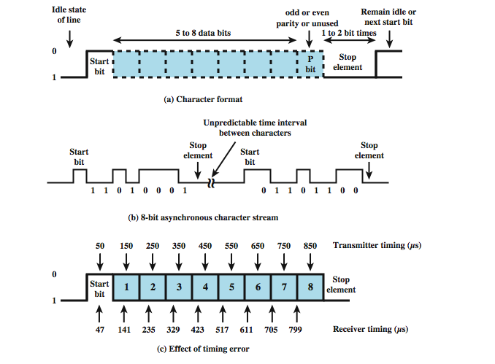
Asynchronous Transmission
Notes:
In asynchronous transmission, each character of data is treated independently. The strategy with this scheme is to avoid the timing problem by not sending long, uninterrupted streams of bits. Instead, data are transmitted one character at a time. Each character begins with a start bit that alerts the receiver that a character is arriving. The receiver samples each bit in the character and then looks for the beginning of the next character. This technique would not work well for long blocks of data because the receiver's clock might eventually drift out of synchronization with the transmitter's clock.
Stallings DCC8e figure 6.1 illustrates this technique. When no character is being transmitted, the line between transmitter and receiver is in an idle state (binary 1 level). The beginning of a character is signaled by a start bit with a value of binary 0. This is followed by the 5 to 8 bits that actually make up the character. The bits of the character are transmitted beginning with the least significant bit. Then the data bits are usually followed by a parity bit, set by the transmitter such that the total number of ones in the character, including the parity bit, is even (even parity) or odd (odd parity). The receiver uses this bit for error detection, as discussed in Section 6.3. The final element is a stop element, which is a binary 1. A minimum length for the stop element is specified, and this is usually 1, 1.5, or 2 times the duration of an ordinary bit. No maximum value is specified. Because the stop element is the same as the idle state, the transmitter will continue to transmit the stop element until it is ready to send the next character. The timing requirements for this scheme are modest.
Stallings DCC8e figure 6.1c shows the effects of a timing error of sufficient magnitude to cause an error in reception. Assume that the receiver is fast by 6%,. Thus, the receiver samples the incoming character every 94 µs (based on the transmitter's clock). As can be seen, the last sample is erroneous.

Slide 5
Asynchronous - Behavior
simple
cheap
overhead of 2 or 3 bits per char (~20%)
good for data with large gaps (keyboard)
Notes:
Asynchronous transmission is simple and cheap but requires an overhead of two to three bits per character. For example, for an 8-bit character with no parity bit, using a 1-bit-long stop element, two out of every ten bits convey no information but are there merely for synchronization; thus the overhead is 20%. Of course, the percentage overhead could be reduced by sending larger blocks of bits between the start bit and stop element. However, as Stallings DCC8e figure 6.1c indicates, the larger the block of bits, the greater the cumulative timing error. To achieve greater efficiency, a different form of synchronization, known as synchronous transmission, is used.

Slide 6
Synchronous Transmission
block of data transmitted sent as a frame
clocks must be synchronized
can use separate clock line
or embed clock signal in data
need to indicate start and end of block
use preamble and postamble
more efficient (lower overhead) than async
Notes:
For large blocks, synchronous transmission is used. Each block of data is formatted as a frame that includes a starting and an ending flag, and is transmitted in a steady stream without start and stop codes. The block may be many bits in length. To prevent timing drift between transmitter and receiver, their clocks must somehow be synchronized. One possibility is to provide a separate clock line between transmitter and receiver. The other alternative is to embed the clocking information in the data signal. For digital signals, this can be accomplished with Manchester or differential Manchester encoding. For analog signals, a number of techniques can be used; for example, the carrier frequency itself can be used to synchronize the receiver based on the phase of the carrier.
With synchronous transmission, there is another level of synchronization required, to allow the receiver to determine the beginning and end of a block of data. To achieve this, each block begins with a preamble bit pattern and generally ends with a postamble bit pattern. The data plus preamble, postamble, and control information are called a frame. The exact format of the frame depends on which data link control procedure is being used.
Stallings DCC8e figure 6.2 shows a typical frame format for synchronous transmission. It starts with a preamble called a flag, which is 8 bits long. The same flag is used as a postamble. This is followed by some number of control fields (containing data link control protocol information), then a data field (variable length for most protocols), more control fields, and finally the flag is repeated. For sizable blocks of data, synchronous transmission is far more efficient than asynchronous. Asynchronous transmission requires 20% or more overhead. The control information, preamble, and postamble in synchronous transmission are typically less than 100 bits.

Slide 7
Types of Error
an error occurs when a bit is altered between transmission and reception
single bit errors
only one bit altered
caused by white noise
burst errors
contiguous sequence of B bits in which first last and any number of intermediate bits in error
caused by impulse noise or by fading in wireless
effect greater at higher data rates
Notes:
In digital transmission systems, an error occurs when a bit is altered between transmission and reception; that is, a binary 1 is transmitted and a binary 0 is received, or a binary 0 is transmitted and a binary 1 is received. Two general types of errors can occur: single-bit errors and burst errors.
A single-bit error is an isolated error condition that alters one bit but does not affect nearby bits. A single-bit error can occur in the presence of white noise, when a slight random deterioration of the signal-to-noise ratio is sufficient to confuse the receiver's decision of a single bit.
A burst error of length B is a contiguous sequence of B bits in which the first and last bits and any number of intermediate bits are received in error. Burst errors are more common and more difficult to deal with. Burst errors can be caused by impulse noise, and by fading in a mobile wireless environment. Note that the effects of burst errors are greater at higher data rates.

Slide 8
Error Detection
will have errors
detect using error-detecting code
added by transmitter
recalculated and checked by receiver
still chance of undetected error
parity
parity bit set so character has even (even parity) or odd (odd parity) number of ones
even number of bit errors goes undetected
Notes:
Regardless of the design of the transmission system, there will be errors, resulting in the change of one or more bits in a transmitted frame. Error detection is performed by calculating an error-detecting code that is a function of the bits being transmitted. The code is appended to the transmitted bits. The receiver calculates the code based on the incoming bits and compares it to the incoming code to check for errors. A detected error occurs if and only if there is a mismatch. There is a probability that a frame contains errors and that the error-detecting scheme will detect that fact. Also have a residual error rate, being the probability that an error will be undetected despite the use of an error-detecting scheme.
The simplest error-detecting scheme is to append a parity bit to the end of a block of data. The value of this bit is selected so that the character has an even number of 1s (even parity) or an odd number of 1s (odd parity). Note, however, that if two (or any even number) of bits are inverted due to error, an undetected error occurs. Typically, even parity is used for synchronous transmission and odd parity for asynchronous transmission. The use of the parity bit is not foolproof, as noise impulses are often long enough to destroy more than one bit, particularly at high data rates.

Slide 9
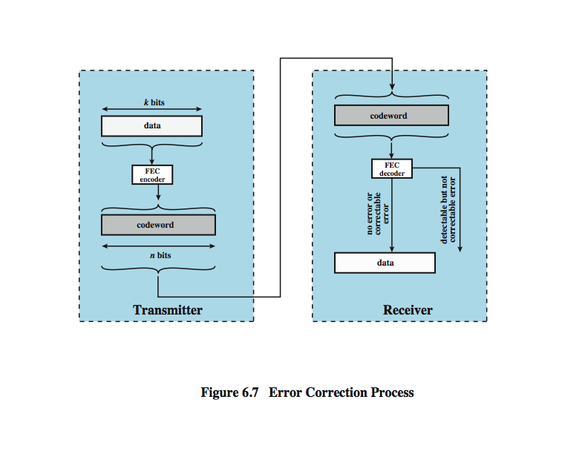
Error Detection Process
Notes:
Stallings DCC8e figure 6.3 illustrates the error detection process. For a given frame of bits, additional bits that constitute an error-detecting code are added by the transmitter. This code is calculated as a function of the other transmitted bits. Typically, for a data block of k bits, the error-detecting algorithm yields an error-detecting code of n – k bits, where (n – k) < k. The error-detecting code, also referred to as the check bits, is appended to the data block to produce a frame of n bits, which is then transmitted. The receiver separates the incoming frame into the k bits of data and (n – k) bits of the error-detecting code. The receiver performs the same error-detecting calculation on the data bits and compares this value with the value of the incoming error-detecting code. A detected error occurs if and only if there is a mismatch.

Slide 10
Cyclic Redundancy Check
one of most common and powerful checks
for block of k bits transmitter generates an n bit frame check sequence (FCS)
transmits k+n bits which is exactly divisible by some number
receiver divides frame by that number
if no remainder, assume no error
for math, see Stallings chapter 6
Notes:
One of the most common, and one of the most powerful, error-detecting codes is the cyclic redundancy check (CRC), which can be described as follows. Given a k-bit block of bits, or message, the transmitter generates an (n – k)-bit sequence, known as a frame check sequence (FCS), such that the resulting frame, consisting of n bits, is exactly divisible by some predetermined number. The receiver then divides the incoming frame by that number and, if there is no remainder, assumes there was no error. Can state this procedure in three equivalent ways: modulo 2 arithmetic, polynomials, and digital logic, as detailed in Stallings DCC8e chapter 6.3. Comes down to working out what remainder exists when divide data by desired number, and using that as the FCS value appended tot eh data to form the block.

Slide 11
Error Correction
correction of detected errors usually requires data block to be retransmitted
not appropriate for wireless applications
bit error rate is high causing lots of retransmissions
when propagation delay long (satellite) compared with frame transmission time, resulting in retransmission of frame in error plus many subsequent frames
instead need to correct errors on basis of bits received
error correction provides this
Notes:
Error detection is a useful technique, found in data link control protocols, such as HDLC, and in transport protocols, such as TCP. However, correction of errors using an error-detecting code, requires that block of data be retransmitted. For wireless applications this approach is inadequate for two reasons:
1. The bit error rate on a wireless link can be quite high, which would result in a large number of retransmissions.
2. In some cases, especially satellite links, the propagation delay is very long compared to the transmission time of a single frame. With a long data link, an error in a single frame necessitates retransmitting many frames.
Instead, it would be desirable to enable the receiver to correct errors in an incoming transmission on the basis of the bits in that transmission. Error correction operates in a fashion similar to error detection but is capable of correcting certain errors in a transmitted bit stream.

Slide 12
Error Correction Process
Notes:
Stallings DCC8e figure 6.7 shows in general how this is done. On the transmission end, each k-bit block of data is mapped into an n-bit block (n > k) called a codeword, using an FEC (forward error correction) encoder. The codeword is then transmitted. During transmission, the signal is subject to impairments, which may produce bit errors in the signal. At the receiver, the incoming signal is demodulated to produce a bit string that is similar to the original codeword but may contain errors. This block is passed through an FEC decoder, with one of four possible outcomes:
1. If there are no bit errors, the input to the FEC decoder is identical to the original codeword, and the decoder produces the original data block as output.
2. For certain error patterns, it is possible for the decoder to detect and correct those errors, the FEC decoder is able to map this block into the original data block.
3. For certain error patterns, the decoder can detect but not correct the errors, the decoder simply reports an uncorrectable error.
For certain, typically rare, error patterns, the decoder does not detect that any errors have occurred and maps the incoming data block into a block different from the original.

Slide 13
How Error Correction Works
adds redundancy to transmitted message
can deduce original despite some errors
eg. block error correction code
map k bit input onto an n bit codeword
each distinctly different
if get error assume codeword sent was closest to that received
for math, see Stallings chapter 6
means have reduced effective data rate
Notes:
In essence, error correction works by adding redundancy to the transmitted message. The redundancy makes it possible for the receiver to deduce what the original message was, even in the face of a certain level of error rate. In this section we look at a widely used form of error-correcting code known as a block error-correcting code. If wish to transmit blocks of data of length k bits, so map each k-bit sequence into a unique n-bit codeword, which differ significantly from each other. Typically, each valid codeword reproduces the original k data bits and adds to them (n – k) check bits to form the n-bit codeword. Then if an invalid codeword is received, assume the valid codeword is the one that is closest to it, and use the input bit sequence associated with it.
The ratio of redundant bits to data bits, (n – k)/k, is called the redundancy of the code, and the ratio of data bits to total bits, k/n, is called the code rate. The code rate is a measure of how much additional bandwidth is required to carry data at the same data rate as without the code. For example, a code rate of 1/2 requires double the transmission capacity of an uncoded system to maintain the same data rate.

Slide 14
Line Configuration - Topology
physical arrangement of stations on medium
point to point - two stations
such as between two routers / computers
multi point - multiple stations
traditionally mainframe computer and terminals
now typically a local area network (LAN)
Notes:
Two characteristics that distinguish various data link configurations are topology and whether the link is half duplex or full duplex.
The topology of a data link refers to the physical arrangement of stations on a transmission medium. If there are only two stations (e.g., a terminal and a computer or two computers), the link is point to point. If there are more than two stations, then it is a multipoint topology. Traditionally, a multipoint link has been used in the case of a computer (primary station) and a set of terminals (secondary stations). In today's environments, the multipoint topology is found in local area networks.

Slide 15
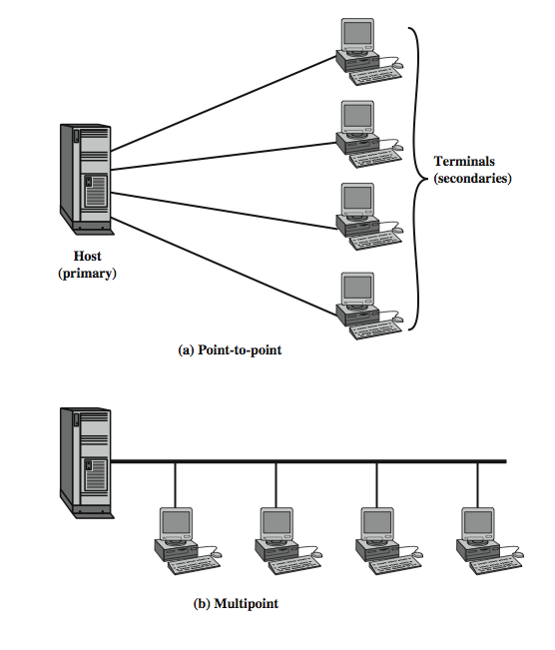
Line Configuration - Topology
Notes:
Stallings DCC8e figure 6.9 illustrates the advantages of the multipoint configuration. If each terminal has a point-to-point link to its computer, then the computer must have one I/O port for each terminal. Also there is a separate transmission line from the computer to each terminal. In a multipoint configuration, the computer needs only a single I/O port and a single transmission line, which saves costs. Traditional multipoint topologies are made possible when the terminals are only transmitting a fraction of the time.

Slide 16
Line Configuration - Duplex
classify data exchange as half or full duplex
half duplex (two-way alternate)
only one station may transmit at a time
requires one data path
full duplex (two-way simultaneous)
simultaneous transmission and reception between two stations
requires two data paths
separate media or frequencies used for each direction
or echo canceling
Notes:
Data exchanges over a transmission line can be classified as full duplex or half duplex.
With half-duplex transmission, only one of two stations on a point-to-point link may transmit at a time. This mode is also referred to as two-way alternate, suggestive of the fact that two stations must alternate in transmitting, and can be compared to a one-lane, two-way bridge. This form of transmission is often used for terminal-to-computer interaction. While a user is entering and transmitting data, the computer is prevented from sending data to the terminal, which would appear on the terminal screen and cause confusion.
For full-duplex transmission, two stations can simultaneously send and receive data from each other. Thus, this mode is known as two-way simultaneous and may be compared to a two-lane, two-way bridge. For computer-to-computer data exchange, this form of transmission is more efficient than half-duplex transmission. With digital signaling, which requires guided transmission, full-duplex operation usually requires two separate transmission paths (e.g., two twisted pairs), while half duplex requires only one. For analog signaling, it depends on frequency: If a station transmits and receives on the same frequency, it must operate in half-duplex mode for wireless transmission, although it may operate in full-duplex mode for guided transmission using two separate transmission lines. If a station transmits on one frequency and receives on another, it may operate in full-duplex mode for wireless transmission and in full-duplex mode with a single line for guided transmission. It is also possible to transmit digital signals simultaneously in both directions on a single transmission line using a signal processing technique called echo cancellation.

Slide 17
Summary
asynchronous verses synchronous transmission
error detection and correction
line configuration issues
Notes:
Stallings DCC8e Chapter 6 summary.

Slide 18
References
CH 6, Data and Computer Communications, William Stallings, Pearson Education, 2007

