Slide 1
Pemrosesan Data Tersebar
QoS Pertemuan 4 Dosen Pengampu: Hendry Gunawan S.Kom, MM
Prodi Teknik Informatika - Fakultas Ilmu Komputer

Slide 2
What is QoS?
Related to a stream of packets from a source to a destination
QoS determined by these quality of these parameters of the stream (low, medium, high):
Reliability
Delay
Jitter
Bandwidth

Slide 3
Reliability
What is reliability?
No bits may be delivered incorrectly
How is it achieved?
Checksumming at source and verification of checksum at destination
Ex. Email, file transfer, web access, remote login require high reliability
Ex. Audio/video require low reliability

Slide 4
Delay
What is delay?
Self-evident
Ex. Videoconferencing has strict delay requirements
Ex. Web Access has medium delay requirements
Ex. Email, streaming audio/video have low delay requirements

Slide 5
Jitter
What is jitter?
Variation (std. dev.) in packet arrival times
Ex. Streaming audio/video, telephony very sensitive to even few millisecond jitter
Ex. Remote login medium sensitive
Ex. Email, file transfer have low sensitivity to jitter

Slide 6
Bandwidth
What is bandwidth?
The amount of data that can be sent from one computer to another through a particular connection in a certain amount of time
Ex. Email requires low bandwidth (usually)
Ex. File transfer, web access require medium bandwidth
Ex. Videoconferencing requires high bandwidth

Slide 7
Other QoS Parameters
Several other parameters determine QoS depending on the situation at hand.
Ex. Security, queuing delay, response time, throughput, latency, latency variation, speed, priority, transmission rate, error rate, etc.
Defining QoS is a work in progress.

Slide 8
Best Effort vs. QoS
Best Effort:
You get a link to the Internet with at most B bits/sec.
If you don’t like it, switch to another provider.
Quality of Service (QoS)
We provide you some kind of guarantees for:
Bandwidth
Latency
Jitter
I.e., network is engineered to provide some Quality beyond “Not to exceed B bits/s”

Slide 9
Two Styles of QoS
Worse-case
Provide bandwidth/delay/jitter guarantee to every packet
E.g., “hard real time”
Average-case
Provide bandwidth/delay/jitter guarantee over many packets
Statistical in nature
E.g. “Soft real time”

Slide 10
Layered Model for QoS
Quality of
Experience
Quality of
Service

Slide 11
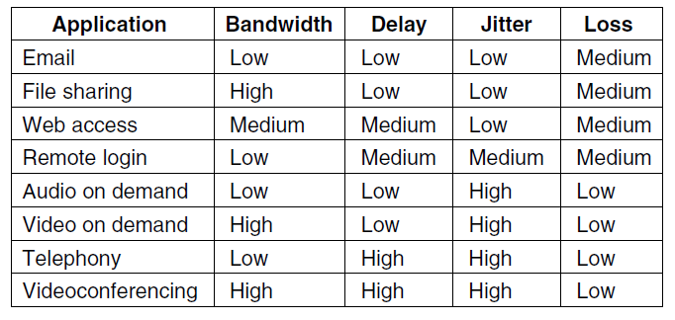
Application QoS Requirement

Slide 12
Application AV QoS Parameters
QoS for Audio service:
Sample rate – 8000 samples/second (8KHz), 44.1 KHz
Sample resolution – 8 bits per sample, 16 bits per sample
QoS for Video service:
Video frame rate – 25 frames per second, 30 frames per second
Frame Period – 40 ms, 30 ms, 25 ms, …
Frame resolution – 320x240 pixels, 640x480 pixels, 1920x1080 pixels, …
Pixel resolution – 24 bits per pixel, 8 bits per pixel
Frame size – 64KB
Compression rate – 8:1

Slide 13
QoS
FLOW: A stream of packets from a source to a destination
flow might be all the packets of a connection in a connection-oriented network, or all the packets sent from one process to another process in a connectionless network.
The needs of each flow can be characterized by four primary parameters:
bandwidth
Delay
Jitter
Loss
Together, these determine the QoS (Quality of Service) the flow requires.

Slide 14
Four issues to ensure Quality of Service:
What applications need from the network.
How to regulate the traffic that enters the network.
How to reserve resources at routers to guarantee performance.
Whether the network can safely accept more traffic.

Slide 15
Different Categories of QoS
To accommodate a variety of applications, networks may support different categories of QoS.
For example ATM networks support:
Constant bit rate (e.g., telephony).
Real-time variable bit rate (e.g., compressed videoconferencing).
Non-real-time variable bit rate (e.g., watching a movie on demand).
Available bit rate (e.g., file transfer).

Slide 16
Applications
Web traffic
QoS factors are service time, queuing delay, response time, bandwidth, throughput.
E-commerce
Session-based; QoS factors are security, throughput, response time.
DiffServ provisioning is 2-d – inter and intra session.
Streaming applications
QoS factors are startup latency, streaming bit rate which in turn has factors of frame rate, frame size, color depth.

Slide 17
Achieving Good QoS
Over provisioning
expensive
Buffering
smoothes jitter, increases delay
Traffic shaping
regulating rate, SLA
Ex. Leaky bucket, token bucket algorithms
Resource reservation
Bandwidth, CPU cycles, buffer space
Admission Control
flow specification parameters token bucket rate, token bucket size, peak data rate, min/max packet sizes
Proportional routing
split traffic over paths
Packet Scheduling
fair queuing, weighted fair queuing

Slide 18
Standardized Solutions
Integrated Services
IETF proposed in 1995-97 using RSVP using multicast routing with spanning trees.
Differentiated Services
IETF proposed in 1998, locally implemented, provides differentiated services among network-independent classes of aggregated traffic flows.
Label switching/MPLS
Router vendor developed.

Slide 19
QoS Techniques
Four common techniques that can be used to improve the quality of service :
Scheduling: A good scheduling technique treats the different flows in a fair and appropriate manner.
Traffic shaping: Leaky bucket, token bucket
Resource reservation
Admission control: accept or reject a flow based on predefined parameters called flow specification

Slide 20
Jitter
JITTER: The variation (i.e., standard deviation) in the delay or packet arrival times
Not sensitive to the packets arriving with irregular time intervals between them:
Email
File Sharing
Web access
Sensitive to Jitter:
Remote login, since updates on the screen will appear in little bursts if the connection suffers much jitter.
Video and especially audio are extremely sensitive to jitter. If a user is watching a video over the network and the frames are all delayed by exactly 2.000 seconds, no harm is done. But if the transmission time varies randomly between 1 and 2 seconds, the result will be terrible unless the applicationhides the jitter.
Audio, a jitter of even a few milliseconds is clearly audible.

Slide 21
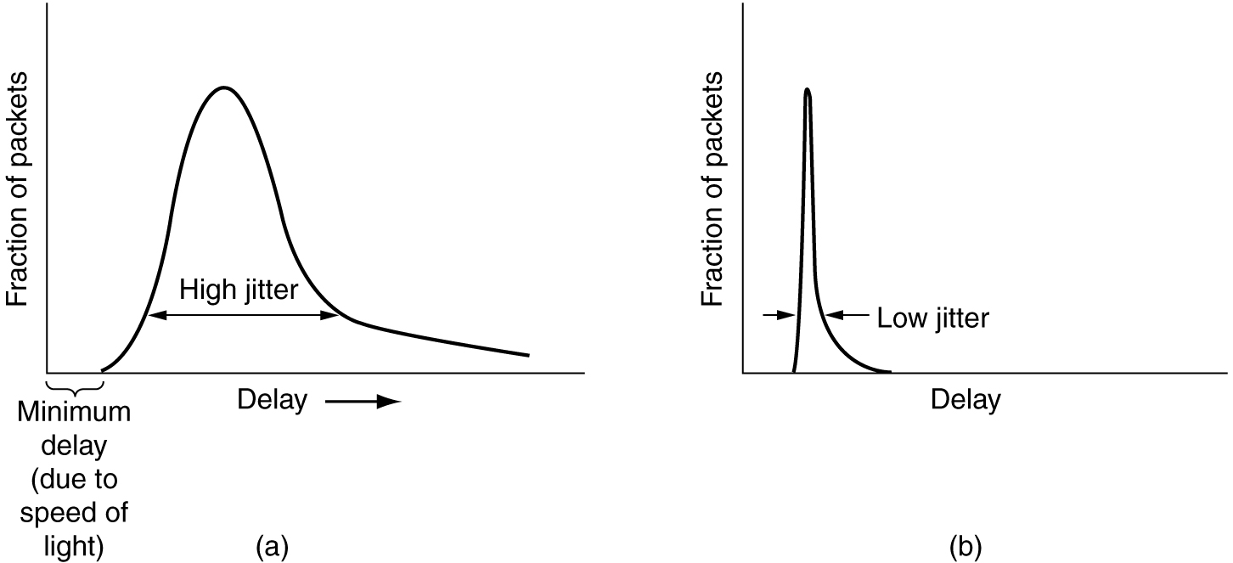
Jitter Control
Schedule Delay according to Deadline Miss
(a) High jitter. (b) Low jitter.

Slide 22
Buffering
Smoothing the output stream by buffering packets.

Slide 23
Traffic Shaping
Traffic in data networks is bursty – typically arrives at non-uniform rates as the traffic rate varies.
Traffic shaping is a technique for regulating the average rate and burstiness of a flow of data that enters the network.
When a flow is set up, the user and the network agree on a certain traffic pattern (shape).
In effect, the customer says to the provider ‘‘My transmission pattern will look like this; can you handle it?’’
Sometimes this agreement is called an SLA (Service Level Agreement).

Slide 24
SLA
SLA (Service Level Agreement), especially when it is made over aggregate flows and long periods of time, such as all of the traffic for a given customer.
As long as the customer fulfills her part of the bargain and only sends packets according to the agreed-on contract, the provider promises to deliver them all in a timely fashion.

Slide 25
TRAFFIC POLICING
Traffic shaping reduces congestion and thus helps the network live up to its promise.
However, to make it work, there is also the issue of how the provider can tell if the customer is following the agreement and what to do if the customer is not.
Packets in excess of the agreed pattern might be dropped by the network, or they might be marked as having lower priority.
Monitoring a traffic flow is called traffic policing.

Slide 26
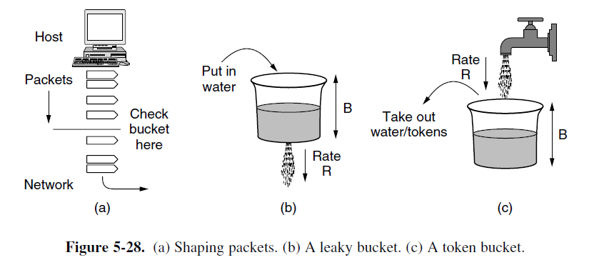
Characterize Traffic

Slide 27
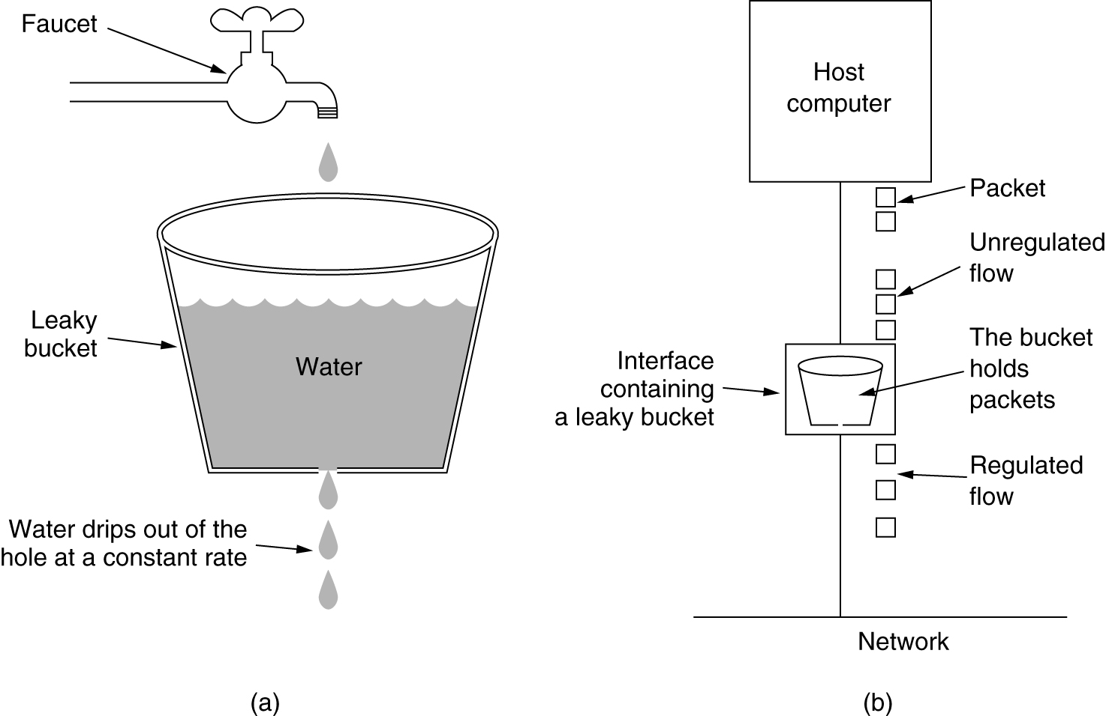
The Leaky Bucket Algorithm
(a) A leaky bucket with water. (b) a leaky bucket with packets.

Slide 28
Leaky Bucket
Used in conjunction with resource reservation to police the host’s reservation
At the host-network interface, allow packets into the network at a constant rate
Packets may be generated in a bursty manner, but after they pass through the leaky bucket, they enter the network evenly spaced

Slide 29
Leaky Bucket: Analogy
Packets from host
Leaky
Bucket
Network

Slide 30
Leaky Bucket
The leaky bucket is a “traffic shaper”: It changes the characteristics of packet stream
Traffic shaping makes more manageable and more predictable
Usually the network tells the leaky bucket the rate at which it may send packets when the connection begins
Polices the average rate

Slide 31
Leaky Bucket: Doesn’t allow bursty transmissions
In some cases, we may want to allow short bursts of packets to enter the network without smoothing them out
For this purpose we use a token bucket, which is a modified leaky bucket

Slide 32
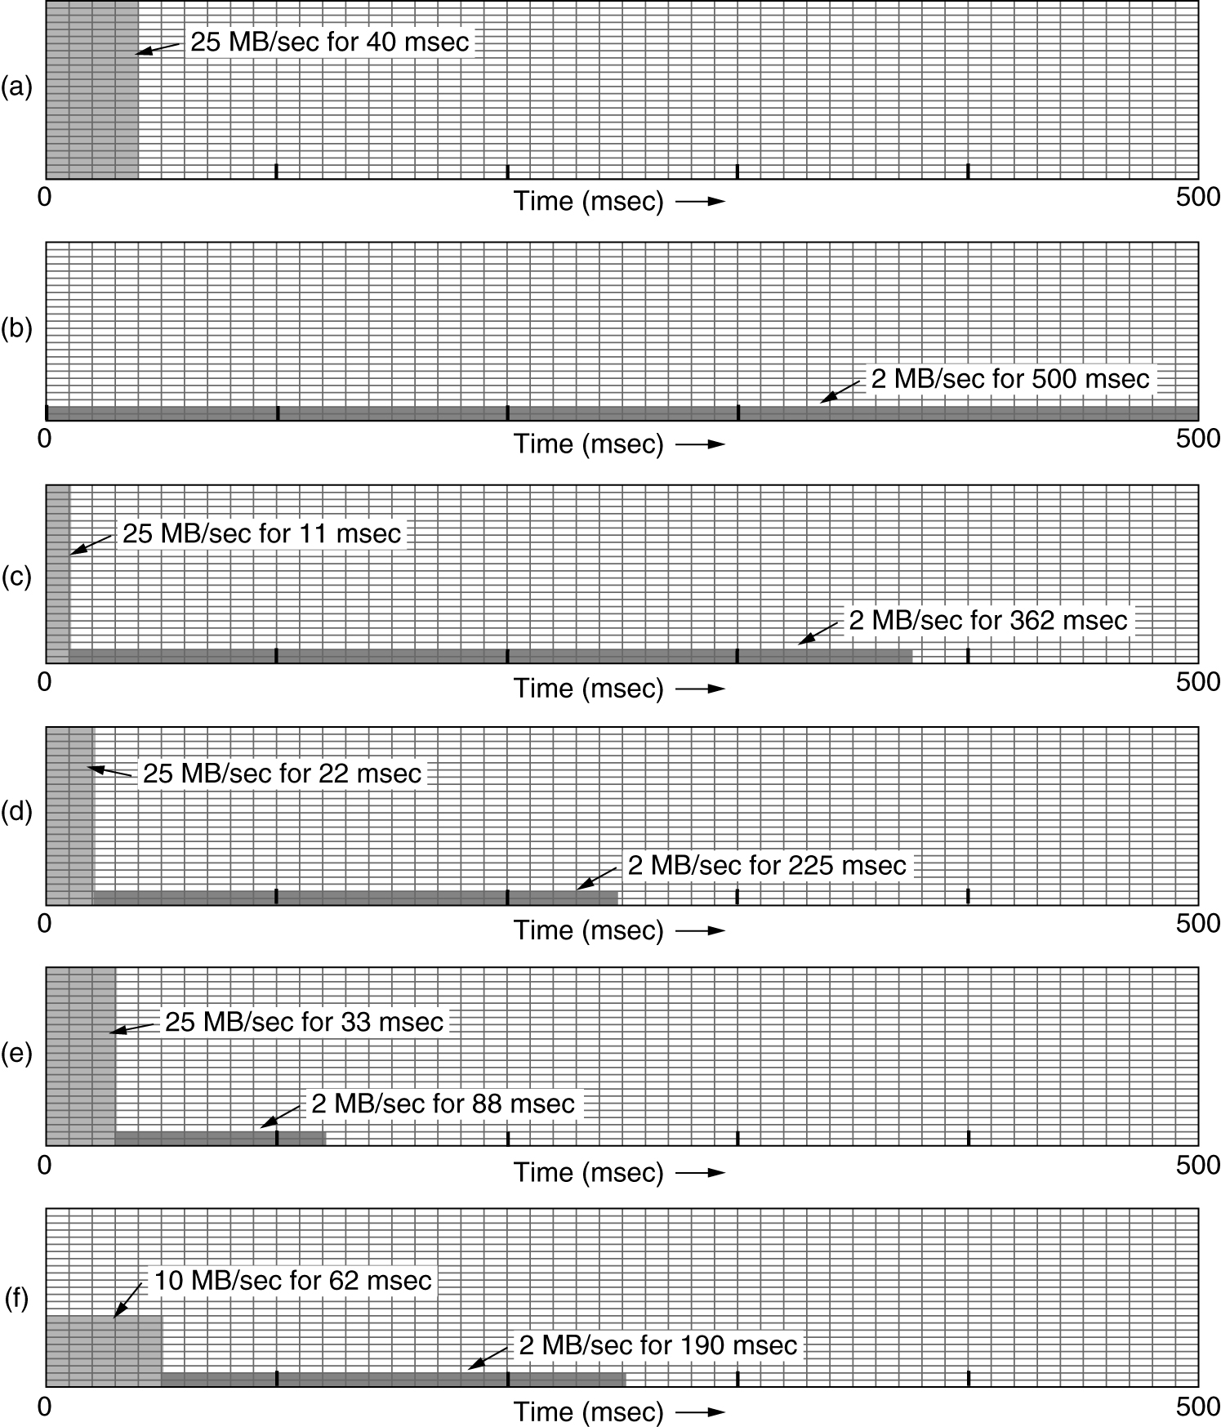
The Leaky Bucket Algorithm
(a) Input to a leaky bucket. (b) Output from a leaky bucket. Output from a token bucket with capacities of (c) 250 KB, (d) 500 KB, (e) 750 KB, (f) Output from a 500KB token bucket feeding a 10-MB/sec leaky bucket.

Slide 33
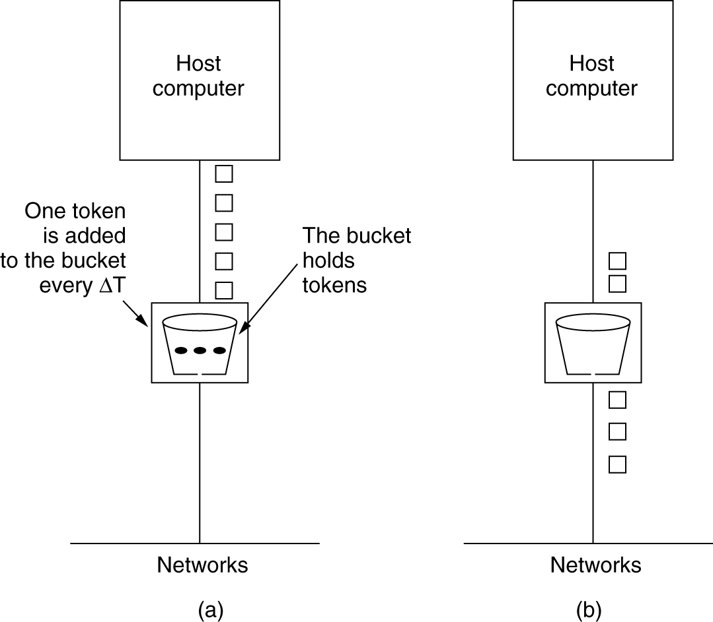
The Token Bucket Algorithm
5-34
(a) Before. (b) After.

Slide 34
Token Bucket
The bucket holds tokens instead of packets
Tokens are generated and placed into the token bucket at a constant rate
When a packet arrives at the token bucket, it is transmitted if there is a token available. Otherwise it is buffered until a token becomes available.
The token bucket has a fixed size, so when it becomes full, subsequently generated tokens are discarded

Slide 35
Token Bucket
Packets from host
Token Generator
(Generates a token
once every T seconds)
Network

Slide 36
Token Bucket Algorithm (2)
Burst length – S sec.
Maximum output rate – M bytes/sec
Token bucket capacity – B bytes
Token arrival rate – R bytes/sec
An output burst contains a maximum of (B + RS) bytes.
The number of bytes in a maximum speed burst of length S seconds is MS.
Hence, we have: B + RS = MS
This equation can be solved to get S = B /(M − R)

Slide 37
Token Bucket vs. Leaky Bucket
Case 1: Short burst arrivals
Arrival time at bucket
0
1
2
3
4
5
6
Departure time from a leaky bucket
Leaky bucket rate = 1 packet / 2 time units
Leaky bucket size = 4 packets
0
1
2
3
4
5
6
Departure time from a token bucket
Token bucket rate = 1 tokens / 2 time units
Token bucket size = 2 tokens
0
1
2
3
4
5
6

Slide 38
Token Bucket vs. Leaky Bucket
Case 2: Large burst arrivals
Arrival time at bucket
0
1
2
3
4
5
6
Departure time from a leaky bucket
Leaky bucket rate = 1 packet / 2 time units
Leaky bucket size = 2 packets
0
1
2
3
4
5
6
Departure time from a token bucket
Token bucket rate = 1 token / 2 time units
Token bucket size = 2 tokens
0
1
2
3
4
5
6

Slide 39
Flow Specification: Token Bucket
Characterized by two parameters (r, b)
r – average rate
b – token depth
Assume flow arrival rate <= R bps (e.g., R link capacity)
A bit is transmitted only when there is an available token
Arrival curve – maximum amount of bits transmitted by time t
r bps
Arrival curve
bits
slope r
b
b bits
slope R
<= R bps
time
regulator

Slide 40
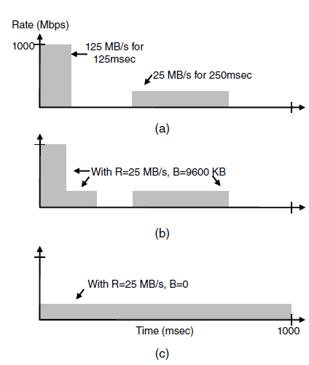
Traffic Shaping (2)
(a) Traffic from a host. Output shaped by a token bucket of rate 200 Mbps and capacity (b) 9600 KB, (c) 0 KB.

Slide 41
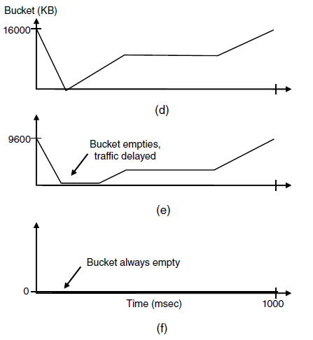
Traffic Shaping (3)
Token bucket level for shaping with rate 200 Mbps and capacity (d) 16000 KB, (e) 9600 KB, and (f) 0KB..

Slide 42
Packet Scheduling
Kinds of resources that can potentially be reserved for different flows:
Bandwidth.
Buffer space.
CPU cycles.

Slide 43
Packet Scheduling (2)
Round-robin Fair Queuing

Slide 44
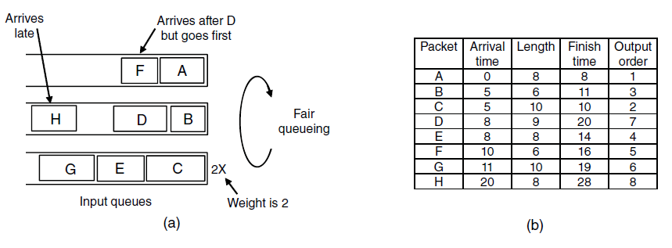
Packet Scheduling (3)
Weighted Fair Queueing.
Finishing times for the packets.

Slide 45
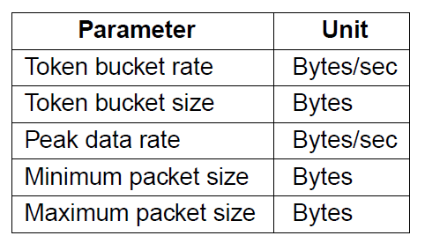
Admission Control (1)
An example flow specification

Slide 46
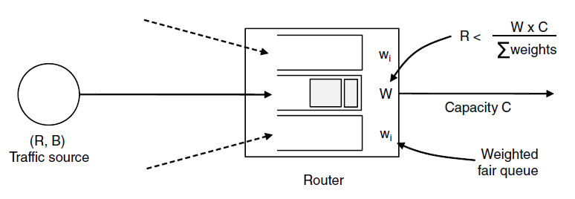
Admission Control (2)
Bandwidth and delay guarantees with token buckets and WFQ.

Slide 47
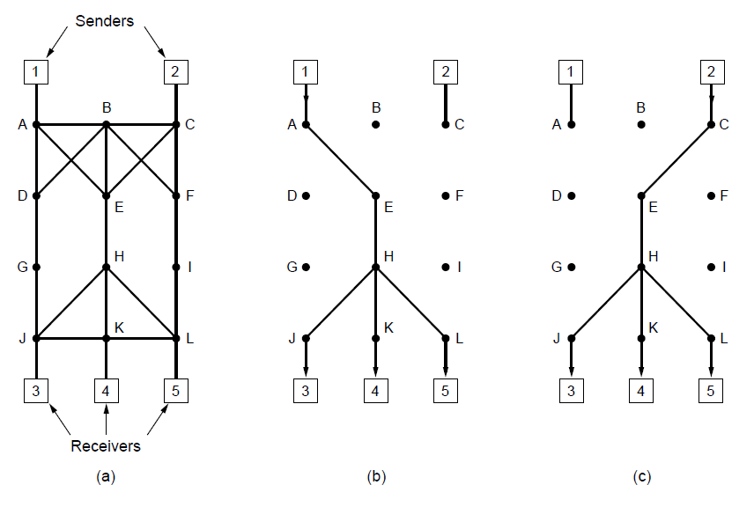
Integrated Services: RSVP—The Resource reSerVation Protocol
(a) A network. (b) The multicast spanning tree for host 1. (c) The multicast spanning tree for host 2.

Slide 48
Integrated Services: RSVP—The Resource reSerVation Protocol
Hosts 1 and 2 are multicast sender
3,4, 5 are multicast receiver
Host 3 reserves for Host 1 and the Host 2
Host 5 reserves Host 1 (so the common path is utilized). However depending on need (Host 5 may be a bigger TV) – provision is made for the greediest part

Slide 49
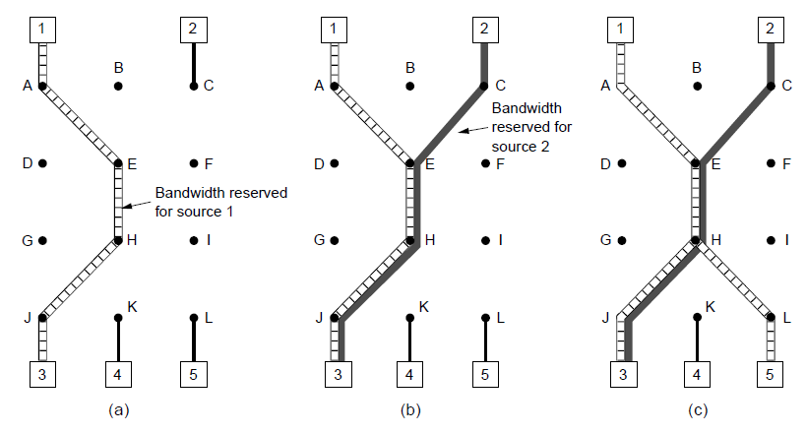
RSVP (2)
(a) Host 3 requests a channel to host 1. (b) Host 3 then requests a second channel, to host 2. (c) Host 5 requests a channel to host 1.

Slide 50
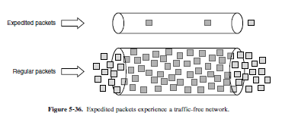
Expedited Forwarding

Slide 51
Assured Forwarding
Class-Based Service
Per Hop Behaviors
Traffic within a class are given preferential treatment
Expedited Forwarding
Packets marked – Regular or Expedited
Assured Forwarding
Gold, Silver, Bronze, common
Packets that face congestion
low (short burst), medium and high
this classes are determined by token bucket algorithm

Slide 52
Assured Forwarding
The first step
to classify the packets into one of the four priority classes.
this step might be done on the sending host or in the ingress router
the rate of higher-priority packets may be limited by the operator as part of the service offering.
The next step
to determine the discard class for each packet.
This is done by passing the packets of each priority class through a traffic policer such as a token bucket.
The policer lets all of the traffic through, but it identifies packets that fit within small bursts as low discard, packets that exceed small bursts as medium discard, and packets that exceed large bursts as high discard.
The combination of priority and discard class is then encoded in each packet.
Last Step
the packets are processed by routers in the network with a packet scheduler that distinguishes the different classes.
A common choice is to use weighted fair queueing for the four priority classes, with higher classes given higher weights. In this way, the higher classes will get most of the bandwidth, but the lower classes will not be starved of bandwidth entirely.
For example, if the weights double from one class to the next higher class, the higher class will get twice the bandwidth.
Within a priority class, packets with a higher discard class can be preferentially dropped by running an algorithm such as RED (Random Early Detection)
At this stage, there is still buffer space with which to accept low discard packets while dropping high discard packets.

Slide 53
Assured Forwarding
A possible implementation of assured forwarding, weighted fair scheduling, RED (randome Early Detection discards packet according to the class).

