Slide 1
Pemrosesan Data Tersebar
Congestion Control & QoS Pertemuan 5 Dosen Pengampu: Hendry Gunawan S.Kom, MM
Prodi Teknik Informatika - Fakultas Ilmu Komputer

Slide 2
DATA TRAFFIC
The main focus of congestion control and quality of service is data traffic.
In congestion control we try to avoid traffic congestion.
In quality of service, we try to create an appropriate environment for the traffic.
Notes:
Congestion control and quality of service are two issues so closely bound together that
improving one means improving the other and ignoring one usually means ignoring the
other. Most techniques to prevent or eliminate congestion also improve the quality of
service in a network.

Slide 3
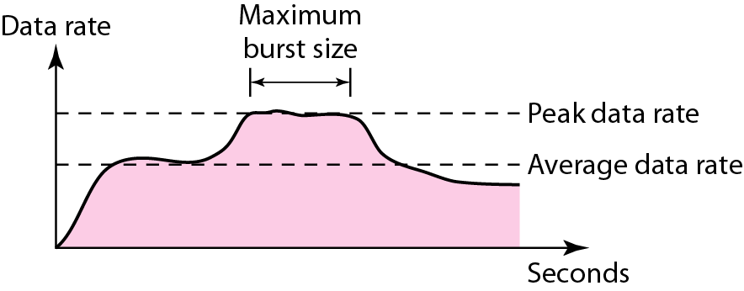
Traffic Descriptors
Traffic descriptors are qualitative values that represent a data flow.
Below shows a traffic flow with some of these values.

Slide 4
Traffic Descriptors
Average Data Rate
The number of bits sent during a period of time, divided by the number of seconds in that period.
Very useful characteristic of traffic because it indicates the average bandwidth needed by the traffic.

Slide 5
Traffic Descriptors
Peak Data Rate
Defines the maximum data rate of the traffic.
In example, it is the maximum y axis value
Very important measurement because it indicates the peak bandwidth that the network needs for traffic to pass through without changing its data flow.

Slide 6
Traffic Descriptors
Maximum Burst Size
normally refers to the maximum length of time the traffic is generated at the peak rate.
Although the peak data rate is a critical value for the network, it can usually be ignored if the duration of the peak value is very short.
For example, if data are flowing steadily at the rate of 1 Mbps with a sudden peak data rate of 2 Mbps for just 1 ms, the network probably can handle the situation.
However, if the peak data rate lasts 60 ms, there maybe a problem for the network.

Slide 7
Traffic Descriptors
Effective Bandwidth
the bandwidth that the network needs to allocate for the flow of traffic.
The effective bandwidth is a function of three values:
average data rate
peak data rate
maximum burst size

Slide 8
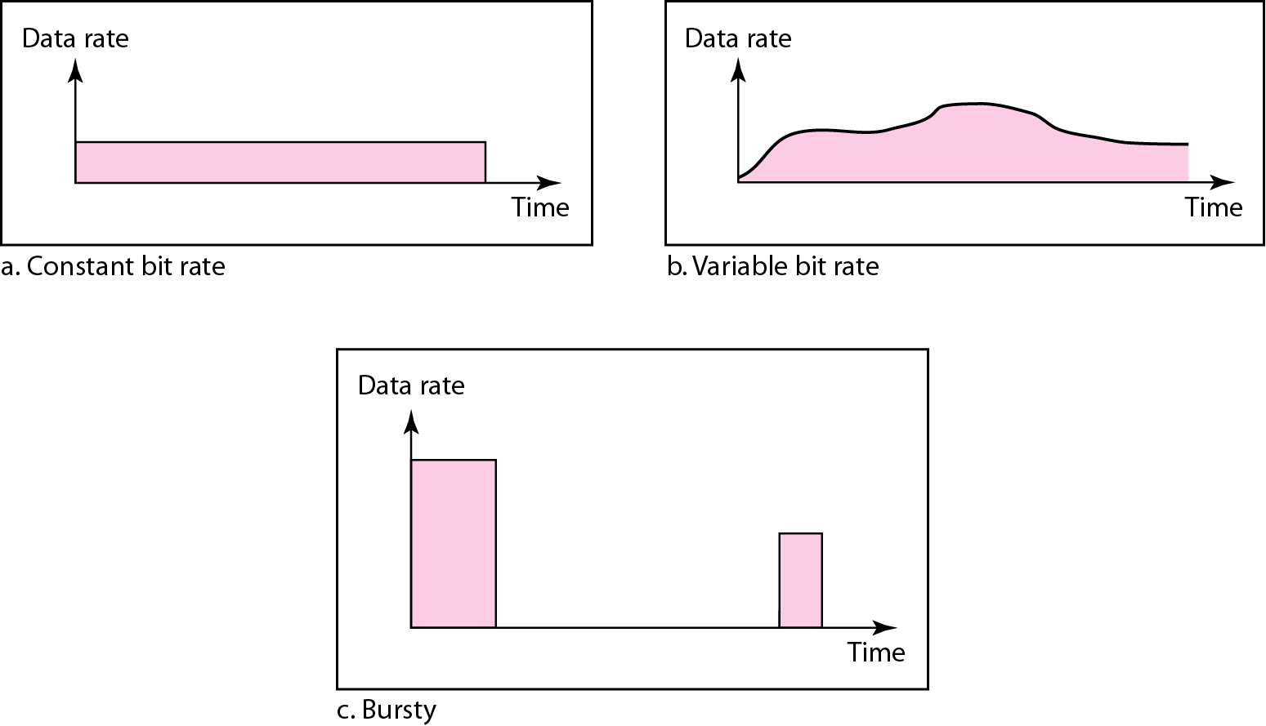
Traffic Profiles

Slide 9
Traffic Profiles
Constant Bit Rate (CBR)/Fixed-rate
traffic model has a data rate that does not change.
In this type of flow, the average data rate and the peak data rate are the same.
The maximum burst size is not applicable.
Very easy for a network to handle since it is predictable.
The network knows in advance how much bandwidth to allocate for this type of flow.

Slide 10
Traffic Profiles
Variable Bit Rate
the rate of the data flow changes in time, with the changes smooth instead of sudden and sharp.
In this type of flow, the average data rate and the peak data rate are different.
The maximum burst size is usually a small value.
More difficult to handle than constant-bit-rate traffic, but it normally does not need to be reshaped

Slide 11
Traffic Profiles
Bursty
The data rate changes suddenly in a very short time.
It may jump from zero, for example, to 1 Mbps in a few microseconds and vice versa.
It may also remain at this value for a while.
The average bit rate and the peak bit rate are very different values in this type of flow.
The maximum burst size is significant.
The most difficult type of traffic for a network to handle because the profile is very unpredictable.
To handle this type of traffic, the network normally needs to reshape it, using reshaping techniques.
Bursty traffic is one of the main causes of congestion in a network.

Slide 12
CONGESTION
Congestion in a network may occur if :
the load on the network—the number of packets sent to the network—is greater than the capacity of the network—the number of packets a network can handle.
Congestion control refers to the mechanisms and techniques to control the congestion and keep the load below the capacity.

Slide 13
CONGESTION
Congestion happens in any system that involves waiting.
For example, congestion happens on a freeway because any abnormality in the flow, such as an accident during rush hour, creates blockage.
Congestion in a network or internetwork occurs because routers and switches have queues-buffers that hold the packets before and after processing.

Slide 14
Queues in a Router
A router, for example, has an input queue and an output queue for each interface.
When a packet arrives at the incoming interface, it undergoes three steps before departing

Slide 15
Queues in a Router
The packet is put at the end of the input queue while waiting to be checked.
The processing module of the router removes the packet from the input queue once it reaches the front of the queue and uses its routing table and the destination address to find the route.
The packet is put in the appropriate output queue and waits its tum to be sent.

Slide 16
Queues in a Router
2 important issues.
if the rate of packet arrival is higher than the packet processing rate, the input queues become longer and longer.
if the packet departure rate is less than the packet processing rate, the output queues become longer and longer.

Slide 17
Network Performance
Congestion control involves two factors that measure the performance of a network: delay and throughput.

Slide 18
Network Performance
Throughput ?
Load ?
Delay?

Slide 19
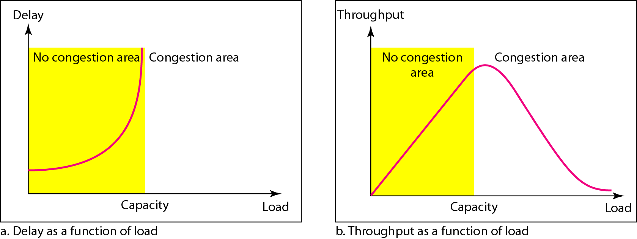
Network Performance
Packet delay and throughput as functions of load

Slide 20
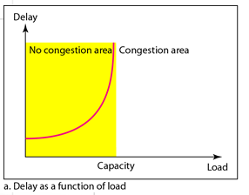
Network Performance
Delay Versus Load
When the load is much less than the capacity of the network, the delay is at a minimum.
This minimum delay is composed of propagation delay and processing delay, both of which are negligible.
However, when the load reaches the network capacity, the delay increases sharply because we now need to add the waiting time in the queues (for all routers in the path) to the total delay.

Slide 21
Network Performance
The delay becomes infinite when the load is greater than the capacity.
Consider the size of the queues when almost no packet reaches the destination, or reaches the destination with infinite delay; the queues become longer and longer.
Delay has a negative effect on the load and consequently the congestion.
When a packet is delayed, the source, not receiving the acknowledgment, retransmits the packet, which makes the delay, and the congestion, worse.

Slide 22
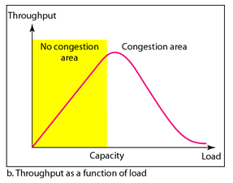
Network Performance
Throughput Versus Load
Throughput : the number of bits passing through a point in a second.
Throughput in a network is the number of packets passing through the network in a unit of time.
When the load is below the capacity of the network, the throughput increases proportionally with the load.

Slide 23
Network Performance
We expect the throughput to remain constant after the load reaches the capacity, but instead the throughput declines sharply.
The reason is the discarding of packets by the routers.
When the load exceeds the capacity, the queues become full and the routers have to discard some packets.
Discarding packet does not reduce the number of packets in the network because the sources retransmit the packets, using time-out mechanisms, when the packets do not reach the destinations.

Slide 24
CONGESTION CONTROL
Congestion control refers to techniques and mechanisms that can either prevent congestion, before it happens, or remove congestion, after it has happened.
Congestion control mechanisms divide into two broad categories:
open-loop congestion control (prevention)
closed-loop congestion control (removal)

Slide 25
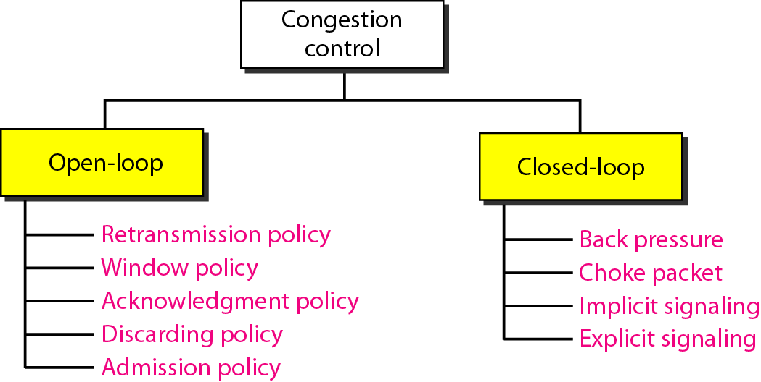
Congestion control categories

Slide 26
Open-Loop Congestion Control
Policies are applied to prevent congestion before it happens.
In these mechanisms, congestion control is handled by either the source or the destination.

Slide 27
Open-Loop Congestion Control
Retransmission Policy
Retransmission is sometimes unavoidable.
If the sender feels that a sent packet is lost or corrupted, the packet needs to be retransmitted.
Retransmission in general may increase congestion in the network. However, a good retransmission policy can prevent congestion.
The retransmission policy and the retransmission timers must be designed to optimize efficiency and at the same time prevent congestion.
For example, the retransmission policy used by TCP is designed to prevent or alleviate congestion.

Slide 28
Open-Loop Congestion Control
Window Policy
The type of window at the sender may also affect congestion.
The Selective Repeat window is better than the Go-Back-N window for congestion control.
In the Go-Back-N window, when the timer for a packet times out, several packets may be resent, although some may have arrived safe and sound at the receiver.
This duplication may make the congestion worse.
The Selective Repeat window, on the other hand, tries to send the specific packets that have been lost or corrupted.

Slide 29
Open-Loop Congestion Control
Acknowledgment Policy
The acknowledgment policy imposed by the receiver may also affect congestion.
If the receiver does not acknowledge every packet it receives, it may slow down the sender and help prevent congestion.
Several approaches are used in this case.
A receiver may send an acknowledgment only if it has a packet to be sent or a special timer expires.
A receiver may decide to acknowledge only N packets at a time.
The acknowledgments are also part of the load in a network.
Sending fewer acknowledgments means imposing less load on the network.

Slide 30
Open-Loop Congestion Control
Discarding Policy
A good discarding policy by the routers may prevent congestion and at the same time may not harm the integrity of the transmission.
For example, in audio transmission, if the policy is to discard less sensitive packets when congestion is likely to happen, the quality of sound is still preserved and congestion is prevented or alleviated.

Slide 31
Open-Loop Congestion Control
Admission Policy
Is a quality-of-service mechanism, can also prevent congestion in virtual-circuit networks.
Switches in a flow first check the resource requirement of a flow before admitting it to the network.
A router can deny establishing a virtual circuit connection if there is congestion in the network or if there is a possibility of future congestion.

Slide 32
Closed-Loop Congestion Control
Closed-loop congestion control mechanisms try to alleviate congestion after it happens.

Slide 33
Closed-Loop Congestion Control
Backpressure
The technique refers to a congestion control mechanism in which a congested node stops receiving data from the immediate upstream node or nodes.
This may cause the upstream node or nodes to become congested, and they, in turn, reject data from their upstream nodes or nodes. And so on.
Backpressure is a node-to-node congestion control that starts with a node and propagates, in the opposite direction of data flow, to the source.
This technique can be applied only to virtual circuit networks, in which each node knows the upstream node from which a flow of data is corning.

Slide 34
Closed-Loop Congestion Control
Backpressure method for alleviating congestion
Node III in the figure has more input data than it can handle. It drops some packets in its input buffer and informs node II to slow down.
Node II, in turn, may be congested because it is slowing down the output flow of data. If node II is congested, it informs node I to slow down, which in turn may create congestion.
If so, node I informs the source of data to slow down. This, in time, alleviates the congestion. Note that the pressure on node III is moved backward to the source to remove the congestion.

Slide 35
Closed-Loop Congestion Control
Backpressure
Was implemented in the first virtual-circuit network, X.25.
The technique cannot be implemented in a datagram network because in this type of network, a node (router) does not have the slightest knowledge of the upstream router.

Slide 36
Closed-Loop Congestion Control
Choke Packet
Is a packet sent by a node to the source to inform it of congestion.
The difference between the backpressure and choke packet methods:
In backpressure, the warning is from one node to its upstream node, although the warning may eventually reach the source station.
In the choke packet method, the warning is from the router, which has encountered congestion, to the source station directly.
The intermediate nodes through which the packet has traveled are not warned.

Slide 37
Closed-Loop Congestion Control
Choke packet
Example : ICMP
When a router in the Internet is overwhelmed with IP datagrams, it may discard some of them; but it informs the source host, using a source quench ICMP message.
The warning message goes directly to the source station; the intermediate routers, and does not take any action.

Slide 38
Closed-Loop Congestion Control
Implicit Signaling
In implicit signaling, there is no communication between the congested node or nodes and the source.
The source guesses that there is a congestion somewhere in the network from other symptoms.
For example, when a source sends several packets and there is no acknowledgment for a while, one assumption is that the network is congested.
The delay in receiving an acknowledgment is interpreted as congestion in the network; the source should slow down.

Slide 39
Closed-Loop Congestion Control
Explicit Signaling
The node that experiences congestion can explicitly send a signal to the source or destination.
The explicit signaling method, however, is different from the choke packet method.
In the choke packet method, a separate packet is used for this purpose; in the explicit signaling method, the signal is included in the packets that carry data.
Explicit signaling can occur in either the forward or the backward direction.

Slide 40
Closed-Loop Congestion Control
Backward Signaling
A bit can be set in a packet moving in the direction opposite to the congestion.
This bit can warn the source that there is congestion and that it needs to slow down to avoid the discarding of packets.
Forward Signaling
A bit can be set in a packet moving in the direction of the congestion.
This bit can warn the destination that there is congestion.
The receiver in this case can use policies, such as slowing down the acknowledgments, to alleviate the congestion.

Slide 41
TWO EXAMPLES
To better understand the concept of congestion control, let us give two examples: one in TCP and the other in Frame Relay.

Slide 42
Congestion Control in TCP
Congestion Window
The sender window size is determined by the available buffer space in the receiver (rwnd).
We assumed that it is only the receiver that can dictate to the sender the size of the sender's window.
But if the network cannot deliver the data as fast as they are created by the sender, it must tell the sender to slow down.
In other words, in addition to the receiver, the network is a second entity that determines the size of the sender's window

Slide 43
Congestion Control in TCP
Today, the sender's window size is determined not only by the receiver but also by congestion in the network.
The sender has two pieces of information:
the receiver-advertised window size
the congestion window size.
The actual size of the window is the minimum of these two.
Actual window size=minimum (rwnd, cwnd)

Slide 44
Congestion Control in TCP
Congestion Policy
TCP's general policy for handling congestion is based on three phases:
Slow start
In the slow-start phase, the sender starts with a very slow rate of transmission, but increases the rate rapidly to reach a threshold.
Congestion avoidance
When the threshold is reached, the data rate is reduced to avoid congestion.
Congestion detection.
Finally if congestion is detected, the sender goes back to the slow-start or congestion avoidance phase based on how the congestion is detected.

Slide 45
Slow start, exponential increase
This algorithm is based on the idea that the size of the congestion window (cwnd) starts with one maximum segment size (MSS).
MSS determined during connection establishment by using an option of the same name.
The size of the window increases one MSS each time an acknowledgment is received.
As the name implies, the window starts slowly, but grows exponentially.

Slide 46
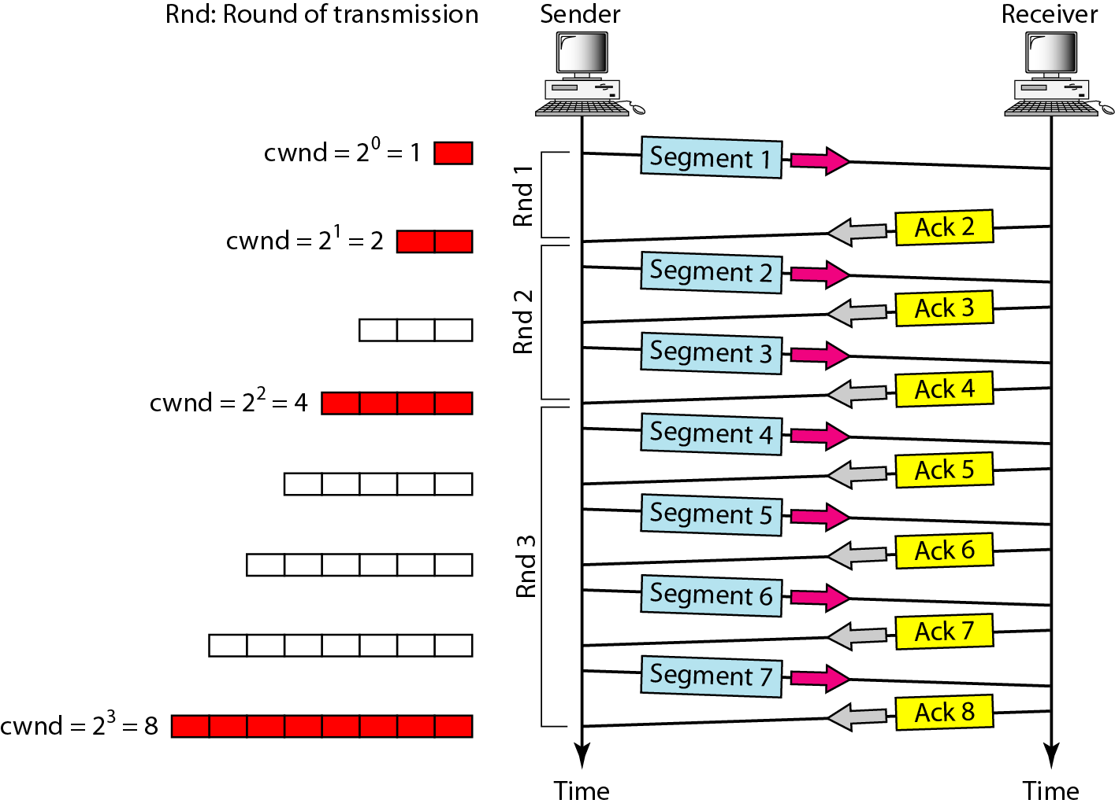
Slow start, exponential increase
In the slow-start algorithm, the size of the congestion window increases exponentially until it reaches a threshold.

Slide 47
Slow start, exponential increase
The sender starts with cwnd =1 MSS. This means that the sender can send only one segment.
After receipt of the acknowledgment for segment 1, the size of the congestion window is increased by 1, which means that cwnd is now 2(2^1). Now two more segments can be sent.
When each acknowledgment is received, the size of the window is increased by 1 MSS.
When all seven segments are acknowledged, cwnd = 8 (2^3).

Slide 48
Slow start, exponential increase
The size of cwnd in terms of rounds (acknowledgment of the whole window of segments), the rate is exponential:

Slide 49
Slow start, exponential increase
If there is delayed ACKs, the increase in the size of the window is less than power of 2.
Slow start cannot continue indefinitely. There must be a threshold to stop this phase.
The sender keeps track of a variable named ssthresh (slow-start threshold).
When the size of window in bytes reaches this threshold, slow start stops and the next phase starts.
In most implementations the value of ssthresh is 65,535 bytes.

Slide 50
Congestion avoidance, additive increase
If we start with the slow-start algorithm, the size of the congestion window increases exponentially.
To avoid congestion before it happens, one must slow down this exponential growth.
TCP defines another algorithm called congestion avoidance, which undergoes an additive increase instead of an exponential one.
When the size of the congestion window reaches the slow-start threshold, the slow-start phase stops and the additive phase begins.
In this algorithm, each time the whole window of segments is acknowledged (one round), the size of the congestion window is increased by 1.

Slide 51
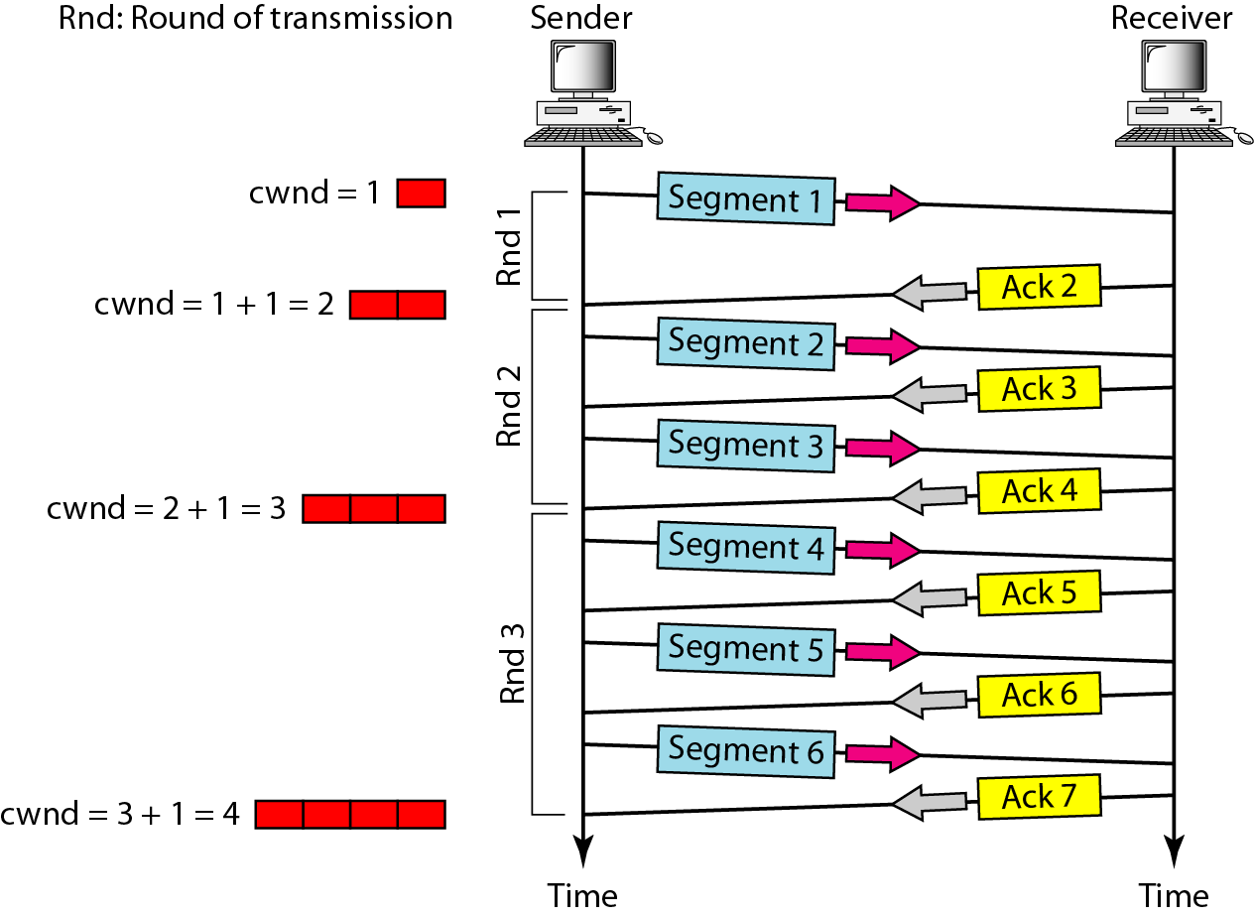
Congestion avoidance, additive increase
In the congestion avoidance algorithm, the size of the congestion window increases additively until congestion is detected.

Slide 52
Congestion avoidance, additive increase
In this case, after the sender has received acknowledgments for a complete window size of segments, the size of the window is increased by one segment.
The size of cwnd in terms of rounds, we find that the rate is additive as :

Slide 53
Congestion Detection: Multiplicative Decrease
If congestion occurs, the congestion window size must be decreased.
The only way the sender can guess that congestion has occurred is by the need to retransmit a segment.
However, retransmission can occur in one of two cases:
when a timer times out or when three ACKs are received.
In both cases, the size of the threshold is dropped to one-half, a multiplicative decrease.
Notes:
Threshold drop and goes back for smart slow or congestion avoidance depends on the cases

Slide 54
Congestion Detection: Multiplicative Decrease
An implementation reacts to congestion detection in one of the following ways:
❏ If detection is by time-out, a new slow start phase starts.
❏ If detection is by three duplicate ACKs, a new congestion avoidance phase starts.

Slide 55
Congestion Detection: Multiplicative Decrease
If a time-out occurs, there is a stronger possibility of congestion; a segment has probably been dropped in the network, and there is no news about the sent segments.
In this case TCP reacts strongly:
It sets the value of the threshold to one-half of the current window size.
It sets cwnd to the size of one segment.
It starts the slow-start phase again.

Slide 56
Congestion Detection: Multiplicative Decrease
If three duplicate ACKs are received, there is a weaker possibility of congestion; a segment may have been dropped, but some segments after that may have arrived safely since three ACKs are received.
This is called fast transmission and fast recovery.
In this case, TCP has a weaker reaction:
It sets the value of the threshold to one-half of the current window size.
It sets cwnd to the value of the threshold (some implementations add three segment sizes to the threshold).
It starts the congestion avoidance phase.

Slide 57
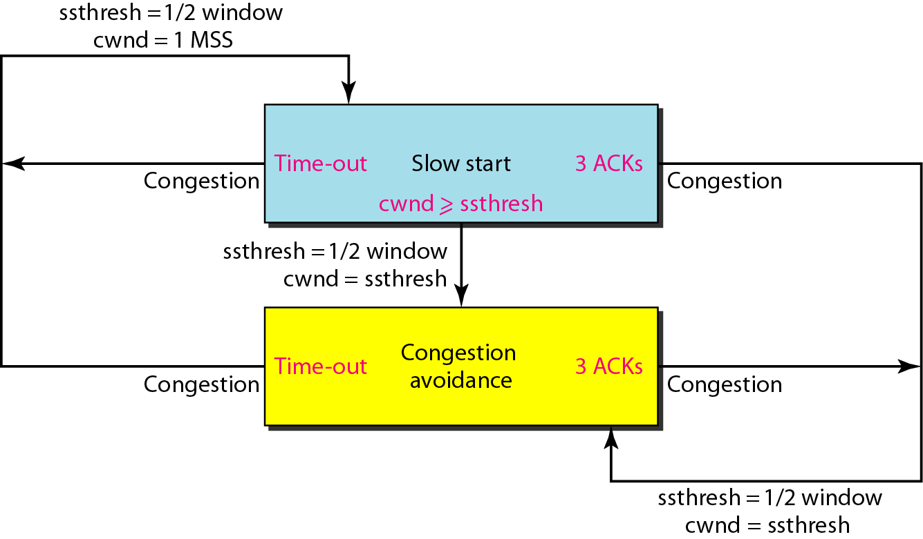
TCP congestion policy summary

Slide 58
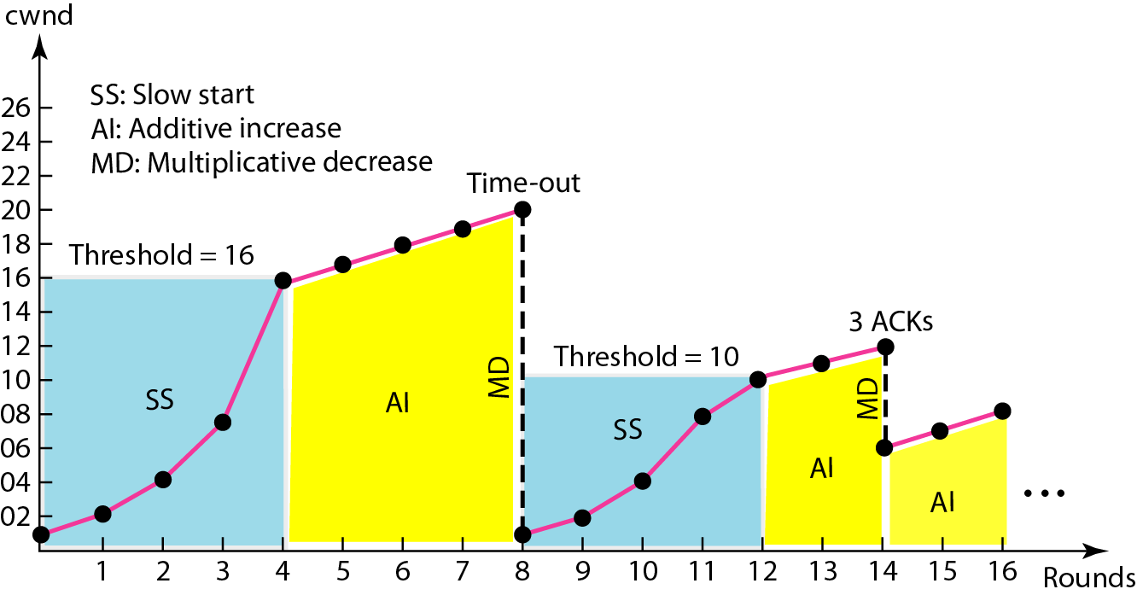
Congestion example

Slide 59
BECN

Slide 60
FECN

Slide 61
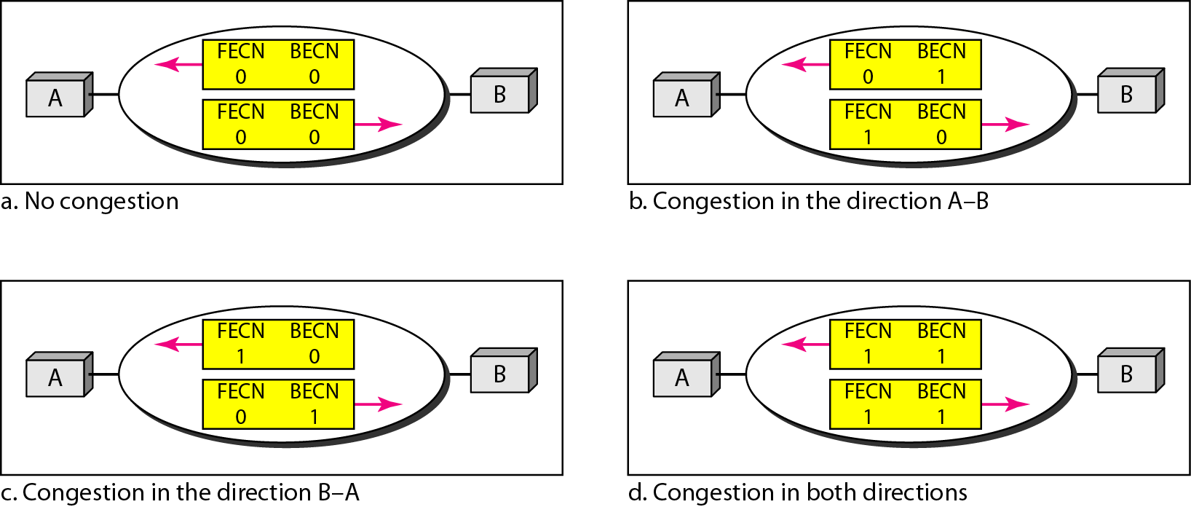
Four cases of congestion

Slide 62
QUALITY OF SERVICE
Quality of service (QoS) is an internetworking issue that has been discussed more than defined. We can informally define quality of service as something a flow seeks to attain.

Slide 63
Flow characteristics

Slide 64
TECHNIQUES TO IMPROVE QoS
In Section 24.5 we tried to define QoS in terms of its characteristics. In this section, we discuss some techniques that can be used to improve the quality of service. We briefly discuss four common methods: scheduling, traffic shaping, admission control, and resource reservation.

Slide 65
Scheduling
Traffic Shaping
Resource Reservation
Admission Control

Slide 66
FIFO queue

Slide 67
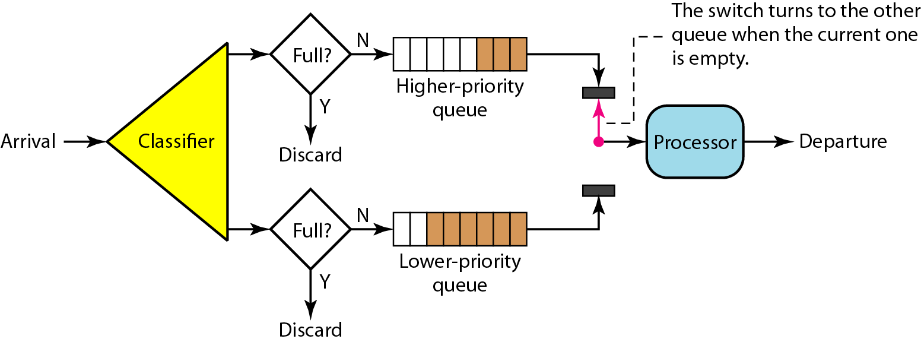
Priority queuing

Slide 68
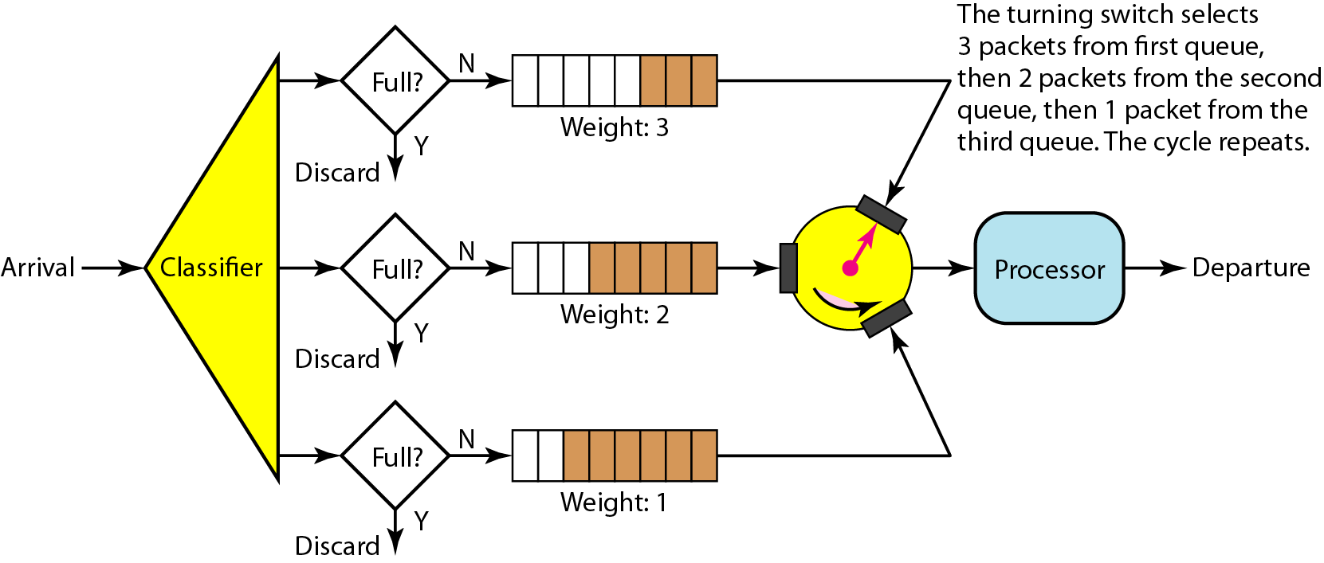
Weighted fair queuing

Slide 69
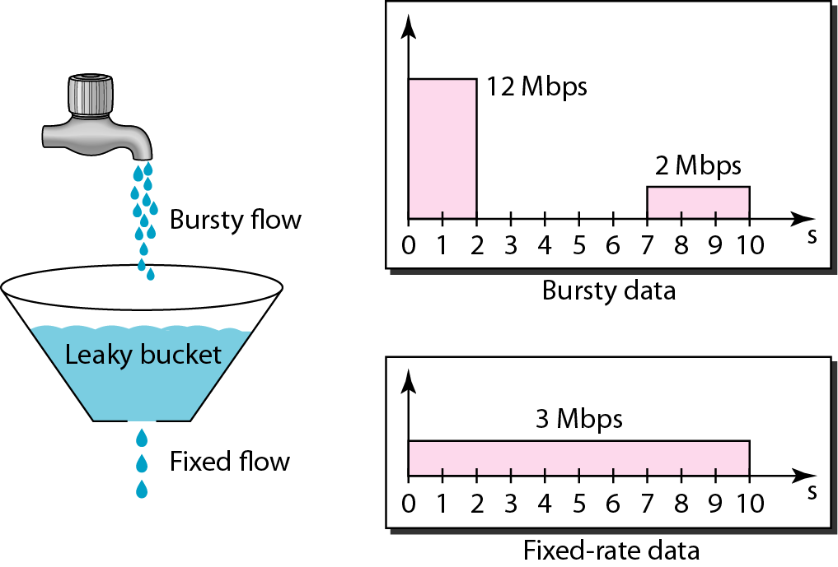
Leaky bucket

Slide 70
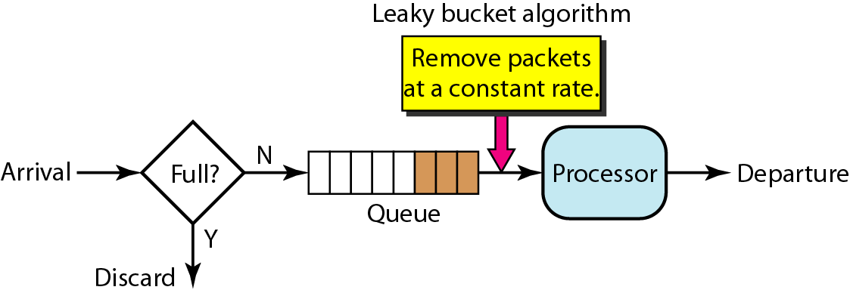
Leaky bucket implementation

Slide 71
A leaky bucket algorithm shapes bursty traffic into fixed-rate traffic by averaging the data rate. It may drop the packets if the bucket is full.

Slide 72
The token bucket allows bursty traffic at a regulated maximum rate.

Slide 73
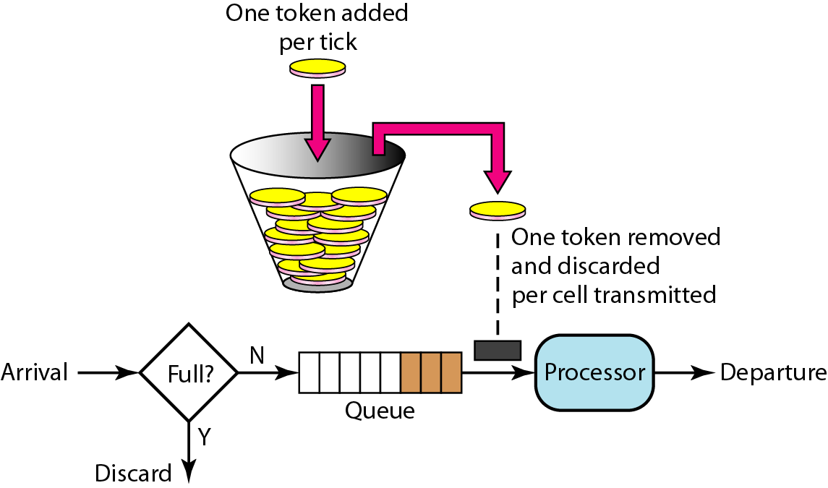
Token bucket

Slide 74
INTEGRATED SERVICES
Two models have been designed to provide quality of service in the Internet: Integrated Services and Differentiated Services. We discuss the first model here.
Integrated Services is a flow-based QoS model designed for IP.

Slide 75
Path messages

Slide 76
Resv messages

Slide 77
Reservation merging

Slide 78
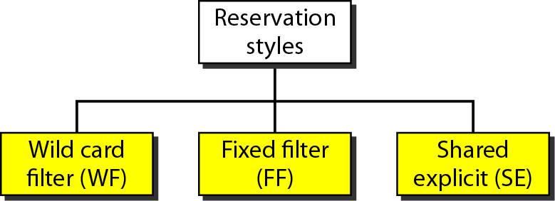
Reservation styles

Slide 79
DIFFERENTIATED SERVICES
Differentiated Services (DS or Diffserv) was introduced by the IETF (Internet Engineering Task Force) to handle the shortcomings of Integrated Services.
Differentiated Services is a class-based QoS model designed for IP.

Slide 80
DS field

Slide 81
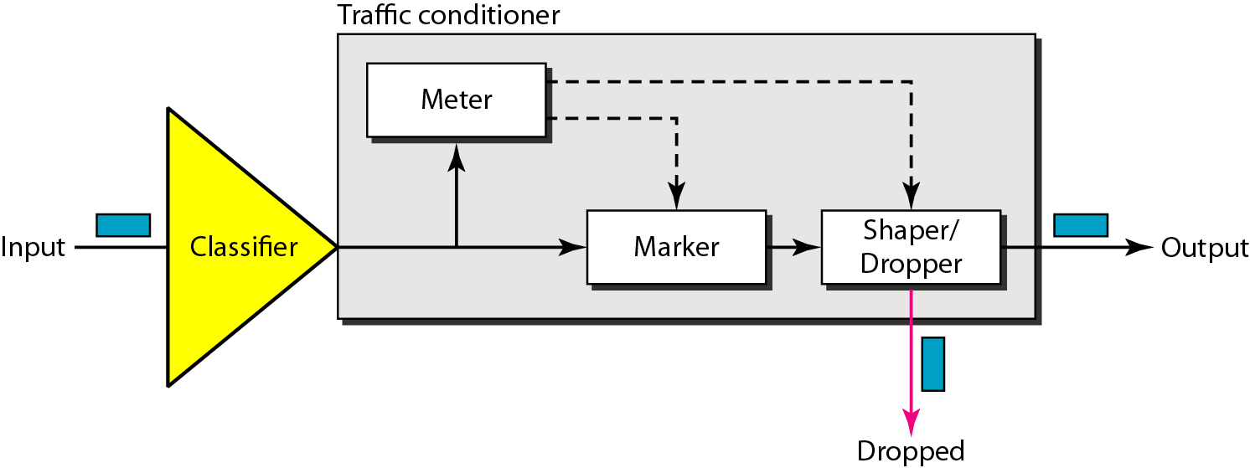
Traffic conditioner

Slide 82
QoS IN SWITCHED NETWORKS
Let us now discuss QoS as used in two switched networks: Frame Relay and ATM. These two networks are virtual-circuit networks that need a signaling protocol such as RSVP.

Slide 83
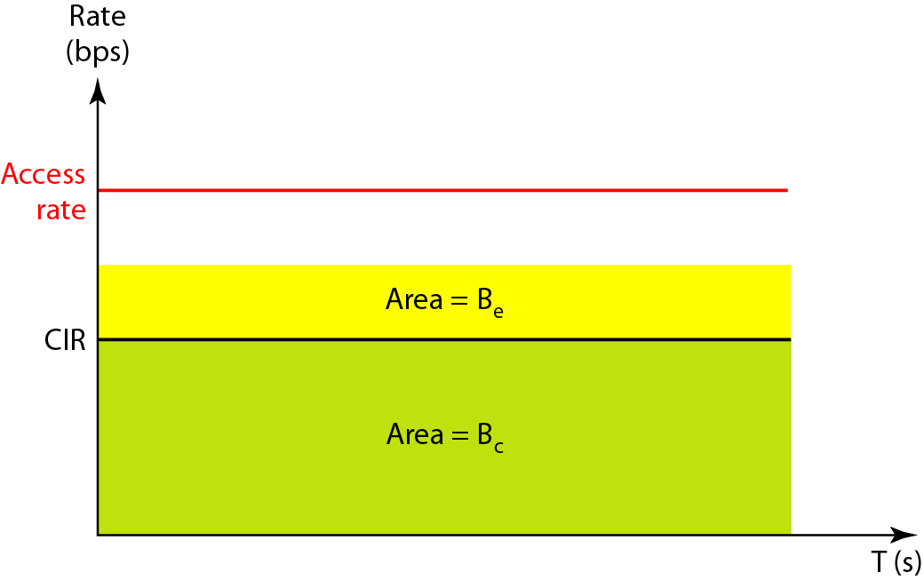
Relationship between traffic control attributes

Slide 84
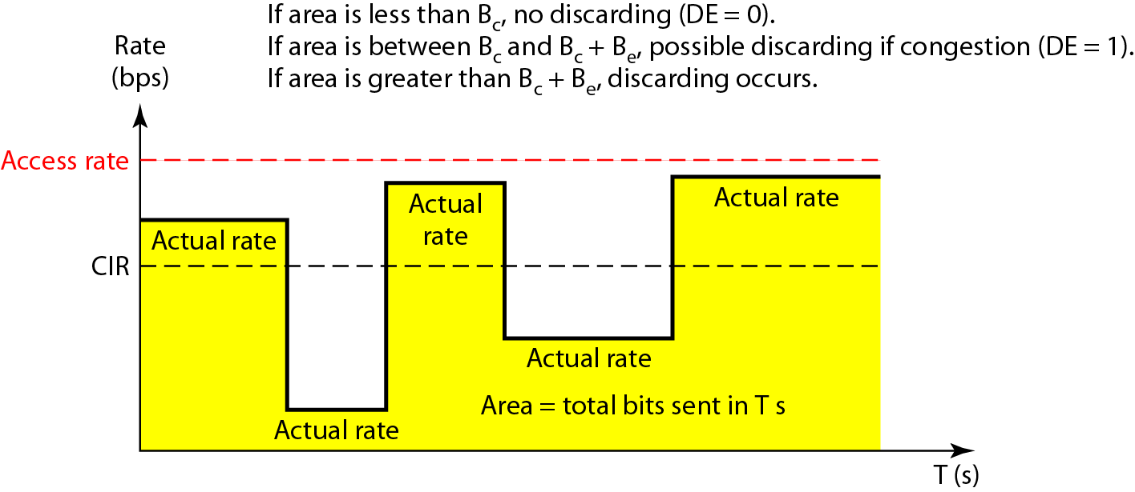
User rate in relation to Bc and Bc + Be

Slide 85
Service classes

Slide 86
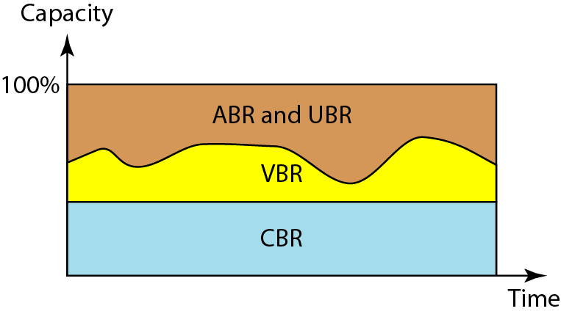
Relationship of service classes to the total capacity of the network

Slide 87
Reference
Ch 24, B. A. Forouzan, Data Communication and Networking: Fourth Edition, McGraw-Hill, 2007

