Slide 1
Pemrosesan Data Tersebar
Pertemuan 6
The Data Communications Interface Dosen Pengampu: Hendry Gunawan S.Kom, MM
Prodi Teknik Informatika - Fakultas Ilmu Komputer

Slide 2
Asynchronous and Synchronous Transmission
Timing problems require a mechanism to synchronize the transmitter and receiver
Two solutions
Asynchronous
Synchronous

Slide 3
Asynchronous
Data transmitted on character at a time
5 to 8 bits
Timing only needs maintaining within each character
Resync with each character

Slide 4
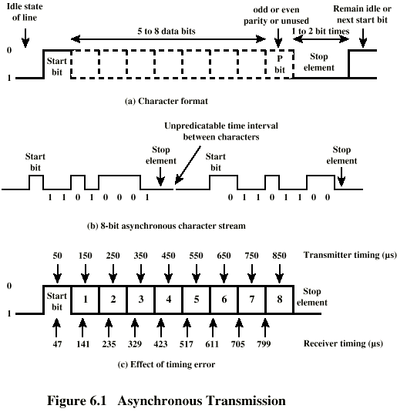
Asynchronous (diagram)

Slide 5
Asynchronous - Behavior
In a steady stream, interval between characters is uniform (length of stop element)
In idle state, receiver looks for transition 1 to 0
Then samples next seven intervals (char length)
Then looks for next 1 to 0 for next char
Simple
Cheap
Overhead of 2 or 3 bits per char (~20%)
Good for data with large gaps (keyboard)

Slide 6
Synchronous - Bit Level
Block of data transmitted without start or stop bits
Clocks must be synchronized
Can use separate clock line
Good over short distances
Subject to impairments
Embed clock signal in data
Manchester encoding
Carrier frequency (analog)

Slide 7
Synchronous - Block Level
Need to indicate start and end of block
Use preamble and postamble
e.g. series of SYN (hex 16) characters
e.g. block of 11111111 patterns ending in 11111110
More efficient (lower overhead) than async

Slide 8
Synchronous (diagram)

Slide 9
Line Configuration
Topology
Physical arrangement of stations on medium
Point to point
Multi point
Computer and terminals, local area network
Half duplex
Only one station may transmit at a time
Requires one data path
Full duplex
Simultaneous transmission and reception between two stations
Requires two data paths (or echo canceling)

Slide 10
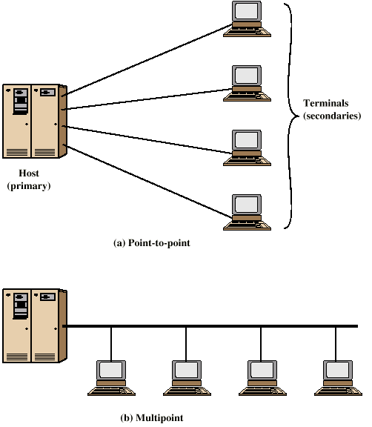
Traditional Configurations

Slide 11
Interfacing
Data processing devices (or data terminal equipment, DTE) do not (usually) include data transmission facilities
Need an interface called data circuit terminating equipment (DCE)
e.g. modem, NIC
DCE transmits bits on medium
DCE communicates data and control info with DTE
Done over interchange circuits
Clear interface standards required

Slide 12
Characteristics of Interface
Mechanical
Connection plugs
Electrical
Voltage, timing, encoding
Functional
Data, control, timing, grounding
Procedural
Sequence of events

Slide 13
V.24/EIA-232-F
ITU-T v.24
Only specifies functional and procedural
References other standards for electrical and mechanical
EIA-232-F (USA)
RS-232
Mechanical ISO 2110
Electrical v.28
Functional v.24
Procedural v.24

Slide 14
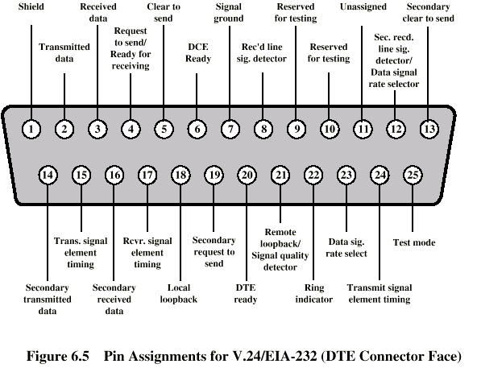
Mechanical Specification

Slide 15
Electrical Specification
Digital signals
Values interpreted as data or control, depending on circuit
More than -3v is binary 1, more than +3v is binary 0 (NRZ-L)
Signal rate < 20kbps
Distance <15m
For control, more than-3v is off, +3v is on

Slide 16
Functional Specification
(See table in Stallings chapter 6)

Slide 17
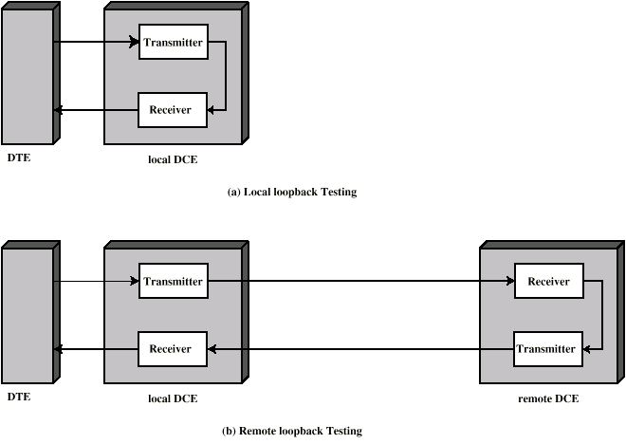
Local and Remote Loopback

Slide 18
Procedural Specification
E.g. Asynchronous private line modem
When turned on and ready, modem (DCE) asserts DCE ready
When DTE ready to send data, it asserts Request to Send
Also inhibits receive mode in half duplex
Modem responds when ready by asserting Clear to send
DTE sends data
When data arrives, local modem asserts Receive Line Signal Detector and delivers data

Slide 19
Dial Up Operation (1)

Slide 20
Dial Up Operation (2)

Slide 21
Dial Up Operation (3)

Slide 22
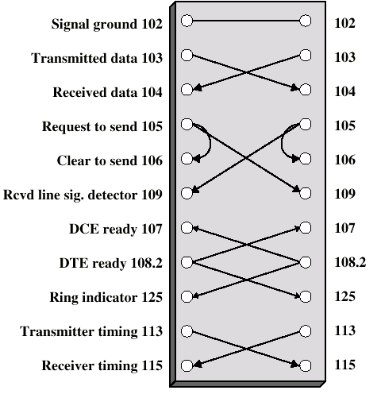
Null Modem

Slide 23
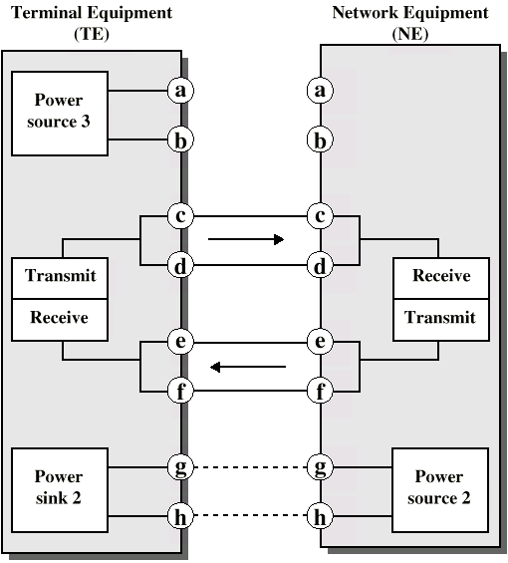
ISDN Physical Interface Diagram

Slide 24
ISDN Physical Interface
Connection between terminal equipment (c.f. DTE) and network terminating equipment (c.f. DCE)
ISO 8877
Cables terminate in matching connectors with 8 contacts
Transmit/receive carry both data and control

Slide 25
ISDN Electrical Specification
Balanced transmission
Carried on two lines, e.g. twisted pair
Signals as currents down one conductor and up the other
Differential signaling
Value depends on direction of voltage
Tolerates more noise and generates less
(Unbalanced, e.g. RS-232 uses single signal line and ground)
Data encoding depends on data rate
Basic rate 192kbps uses pseudoternary
Primary rate uses alternative mark inversion (AMI) and B8ZS or HDB3

Slide 26
Foreground Reading
Stallings chapter 6
Web pages from ITU-T on v. specification
Web pages on ISDN

