Slide 1
Pemrosesan Data Tersebar
Pertemuan 7
Data Link Control Dosen Pengampu: Hendry Gunawan S.Kom, MM
Prodi Teknik Informatika - Fakultas Ilmu Komputer

Slide 2
Flow Control
Ensuring the sending entity does not overwhelm the receiving entity
Preventing buffer overflow
Transmission time
Time taken to emit all bits into medium
Propagation time
Time for a bit to traverse the link

Slide 3
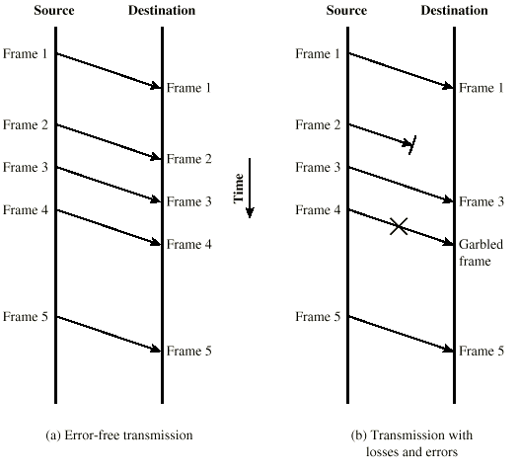
Model of Frame Transmission

Slide 4
Stop and Wait
Source transmits frame
Destination receives frame and replies with acknowledgement
Source waits for ACK before sending next frame
Destination can stop flow by not send ACK
Works well for a few large frames

Slide 5
Fragmentation
Large block of data may be split into small frames
Limited buffer size
Errors detected sooner (when whole frame received)
On error, retransmission of smaller frames is needed
Prevents one station occupying medium for long periods
Stop and wait becomes inadequate

Slide 6
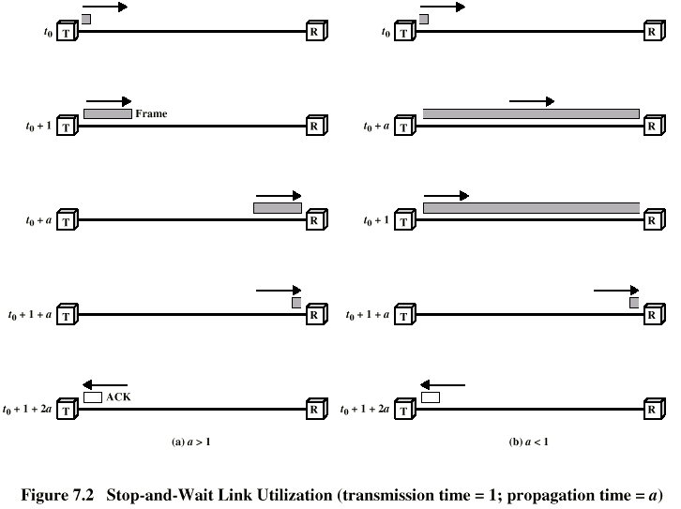
Stop and Wait Link Utilization

Slide 7
Sliding Windows Flow Control
Allow multiple frames to be in transit
Receiver has buffer W long
Transmitter can send up to W frames without ACK
Each frame is numbered
ACK includes number of next frame expected
Sequence number bounded by size of field (k)
Frames are numbered modulo 2^{k}

Slide 8
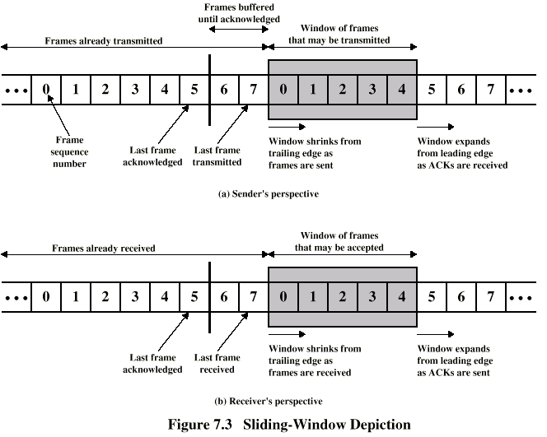
Sliding Window Diagram

Slide 9
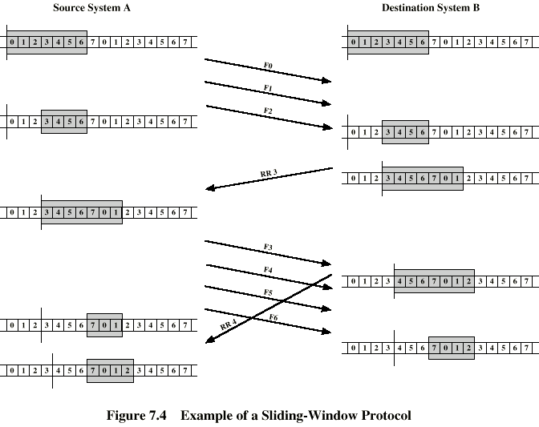
Example Sliding Window

Slide 10
Sliding Window Enhancements
Receiver can acknowledge frames without permitting further transmission (Receive Not Ready)
Must send a normal acknowledge to resume
If duplex, use piggybacking
If no data to send, use acknowledgement frame
If data but no acknowledgement to send, send last acknowledgement number again, or have ACK valid flag (TCP)

Slide 11
Error Detection
Additional bits added by transmitter for error detection code
Parity
Value of parity bit is such that character has even (even parity) or odd (odd parity) number of ones
Even number of bit errors goes undetected

Slide 12
Cyclic Redundancy Check
For a block of k bits transmitter generates n bit sequence
Transmit k+n bits which is exactly divisible by some number
Receive divides frame by that number
If no remainder, assume no error
For math, see Stallings chapter 7

Slide 13
Error Control
Detection and correction of errors
Lost frames
Damaged frames
Automatic repeat request
Error detection
Positive acknowledgment
Retransmission after timeout
Negative acknowledgement and retransmission

Slide 14
Automatic Repeat Request (ARQ)
Stop and wait
Go back N
Selective reject (selective retransmission)

Slide 15
Stop and Wait
Source transmits single frame
Wait for ACK
If received frame damaged, discard it
Transmitter has timeout
If no ACK within timeout, retransmit
If ACK damaged,transmitter will not recognize it
Transmitter will retransmit
Receive gets two copies of frame
Use ACK0 and ACK1

Slide 16
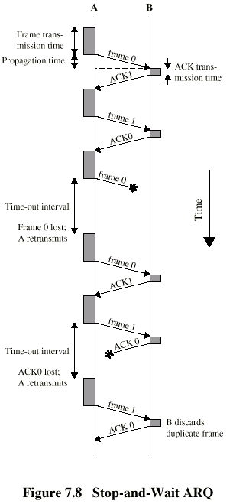
Stop and Wait - Diagram

Slide 17
Stop and Wait - Pros and Cons
Simple
Inefficient

Slide 18
Go Back N (1)
Based on sliding window
If no error, ACK as usual with next frame expected
Use window to control number of outstanding frames
If error, reply with rejection
Discard that frame and all future frames until error frame received correctly
Transmitter must go back and retransmit that frame and all subsequent frames

Slide 19
Go Back N - Damaged Frame
Receiver detects error in frame i
Receiver sends rejection-i
Transmitter gets rejection-i
Transmitter retransmits frame i and all subsequent

Slide 20
Go Back N - Lost Frame (1)
Frame i lost
Transmitter sends i+1
Receiver gets frame i+1 out of sequence
Receiver send reject i
Transmitter goes back to frame i and retransmits

Slide 21
Go Back N - Lost Frame (2)
Frame i lost and no additional frame sent
Receiver gets nothing and returns neither acknowledgement nor rejection
Transmitter times out and sends acknowledgement frame with P bit set to 1
Receiver interprets this as command which it acknowledges with the number of the next frame it expects (frame i )
Transmitter then retransmits frame i

Slide 22
Go Back N - Damaged Acknowledgement
Receiver gets frame i and send acknowledgement (i+1) which is lost
Acknowledgements are cumulative, so next acknowledgement (i+n) may arrive before transmitter times out on frame i
If transmitter times out, it sends acknowledgement with P bit set as before
This can be repeated a number of times before a reset procedure is initiated

Slide 23
Go Back N - Damaged Rejection
As for lost frame (2)

Slide 24
Go Back N - Diagram

Slide 25
Selective Reject
Also called selective retransmission
Only rejected frames are retransmitted
Subsequent frames are accepted by the receiver and buffered
Minimizes retransmission
Receiver must maintain large enough buffer
More complex login in transmitter

Slide 26
Selective Reject - Diagram

Slide 27
High Level Data Link Control
HDLC
ISO 33009, ISO 4335

Slide 28
HDLC Station Types
Primary station
Controls operation of link
Frames issued are called commands
Maintains separate logical link to each secondary station
Secondary station
Under control of primary station
Frames issued called responses
Combined station
May issue commands and responses

Slide 29
HDLC Link Configurations
Unbalanced
One primary and one or more secondary stations
Supports full duplex and half duplex
Balanced
Two combined stations
Supports full duplex and half duplex

Slide 30
HDLC Transfer Modes (1)
Normal Response Mode (NRM)
Unbalanced configuration
Primary initiates transfer to secondary
Secondary may only transmit data in response to command from primary
Used on multi-drop lines
Host computer as primary
Terminals as secondary

Slide 31
HDLC Transfer Modes (2)
Asynchronous Balanced Mode (ABM)
Balanced configuration
Either station may initiate transmission without receiving permission
Most widely used
No polling overhead

Slide 32
HDLC Transfer Modes (3)
Asynchronous Response Mode (ARM)
Unbalanced configuration
Secondary may initiate transmission without permission form primary
Primary responsible for line
rarely used

Slide 33
Frame Structure
Synchronous transmission
All transmissions in frames
Single frame format for all data and control exchanges

Slide 34
Frame Structure Diagram

Slide 35
Flag Fields
Delimit frame at both ends
01111110
May close one frame and open another
Receiver hunts for flag sequence to synchronize
Bit stuffing used to avoid confusion with data containing 01111110
0 inserted after every sequence of five 1s
If receiver detects five 1s it checks next bit
If 0, it is deleted
If 1 and seventh bit is 0, accept as flag
If sixth and seventh bits 1, sender is indicating abort

Slide 36
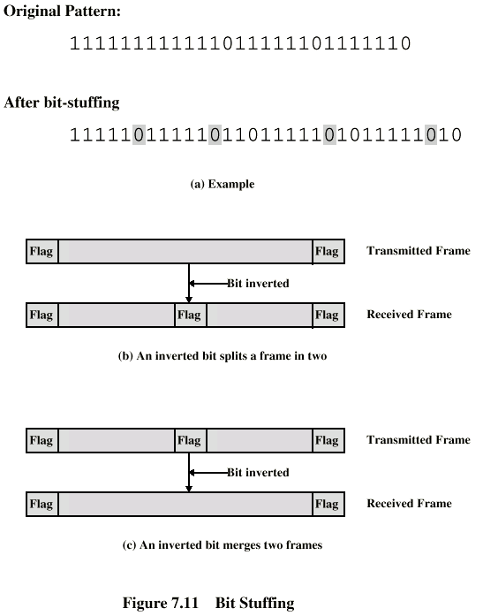
Bit Stuffing
Example with possible errors

Slide 37
Address Field
Identifies secondary station that sent or will receive frame
Usually 8 bits long
May be extended to multiples of 7 bits
LSB of each octet indicates that it is the last octet (1) or not (0)
All ones (11111111) is broadcast

Slide 38
Control Field
Different for different frame type
Information - data to be transmitted to user (next layer up)
Flow and error control piggybacked on information frames
Supervisory - ARQ when piggyback not used
Unnumbered - supplementary link control
First one or two bits of control filed identify frame type
Remaining bits explained later

Slide 39
Control Field Diagram

Slide 40
Poll/Final Bit
Use depends on context
Command frame
P bit
1 to solicit (poll) response from peer
Response frame
F bit
1 indicates response to soliciting command

Slide 41
Information Field
Only in information and some unnumbered frames
Must contain integral number of octets
Variable length

Slide 42
Frame Check Sequence Field
FCS
Error detection
16 bit CRC
Optional 32 bit CRC

Slide 43
HDLC Operation
Exchange of information, supervisory and unnumbered frames
Three phases
Initialization
Data transfer
Disconnect

Slide 44
Examples of Operation (1)

Slide 45
Examples of Operation (2)

Slide 46
Other DLC Protocols (LAPB,LAPD)
Link Access Procedure, Balanced (LAPB)
Part of X.25 (ITU-T)
Subset of HDLC - ABM
Point to point link between system and packet switching network node
Link Access Procedure, D-Channel
ISDN (ITU-D)
ABM
Always 7-bit sequence numbers (no 3-bit)
16 bit address field contains two sub-addresses
One for device and one for user (next layer up)

Slide 47
Other DLC Protocols (LLC)
Logical Link Control (LLC)
IEEE 802
Different frame format
Link control split between medium access layer (MAC) and LLC (on top of MAC)
No primary and secondary - all stations are peers
Two addresses needed
Sender and receiver
Error detection at MAC layer
32 bit CRC
Destination and source access points (DSAP, SSAP)

Slide 48
Other DLC Protocols (Frame Relay) (1)
Streamlined capability over high speed packet witched networks
Used in place of X.25
Uses Link Access Procedure for Frame-Mode Bearer Services (LAPF)
Two protocols
Control - similar to HDLC
Core - subset of control

Slide 49
Other DLC Protocols (Frame Relay) (2)
ABM
7-bit sequence numbers
16 bit CRC
2, 3 or 4 octet address field
Data link connection identifier (DLCI)
Identifies logical connection
More on frame relay later

Slide 50
Other DLC Protocols (ATM)
Asynchronous Transfer Mode
Streamlined capability across high speed networks
Not HDLC based
Frame format called “cell”
Fixed 53 octet (424 bit)
Details later

Slide 51
Required Reading
Stallings chapter 7
Web sites on HDLC, frame relay, Ethernet and ATM

