Slide 1
Instructor Materials Chapter 2: Elements of the IoE
Introduction to the Internet of Things
Notes:
Cisco Networking Academy Program
Introduction to the Internet of Things
Chapter 2: Elements of the IoE

Slide 2
Instructor Materials - Chapter 2 Planning Guide
This PowerPoint deck is divided in two parts:
Instructor Planning Guide
Information to help you become familiar with the chapter
Teaching aids
Instructor Class Presentation
Optional slides that you can use in the classroom
Begins on slide # 9
Note: Remove the Planning Guide from this presentation before sharing with anyone.
Notes:
2

Slide 3
Introduction to the Internet of Things Planning Guide
Chapter 2: Elements of the IoE
Notes:
Introduction to the Internet of Things
Chapter 2: Elements of the IoE

Slide 4
Chapter 2: Activities
What activities are associated with this chapter?
Page # | Activity Type | Activity Name
2.1.3.5 | Interactive Activity | Identify IoT Terms
2.2.1.4 | Interactive Activity | Identify Data Measurements
2.2.2.5 | Packet Tracer | Transportation of Data
2.2.4.6 | Interactive Activity | Match the Cloud Computing Services
2.2.4.7 | Lab | Install a Linux Virtual Machine
The password used in the Packet Tracer activities in this chapter is: PT_I2IoT
Notes:
4

Slide 5
Chapter 2: Assessment
Students should complete Chapter 2 Quiz after completing Chapter 2.
Labs, Packet Tracers, and other activities can be used to informally assess student progress.
Notes:
5

Slide 6
Chapter 2: Best Practices
Prior to teaching Chapter 2, the instructor should:
Read the chapter and complete all activities, including the chapter quiz.
Notes:
6

Slide 7
Chapter 2: Additional Help
For additional help with teaching strategies, including lesson plans, analogies for difficult concepts, and discussion topics, visit the Facebook page for community and peer support at the following: www.facebook.com/cisconetworkingacademy.
Notes:
7

Slide 9
Chapter 2: Elements of the IoE
Introduction to the Internet of Things
Notes:
Cisco Networking Academy Program
Introduction to the Internet of Things
Chapter 2: Elements of the IoE

Slide 10
Chapter 2 - Sections & Objectives
2.1 Things as an Element
Explain things as an element of the IoE
2.2 Data as an Element
Explain data as an element of the IoE
2.3 People as an Element
Explain people as an element of the IoE
2.4 Process as an Element
Explain process as an element of the IoE that manages the way things, data, and people work together.
Notes:
10

Slide 11
2.1 Things as an Element
Notes:
Cisco Networking Academy Program
Introduction to the Internet of Things
Chapter 2: Elements of the IoE

Slide 12
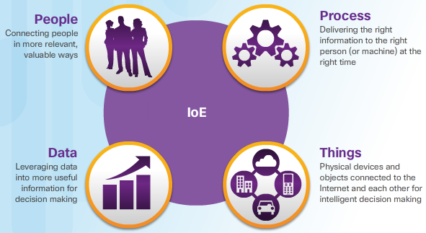
Things as an Element Connecting to Traditional Computer Things
The Four Elements
People, Process, Data, and Things
What are Things
contain embedded technology to interact with internal servers and the external environment
network-capable
can communicate across a secure, reliable and available network platform
Can create vast amounts of data.
Notes:
2.1 – Things as an Element
2.1.1 – Connecting to Traditional Computer Things

Slide 13
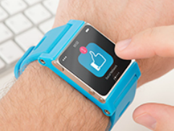
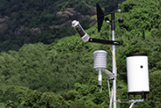
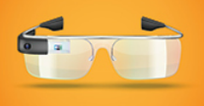
Things as an Element Connecting to Traditional Computers
Can you name a few common devices and different ways to connect them wirelessly?
Here are some examples:
Common devices: laptop and desktop computers
Ways to connect: Wi-Fi
Notes:
2.1 – Things as an Element
2.1.2 – Connecting to Traditional Computers

Slide 14
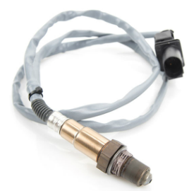
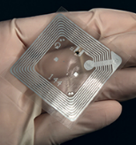
Things as an Element Connecting to Non-Traditional Computer Things
Sensors
Collect data from non-computers
convert physical aspects of our environment into electrical signals that can be processed by computers
Some examples: soil moisture sensors, air temperature sensors, radiation sensors, and motion sensors
RFID – Radio frequency identification
Communicate information between small coded tags (RFID tags) and an RFID reader. Usually, RFID tags are
Use to identify and track what they are embedded into
Controller
collects data from sensors and providing an Internet connection
May have the ability to make immediate decisions or send data to a more powerful computer for analysis.
Notes:
2.1 – Things as an Element
2.1.3 – Connecting to Non-Traditional Computer Things

Slide 15
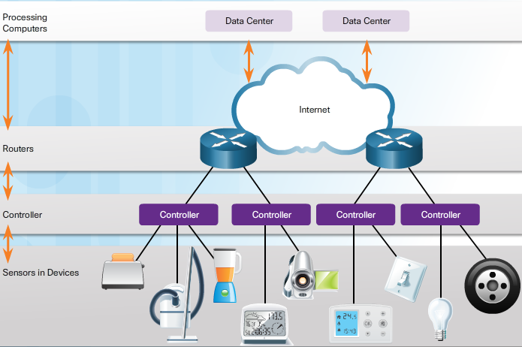
Things as an Element Connecting to Non-Traditional Computer Things (Cont.)
Notes:
2.1 – Things as an Element
2.1.3 – Connecting to Non-Traditional Computer Things (Cont.)

Slide 16
Data as an Element Data
What is Data?
Data is a value assigned to anything that is around us.
In electronic communication, data is represented as 1s and 0s, known as bits (or binary digits).
The advantage of using digital coding is that data can be stored more efficiently and can be transmitted over long distances without the quality becoming degraded.
Management of Data
Structured Data – data entered and maintained in fixed fields within a file or record
Unstructured Data – raw data
Data Storage – local data, centralized data, and distributed data
Notes:
2.2 – Data as an Element
2.2.1 – Data

Slide 17
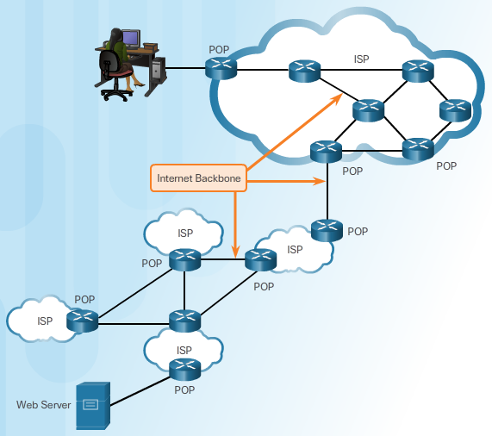
Data as an Element Transportation of Data
Internet Service Providers
Forward the data across the Internet
Supply the connections to allow Internet access to individuals and businesses
Interconnect with other ISPs
Connect networks at Point of Presence (POP)
Form the Internet Backbone when multiple ISPs are interconnected
Notes:
2.2 – Data as an Element
2.2.2 – Transportation of Data

Slide 18
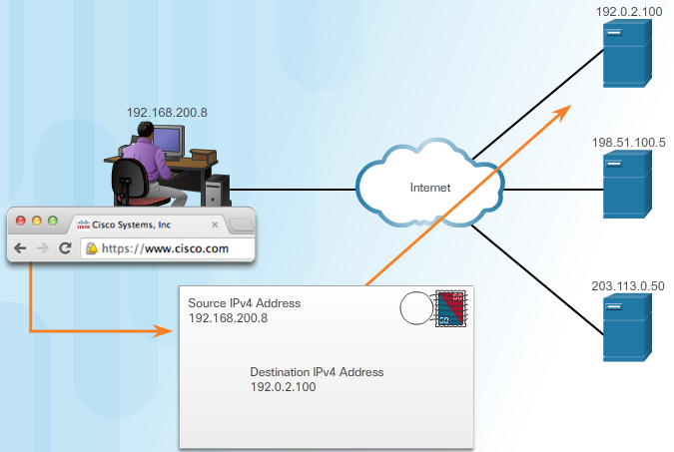
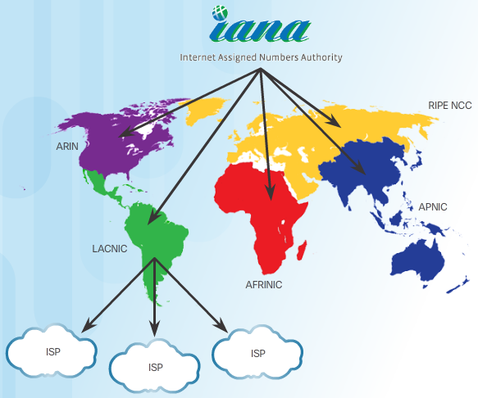
Data as an Element Transportation of Data (Cont.)
IP Addressing
IP packet must contain a valid source and destination IP address
IP protocol specifies how these addresses are used in routing of packets
IP Address Management
Internet Assigned Numbers Authority (IANA)
Distributes IP addresses so that there is no duplication.
Allocates blocks of IP addresses to one of five regional Internet registries (RIR).
ISPs
Obtain blocks of IP addresses from the RIR in their geographic region.
Manage and assign IP addresses to customer networks
Determine where to forward the traffic
Notes:
2.2 – Data as an Element
2.2.2 – Transportation of Data (Cont.)

Slide 19
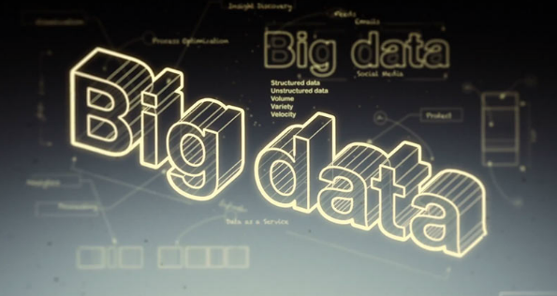
Data as an Element Big Data
Data in Motion
Data at rest - Collected, static data
Data in motion - Devices, sensors, and video on the IoT are a growing source of new data on a constant basis. This data provides maximum value while it is interacting in real-time.
Managing Big Data
Volume – amount of data being transported and stored
Variety – type of data
Velocity – rate of data movement
Notes:
2.2 – Data as an Element
2.2.3 – Big Data

Slide 20
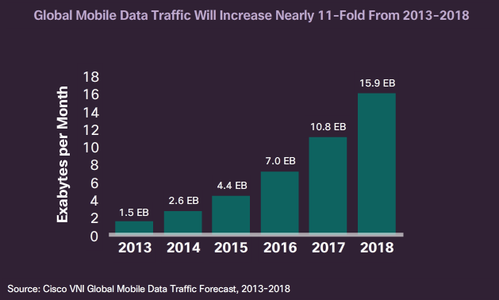
Data as an Element Big Data (Cont.)
Big Data Analytics
Collection and analysis of vast stores of data for insights
How much data is generated
How this data is identified and managed as an asset to the organization
How this data is turned into usable information
How organizations use this data to make decisions
Data sources and trends
Mobility - Mobile devices, events, sharing, and sensor integration
Data access and consumption – Internet, interconnected systems, social networking, and access models
Ecosystem capabilities – Major changes in the information processing model and the availability of an open source framework
Notes:
2.2 – Data as an Element
2.2.3 – Big Data (Cont.)

Slide 21
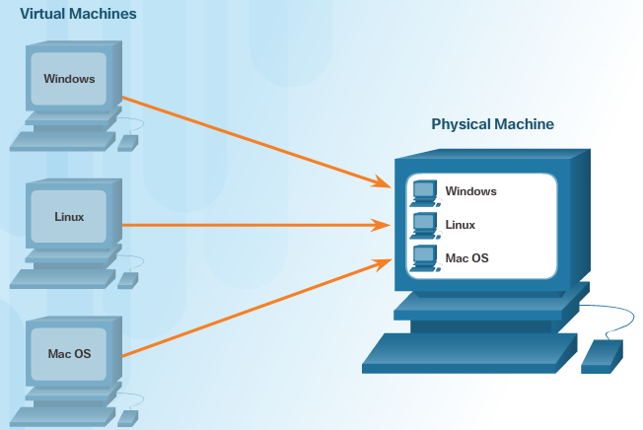
Data as an Element Virtualization and Cloud Computing
Virtualization
Software emulation
Virtual computer operates independently
Virtual computer has its own operating system, applications, and dedicated hardware components.
Cloud Computing
Is another way to mange, store, and access data
Involves large numbers of computers connected through a network
Allows the users to access their data anywhere and at any time
Uses a shared pool of computing resources
Types of cloud services: SaaS, PaaS, IaaS, ITaaS
enables organizations to streamline their IT operations by subscribing only to needed services
Data Centers
Are a critical enabler to cloud computing
Provide business continuity by keeping computing services available at all times
Notes:
2.2 – Data as an Element
2.2.4 – Virtualization and Cloud Computing

Slide 22
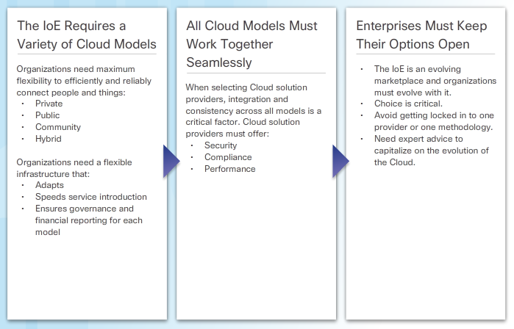
Data as an Element Virtualization and Cloud Computing (Cont.)
Notes:
2.2 – Data as an Element
2.2.4 – Virtualization and Cloud Computing (Cont.)

Slide 23
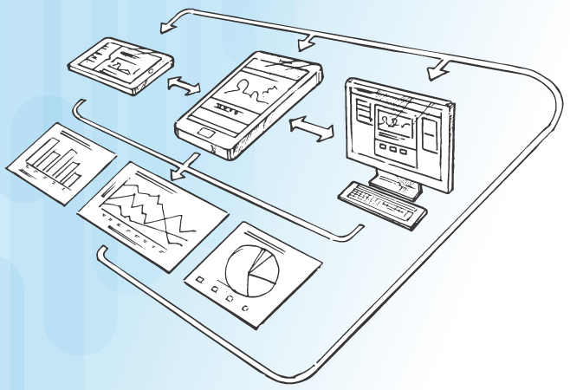
People as an Element Behavior Adapts to Information
People Must be Connected
Data transform into usable information leads to:
better-informed decisions
appropriate actions
Information Transforms Behavior
Allows people to make informed decisions that bridge the differences between actual outputs and desired output
Feedback loop
real-time information based on current behavior
deliver actionable information to modify that behavior
Notes:
2.3 – People as an Element
2.3.1 – Behavior Adapts to Information

Slide 24
People as an Element Organization Adapts to Information
How Businesses Use Data
creates differentiated offerings based on customer needs
Target marketing
aimed at a specific group of people, separate from the market as a whole
based upon people who live in the same region, or have the same job title, or make a certain amount of money
Micromarketing – more precise version of marketing by businesses
loyalty cards
E-commerce
Collaboration
Facilitate innovative new offerings that realize the potential of the IoE
Make organizations more aware of customer needs and opportunities
Allows organizations to identify potential problems and resolve them, foster better relationships
Notes:
2.3 – People as an Element
2.3.2 – Organization Adapts to Information

Slide 25
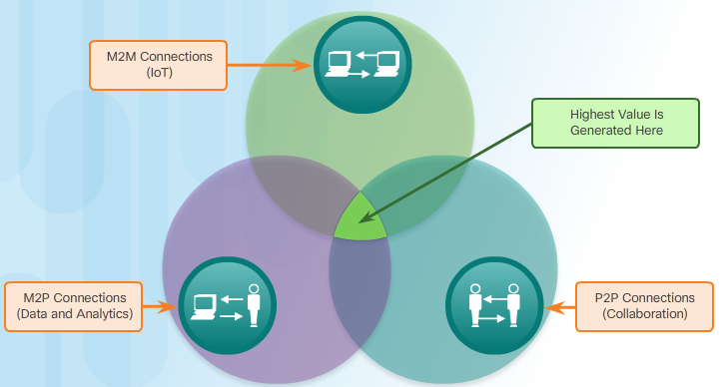
Process as an Element The Role of Process
M2M Connections
Data is transferred from one machine or “thing” to another over a network.
M2M is the most critical part of the Internet of Things.
Critical components include sensors, actuators, and controllers with network connections for communications and instructions
The most well-known type of M2M communication is telemetry.
M2P Connections
Information is transferred between a machine and a person
Facilitate the movement, manipulation, and reporting of data from machines to help people make informed judgments
P2P Connections
Information is transferred from one person to another, often called Collaboration.
Timely and Relevant Information
Leverages the connections between data, things, and people to deliver the right information, to the right thing or person, at the right time
Notes:
2.4 – Process as an Element
2.4.1 – The Role of Process

Slide 26
2.5 Chapter Summary
Notes:
Cisco Networking Academy Program
Introduction to the Internet of Things
Chapter 2: Elements of the IoE

Slide 27
Chapter Summary Summary
The four elements of the IoE are: People, Process, Data, and Things.
Things
Devices are connected via wires or wirelessly so that they can communicate.
Devices that are not traditionally connected to the network require sensors, RFIDs, and controllers.
Data
Big Data requires new products and techniques to manage, store, and analyze the data generated by the connected devices: virtualization and cloud computing.
Organizations collect and analyze vast stores of data for insights that can help identify trends, predict behavior, and empower decision makers.
People
Connected people make behavioral transformations based on their access to information, and their changed behavior affects the information that is generated. This is known as a feedback loop.
Organizations use data generated by connected people to refine and target their marketing strategies.
Process
Processes occur between people, things, and data.
The IoE brings them all together by combining M2M, M2P, and P2P connections.
Notes:
2.5.1.1 - Summary

