Slide 1
Instructor Materials Chapter 3: Connecting the Unconnected
Introduction to the Internet of Things
Notes:
Cisco Networking Academy Program
Introduction to the Internet of Things
Chapter 3: Connecting the Unconnected

Slide 2
Instructor Materials - Chapter 3 Planning Guide
This PowerPoint deck is divided in two parts:
Instructor Planning Guide
Information to help you become familiar with the chapter
Teaching aids
Instructor Class Presentation
Optional slides that you can use in the classroom
Begins on slide # 9
Note: Remove the Planning Guide from this presentation before sharing with anyone.
Notes:
2

Slide 3
Introduction to the Internet of Things Planning Guide
Chapter 3: Connecting the Unconnected
Notes:
Introduction to the Internet of Things
Chapter 3: Connecting the Unconnected

Slide 4
Chapter 3: Activities
What activities are associated with this chapter?
Page # | Activity Type | Activity Name | Optional
3.1.5.5 | Interactive Activity | Match Each Pillar to its Description
3.2.2.5 | Packet Tracer | Install and Configure IoT Devices
3.2.4.5 | Packet Tracer | Home IoT Implementation
3.3.1.5 | Interactive Activity | Identify Program Terms
3.3.2.4 | Lab | Create a Program with Blockly
3.3.2.5 | Lab | Learn about Python
3.4.2.5 | Challenge Lab | Learn about Wyliodrin | Yes
3.4.2.6 | Challenge Lab | Introduction to the Raspberry Pi | Yes
3.4.2.7 | Challenge Lab | Introduction to Arduino | Yes
The password used in the Packet Tracer activities in this chapter is: PT_I2IoT
Notes:
4

Slide 5
Chapter 3: Assessment
Students should complete Chapter 3 Quiz after completing Chapter 3.
Labs, Packet Tracers, and other activities can be used to informally assess student progress.
Notes:
5

Slide 6
Chapter 3: Best Practices
Prior to teaching Chapter 3, the instructor should:
Read the chapter and complete all activities, including the chapter quiz.
Notes:
6

Slide 7
Chapter 3: Additional Help
For additional help with teaching strategies, including lesson plans, analogies for difficult concepts, and discussion topics, visit the Facebook page for community and peer support at the following: www.facebook.com/cisconetworkingacademy.
Notes:
7

Slide 9
Chapter 3 Connecting the Unconnected
Introduction to the Internet of Things
Notes:
Cisco Networking Academy Program
Introduction to the Internet of Things
Chapter 3: Connecting the Unconnected

Slide 10
Chapter 3 - Sections & Objectives
3.1 Introduction to the Cisco IoT System
Explain the features and functions of the Cisco IoT System.
3.2 Introduction to Configuring Things
Configure devices to communicate in the IoT.
3.3 Programming
Apply basic programming codes.
3.4 Prototyping Your Ideas
Explain prototyping and its purpose.
Notes:
10

Slide 11
3.1 Introduction to the Cisco IoT System
Notes:
Cisco Networking Academy Program
Introduction to the Internet of Things
Chapter 3: Connecting the Unconnected

Slide 12
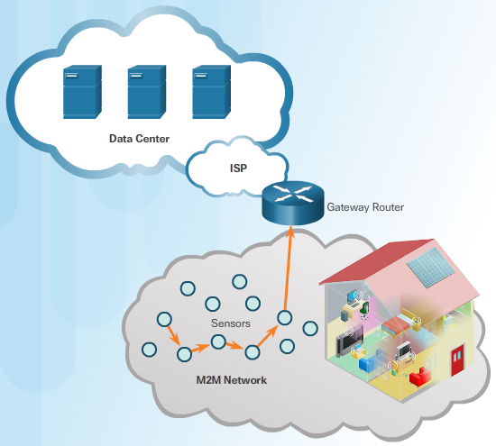
Introduction to the Cisco IoT System Things to Connect
Connecting Things for Consumers
The home network probably has a router with both wired and wireless capabilities.
The home network connects to the Internet through a local Internet Service Provider (ISP).
Sensors can be part of the home network.
These sensors are part of the M2M networks that are unique to the IoT. The sensors can communicate with each other and send data through the gateway router (home router), through the ISP network, to a server environment in the Cloud. Here data can be accumulated and analyzed.
Connecting Things for Industries
Requires reliability and autonomy
May require operations and calculations that happen too quickly to depend on human intervention.
Notes:
3.1 – Introduction to the Cisco IoT System
3.1.1 – Things to Connect

Slide 13
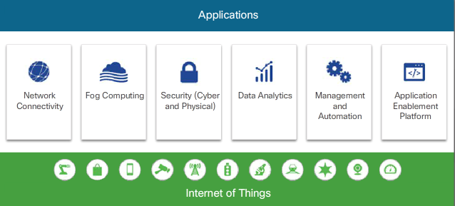
Introduction to the Cisco IoT System The Cisco IoT System
Challenges to Connecting Things
Integration of millions of things consisting of devices from different vendors each using custom applications
Integration new things to the existing network infrastructure
Security of these new devices, each configured with varying levels of security
The Six Pillars of the Cisco IoT System
Help organizations and industries adopt IoT solutions by reducing the complexities of digitization
Provide an infrastructure designed to manage large scale systems of very different endpoints and platforms, and the huge amount of data that they create
Use the concept of pillars to identify foundational elements
Notes:
3.1 – Introduction to the Cisco IoT System
3.1.2 – The Cisco IoT System

Slide 14
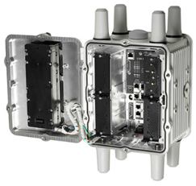
Introduction to the Cisco IoT System The Network Connectivity Pillar
Support the IoT in Industry
create a safe and more comfortable environment
provide network connectivity
Industrial IoT Devices
Industrial routers – compact, ruggedized modular platforms on which industrial organizations can build a highly secure, reliable, and scalable communications infrastructure.
Industrial switches – compact, ruggedized switches that handle security, voice, and video traffic across industrial networks.
Industrial wireless – can be deployed in outdoor, harsh, and hazardous environments
Embedded networks – compact form factor switch and router cards
Notes:
3.1 – Introduction to the Cisco IoT System
3.1.3 – The Network Connectivity Pillar

Slide 15
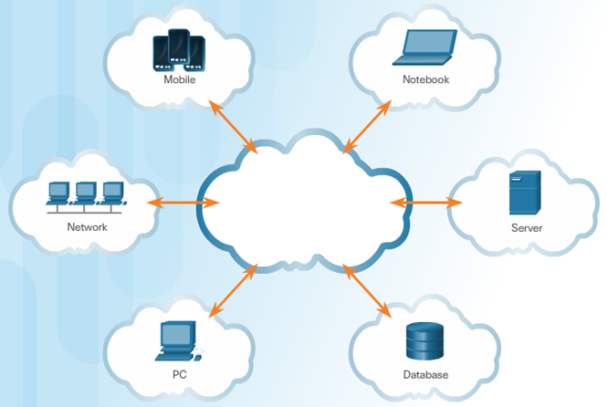
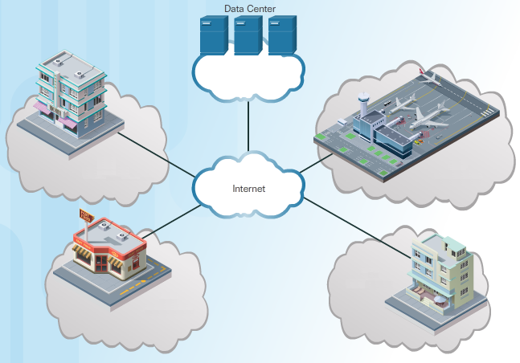
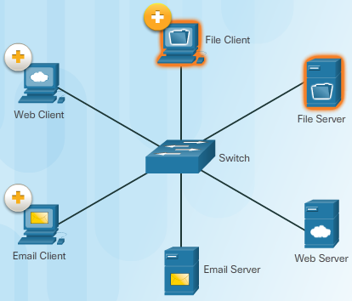
Introduction to the Cisco IoT System The Fog Computing Pillar
Network Models - describe how data flows within a network.
Can you describe the models? Can you match the figures to the models?
Notes:
3.1 – Introduction to the Cisco IoT System
3.1.4 – The Fog Computing Pillar

Slide 16
Introduction to the Cisco IoT System The Fog Computing Pillar (Cont.)
Fog Applications
All Fog applications monitor or analyze real-time data from network-connected things and then take action
The action can involve machine-to-machine (M2M) communications and machine-to-people (M2P) interaction.
The Fog computing pillar provides a combination of hardware and software solutions.
Some Fog computing platforms support a special operating system called Cisco IOx. IOx enables an IoT router to run IOS and a Linux-based Fog application without interaction with the cloud.
Notes:
3.1 – Introduction to the Cisco IoT System
3.1.4 – The Fog Computing Pillar (Cont.)

Slide 17
Introduction to the Cisco IoT System Other Cisco IoT System Pillars
Security (Cyber and Physical) Pillar
offers scalable cybersecurity solutions, enabling an organization to quickly and effectively discover, contain, and remediate an attack to minimize damage.
Cybersecurity solutions include:
Operational Technology (OT) specific security
IoT Network security
IoT Physical Security
Data Analytics Pillar
Process data rapidly and transformed into actionable intelligence
Management and Automation Pillar
Deliver a broad range of IoT management and automation capabilities throughout the extended network.
Can be customized for specific industries to provide enhanced security and control and support.
Application Enablement Platform Pillar
Provides the infrastructure for application hosting and application mobility between Cloud and Fog computing
Notes:
3.1 – Introduction to the Cisco IoT System
3.1.5 – Other Cisco IoT System Pillars

Slide 18
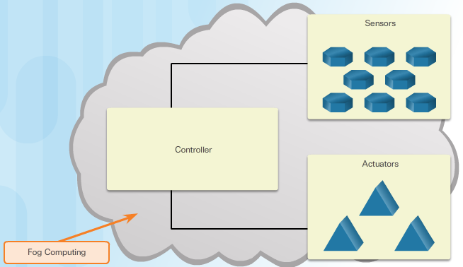
Introduction to Configuring Things Non-IP-Enabled Devices Communicate Across a Network
Sensors
Purchased with pre-programmed specific instructions
Maybe configured to change their degree of sensitivity or the frequency of feedback.
Actuators
Basic motors that can be used to move or control a mechanism or system, based on a specific set of instructions. Three types of actuators used in the IoT:
Hydraulic - Uses fluid pressure to perform mechanical movement.
Pneumatic - Uses compressed air at high pressure to enable mechanical operation.
Electrical - Powered by a motor that converts electrical energy to mechanical operation.
Do not process data, only perform actions signaled by the controller
Controllers in the Fog
Can forward any information gathered from the sensors to other devices in the Fog
Notes:
3.2 – Introduction to Configuring Things
3.2.1 – Non-IP-Enabled Devices Communicate Across a Network

Slide 19
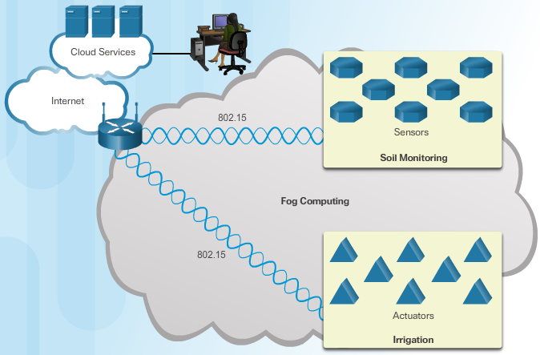
Introduction to Configuring Things Configuring IP-Enabled Devices
IP-Enabled Controllers
Forward information across an IP network
Allows individuals to access the controller remotely
May perform more complex operations in an M2M configuration
May consolidate information from multiple sensors or perform basic analysis of data received.
IP-Enabled Sensors
Some sensors and actuators support TCP/IP.
The data these devices generate can be transported remotely for further processing
IP Addressing
To communicate over an IP network, the IP-enabled devices must be configured with correct IP address information.
Static IP Addressing – configured manually
Automatic IP Addressing – assigned automatically by Dynamic Host Configuration Protocol (DHCP) server for IPv4 or IPv6 and Stateless Address Autoconfiguration (SLAAC) .
Notes:
3.2 – Introduction to Configuring Things
3.2.2 - Configuring IP-Enabled Devices

Slide 20
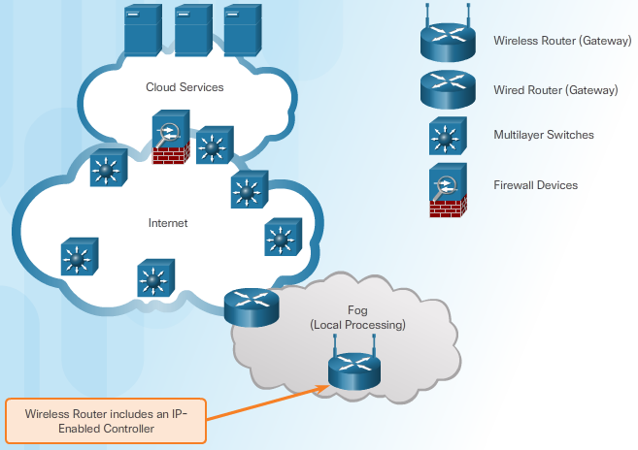
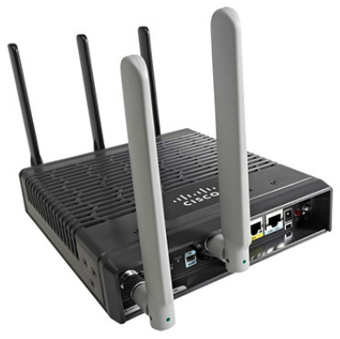
Introduction to Configuring Things Configuring Infrastructure Devices
Role of IoT Infrastructure Devices
Wireless and wired connectivity
Quality of service queuing
High availability
Secure transfer
Routers
Route traffic from the local network to devices on remote networks
Collect information about the location of different networks and determine the best path
Notes:
3.2 – Introduction to Configuring Things
3.2.3 – Configuring Infrastructure Devices

Slide 21
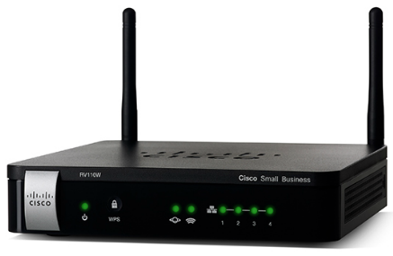
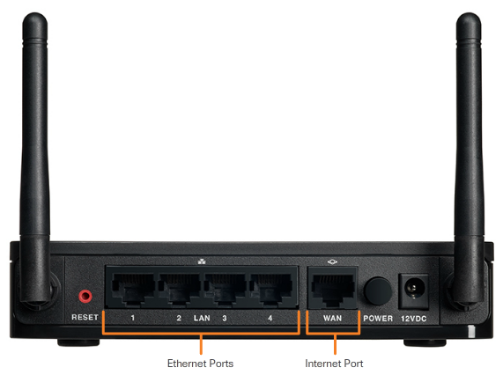
Introduction to Configuring Things Configuring Small Business Routers
Types of Ports
Small business and home routers typically have two primary ports:
Ethernet Ports - These ports connect to the internal switch portion of the router. All devices connected to the switch ports are on the same local network.
Internet Port - This port is used to connect the device to another network, such as the Internet.
Settings
Wireless Network Name (SSID) - Name of the WLAN network
Wireless Password - Password clients use to connect to the wireless network
Router Password - Password used to manage the router
Wireless router provides DHCP services to connected local network clients when connected to the wireless router.
What can you do secure the router?
Gateway
To reach a device on a different IP network, the devices must first forward the packet to the default gateway.
In a small business environment the default gateway is the router used to connect the LAN to the Internet.
Notes:
3.2 – Introduction to Configuring Things
3.2.4 – Configuring Small Business Routers

Slide 22
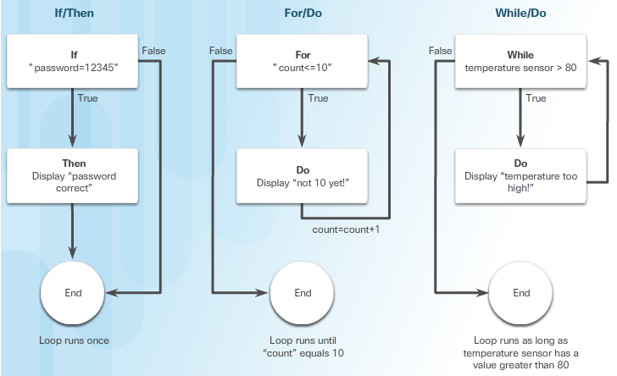
Programming What are Programs?
Programming Facilitates the IoT
Sensors must be told what to capture and where to send that data.
A controller must be programmed with a set of instructions to receive that data and decide if it should process and relay that data to another device.
What is a program?
A computer program is a set of instructions given to a computer, to be executed in a specific order.
Most common logical structures found in programming languages:
IF condition THEN instructions (If/Then)
FOR expression DO instructions (For/Do)
WHILE condition DO instructions (While/Do)
Types of Programs
Firmware contains the instructions that the device performs as it boots up.
Operating Systems allow humans to interact with a computer.
Applications are designed and written to perform a specific task or service.
Programming Languages
Can you name a few?
Notes:
3.3 – Programming
3.3.1 – What are Programs?

Slide 23
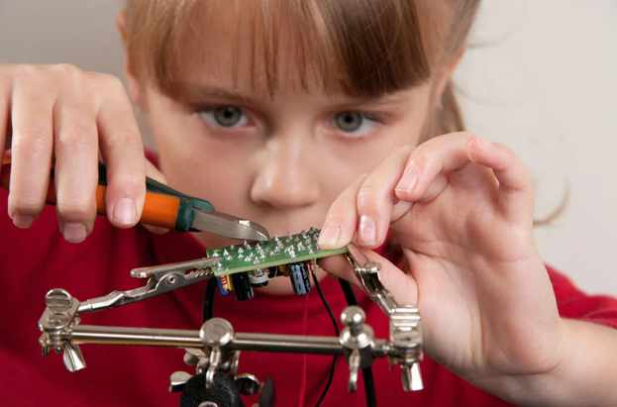
Prototyping Your Ideas What is Prototyping?
Defining Prototyping
Prototyping is the process of creating a rudimentary working model of a product or system.
Prototyping requires some design skills, electrical skills, physical/mechanical skills, programming skills, and to understand how TCP/IP works.
How to Prototype
One method is “Rapid Prototyping Method”. Can you explain the process?
Some crowd funding programs - Kickstarter, Indiegogo, and Crowdfunder
Notes:
3.4 – Prototyping Your Ideas
3.4.1 – What is Prototyping?

Slide 24
Prototyping Your Ideas Prototyping Resources
Physical Materials
What materials would you use to prototype your ideas?
Electronic Toolkits
Arduino - an open-source physical computing platform based on a simple microcontroller board and a development environment for writing software for the board to interact with a variety of switches or sensors to control lights, motors, and other physical objects.
Raspberry Pi is a low cost, credit-card-sized computer that plugs into a computer monitor or TV and can be operated with a standard keyboard and mouse.
The Beaglebone - very similar to the Raspberry Pi in size, power requirements, and application, but it has more processing power.
Programming Resources
Khan Academy is a non-profit educational website that provides “a free, world-class education for anyone, anywhere”.
Code Academy relies on interactivity to teach computer programming.
What workshops are available in your community?
Notes:
3.4 – Prototyping Your Ideas
3.4.2 – Prototyping Resources

Slide 25
3.5 Chapter Summary
Notes:
Cisco Networking Academy Program
Introduction to the Internet of Things
Chapter 3: Connecting the Unconnected

Slide 26
Chapter Summary Summary
The IoT is made up of a loose collection of disparate, use-specific networks. The M2M connection is a network type that is unique to the IoT.
Cisco introduced an approach to the IoT which is named the Cisco IoT System. The six pillars of Cisco’s IoT System are:
Network Connectivity
Fog Computing
Security (Cyber and Physical)
Data Analytics
Management and Automation
Application Enablement
Protocols refer to the rules of communication that devices use and are specific to the characteristics of the conversation.
A group of interrelated protocols is called a protocol suite, which helps ensure interoperability between network devices.
Notes:
3.5.1.1 - Summary

Slide 27
Chapter Summary Summary (Cont.)
Cloud computing is a type of client-server model in which servers and services are dispersed all over the globe in distributed data centers. Fog computing extends Cloud computing and services to the edge of the network.
End devices, sensors, RFID tags, and actuators can use controllers that are in the Fog. These IP-enabled controllers are able to forward information across an IP network, and allow individuals to access the controller remotely.
Infrastructure devices are primarily responsible for moving data between the controller devices and other end devices across the network.
Sensors must be told what data to capture and where to send that data. A controller must be programmed to receive that data and decide if it should relay a message to another device.
A computer program is a set of instructions given to a computer, to be executed in a specific order. These languages allow humans to write instructions in a way that computers can understand.
Programming is critical to the IoE. There are many other free resources that can help you get started with programming. Three of the most popular platforms are Arduino, Raspberry PI, and Beaglebone.
Notes:
3.5.1.1 – Summary (Cont.)

