Slide 1
Instructor Materials Chapter 4: Transitioning to the IoE
Introduction to the Internet of Things
Notes:
Cisco Networking Academy Program
Introduction to the Internet of Things
Chapter 4: Transitioning to the IoE

Slide 2
Instructor Materials - Chapter 4 Planning Guide
This PowerPoint deck is divided in two parts:
Instructor Planning Guide
Information to help you become familiar with the chapter
Teaching aids
Instructor Class Presentation
Optional slides that you can use in the classroom
Begins on slide # 9
Note: Remove the Planning Guide from this presentation before sharing with anyone.
Notes:
2

Slide 3
Introduction to the Internet of Things Planning Guide
Chapter 4: Transitioning to the IoE
Notes:
Introduction to the Internet of Things
Chapter 4: Transitioning to the IoE

Slide 4
Chapter 4: Activities
What activities are associated with this chapter?
Page # | Activity Type | Activity Name
4.1.2.8 | Interactive Activity | Identify the Interaction
4.2.1.7 | Interactive Activity | Match the Technical Requirement to its Description
4.2.1.8 | Interactive Activity | Match the Potential Constraint to its Description
Notes:
4

Slide 5
Chapter 4: Assessment
Students should complete Chapter 4 Quiz after completing Chapter 4.
Labs, Packet Tracers, and other activities can be used to informally assess student progress.
Notes:
5

Slide 6
Chapter 4: Best Practices
Prior to teaching Chapter 4, the instructor should:
Read the chapter and complete all activities, including the chapter quiz.
Notes:
6

Slide 7
Chapter 4: Additional Help
For additional help with teaching strategies, including lesson plans, analogies for difficult concepts, and discussion topics, visit the Facebook page for community and peer support at the following: www.facebook.com/cisconetworkingacademy.
Notes:
7

Slide 9
Chapter 4: Transitioning to the IoE
Introduction to the Internet of Things
Notes:
Cisco Networking Academy Program
Introduction to the Internet of Things
Chapter 4: Transitioning to the IoE

Slide 10
Chapter 4 - Sections & Objectives
4.1 The IoE Connections
Explain the characteristics of given IoE solutions.
4.2 Implementing an IoE Solution
Explain an IoE solution to address real-world opportunities.
4.3 IoE Security
Explain how the IoE increases the need for additional security measures.
Notes:
10

Slide 11
4.1 The IoE Connections
Notes:
Cisco Networking Academy Program
Introduction to the Internet of Things
Chapter 4: Transitioning to the IoE

Slide 12
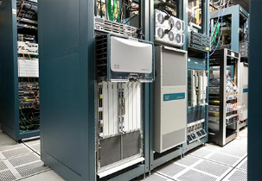
The IoE Connections IT and OT in IoE
IT and OT
IT - The network infrastructure, telecommunications, and software applications that allows the exchange of information between humans.
OT - Industrial control and automation infrastructure that allows communications between machines.
Converging IT and OT
Simplify the Infrastructure (Simple)
Create Intelligence and Agility (Smart)
Deliver End-to-End Security (Secure)
Notes:
4.1 – The IoE Connections
4.1.1 – IT and OT in IoE

Slide 13
The IoE Connections M2M, M2P, and P2P Interactions in an IoE Solution
M2M Connections
sensors, actuators, and controllers
a network communications link
programming that instructs a device how to interpret data, and based on predefined parameters, forward that data.
M2P Connections
People can send information to technical systems and receive information from these systems.
The gathered intelligence from M2M connections allows people to make optimal decisions.
P2P Connections
Collaboration via voice, video, and data
P2P Interactions in IoE Solutions
M2M, M2P, P2P Interacting to Form Solutions
Provides organizations and individuals with actionable insights and seamless automation.
Notes:
4.1 – The IoE Connections
4.1.2 – M2M, M2P, and P2P Interactions in an IoE Solution

Slide 14
Implementing an IoE Solution Preparing for the Transition to the IoE
Understanding Existing Business Processes
Who their suppliers and customers are
What their customers need
What the schedule and process steps are for creating and delivering an offering
Understanding Existing IT and OT Networks
Understand how IT network users interact with the network resources and services
Gather information about all internal and external access to the existing network infrastructure.
Understand how current networks of OT systems operate.
Business Goals and Opportunities
Profitability
Business growth and market share
Customer satisfaction
Notes:
4.2 – Implementing an IoE Solution
4.2.1 – Preparing for the Transition to the IoE

Slide 15
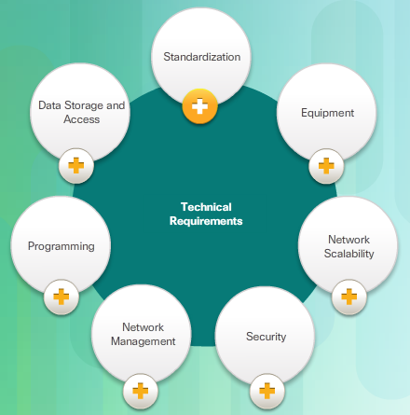
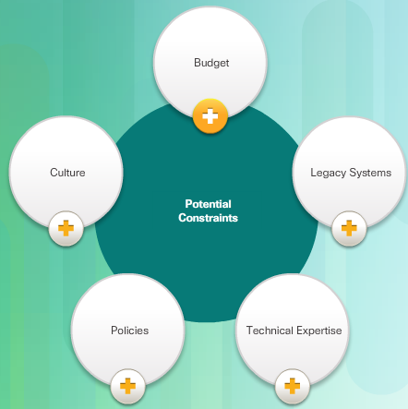
Implementing an IoE Solution Preparing for the Transition to the IoE (Cont.)
Technical Requirements and Potential Constraints
Notes:
4.2 – Implementing an IoE Solution
4.2.1 – Preparing for the Transition to the IoE (Cont.)

Slide 16
Implementing an IoE Solution Planning an IoE Solution
The IoE Architectural Approach
Application Layer
Platform Layer
Infrastructure Layer
Adjusting Technologies
Standard Infrastructure
Responsive Software
Holistic Security
Connecting Processes
Interaction between people, data, and things
Visibility into new processes
Notes:
4.2 – Implementing an IoE Solution
4.2.2 – Planning an IoE Solution

Slide 17
Implementing an IoE Solution IoE Examples Across Industries
The IoE in Retail
Retailers have the opportunity to create new and better connections in their stores, corporate offices, distribution centers, and other environments.
The IoE in Manufacturing
Products and services can include embedded sensors that provide manufacturers with constant data and feedback.
The IoE in the Public Sector
Create new and better connections with the public
The IoE for Service Providers
Deliver rich, new services to the customers
The Cisco IoT System in IoE Solutions
Critical part to the IoE solutions
Notes:
4.2 – Implementing an IoE Solution
4.2.3 – IoE Examples Across Industries

Slide 18
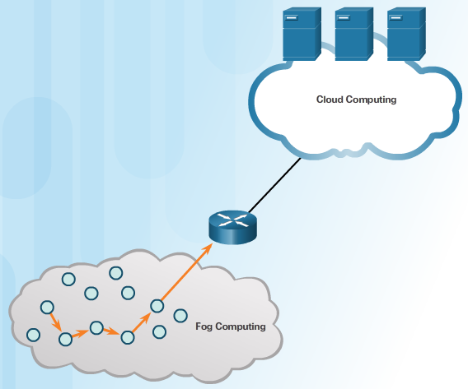
Implementing an IoE Solution Challenges to Implementing IoE Solutions
Proprietary Ecosystems = Proprietary Protocols
convert proprietary networks to IP-based networks
proprietary protocols can communicate through a translator
Accelerated Technological Growth
Growth Relevancy to IoE
Moore’s and Metcalfe’s Laws allows the prediction of:
Computing powers
Availability of new technology
Advances of competitors
Big Data Challenges
Bandwidth capacity
User data privacy
Data Management
Selection and analysis of appropriate data
More connected things = Bandwidth Requirements
Cloud vs Fog Computing
Where should the data be processed? – away (cloud computing) or close to the source (fog computing)
The Learning Society – Training is necessary to take advantage of the opportunities in IoE
Notes:
4.2 – Implementing an IoE Solution
4.2.4 – Challenges to Implementing IoE Solutions

Slide 19
Security and the IoE IoE Security
Need for Additional Security
Increased amount of connected devices and data = increased demand for security of data
Hacking attacks are a daily occurrence
No organization is immune
Security Strategy
Adaptable & Real-Time Security
Secure & Dynamic Connections
Protecting Customer & Brand Trust
Notes:
4.3 – Security and the IoE
4.3.1 – IoE Security

Slide 20
Security and the IoE IoE Security (Cont.)
Pervasive security solution avoids disjointed security implementations.
Consistent, automated, and extend to secured boundaries across organizations
Dynamic, to better recognize security threats through real-time predictive analytics
Intelligent, providing visibility across all connections, and elements of the infrastructure
Scalable, to meet the needs of a growing organization
Agile, able to react in real-time
Comprehensive, end-to-end solution
Notes:
4.3 – Security and the IoE
4.3.1 – IoE Security (Cont.)

Slide 21
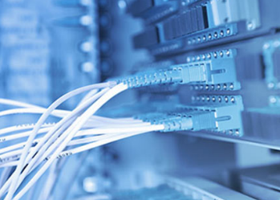
Security and the IoE Security Measures
Security Architecture
Access Control
Context-Aware Policies
Context-Aware Inspection and Enforcement
Network and Global Intelligence
Security Devices
Firewalls
Intrusion Prevention System (IPS)
Application-Centric Security
protect environments by fully integrating customized security technologies for the needs of a specific application
Wireless Security – What security would you implement at the access point?
Redundancy and High Availability
Redundant equipment and network connections
Load sharing
Secured backups of data in an encrypted format
Notes:
4.3 – Security and the IoE
4.3.2 – Security Measures

Slide 22
Security and the IoE People and the IoE
People are the Weakest Link
Malicious intent
Mistakes or follow unsecure practices
Security Policy – rules, regulations, and procedure
Remote Access Policy
Information Privacy Policy
Computer Security Policy
Physical Security Policy
Password Policy
Personal Data and the IoE
Volunteered
Observed
Inferred
Notes:
4.3 – Security and the IoE
4.3.3 – People and the IoE

Slide 23
4.4 Chapter Summary
Notes:
Cisco Networking Academy Program
Introduction to the Internet of Things
Chapter 4: Transitioning to the IoE

Slide 24
Chapter Summary Summary
The IoE requires a convergence of the OT and IT systems that an organization has in place.
M2M refers to any technology that enables networked devices to exchange information and perform actions without the manual assistance of humans. In M2P connections, technical systems interact with individuals and organizations to provide or receive information. P2P connections are collaborative solutions that leverage the existing network infrastructure, devices, and applications, to allow seamless communication and collaboration between people. Each of these types of connections is transactional.
Steps in implementing an IoE solution are to understand current processes and procedures and consider the existing IT network infrastructure, network operations, and network management tools.
Security must be able to react in real-time, so it must be high-performance and scalable. A security policy defines all of the rules, regulations, and procedures that must be followed to keep an organization, people, and systems secure.
The definition of personal data is evolving.
Notes:
4.4.1.1 - Summary

