Slide 1
Instructor Materials Chapter 5: Bringing it all Together
Introduction to the Internet of Things
Notes:
Cisco Networking Academy Program
Introduction to the Internet of Things
Chapter 5: Bringing it all Together

Slide 2
Instructor Materials - Chapter 5 Planning Guide
This PowerPoint deck is divided in two parts:
Instructor Planning Guide
Information to help you become familiar with the chapter
Teaching aids
Instructor Class Presentation
Optional slides that you can use in the classroom
Begins on slide # 9
Note: Remove the Planning Guide from this presentation before sharing with anyone.
Notes:
2

Slide 3
Introduction to the Internet of Things Planning Guide
Chapter 5: Bringing it all Together
Notes:
Introduction to the Internet of Things
Chapter 5: Bringing it all Together

Slide 4
Chapter 5: Activities
What activities are associated with this chapter?
Page # | Activity Type | Activity Name
5.1.1.8 | Interactive Activity | Identify the Analytic Type
5.1.1.9 | Packet Tracer | Diabetic Patient Healthcare IoE Solution
The password used in the Packet Tracer activities in this chapter is: PT_I2IoT
Notes:
4

Slide 5
Chapter 5: Assessment
Students should complete Chapter 5 Quiz after completing Chapter 5.
Labs, Packet Tracers, and other activities can be used to informally assess student progress.
Notes:
5

Slide 6
Chapter 5: Best Practices
Prior to teaching Chapter 5, the instructor should:
Read the chapter and complete all activities, including the chapter quiz.
Notes:
6

Slide 7
Chapter 5: Additional Help
For additional help with teaching strategies, including lesson plans, analogies for difficult concepts, and discussion topics, visit the Facebook page for community and peer support at the following: www.facebook.com/cisconetworkingacademy.
Notes:
7

Slide 9
Chapter 5: Bringing it all Together
Introduction to the Internet of Things
Notes:
Cisco Networking Academy Program
Introduction to the Internet of Things
Chapter 5: Bringing it all Together

Slide 10
Chapter 5 - Sections & Objectives
5.1 Modeling an IoE Solution
Explain a given IoE solution.
5.2 Digitally Transforming Everything
Explain the advantages of digitization.
5.3 Want to Go Further?
Explain IoE educational and employment opportunities.
Notes:
10

Slide 11
5.1 Modeling an IoE Solution
Notes:
Cisco Networking Academy Program
Introduction to the Internet of Things
Chapter 5: Bringing it all Together

Slide 12
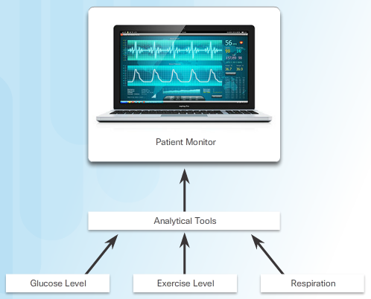
Modeling an IoE Solution IoE Interactions in a Healthcare Model
A Diabetic Patient Healthcare Solution Model
M2M Interactions – The traffic signal changes as mobile treatment center is approaching.
M2P Interactions – The health monitor company collects the data to allow for better treatment
P2P Interactions – Doctor to patient interaction
Analytical Tools
Descriptive - Uses historical data to create reports designed to facilitate understanding
Predictive - Uses data mining and modeling techniques to determine what could happen next
Prescriptive - Uses simulation, business rules, and machine learning to recommend a course of action and predict the possible outcome
Analytics in Healthcare
Monitor patient‘s health by analyzing the stream of data gathered from sensors
Other uses: faster response time in an emergency
Notes:
5.1 – Modeling an IoE Solution
5.1.1 – IoE Interactions in a Healthcare Model

Slide 13
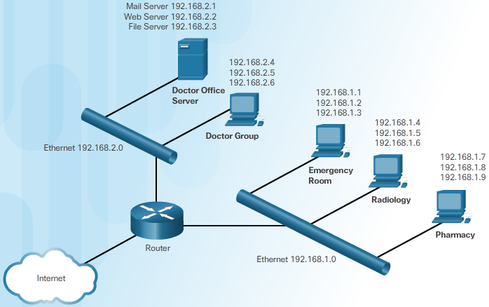
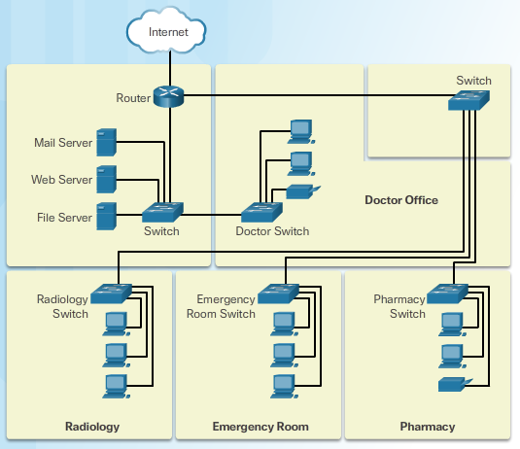
Modeling an IoE Solution Modeling
What are the benefits of good modeling?
Can you name and describe these symbols in a flowchart?
Network Topology – Map that identifies various elements of a computer network
Physical Topology - Displays the layout and location of all of the devices and how they are connected
Logical Topology – Represents how the data flows through the network
Can you the type of network topology represented below?
Notes:
5.1 – Modeling an IoE Solution
5.1.2 – Modeling

Slide 14
Digitally Transforming Everything The Path is Clear
Let’s get Digital
IoE – When people, process, data, and things are all intelligently connected.
Digitization – The process by which an organization becomes digital.
Digital – An ideal end-state whereby an enterprise is fully technology-enabled and optimized
What are some of the benefits of Digital Transformation?
Notes:
5.2 – Digitally Transforming Everything
5.2.1 – The Path is Clear

Slide 15
Want to Go Further? Learning Opportunities
The Cisco Networking Academy Program
Prepares individuals for information and communication technology (ICT) careers
Addresses the growing demand for ICT professionals
IT Industrial Certifications
Vendor neutral
Vendor specific
Name a few other learning opportunities.
Notes:
5.3 – Want to Go Further?
5.3.1 – Learning Opportunities

Slide 16
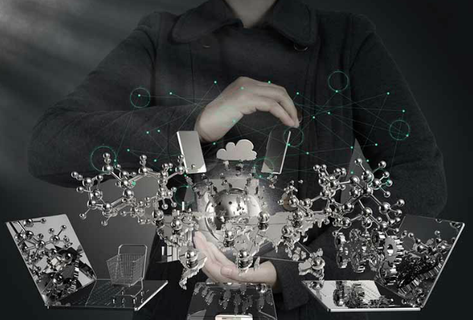
Want to Go Further? IoE Occupations
IT Industry Jobs for the IoE
Process development
Specialization
Computer science, computer engineering
Software engineering
Create Your Own IoE Job
New kind of IT specialist
Skillsets to create new products and process the data
Notes:
5.3 – Want to Go Further?
5.3.1 – IoE Occupations

Slide 17
5.4 Chapter Summary
Notes:
Cisco Networking Academy Program
Introduction to the Internet of Things
Chapter 5: Bringing it all Together

Slide 18
Chapter Summary Summary
The Healthcare model that is used in this chapter details M2M, M2P, and P2P interactions. It models every aspect of patient monitoring from basic vital signs to dispatching healthcare professionals to treat patients.
Descriptive, predictive, and prescriptive analytics help shape how a business functions.
Modeling the potential IoE solution identifies the changes in the organization’s processes. A flowchart uses symbols to represent workflows and decisions.
A network topology is a kind of map. There are two types of network topologies, physical and logical. The physical topology displays the layout and location of all of the devices that comprise the network. The logical topology represents the way data flows through the network.
To prototype ideas for the IoE, it helps to have design skills, electrical skills, physical/mechanical skills, programming skills, and an understanding of how TCP/IP works.
The Cisco Networking Academy helps individuals prepare for industry-recognized certifications and entry-level information and communication technology (ICT) careers in virtually every type of industry. The Internet of Everything is creating demand for a broad spectrum of IT jobs, and creating opportunities for exciting new jobs in emerging fields.
Notes:
5.4.1.1 - Summary

