Slide 1
Instructor Materials Chapter 1: Routing Concepts
CCNA Routing and Switching
Routing and Switching Essentials v6.0
Notes:
Cisco Networking Academy Program
Routing and Switching Essentials v6.0
Chapter 1: Routing Concepts

Slide 2
Instructor Materials – Chapter 1 Planning Guide
This PowerPoint deck is divided in two parts:
Instructor Planning Guide
Information to help you become familiar with the chapter
Teaching aids
Instructor Class Presentation
Optional slides that you can use in the classroom
Begins on slide # 13
Note: Remove the Planning Guide from this presentation before sharing with anyone.
Notes:
2

Slide 3
Routing and Switching Essentials 6.0
Planning Guide
Chapter 1: Routing Concepts
Notes:
Routing and Switching Essentials Planning Guide
Chapter 1: Routing Concepts

Slide 4
Chapter 1: Activities
What activities are associated with this chapter?
Page # | Activity Type | Activity Name | Optional?
1.0.1.2 | Class Activity | Do We Really Need a Map? | Optional
1.1.1.7 | Class Activity | Identify Router Components | -
1.1.1.8 | Packet Tracer | Use Traceroute to Discover the Network | Recommended
1.1.1.9 | Lab | Mapping the Internet | Optional
1.1.2.7 | Syntax Checker | Configure the Management SVI on S2 | -
1.1.2.8 | Class Activity | Document an Addressing Scheme | -
1.1.2.9 | Packet Tracer | Document the Network | Recommended
1.1.3.1 | Syntax Checker | Configure Basic Settings on R2 | -
1.1.3.2 | Syntax Checker | Configure an IPv4 Router Interface | -
1.1.3.5 | Packet Tracer | Configure IPv4 and IPv6 Interfaces | Recommended
The password used in the Packet Tracer activities in this chapter is: PT_ccna5
Notes:
4

Slide 5
Chapter 1: Activities
What activities are associated with this chapter?
Page # | Activity Type | Activity Name | Optional?
1.1.4.1 | Syntax Checker | Verfiy Router Interfaces (Fig.4) | -
1.1.4.1 | Syntax Checker | Verify Router IP Interfaces (Fig.5) | -
1.1.4.3 | Syntax Checker | Filtering Show Commands | -
1.1.4.4 | Syntax Checker | Command History Feature | -
1.1.4.5 | Packet Tracer | Configure and Verify a Small Network | Recommended
1.1.4.6 | Lab | Configure Basic Router Settings with IOS CLI | Optional
1.2.1.6 | Class Activity | Match Layer 2 and Layer 3 Addressing | -
1.2.2.5 | Class Activity | Order the Steps in the Packet Forwarding Process | -
1.2.2.6 | Class Activity | Match the Administrative Distance to the Route Source | -
1.3.1.4 | Class Activity | Interpret the Content of a Routing Table Entry | -
The password used in the Packet Tracer activities in this chapter is: PT_ccna5
Notes:
5

Slide 6
Chapter 1: Activities
What activities are associated with this chapter?
Page # | Activity Type | Activity Name | Optional?
1.3.2.3 | Syntax Checker | Configure the Directly Connected Interfaces on R2 | -
1.3.2.5 | Packet Tracer | PT Investigating Directly Connected Routes | Recommended
1.3.3.2 | Syntax Checker | Configure a Default Static Route on R1 (Fig. 3) | -
1.3.3.2 | Syntax Checker | Configure Static Route on R2 (Fig. 4) | -
1.4.1.1 | Class Activity | We Really Could Use a Map! | Optional
The password used in the Packet Tracer activities in this chapter is: PT_ccna5
Notes:
6

Slide 7
Chapter 1: Assessment
Students should complete Chapter 1, “Assessment” after completing Chapter 1.
Quizzes, labs, Packet Tracers and other activities can be used to informally assess student progress.
Notes:
7

Slide 8
Chapter 1: Best Practices
Prior to teaching Chapter 1, the instructor should:
Complete Chapter 1, “Assessment.”
The objectives of this chapter are:
Describe the primary functions and features of a router.
Connect devices for a small routed network.
Using the CLI, configure a router to route between multiple directly connected networks.
Explain the encapsulation and de-encapsulation process used by routers when switching packets between interfaces.
Explain the path determination function of a router.
Compare ways in which a router builds a routing table when operating in a small- to medium-sized business network.
Explain routing table entries for directly connected networks.
Explain how a router builds a routing table of directly connected networks.
Explain how a router builds a routing table using static routes.
Explain how a router builds a routing table using a dynamic routing protocol.
Notes:
8

Slide 9
Chapter 1: Best Practices (Cont.)
Section 1.1
Review the OSI model and the TCP/IP protocol stack and review the process of encapsulation.
Discuss the key Network Characteristics:
Topology
Reliability
Scalability
Availability
Speed
Cost
Security
Highlight the routers position in the OSI model and the process of encapsulation.
Emphasize that routers are specialized computers.
Emphasize the types of memory used by routers and what is stored in each.
Notes:
9

Slide 10
Chapter 1: Best Practices (Cont.)
Section 1.1 (cont.)
Make sure students are clear on what role a router plays in a network:
To determine best path for packets
To forward packets toward their destination
To interconnect networks
Discuss the three packet-forwarding mechanisms that routers use. Stressing that Cisco Express Forwarding (CEF) is the most recent and preferred method
Ask students what addresses are required in order to connect to a network. And how they are assigned. IP address, subnet mask or prefix, and default gateway.
Review basic configuration of a router and commands to verify configuration.
The show command can be filtered for specific parameters to reduce the amount of output by using the pipe (|) character after the show.
Show ip interface brief | exclude unassigned
Show running config | section line vty
Notes:
10

Slide 11
Chapter 1: Best Practices (Cont.)
Section 1.2
Review encapsulation and de-encapsulation of packets. Encourage students to test their understanding using activity 1.2.1.6
Discuss Metrics and how the best path is selected by a routing protocol based on the value or metric it uses to determine the distance to reach a network.
Have students evaluate different paths to a local destination eg via highway - further but faster or local roads –shorter but slower. Compare to routing metrics.
Students need to be very familiar with the default Administrative Distances.
Describe the differences between, and advantages and disadvantages of, Static and Dynamic Routing.
Section 1.3
Stress the importance of understanding the routing table for verification that the route entries are present and correct. Routing tables contain important information used for troubleshooting.
Notes:
11

Slide 12
Chapter 1: Best Practices (Cont.)
Section 1.3 (cont.)
Provide the student with extra practice exercises interpreting entries in the routing table.
Demonstrate and encourage the use of the Syntax Checker utility to practice CLI commands.
Recommendation – Students should keep notes of commands especially “show commands” and the results.
CLI resources – basic router CLI commands
http://www.youtube.com/watch?v=-zvihHxrfzM
http://www.cisco.com/en/US/docs/routers/access/1900/software/configuration/guide/routconf.html
Notes:
12

Slide 13
Chapter 1: Additional Help
For additional help with teaching strategies, including lesson plans, analogies for difficult concepts, and discussion topics, visit the CCNA Community at: https://www.netacad.com/group/communities/community-home
Best practices from around the world for teaching CCNA Routing and Switching. https://www.netacad.com/group/communities/ccna-blog
If you have lesson plans or resources that you would like to share, upload them to the CCNA Community in order to help other instructors.
Students can enroll in Packet Tracer Know How 1: Packet Tracer 101 (self-enroll)
Notes:
13

Slide 15
Chapter 1: Routing Concepts
Routing and Switching Essentials v6.0

Slide 16
Chapter 1 - Sections & Objectives
1.1 Router Initial Configuration
Describe the primary functions and features of a router.
Configure basic settings on a router to route between two directly-connected networks, using CLI.
Verify connectivity between two networks that are directly connected to a router.
1.2 Routing Decisions
Explain the encapsulation and de-encapsulation process used by routers when switching packets between interfaces.
Explain the path determination function of a router.
1.3 Router Operation
Explain routing table entries for directly connected networks.
Explain how a router builds a routing table of directly connected networks.
Explain how a router builds a routing table using static routes.
Explain how a router builds a routing table using a dynamic routing protocol.
Notes:
16

Slide 17
1.1 Router Initial Configuration
Notes:
Cisco Networking Academy Program
Routing and Switching Essentials v6.0
Chapter 1: Dynamic Routing

Slide 18
Router Functions Characteristics of a Network
Notes:
1.1 - Router Initial Configuration
1.1.1 - Router Functions
1.1.1.1 - Characteristics of a Network

Slide 19
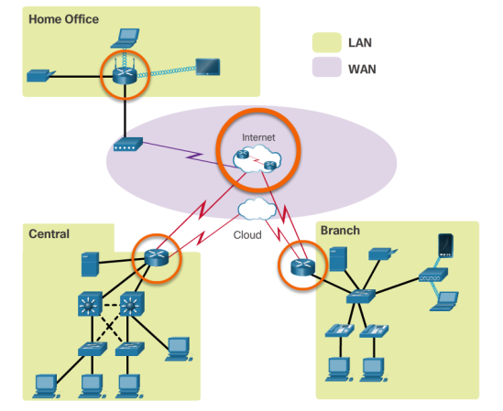
Router Functions Why Routing?
The router is responsible for the routing of traffic between networks.
Notes:
1.1 - Router Initial Configuration
1.1.1 - Router Functions
1.1.1.2 - Why Routing?

Slide 20
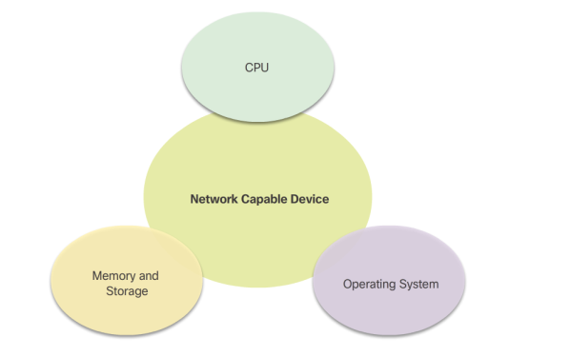
Router Functions Routers are Computers
Routers are specialized computers containing the following required components to operate:
Central processing unit (CPU)
Operating system (OS) - Routers use Cisco IOS
Memory and storage (RAM, ROM, NVRAM, Flash, hard drive)
Notes:
1.1 - Router Initial Configuration
1.1.1 - Router Functions
1.1.1.3 - Routers are Computers

Slide 21
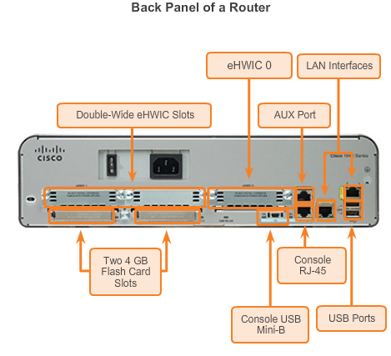
Router Functions Routers are Computers (cont.)
Routers use specialized ports and network interface cards to interconnect to other networks.
Notes:
1.1 - Router Initial Configuration
1.1.1 - Router Functions
1.1.1.3 - Routers are Computers (cont.)

Slide 22
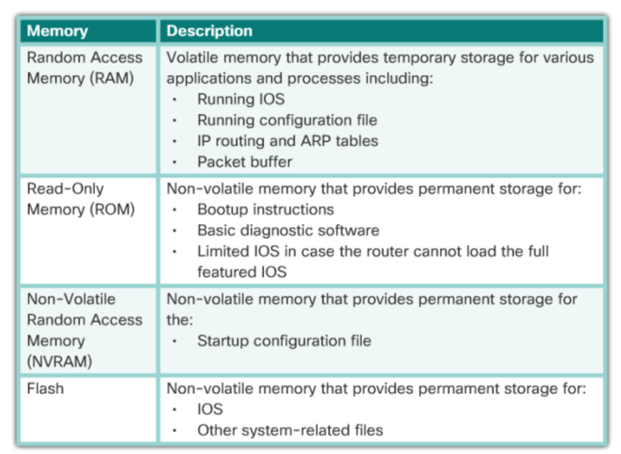
Router Functions Routers are Computers
Router Memory
Notes:
1.1 - Router Initial Configuration
1.1.1 - Router Functions
1.1.1.3 - Routers are Computers

Slide 23
Router Functions Routers Interconnect Networks
Notes:
1.1 - Router Initial Configuration
1.1.1 - Router Functions
1.1.1.4 Routers Interconnect Networks

Slide 24
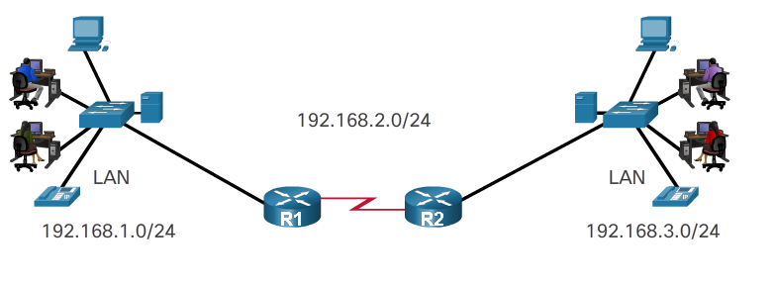
Router Functions Routers Choose Best Paths
Routers use static routes and dynamic routing protocols to learn about remote networks and build their routing tables.
Routers use routing tables to determine the best path to send packets.
Routers encapsulate the packet and forward it to the interface indicated in routing table.
Notes:
1.1 - Router Initial Configuration
1.1.1 - Router Functions
1.1.1.5 Routers Choose Best Paths

Slide 25
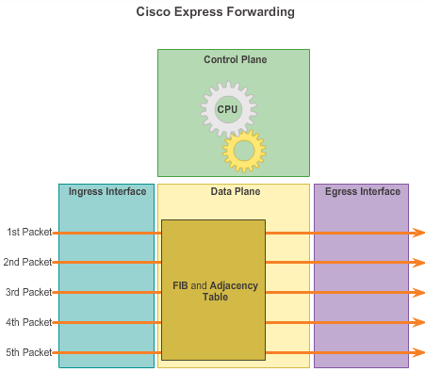
Router Functions Packet Forwarding Methods
Process switching – An older packet forwarding mechanism still available for Cisco routers.
Fast switching – A common packet forwarding mechanism which uses a fast-switching cache to store next hop information.
Cisco Express Forwarding (CEF) – The most recent, fastest, and preferred Cisco IOS packet-forwarding mechanism.
Notes:
1.1 - Router Initial Configuration
1.1.1 - Router Functions
1.1.1.6 – Packet Forwarding Methods

Slide 26
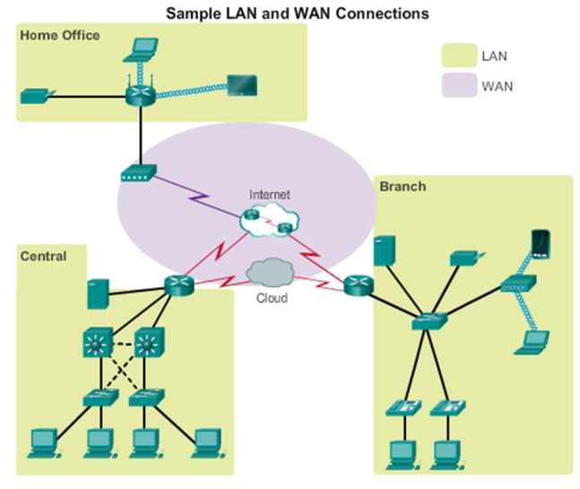
Connect Devices Connect to a Network
Notes:
1.1 - Router Initial Configuration
1.1.2 – Connect Devices
1.1.2.1 - Connect to a Network

Slide 27
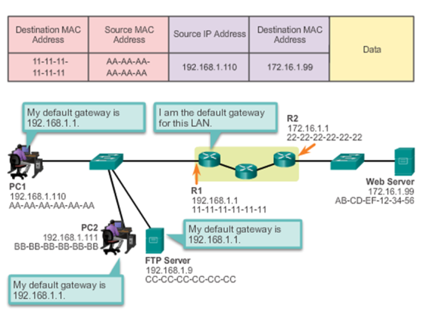
Connect Devices Default Gateways
To enable network access devices, must be configured with the following IP address information:
IP address - Identifies a unique host on a local network.
Subnet mask - Identifies the host’s network subnet.
Default gateway - Identifies the router a packet is sent to when the destination is not on the same local network subnet.
Notes:
1.1 - Router Initial Configuration
1.1.2 – Connect Devices
1.1.2.2 - Default Gateways

Slide 28
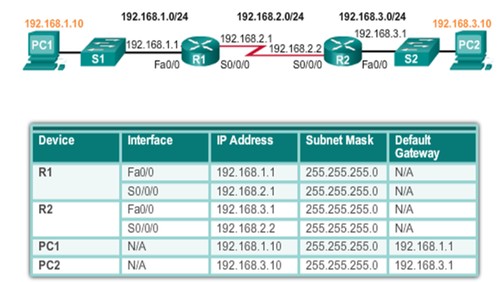
Connect Devices Document Network Addressing
Network documentation should include at least the following in a topology diagram and addressing table:
Device names
Interfaces
IP addresses and
subnet masks
Default gateways
Notes:
1.1 - Router Initial Configuration
1.1.2 – Connect Devices
1.1.2.3 - Document Network Addressing

Slide 29
Connect Devices Enable IP on a Host
Statically Assigned IP address – The host is manually assigned an IP address, subnet mask and default gateway. A DNS server IP address can also be assigned.
Used to identify specific network resources such as network servers and printers.
Can be used in very small networks with few hosts.
Dynamically Assigned IP Address – IP Address information is dynamically assigned by a server using Dynamic Host Configuration Protocol (DHCP).
Most hosts acquire their IP address information through DHCP.
DHCP services can be provided by Cisco routers.
Notes:
1.1 - Router Initial Configuration
1.1.2 – Connect Devices
1.1.2.4 - Enable IP on a Host

Slide 30
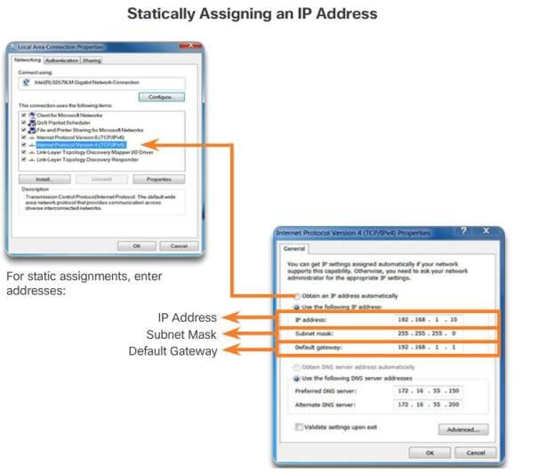
Connect Devices Enable IP on a Host
Notes:
1.1 - Router Initial Configuration
1.1.2 – Connect Devices
1.1.2.4 - Enable IP on a Host

Slide 31
Connect Devices Enable IP on a Host
Notes:
1.1 - Router Initial Configuration
1.1.2 – Connect Devices
1.1.2.4 - Enable IP on a Host

Slide 32
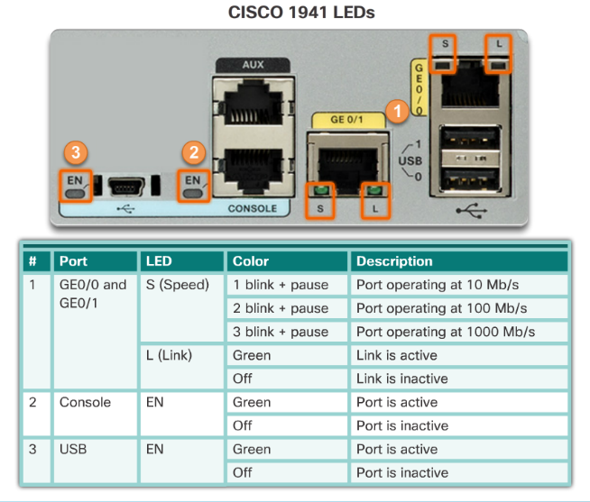
Connect devices Device LEDs
Notes:
1.1 - Router Initial Configuration
1.1.2 – Connect Devices
1.1.2.5 - Device LEDs

Slide 33
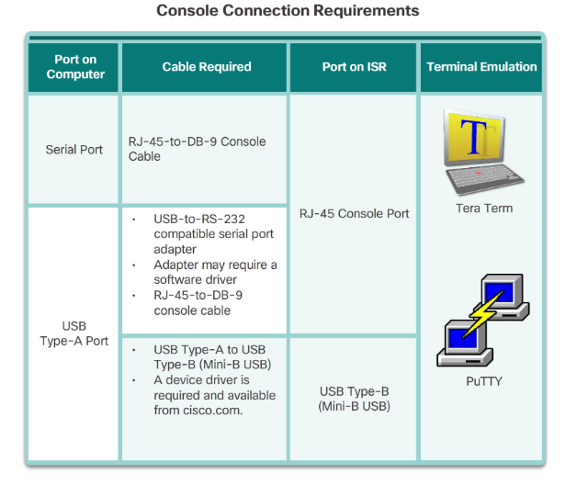
Connect Devices Console Access
Console Access
Notes:
1.1 - Router Initial Configuration
1.1.2 – Connect Devices
1.1.2.6 - Console Access

Slide 34
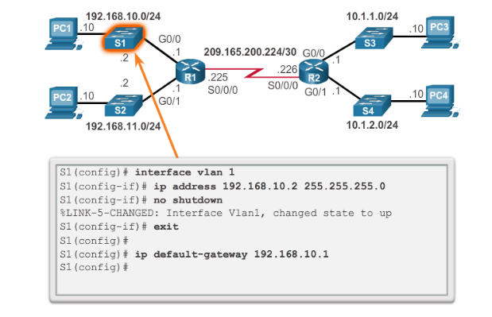
Connect Devices Enable IP on a Switch
Network infrastructure devices require IP addresses to enable remote management.
On a switch, the management IP address is assigned on a virtual interface called a switched virtual interface (SVI)
Notes:
1.1 - Router Initial Configuration
1.1.2 – Connect Devices
1.1.2.7 - Enable IP on a Switch

Slide 35
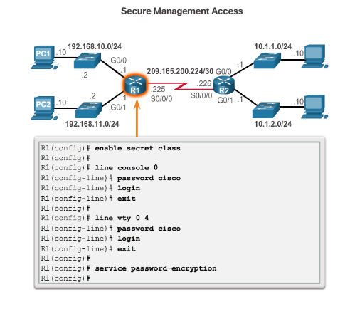
Router Basic Settings Configure Router Basic Settings
Name the device – Distinguishes it from other routers
Secure management access – Secures privileged EXEC, user EXEC, and Telnet access, and encrypts passwords .
Configure a banner – Provides legal notification of unauthorized access.
Save the Configuration
Notes:
1.1 - Router Initial Configuration
1.1.3 – Router Operation
1.1.3.1 - Configure Router Basic Settings

Slide 36
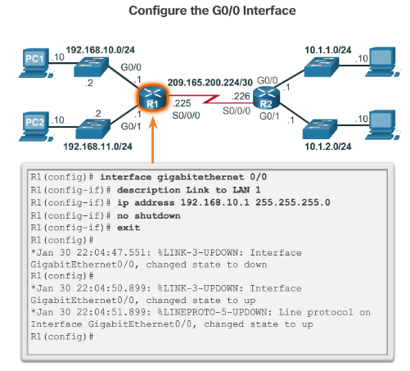
Router Basic Settings Configure an IPv4 Router Interface
To be available, a router interface must be:
Configured with an address and subnet mask.
Activated using no shutdown command. By default LAN and WAN interfaces are not activated.
Configured with the clock rate command on the Serial cable end labeled DCE.
Optional description can be included.
Notes:
1.1 - Router Initial Configuration
1.1.3 – Router Operation
1.1.3.2 - Configure an IPv4 Router Interface

Slide 37
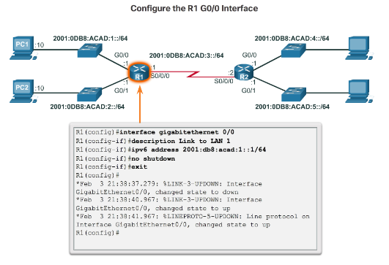
Router Basic Settings Configure an IPv6 Router Interface
Configure interface with IPv6 address and subnet mask:
Use the ipv6 address ipv6-address/ipv6-length [link-local | eui-64]interface configuration command.
Activate using the no shutdown command.
Notes:
1.1 - Router Initial Configuration
1.1.3 – Router Operation
1.1.3.3 - Configure an IPv6 Router Interface

Slide 38
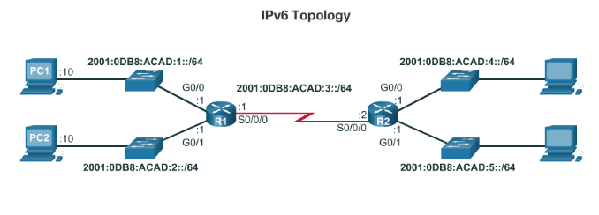
Router Basic Settings Configure an IPv6 Router Interface (cont.)
IPv6 interfaces can support more than one address:
Configure a specified global unicast – ipv6address ipv6-address /ipv6-length
Configure a global IPv6 address with an interface identifier (ID) in the low-order 64 bits - ipv6address ipv6-address /ipv6-length eui-64
Configure a link-local address - ipv6address ipv6-address /ipv6-length link-local
Notes:
1.1 - Router Initial Configuration
1.1.3 – Router Operation
1.1.3.3 - Configure an IPv6 Router Interface (cont.)

Slide 39
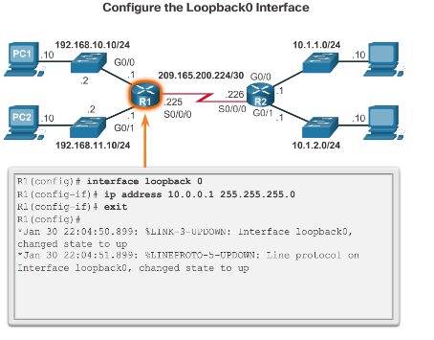
Router Basic Settings Configure an IPv4 Loopback Interface
A loopback interface is a logical interface that is internal to the router:
It is not assigned to a physical port, it is considered a software interface that is automatically in an UP state.
A loopback interface is useful for testing.
It is important in the OSPF routing process.
Notes:
1.1 - Router Initial Configuration
1.1.3 – Router Operation
1.1.3.4 - Configure an IPv4 Loopback Interface

Slide 40
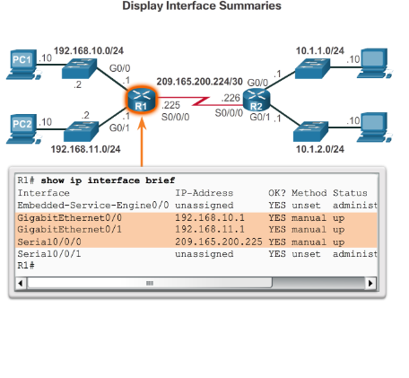
Verify Connectivity of Directly Connected Networks Verify Interface Settings
Show commands are used to verify operation and configuration of interface:
show ip interfaces brief
show ip route
show running-config
Show commands that are used to gather more detailed interface information:
show interfaces
show ip interfaces
Notes:
1.1 - Router Initial Configuration
1.1.4 – Verify Connectivity of Directly Connected Networks
1.1.4.1 - Verify Interface Settings

Slide 41
Verify Connectivity of Directly Connected Networks Verify Interface Settings (cont.)
Notes:
1.1 - Router Initial Configuration
1.1.4 – Verify Connectivity of Directly Connected Networks
1.1.4.1 - Verify Interface Settings (cont.)

Slide 42
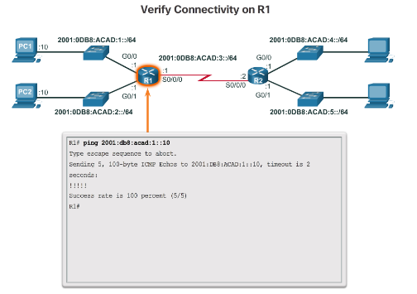
Verify Connectivity of Directly Connected Networks Verify IPv6 Interface Settings
Common commands to verify the IPv6 interface configuration:
show ipv6 interface brief - displays a summary for each of the interfaces.
show ipv6 interface gigabitethernet 0/0 - displays the interface status and all the IPv6 addresses for this interface.
show ipv6 route - verifies that IPv6 networks and specific IPv6 interface addresses have been installed in the IPv6 routing table.
Notes:
1.1 - Router Initial Configuration
1.1.4 – Verify Connectivity of Directly Connected Networks
1.1.4.2 - Verify IPv6 Interface Settings

Slide 43
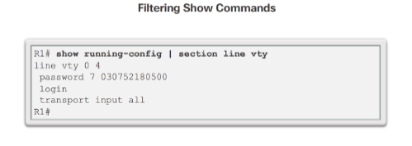
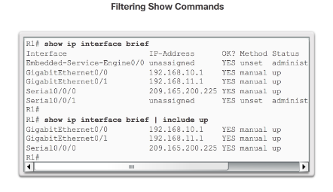
Verify Connectivity of Directly Connected Networks Filter Show Command Output
Show command output can be managed using the following command and filters:
Use the terminal length number command to specify the number of lines to be displayed.
To filter specific output of commands use the (|)pipe character after show command. Parameters that can be used after pipe include:
section, include, exclude, begin
Notes:
1.1 - Router Initial Configuration
1.1.4 – Verify Connectivity of Directly Connected Networks
1.1.4.3 - Filter Show Command Output

Slide 44
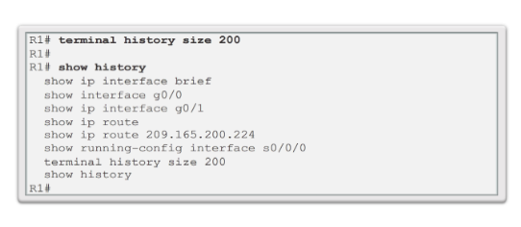
Verify Connectivity of Directly Connected Networks Command History Feature
The command history feature temporarily stores a list of executed commands for access:
To recall commands press Ctrl+P or the UP Arrow.
To return to more recent commands press Ctrl+N or the Down Arrow.
By default, command history is enabled and the system captures the last 10 commands in the buffer. Use the show history privileged EXEC command to display the buffer contents.
Use the terminal history size user EXEC command to increase or decrease size of the buffer.
Notes:
1.1 - Router Initial Configuration
1.1.4 – Verify Connectivity of Directly Connected Networks
1.1.4.4 - Command History Feature

Slide 45
1.2 Routing Decisions
Notes:
1.2 - Routing Decisions

Slide 46
Switching Packets Between Networks Router Switching Function
Notes:
1.2 - Routing Decisions
1.2.1 – Switching Packets Between Networks
1.2.1.1 - Router Switching Function

Slide 47
Switching Packets Between Networks Send a Packet
Notes:
1.2 - Routing Decisions
1.2.1 – Switching Packets Between Networks
1.2.1.2 - Send a Packet

Slide 48
Switching Packets Between Networks Forward to Next Hop
Notes:
1.2 - Routing Decisions
1.2.1 – Switching Packets Between Networks
1.2.1.3 - Forward to Next Hop

Slide 49
Switching Packets Between Networks Packet Routing
Notes:
1.2 - Routing Decisions
1.2.1 – Switching Packets Between Networks
1.2.1.4 - Packet Routing

Slide 50
Switching Packets Between Networks Reach the Destination
Notes:
1.2 - Routing Decisions
1.2.1 – Switching Packets Between Networks
1.2.1.5 - Reach the Destination

Slide 51
Path Determination Routing Decisions
Notes:
1.2 - Routing Decisions
1.2.2 – Path Determination
1.2.2.1 - Routing Decisions

Slide 52
Path Determination Best Path
Best path is selected by a routing protocol based on the value or metric it uses to determine the distance to reach a network:
A metric is the value used to measure the distance to a given network.
Best path to a network is the path with the lowest metric.
Dynamic routing protocols use their own rules and metrics to build and update routing tables:
Routing Information Protocol (RIP) - Hop count
Open Shortest Path First (OSPF) - Cost based on cumulative bandwidth from source to destination
Enhanced Interior Gateway Routing Protocol (EIGRP) - Bandwidth, delay, load, reliability
Notes:
1.2 - Routing Decisions
1.2.2 – Path Determination
1.2.2.2 - Best Path

Slide 53
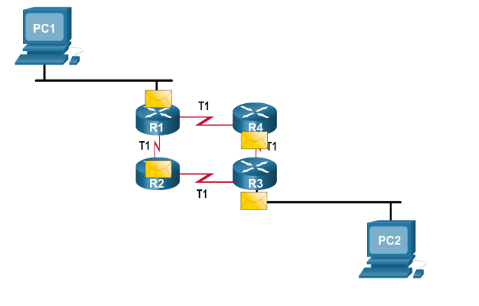
Path Determination Load Balancing
When a router has two or more paths to a destination with equal cost metrics, then the router forwards the packets using both paths equally:
Equal cost load balancing can improve network performance.
Equal cost load balancing can be configured to use both dynamic routing protocols and static routes.
Notes:
1.2 - Routing Decisions
1.2.2 – Path Determination
1.2.2.3 - Load Balancing

Slide 54
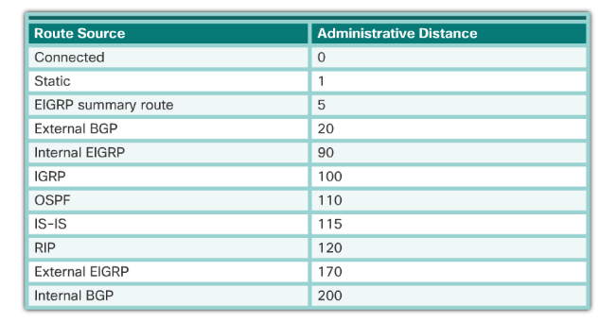
Path Determination Administrative Distance
If multiple paths to a destination are configured on a router, the path installed in the routing table is the one with the lowest Administrative Distance (AD):
A static route with an AD of 1 is more reliable than an EIGRP-discovered route with an AD of 90.
A directly connected route with an AD of 0 is more reliable than a static route with an AD of 1.
Notes:
1.2 - Routing Decisions
1.2.2 – Path Determination
1.2.2.4 - Administrative Distance

Slide 55
1.3 Router Operation

Slide 56
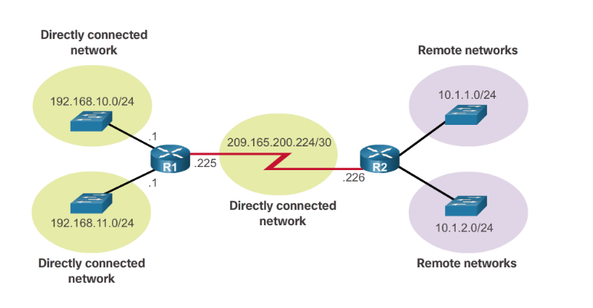
Analyze the Routing Table The Routing Table
A routing table is a file stored in RAM that contains information about:
Directly connected routes
Remote routes
Notes:
1.3 – Router Operation
1.3.1 – Analyze the Routing Table
1.3.1.1 - The Routing Table

Slide 57
Analyze the Routing Table Routing Table Sources
The show ip route command is used to display the contents of the routing table:
Local route interfaces - Added to the routing table when an interface is configured. (displayed in IOS 15 or newer for IPv4 routes and all IOS releases for IPv6 routes.)
Directly connected interfaces - Added to the routing table when an interface is configured and active.
Static routes - Added when a route is manually configured and the exit interface is active.
Dynamic routing protocol - Added when EIGRP or OSPF are implemented and networks are identified.
Notes:
1.3 – Router Operation
1.3.1 – Analyze the Routing Table
1.3.1.2 - Routing Table Sources

Slide 58
Analyze the Routing Table Routing Table Sources (cont.)
Notes:
1.3 – Router Operation
1.3.1 – Analyze the Routing Table
1.3.1.2 - Routing Table Sources (cont.)

Slide 59
Analyze the Routing Table Remote Network Routing Entries
Interpreting the entries in the routing table
Notes:
1.3 – Router Operation
1.3.1 – Analyze the Routing Table
1.3.1.3 - Remote Network Routing Entries

Slide 60
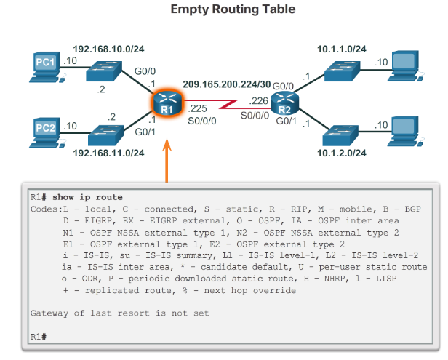
Directly Connected Routes Directly Connected Interfaces
A newly deployed router, without any configured interfaces, has an empty routing table.
Notes:
1.3 – Router Operation
1.3.2 – Directly Connected Routes
1.3.2.1 - Directly Connected Interfaces

Slide 61
Directly Connected Routes Directly Connected Routing Table Entries
Notes:
1.3 – Router Operation
1.3.2 – Directly Connected Routes
1.3.2.2 - Directly Connected Routing Table Entries

Slide 62
Directly Connected Routes Directly Connected Example
Notes:
1.3 – Router Operation
1.3.2 – Directly Connected Routes
1.3.2.3 - Directly Connected Example

Slide 63
Directly Connected Routes Directly Connected IPv6 Example
Notes:
1.3 – Router Operation
1.3.2 – Directly Connected Routes
1.3.2.4 - Directly Connected IPv6 Example

Slide 64
Statically Learned Routes Static Routes
Static routes and default static routes can be implemented after directly connected interfaces are added to the routing table:
Static routes are manually configured.
They define an explicit path between two networking devices.
Static routes must be manually updated if the topology changes.
Their benefits include improved security and control of resources.
Configure a static route to a specific network using the ip route network mask {next-hop-ip | exit-intf} command.
A default static route is used when the routing table does not contain a path for a destination network.
Configure a default static route using the ip route 0.0.0.0 0.0.0.0 {exit-intf | next-hop-ip} command.
Notes:
1.3 – Router Operation
1.3.3 - Statically Learned Routes
1.3.3.1 - Static Routes

Slide 65
Statically Learned Routes Static Route Example
Notes:
1.3 – Router Operation
1.3.3 - Statically Learned Routes
1.3.3.2 - Static Route Example

Slide 66
Statically Learned Routes Static Route Example (cont.)
Entering and Verifying a Static Route
Notes:
1.3 – Router Operation
1.3.3 - Statically Learned Routes
1.3.3.2 - Static Route Example (cont.)

Slide 67
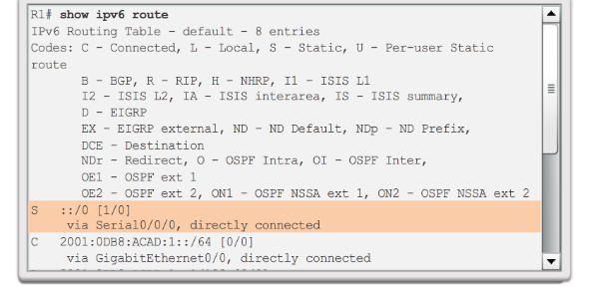
Statically Learned Routes Static IPv6 Route Examples
Notes:
1.3 – Router Operation
1.3.3 - Statically Learned Routes
1.3.3.3 - Static IPv6 Route Examples

Slide 68
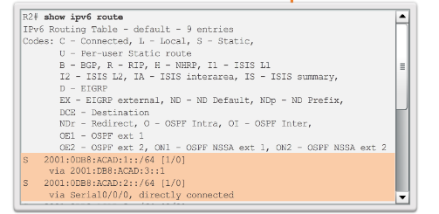
Statically Learned Routes Static IPv6 Route Examples
Notes:
1.3 – Router Operation
1.3.3 - Statically Learned Routes
1.3.3.3 - Static IPv6 Route Examples (cont.)

Slide 69
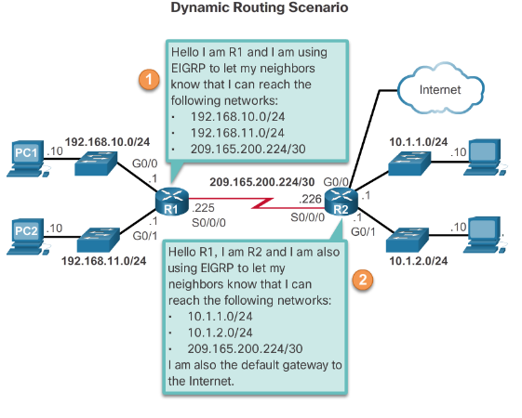
Dynamic Routing Protocols Dynamic Routing
Dynamic routing is used by routers to share information about the reachability and status of remote networks.
It performs network discovery and maintains routing tables.
Routers have converged after they have finished exchanging and updating their routing tables.
Notes:
1.3 – Router Operation
1.3.4 – Dynamic Routing Protocols
1.3.4.1 - Dynamic Routing

Slide 70
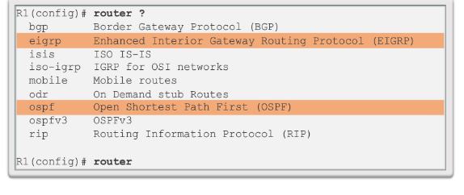
Dynamic Routing Protocols IPv4 Routing Protocols
Cisco routers can support a variety of dynamic IPv4 routing protocols including:
EIGRP – Enhanced Interior Gateway Routing Protocol
OSPF – Open Shortest Path First
IS-IS – Intermediate System-to-Intermediate System
RIP – Routing Information Protocol
Use the router ? Command in global configuration mode to determine which routing protocols are supported by the IOS.
Notes:
1.3 – Router Operation
1.3.4 – Dynamic Routing Protocols
1.3.4.2 - IPv4 Routing Protocols

Slide 71
Dynamic Routing Protocols IPv4 Dynamic Routing Examples
Notes:
1.3 – Router Operation
1.3.4 – Dynamic Routing Protocols
1.3.4.3 - IPv4 Dynamic Routing Examples

Slide 72
Dynamic Routing Protocols IPv6 Routing Protocols
IPv6 Routing Protocols
Cisco routers can support a variety of dynamic IPv6 routing protocols including:
RIPng (RIP next generation)
OSPFv3
EIGRP for IPv6
Use the ipv6 router ? command to determine which routing protocols are supported by the IOS
Notes:
1.3 – Router Operation
1.3.4 – Dynamic Routing Protocols
1.3.4.4 - IPv6 Routing Protocols

Slide 73
Dynamic Routing Protocols IPv6 Dynamic Routing Examples
Notes:
1.3 – Router Operation
1.3.4 – Dynamic Routing Protocols
1.3.4.5 - IPv6 Dynamic Routing Examples

Slide 74
1.4 Chapter Summary

Slide 75
Chapter Summary Summary
Describe the primary functions and features of a router.
Configure basic settings on a router to route between two directly-connected networks, using CLI.
Verify connectivity between two networks that are directly connected to a router.
Explain how routers use information in data packets to make forwarding decisions in a small to medium-sized business network.
Explain the encapsulation and de-encapsulation process used by routers when switching packets between interfaces.
Explain the path determination function of a router.
Explain how a router learns about remote networks when operating in a small to medium-sized business network.
Explain how a router builds a routing table of directly connected networks.
Explain how a router builds a routing table using static routes.
Explain how a router builds a routing table using a dynamic routing protocol.
Notes:
1.4 - Summary

Slide 76
Section 1.1 New Terms and Commands
Topology
Speed
Cost
Security
Availability
Scalability
Reliability
Point-to-Point Protocol (PPP)
Process Switching
Fast switching
Cisco Express Forwarding (CEF)
Wireless access points (WAPs)
Edge router
Gateway of Last Resort
Topology diagram
Secure Shell (SSH)
Hypertext Transfer Protocol Secure (HTTPS)
Console cable
Terminal emulation software - Tera Term, PuTTY, HyperTerminal
Secure management access
Ipv6 address ipv6-address/ipv6-length [link-local | eui-64] interface configuration command.
no shutdown command
loopback interface
interface loopback number command
show ip route command
show running-config interfaceinterface-id
show ip interface brief command
show running-config interface command
show ip interfaces command
Show ipv6 interface command
Notes:
New Terms and Commands

Slide 77
Section 1.1 (cont.) New Terms and Commands
show interfaces command
show ipv6 interface brief command
show ipv6 route command
pipe (|) character
Ctrl+P
Ctrl+N
show history
terminal history
Notes:
New Terms and Commands

Slide 78
Section 1.2 New Terms and Commands
Metrics
Routing Information Protocol (RIP)
Open Shortest Path First (OSPF)
Enhanced Interior Gateway Routing Protocol (EIGRP)
load balancing
IS-IS - Intermediate System-to-Intermediate System
RIPng (RIP next generation)
OSPFv3
Notes:
New Terms and Commands

Slide 79
Section 1.3 New Terms and Commands
Administrative Distance (AD)
Local Route interfaces
Static routes
Route timestamp
Route source
ip route network mask { next-hop-ip | exit-intf }
ip route 0.0.0.0 0.0.0.0 { exit-intf | next-hop-ip }
ipv6 unicast-routing
ipv6 route ::/0 {ipv6-address | interface-type interface-number}
ipv6 route ipv6-prefix/prefix-length {ipv6-address|interface-type interface-number}
Router ? command
Ipv6 router ? command
Notes:
New Terms and Commands

