Slide 1
Instructor Materials Chapter 1 What is the Internet of Things?
Introduction to the Internet of Things
Notes:
Cisco Networking Academy Program
Introduction to the Internet of Things
Chapter 1: What is the Internet of Things?

Slide 2
Instructor Materials - Chapter 1 Planning Guide
This PowerPoint deck is divided in two parts:
Instructor Planning Guide
Information to help you become familiar with the chapter
Teaching aids
Instructor Class Presentation
Optional slides that you can use in the classroom
Begins on slide # 9
Note: Remove the Planning Guide from this presentation before sharing with anyone.
Notes:
2

Slide 3
Introduction to the Internet of Things Planning Guide
Chapter 1: What is the Internet of Things
Notes:
Introduction to the Internet of Things
Chapter 1: What is the Internet of Things

Slide 4
Chapter 1: Activities
What activities are associated with this chapter?
Page # | Activity Type | Activity Name
1.2.2.5 | Interactive Activity | Match the Core Priorities to their Descriptions
1.3.2.5 | Interactive Activity | Classify the Network Components
1.3.2.6 | Packet Tracer | Packet Tracer Introduction
1.3.3.4 | Lab | Mapping the Internet
1.3.3.5 | Packet Tracer | Packet Switching Simulation
1.3.4.5 | Interactive Activity | Match the Layers of the TCP/IP Model
The password used in the Packet Tracer activities in this chapter is: PT_I2IoT
Notes:
4

Slide 5
Chapter 1: Assessment
Students should complete Chapter 1 Quiz after completing Chapter 1.
Labs, Packet Tracers, and other activities can be used to informally assess student progress.
Notes:
5

Slide 6
Chapter 1: Best Practices
Prior to teaching Chapter 1, the instructor should:
Read the chapter and complete all activities, including the chapter quiz.
Notes:
6

Slide 7
Chapter 1: Additional Help
For additional help with teaching strategies, including lesson plans, analogies for difficult concepts, and discussion topics, visit the Facebook page for community and peer support at the following: www.facebook.com/cisconetworkingacademy.
Notes:
7

Slide 9
Chapter 1: What is the Internet of Things?
Introduction to the Internet of Things
Notes:
Cisco Networking Academy Program
Introduction to the Internet of Things
Chapter 1: What is the Internet of Things?

Slide 10
Chapter 1 - Sections & Objectives
1.1 Internet of Things
Explain the positive effects of the Internet of Everything on our everyday lives
1.2 The Value of the IoE
Identify the elements of the IoE
1.3 Globally Connected
Explain how multiple networks are used in everyday life.
Notes:
10

Slide 11
1.1 Internet of Things
Notes:
Cisco Networking Academy Program
Introduction to the Internet of Things
Chapter 1: What is the Internet of Things?

Slide 12
Internet of Things The Internet
The Internet
A network of networks
Using a physical cable or wireless media for connection
Transitioning to the IoT
Notes:
1.1 – Internet of Things
1.1.1 – The Internet

Slide 13
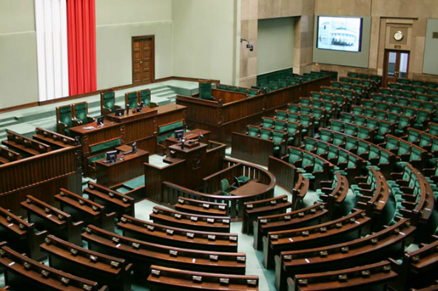
The Value of the IoE The Changing Environment
Adapt or Lose Competitive Edge
Streamline through the use collaboration and automation
Provide more relevant offerings
React to feedback by customers or employees
Governments and Technology
Government must change with technology
Government must respond to emergencies
Citizens can connect through social media
Citizens can gather support for change
Barcelona, Spain – This project uses technical innovations to foster economic growth and the welfare of its citizens.
Notes:
1.2 – The Value of the IoE
1.2.1 – The Changing Environment

Slide 14
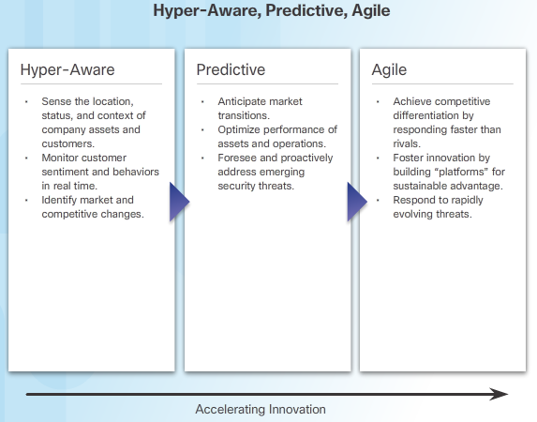
The Value of the IoE Transforming Businesses with IoE
Notes:
1.2 – The Value of the IoE
1.2.2 – Transforming Businesses with IoE

Slide 15
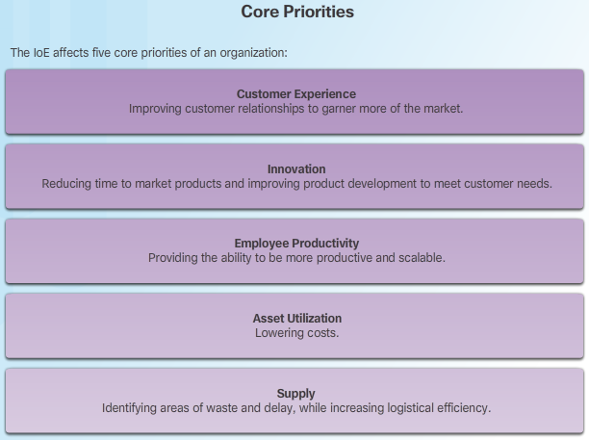
The Value of the IoE Transforming Businesses with IoE (Cont.)
Notes:
1.2 – The Value of the IoE
1.2.2 – Transforming Businesses with IoE (Cont.)

Slide 16
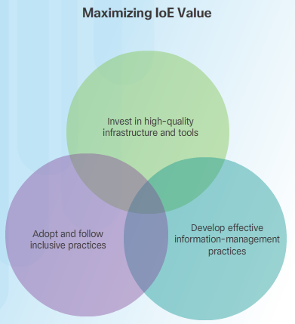
The Value of the IoE Transforming Businesses with IoE (Cont.)
Notes:
1.2 – The Value of the IoE
1.2.2 – Transforming Businesses with IoE (Cont.)

Slide 17
Globally Connected Networking Today
Networks of Many Sizes
Simple networks
Home networks or small office / home office (SOHO)
Few devices and shared resources
Business and large organization networks
Provide products and services to their customers
Provide consolidation, storage, and access to information on network servers
Allow for email, instant messaging, and collaboration among employees
Enable connectivity to new places, giving machines more value in industrial environments.
Internet
Network of a collection of interconnected private and public networks
Notes:
1.3 – Globally Connected
1.3.1 – Networking Today

Slide 18
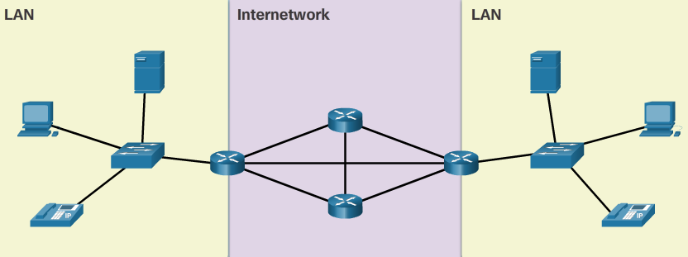
Globally Connected Components of a Network
End Devices
Form the interface between users and the communication network
Source or destination of data transmission over the network
Servers vs. clients
Intermediate Network Devices
Interconnect end devices
Connect end devices to the network
Connect multiple networks to from an internetwork
Network Media
Cable or through the air
Can you identify each component?
Notes:
1.3 – Globally Connected
1.3.2 – Components of a Network

Slide 19
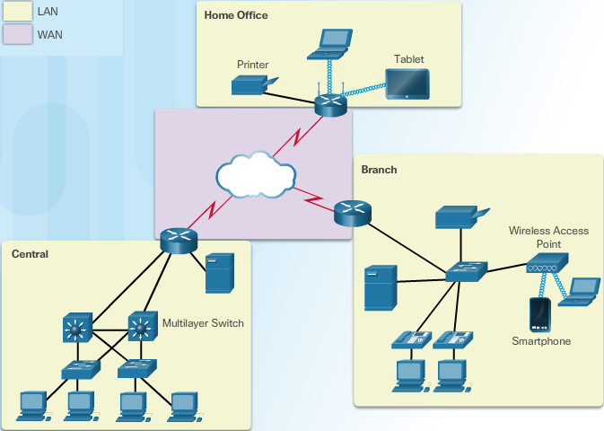
Globally Connected LANs, WANs, and the Internet
LAN (Local Area Network)
Provides access in a limited area
Provides high speed bandwidth
WAN (Wide Area Network)
Interconnects LANs over wide geographical areas
Owned by an autonomous organization
Internet
Not owned by any individual or group
a worldwide collection of interconnected networks
exchange information using common standards.
Use telephone wires, fiber optic cables, wireless transmissions, and satellite links to exchange information
Notes:
1.3 – Globally Connected
1.3.3 – LANs, WANs, and the Internet

Slide 20
Globally Connected LANs, WANs, and the Internet
LAN (Local Area Network)
Provides access in a limited area
Provides high speed bandwidth
WAN (Wide Area Network)
Interconnects LANs over wide geographical areas
Owned by an autonomous organization
Internet
Not owned by any individual or group
a worldwide collection of interconnected networks
exchange information using common standards.
Use telephone wires, fiber optic cables, wireless transmissions, and satellite links to exchange information
Notes:
1.3 – Globally Connected
1.3.3 – LANs, WANs, and the Internet

Slide 21
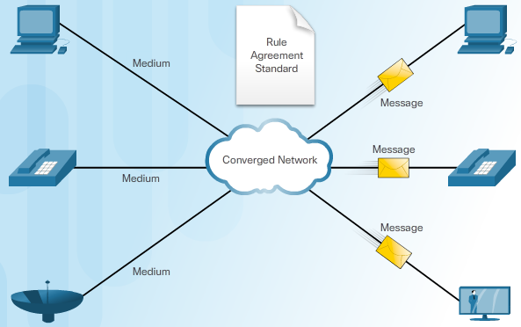
Globally Connected LANs, WANs, and the Internet (Cont.)
Converged Networks
Consolidate these different kinds of networks onto one platform
Capable of delivering voice, video, text, and graphics
One common network infrastructure
Uses a common set of rules, agreements, and implementation standards
Notes:
1.3 – Globally Connected
1.3.3 – LANs, WANs, and the Internet (Cont.)

Slide 22
Globally Connected Communication Across Networks
Need for Standards
Rules of communication that devices use and are specific to the characteristics of the conversation.
Protocols define the details of how messages are transmitted and received.
Protocols contain rules for how devices communicate.
Protocol Suite - TCP/IP
Application
Transport
Internet
Network Access
Network Connectivity (Network Access Layer)
Transfer data across the network
Wired examples - Category 5 cable, coaxial cable, Ethernet over powerline
Wireless examples – Wi-Fi, Cellular, NFC, ZigBee, Bluetooth
Network Access for Currently Unconnected Things
Bluetooth, ZigBee, NFC, 6LoWPAN
Notes:
1.3 – Globally Connected
1.3.4 – Communication Across Networks

Slide 23
1.4 Chapter Summary
Notes:
Cisco Networking Academy Program
Introduction to the Internet of Things
Chapter 1: What is the Internet of Things?

Slide 24
Chapter Summary Summary
The Internet is a network of networks that brings people, process, data, and things together.
The IoE brings value to organizations in these five areas: customer experience, innovation, employee productivity, asset utilization, and supply.
Networks provide the foundation for the Internet and, ultimately, the IoE. The components of a network fall into one of three categories: devices, media, and services.
The two most common types of networks are LAN and WAN.
Consolidating different types of networks onto one platform creates a “converged network.” Protocols define the details of how messages are transmitted and received. A group of inter-related protocols that are necessary to perform a communication function is called a protocol suite. Protocol suites help ensure interoperability between network devices.
One of the most common networking protocol suites is known as Transmission Control Protocol/Internet Protocol (TCP/IP). The bottom layer of the TCP/IP protocol suite, network access covers the protocols that devices must use when transferring data across the network. The devices can be connected to the network in one of two ways: wired and wireless.
Notes:
1.4.1.1 - Summary

