Slide 1
Use Case
Pertemuan 5
Dosen Pengampu: Sandfreni
Prodi Sistem Informasi - Fakultas Ilmu Komputer

Slide 2
Use Cases
Scenarios that describe how the product will be used in specific situations.
Written narratives that describe the role of an actor (user or device) as it interacts with the system.
Use-cases designed from the actor's point of view.
Not all actors can be identified during the first iteration of requirements elicitation, but it is important to identify the primary actors before developing the use-cases.

Slide 3
User Profile - Example
Full Control (Administrator)
Read/Write/Modify All (Manager)
Read/Write/Modify Own (Inspector)
Read Only (General Public)

Slide 4
Use Case Example - 1
Read Only Users
The read-only users will only read the database and cannot insert, delete or modify any records.
Read/Write/Modify Own Users
This level of users will be able to insert new inspection details, facility information and generate letters. They will be also able to modify the entries they made in the past.

Slide 5
Use Case Example - 2
Read/Write/Modify All Users
This level of users will be able to do all the record maintenance tasks. They will be able to modify any records created by any users.
Full Control Users
This is the system administrative level which will be able to change any application settings, as well as maintaining user profiles.

Slide 6
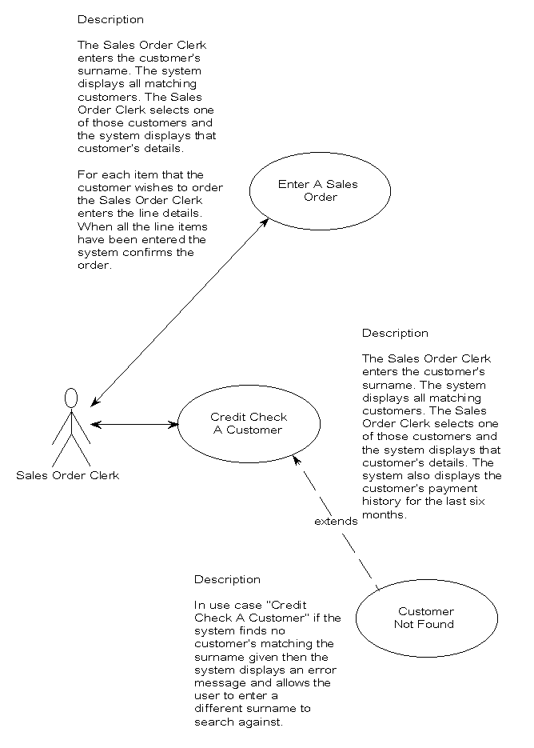

Slide 7
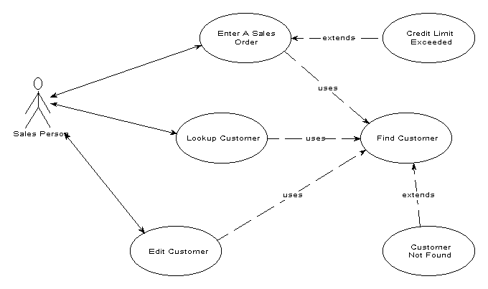

Slide 8
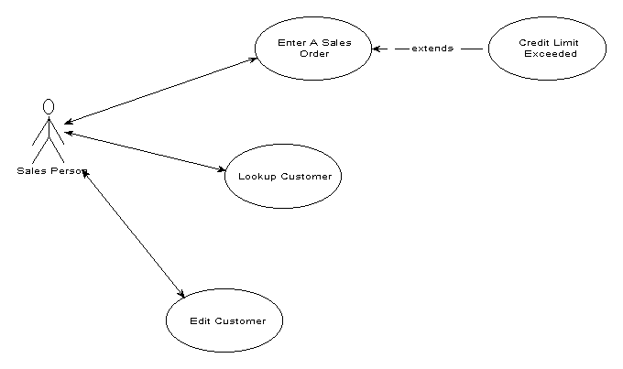

Slide 9
Analysis Principles
Information domain of problem must be presented & understood.
Models depicting system information, functions, and behavior should be developed.
Models and problems must be partitioned in a manner that uncovers detail in layers.
Analysis proceeds from essential information toward implementation detail
Must be traceable.

Slide 10
Information Domain
Encompasses all data objects that contain numbers, text, images, audio, or video.
Information content or data model
shows the relationships among the data and control objects that make up the system
Information flow
represents manner in which data and control objects change as each moves through system
Information structure
representations of the internal organizations of various data and control items

Slide 11
Modeling
Data model
shows relationships among system objects
Functional model
description of the functions that enable the transformations of system objects
Behavioral model
manner in which software responds to events from the outside world

Slide 12
Partitioning
Process that results in the elaboration of data, function, or behavior.
Horizontal partitioning
breadth-first decomposition of the system function, behavior, or information, one level at a time.
Vertical partitioning
depth-first elaboration of the system function, behavior, or information, one subsystem at a time.

Slide 13
Requirements Views
Essential view
presents the functions to be accomplished and the information to be processed while ignoring implementation
Implementation view
presents the real world realization of processing functions and information structures
Avoid the temptation to move directly to the implementation view and assuming that the essence of the problem is obvious.

