Slide 1
Requirement Spesification
Pertemuan 8
Dosen Pengampu: Sandfreni
Prodi Sistem Informasi - Fakultas Ilmu Komputer

Slide 2
Requirements specification
The process of writing donw the user and system requirements in a requirements document.
User requirements have to be understandable by end-users and customers who do not have a technical background.
System requirements are more detailed requirements and may include more technical information.
The requirements may be part of a contract for the system development
  It is therefore important that these are as complete as possible.

Slide 3
Ways of writing a system requirements specification
Notation | Description
Natural language | The requirements are written using numbered sentences in natural language. Each sentence should express one requirement.
Structured natural language | The requirements are written in natural language on a standard form or template. Each field provides information about an aspect of the requirement.
Design description languages | This approach uses a language like a programming language, but with more abstract features to specify the requirements by defining an operational model of the system. This approach is now rarely used although it can be useful for interface specifications.
Graphical notations | Graphical models, supplemented by text annotations, are used to define the functional requirements for the system; UML use case and sequence diagrams are commonly used.
Mathematical specifications | These notations are based on mathematical concepts such as finite-state machines or sets. Although these unambiguous specifications can reduce the ambiguity in a requirements document, most customers don’t understand a formal specification. They cannot check that it represents what they want and are reluctant to accept it as a system contract

Slide 4
Requirements and design
In principle, requirements should state what the system should do and the design should describe how it does this.
In practice, requirements and design are inseparable
  A system architecture may be designed to structure the requirements;
  The system may inter-operate with other systems that generate design requirements;
  The use of a specific architecture to satisfy non-functional requirements may be a domain requirement.
  This may be the consequence of a regulatory requirement.

Slide 5
Natural language specification
Requirements are written as natural language sentences supplemented by diagrams and tables.
Used for writing requirements because it is expressive, intuitive and universal. This means that the requirements can be understood by users and customers.

Slide 6
Guidelines for writing requirements
Invent a standard format and use it for all requirements.
Use language in a consistent way. Use shall for mandatory requirements, should for desirable requirements.
Use text highlighting to identify key parts of the requirement.
Avoid the use of computer jargon.
Include an explanation (rationale) of why a requirement is necessary.

Slide 7
Problems with natural language
Lack of clarity
  Precision is difficult without making the document difficult to read.
Requirements confusion
  Functional and non-functional requirements tend to be mixed-up.
Requirements amalgamation
  Several different requirements may be expressed together.

Slide 8
Example requirements for the insulin pump software system
3.2 The system shall measure the blood sugar and deliver insulin, if required, every 10 minutes. (Changes in blood sugar are relatively slow so more frequent measurement is unnecessary; less frequent measurement could lead to unnecessarily high sugar levels.) 3.6 The system shall run a self-test routine every minute with the conditions to be tested and the associated actions defined in Table 1. (A self-test routine can discover hardware and software problems and alert the user to the fact the normal operation may be impossible.)

Slide 9
Structured specifications
An approach to writing requirements where the freedom of the requirements writer is limited and requirements are written in a standard way.
This works well for some types of requirements e.g. requirements for embedded control system but is sometimes too rigid for writing business system requirements.

Slide 10
Form-based specifications
Definition of the function or entity.
Description of inputs and where they come from.
Description of outputs and where they go to.
Information about the information needed for the computation and other entities used.
Description of the action to be taken.
Pre and post conditions (if appropriate).
The side effects (if any) of the function.

Slide 11
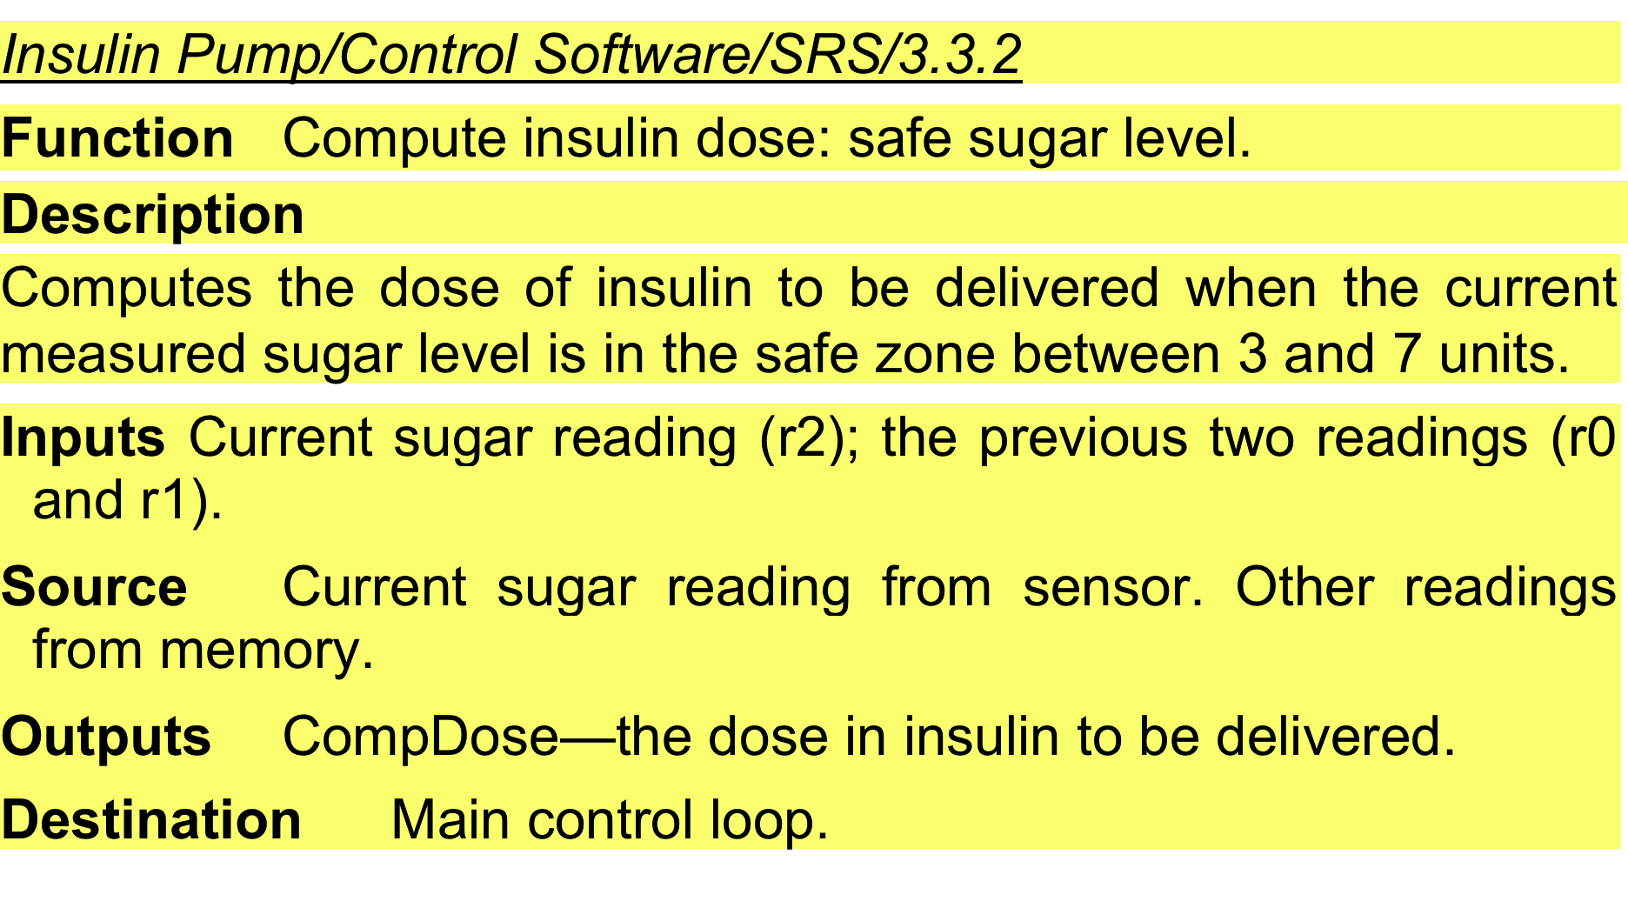
A structured specification of a requirement for an insulin pump

Slide 12
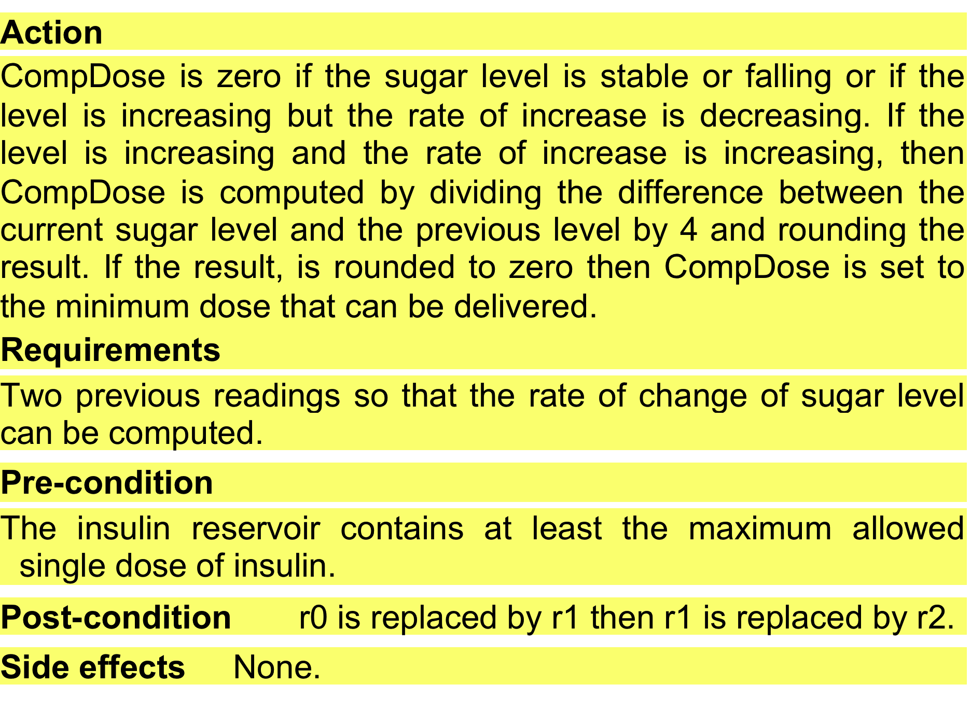
A structured specification of a requirement for an insulin pump

Slide 13
Tabular specification
Used to supplement natural language.
Particularly useful when you have to define a number of possible alternative courses of action.
For example, the insulin pump systems bases its computations on the rate of change of blood sugar level and the tabular specification explains how to calculate the insulin requirement for different scenarios.

Slide 14
Tabular specification of computation for an insulin pump
Condition | Action
Sugar level falling (r2 < r1) | CompDose = 0
Sugar level stable (r2 = r1) | CompDose = 0
Sugar level increasing and rate of increase decreasing ((r2 – r1) < (r1 – r0)) | CompDose = 0
Sugar level increasing and rate of increase stable or increasing ((r2 – r1) ≥ (r1 – r0)) | CompDose = round ((r2 – r1)/4) If rounded result = 0 then CompDose = MinimumDose

Slide 15
Use cases
Use-cases are a kind of scenario that are included in the UML.
Use cases identify the actors in an interaction and which describe the interaction itself.
A set of use cases should describe all possible interactions with the system.
High-level graphical model supplemented by more detailed tabular description (see Chapter 5).
UML sequence diagrams may be used to add detail to use-cases by showing the sequence of event processing in the system.

Slide 16
Use cases for the Mentcare system

Slide 17
The software requirements document
The software requirements document is the official statement of what is required of the system developers.
Should include both a definition of user requirements and a specification of the system requirements.
It is NOT a design document. As far as possible, it should set of WHAT the system should do rather than HOW it should do it.

Slide 18
Users of a requirements document

Slide 19
Requirements document variability
Information in requirements document depends on type of system and the approach to development used.
Systems developed incrementally will, typically, have less detail in the requirements document.
Requirements documents standards have been designed e.g. IEEE standard. These are mostly applicable to the requirements for large systems engineering projects.

Slide 20
The structure of a requirements document
Chapter | Description
Preface | This should define the expected readership of the document and describe its version history, including a rationale for the creation of a new version and a summary of the changes made in each version.
Introduction | This should describe the need for the system. It should briefly describe the system’s functions and explain how it will work with other systems. It should also describe how the system fits into the overall business or strategic objectives of the organization commissioning the software.
Glossary | This should define the technical terms used in the document. You should not make assumptions about the experience or expertise of the reader.
User requirements definition | Here, you describe the services provided for the user. The nonfunctional system requirements should also be described in this section. This description may use natural language, diagrams, or other notations that are understandable to customers. Product and process standards that must be followed should be specified.
System architecture | This chapter should present a high-level overview of the anticipated system architecture, showing the distribution of functions across system modules. Architectural components that are reused should be highlighted.

Slide 21
The structure of a requirements document
Chapter | Description
System requirements specification | This should describe the functional and nonfunctional requirements in more detail. If necessary, further detail may also be added to the nonfunctional requirements. Interfaces to other systems may be defined.
System models | This might include graphical system models showing the relationships between the system components and the system and its environment. Examples of possible models are object models, data-flow models, or semantic data models.
System evolution | This should describe the fundamental assumptions on which the system is based, and any anticipated changes due to hardware evolution, changing user needs, and so on. This section is useful for system designers as it may help them avoid design decisions that would constrain likely future changes to the system.
Appendices | These should provide detailed, specific information that is related to the application being developed; for example, hardware and database descriptions. Hardware requirements define the minimal and optimal configurations for the system. Database requirements define the logical organization of the data used by the system and the relationships between data.
Index | Several indexes to the document may be included. As well as a normal alphabetic index, there may be an index of diagrams, an index of functions, and so on.

