Slide 1
Analisis Resiko
Sistem Informasi
Risk analysis definition
Pertemuan 2
Dosen Pengampu: Alivia Yulfitri (2017)
Prodi Sistem Informasi - Fakultas Ilmu Komputer

Slide 2
Risk Analysis
Outline
What is risk analysis?
What terms are needed in risk analysis?
What are assets?
What are vulnerabilities?
What are threats?
What types of risk exist?
  Security Risk
  Physical Asset Risks
  Mission Risks
  Security Risks

Slide 3
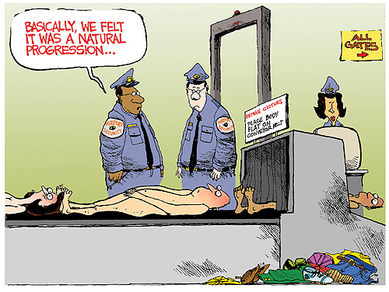
Example: Airport security

Slide 4
List of possible measures
Scissors etc. not allowed
ID check (photo ID must be presented)
Only the person named on the ticket can travel
X-rays
Lighters are not allowed anywhere in the airport (…it’s time to quit smoking)
Biometrics
Boot your laptop to see if it has a battery
Lock the captain’s cabin
Armed guards on board
Interview all passengers before boarding

Slide 5
In such a complex environment…
Total security is out of the question
  People’s behaviour is unpredictable
  We cannot account for all possible threats and we cannot detect all vulnerabilities.
  Security costs money; and also time, people and other resources.
So, what shall we do?

Slide 6
In such a complex environment…
Total security is out of the question
  People’s behaviour is unpredictable
  We cannot account for all possible threats and we cannot detect all vulnerabilities.
  Security costs money; and also time, people and other resources.
So, what shall we do?

Slide 7
What is Risk and how to measure it
Risk is determined by the following factors
  Assets (A)
  Impact (I)
  Threats (T)
  Vulnerabilities (V)
R= f(A, I, T, V)

Slide 8
Risk Life Cycle
Exploits
Threat Agent
Leads to
Vulnerability
Risk
Asset
Can damage
Exposures
And cause an
Safeguard
Can be
countermeasured by a

Slide 9
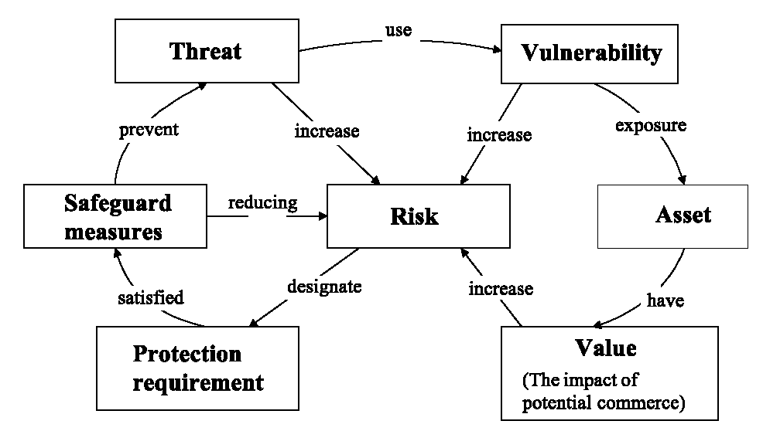
Risk Analysis
Conceptualisation map of Information System
Source: Australian Standard Handbook of Information Security Risk Management – HB231-2000
Notes:
Threats exploit system vulnerabilities which expose system assets.
safeguard measures protect against threats by meeting security requirements established on the basis of asset values.

Slide 10
Risk Analysis
Basic Definitions
Assets; what needs protection
Business impact is the outcome of a failure to protect the assets of the IS.
Threat is any action or event that may cause damage to an Information System.
Vulnerability is a characteristic of the IS that may allow a threat to succeed.
Safeguard measures- is the probability that a specific threat will successfully exploit a vulnerability causing a loss.
Protection Requirement - Implementations to reduce overall risk and vulnerability

Slide 11
Risk Analysis
Assets
Assets: Something that the agency values and has to protect. Assets include all information and supporting items that an agency requires to conduct business.
Data
  Breach of confidentiality
  Loss of data integrity
  Denial of service
  Corruption of Applications
  Disclosure of Data
Organization
  Loss of trust
  Embarrassment
  Management failure
Personnel
  Injury and death
  Sickness
  Loss of morale

Slide 12
Risk Analysis
Assets Cont’d
Infrastructure
  Electrical grid failure
  Loss of power
  Chemical leaks
  Facilities & equipment
  Communications
Legal
  Use or acceptance of unlicensed software
  Disclosure of Client Secrets
Operational
  Interruption of services
  Loss/Delay in Orders
  Delay in Shipments

Slide 13
Risk Analysis
Vulnerabilities
Vulnerabilities are flaws within an asset, such as an operating system, router, network, or application, which allows the asset to be exploited by a threat.
Examples
  Software design flaws
  Software implementation errors
  System misconfiguration (e.g. misconfigured firewalls)
  Inadequate security policies
  Poor system management
  Lack of physical protections
  Lack of employee training (e.g. passwords on post-it notes in drawers or under keyboards)

Slide 14
Risk Analysis
Threats
Threats are potential causes of events which have a negative impact.
  Threats exploit vulnerabilities causing impact to assets
Examples
  Denial of Service (DOS) Attacks
  Spoofing and Masquerading
  Malicious Code
  Human Error
  Insider Attacks
  Intrusion

Slide 15
Risk Analysis
Sources of Threats
Source | Examples of Reasons
External Hackers with Malicious Intent | Espionage Intent to cause damage Terrorism
External Hackers Seeking Thrill | Popularity
Insiders with Malicious Intent | Anger at company Competition with co-worker(s)
Accidental Deletion of Files and Data | User errors
Environmental Damage | Floods Earthquakes Fires
Equipment and Hardware Failure | Hard disk crashes

Slide 16
RISK TYPES
What types of risk exist?
  Physical Asset Risks
  Mission Risks
  Security Risks

Slide 17
Risk Analysis
Risk
Risk is the probability that a specific threat will successfully exploit a vulnerability causing a loss.
Risks of an organization are evaluated by three distinguishing characteristics:
  loss associated with an event, e.g., disclosure of confidential data, lost time, and lost revenues.
  likelihood that event will occur, i.e. probability of event occurrence
  Degree that risk outcome can be influenced, i.e. controls that will influence the event
Various forms of threats exist
Different stakeholders have various perception of risk
Several sources of threats exist simultaneously

Slide 18
Risk Analysis
Physical Asset Risks
Physical Asset Risks
  Relating to items with physical and tangible items that have an associated financial value

Slide 19
Risk Analysis
Mission Risks
Mission Risks
  Relating to functions, jobs or tasks that need to be performed

Slide 20
Risk Analysis
Security Risks
Security Risks
  Integrates with both asset and mission risks

Slide 21
Difference
Risk Assessment vs. Risk Analysis vs. Risk Audit
 | Assessment | Analysis | Audit
Objective | Baseline | Determine Exposure and Potential Loss | Measure against a Standard
Method | Various (including use of tools) | Various (including tools) | Audit Program/ Checklist
Deliverables | Gaps and Recommendations | Identification of Assets, Threats & Vulnerabilities | Audit Report
Performed by: | Internal or External | Internal or External | Auditors
Value | Focused Improvement | Preparation for Assessment | Compliance

Slide 22
EXERCISE

Slide 23
Crossing the road
B
A
Footbridge Underpass Traffic lights
Notes:
This example may be useful as it allows us to think ‘outside the box’.
As background, the two figures shown talking wish to get across the road from A to B.
Encourage delegates to stick at first to the straightforward task of crossing the road and the first line hazards
These must include
Speed of traffic
Frequency of traffic
Weather conditions
Then individual factors
Physical ability of the two people (including eyesight and hearing)
Age and experience
Then control measures
Traffic lights

Slide 24
Summary of risk factors
Physical attributes of pedestrians
Speed of crossing road
Daylight/night
Threat of attack in underpass
Distance to footbridge
Notes:
At the second stage it is suggested you introduce other factors affecting the assessment.
There are alternatives of an underpass available at the point of crossing and a footbridge, say, 200 metres away.
The 3 first points were considered already, but if people propose using the underpass as a way of eliminating the hazards, introduce the idea that the underpass is poorly maintained and there is a history of people being mugged.
The proposal to use the footbridge is safe from traffic and probably the only option for pushchairs and wheelchairs – but is a distance away – so how will people JUDGE THE RISK and decide the LEVEL OF TOLERABLE RISK.

Slide 25
Scenarios
Elderly persons crossing in dry conditions (day)
Male adult crossing in dry conditions (night)
Parent/child with pushchair crossing in rain (day)
Notes:
This is offered as a quick exercise either individually or as a group.
The purpose is to illustrate that an assessment to perform a task can influenced by the question “Who is doing it?”, bringing in questions of individual capability and vulnerability. This may affect how the objective is achieved.
Left to individual choice, each person will decide on the level of risk (s)he wishes to retain. The employer still has that choice, but has to make it for others and will probably adopt a lower threshold.

Slide 26
Crossing the road
Footbridge Underpass Traffic lights
Notes:
The repeat slide is included to allow free discussion as a summary.

Slide 27
Exercise - Tyre change
Carry out a risk assessment on a tyre change.
What are the hazards in changing a tyre?
What controls can you use to reduce the risk?
Notes:
This can be used as another interactive example that covers elimination as well as a broad view of risk control.
The prime task is to carry out a risk assessment on changing a tyre.
To start with, you should ask for the basic hazard identification involved with the process itself
Car rolling away
Car dropping off jack
Operation of jack (including resistance of bolts)
Faulty equipment
Oncoming traffic
Not being visible
etc

Slide 28

What hazards are here?
Notes:
The following series of slides illustrates how local conditions can affect the existing hazards and add additional ones.
In this picture the point is being on a hill
(increasing ‘rolling’ hazard)

Slide 29

What about this one?
Notes:
This one is in the dark adding to the ‘not being visible’ hazard

Slide 30

Would you like to have to make the change here?
Notes:
No one would like to be faced with changing a tyre here in the middle of motorway.
Increases ‘oncoming’ traffic hazard

Slide 31
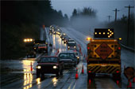
Can it get worse?
Notes:
Here we have wet conditions, compounded by darkness and being on a hill

Slide 32

- And worse?
Notes:
The appearance of snow may actually reduce the visibility hazard as the vehicle may stand out more, but the additional hazard of instability on a wet surface plus the hazard of cold, reducing dexterity more than compensate for that.

Slide 33

Beautiful – but other hazards?
Notes:
You should encourage people to move away from thinking ‘weather’ to thinking ‘isolation’.
Being stuck in remote location can bring additional fears but can also bring in a sense of complacency that nothing will come by and threaten hitting you.

Slide 34
So how can we prepare for the worst
– to make it better?
Notes:
The delegates should now have an appreciation that although the main task is not that complicated, other related issues can increase the hazards.
We should now think ‘Elimination and control’
We now move on to use of devices that reduce the risk of injury and/or should be addressed in preparation.

Slide 35

Warn others to protect yourself
Notes:
Not often we can use cones to warn others – not many of us carry them, but drivers should consider carrying a warning triangle to reduce the chance of being hit.

Slide 36

A light can be helpful in dark conditions
Notes:
Placing a light on the roof can be helpful, and can be powered via the cigarette lighter.

Slide 37
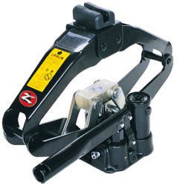
A jack is a must
Notes:
You must carry a jack – know how to fit. Incorrectly placed it can damage the car, but more importantly, can increase the risk of the car dropping down.

Slide 38
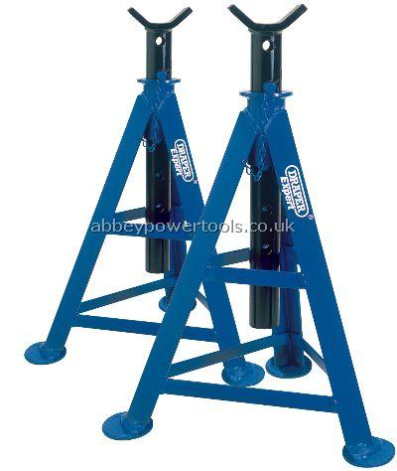
- And you may consider axle supports
Notes:
For larger vehicles, axle supports can be used to give additional support and stability.

Slide 39
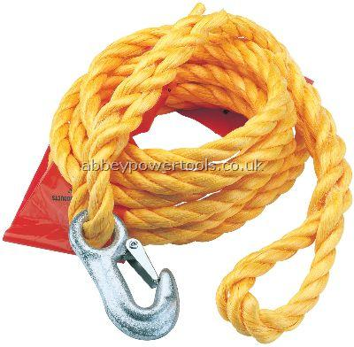
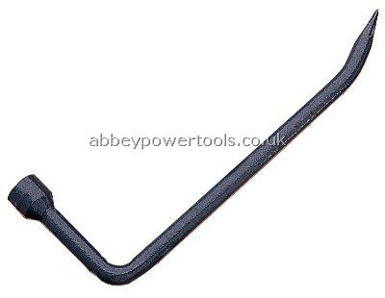
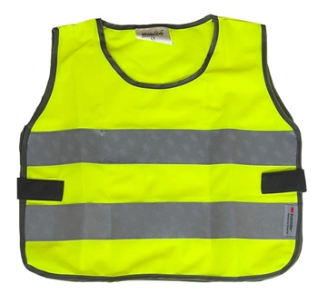
Other items are important
Notes:
Visibility aprons can protect the driver and additional length on a jack can enable the driver to undo the reluctant bolt with less risk of injury.
Just in case, a tow rope is important to get you out of trouble.
Before going on to the final slide, remind delegates of other options, including elimination and substitution.

Slide 40
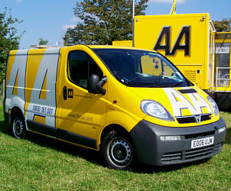
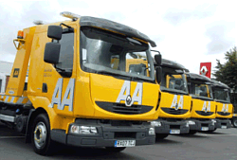
But remember our assessment options
Notes:
Many drivers have already weighed up the risks and decided to pass the risk onto others.
Call in the experts at modest cost!

Slide 41
Referensi
Sanjay Goel, School of Business/Center for Information Forensics and Assurance, University at Albany Proprietary Information

