Slide 1
Analisis Resiko Sistem Informasi
Risk Analysis Methodology 1
Pertemuan 3 Dosen Pengampu: Alivia Yulfitri (2017)
Prodi Sistem Informasi - Fakultas Ilmu Komputer

Slide 2
Risk Assessment: Methodology When to perform?
Periodically
Often event-driven
Typically year-over-year comparison
Generally labor-intensive
Most organizations start with periodic assessments
Continuously
Part of the normal workflow
Provides “real-time” risk view
Often supported by technology and analysis tools
Integrated with other IT/business processes
Notes:
“The terms Risk Analysis, Risk Assessment, and Risk Management are used interchangeably by some individuals and, in the field of Program Management, are construed to represent similar concepts but the order of precedence is inverse to that for Automation or Computer Security.”
Definition: “Risk Analysis is the identification of a specific installation’s assets, the threats to them, the system’s vulnerability to those threats, and the presumed loss in consideration of existing and projected safeguards. To accomplish either qualitative or quantitative analysis of the system’s risk posture, presumptions should be made that the threats actually occur periodically, if unpredictably, and result in significant damage to system assets that constitute some discernable value to the organization; further, safeguards under review should be considered to be properly conceived and to work correctly in order to make reasonable comparisons. Although approximations and simplifications may be made for the sake of expediency to accomplish a risk analysis, objectivity can prevail when reasonable compromises are made. The most realistic portrayal of actual situations can be made when figures used in computations closely represent the documented local conditions as contrasted with generic, averaged conditions. A concurrent or subsequent security test and evaluation of those very safeguards should be made to establish whether, in fact, the presumptions are correct and, if not, what improvement should be effected.”
Definition: “Risk Assessment is a comprehensive determination of the state of risk associated with a system based upon a thorough analysis of the foregoing considerations; by definition, the assessment should include recommendations to support subsequent management decision for (elimination of unnecessarily onerous restrictions and/or) adoption of specific additional safeguards that would reduce the level of system risk to an acceptable level within the constraints imposed by mission, budgetary, political, societal, and other relevant factors.”

Slide 3
Introduction
Risk Analysis and Management Framework
Assets Threats Vulnerabilities
}
Analysis
Risks
}
Management
Security Measures

Slide 4
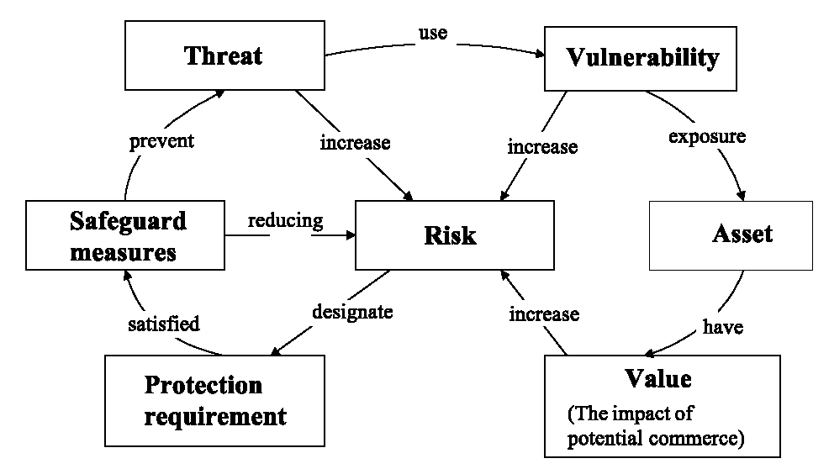
Risk Analysis Conceptualisation map of Information System
Security
Measures/
Source: Australian Standard Handbook of Information Security Risk Management – HB231-2000
Notes:
Threats exploit system vulnerabilities which expose system assets.
safeguard measures protect against threats by meeting security requirements established on the basis of asset values.

Slide 5
Definitions
The meanings of terms in this area is not universally agreed. We will use the following
Threat: Harm that can happen to an asset
Impact: A measure of the seriousness of a threat
Attack: A threatening event
Attacker: The agent causing an attack (not necessarily human)
Vulnerability: a weakness in the system that makes an attack more likely to succeed
Risk: a quantified measure of the likelihood of a threat being realised

Slide 6
Goals of Risk Analysis
All assets have been identified
All threats have been identified
Their impact on assets has been valued
All vulnerabilities have been identified and assessed

Slide 7
Problems of Measuring Risk
Businesses normally wish to measure in money, but
Many of the entities do not allow this
Valuation of assets
Value of data and in-house software - no market value
Value of goodwill and customer confidence
Likelihood of threats
How relevant is past data to the calculation of future probabilities?
The nature of future attacks is unpredictable
The actions of future attackers are unpredictable
Measurement of benefit from security measures
Problems with the difference of two approximate quantities
How does an extra security measure affect a ~10⁻⁵ probability of attack?

Slide 8
Risk Management Cycle
Identify Risks
Risk Assessment
The Processes are organized
Each Step output considered
as an input for the next step
Assess Risks
Define Desired
Results
The Process
is iteration
Select Strategy
Implement
Strategy
Risk Control
Monitor
Evaluate and
Adjust

Slide 9
Methods of Risk Analysis
There are various methods analysing risk:
First : Quantitative risk analysis:
generally estimates values of Information Systems components as ; information, systems, business processes, recovery costs, etc.,
risk can be measured in terms of direct and indirect costs , based on
(1) the likelihood that a damaging event will occur
(2) the costs of potential losses
(3) the costs of mitigating actions that could be taken.
,

Slide 10
Second : Qualitative Risk Assessment
This approach can be taken by defining
Risk in more subjective and general terms such as high, medium, and low.
In this regard, qualitative analysis depend more on the expertise, experience, and judgment of those conducting the assessment.
Qualitative risk analysis typically give risk results of “High”, “Moderate” and “Low”. However, by providing the impact and likelihood definition tables and the description of the impact, it is possible to adequately communicate the assessment to the organization’s management.

Slide 11
Third :Quantitative and Qualitative
It is also possible to use a combination of quantitative and qualitative method

Slide 12
Risk Analysis: Methodology Key Steps
Define objectives
Define deliverables
Establish a work plan -> Methodology
Determine tools to assist with process
Notes:
“The terms Risk Analysis, Risk Assessment, and Risk Management are used interchangeably by some individuals and, in the field of Program Management, are construed to represent similar concepts but the order of precedence is inverse to that for Automation or Computer Security.”
Definition: “Risk Analysis is the identification of a specific installation’s assets, the threats to them, the system’s vulnerability to those threats, and the presumed loss in consideration of existing and projected safeguards. To accomplish either qualitative or quantitative analysis of the system’s risk posture, presumptions should be made that the threats actually occur periodically, if unpredictably, and result in significant damage to system assets that constitute some discernable value to the organization; further, safeguards under review should be considered to be properly conceived and to work correctly in order to make reasonable comparisons. Although approximations and simplifications may be made for the sake of expediency to accomplish a risk analysis, objectivity can prevail when reasonable compromises are made. The most realistic portrayal of actual situations can be made when figures used in computations closely represent the documented local conditions as contrasted with generic, averaged conditions. A concurrent or subsequent security test and evaluation of those very safeguards should be made to establish whether, in fact, the presumptions are correct and, if not, what improvement should be effected.”
Definition: “Risk Assessment is a comprehensive determination of the state of risk associated with a system based upon a thorough analysis of the foregoing considerations; by definition, the assessment should include recommendations to support subsequent management decision for (elimination of unnecessarily onerous restrictions and/or) adoption of specific additional safeguards that would reduce the level of system risk to an acceptable level within the constraints imposed by mission, budgetary, political, societal, and other relevant factors.”

Slide 13
How to assess the risks
Risk is assessed by following the following steps:
Identifiying assets
Identifying threats and impact
Identifying vulnerabilities
Relating Threats to Vulnerabilities
determining the likelihood
Evaluate impact for each risk
Evaluate impact
for each risk
determining the
likelihood
Relating Threats
to Vulnerabilities
Identifying vulnerabilities
Identifying threats

Slide 14
1. Risk Analysis - Identification of Assets
Types of asset
Hardware
Software: purchased or developed programs
Data
People: who run the system
Documentation: manuals, administrative procedures, etc
Supplies: paper forms, magnetic media, printer liquid, etc
Money
Intangibles
Goodwill
Organisation confidence
Organisation image

Slide 15
1. Risk Analysis - Identification of Assets Outline
What are tangible assets?
What are non-tangible assets?
How to assign value to assets?
What questions should be asked?
Example
Lemonade Stand

Slide 16
Identification of Assets Tangible
Assets- Something that the agency values and has to protect. Assets include all information and supporting items that an agency requires to conduct business.
Hardware
Processors, boards, monitors, keyboards, terminals, drives, cables, connections, controllers, communications media, etc.
Software: purchased or developed programs
Source programs, object programs, purchased programs, operating systems, systems programs, diagnostic programs, etc.
Information/Data
Data used during execution, stored data on various media, archival records, audit data, files with payment details, voice records, image files, product information, continuity plans.
Services
Provided by the company. (e.g. computing and communication services, service providers and utilities)
Documentation
On programs, hardware, systems, administrative procedures and the entire system, contracts, completed forms.

Slide 17
Identification of Assets Non-Tangible
People and their knowledge (Employees)
Integral function/skills which the employee provides (e.g. technical, operational, marketing, legal, financial, contractors/consultants, outsourced providers)
Reputation and Image
Value attributed to an organization as a result of its general estimation in the public eye. (e.g. political standing in the case of government agencies)
Trust
Value consistent with public opinion on the integrity and character of an organization.
Intellectual Property
Any product of the human intellect that is unique, novel, and unobvious (and has some value in the marketplace)
Source: http://www.uta.edu/tto/ip-defs.htm

Slide 18
Information Assets
IS
Components
People
Employees
Authorized
Staff
Other staff
Non-
employees
People at
trusted
organizations
Strangers
Procedures
Standard
\Procedures
Sensitive
Procedures
Data
Transmission
Process
Storage
SW
Application
OS
Security
Component
HW
System
Devises
Net Work

Slide 19
Determine Assets Valuation
Asset values are used to identify the appropriate protection of assets and to determine the importance of the assets to the business.
Values can be expressed in terms of:
Potential business impacts affecting loss of confidentiality, integrity and availability.
Valuation of some assets different for small and large organizations
Intangible assets hard to quantify
Hidden costs of damages to recovery (often underestimated)

Slide 20
Determine Assets Valuation, cont’d.
In this step, ramifications of failure on organization are determined.
Often inaccurate
Costs of human capital required to recover from failure undervalued e.g. cost of restoring data
Indirect consequences of an event unknown until the event actually happens
Catastrophic events that cause heavy damage are so infrequent that correct data unavailable
Non-tangible assets hard to quantify
The questions on the next slide prompt us to think about issues of explicit and hidden cost related to security.
The answers may not produce precise cost figures, but help identify sources of various types of costs.

Slide 21
Determine Assets Guiding Questions to Reflect on Intangible Assets
What are the legal obligations in preserving confidentiality or integrity of data?
What business requirements and agreements cover the situation?
Could release of a data item cause harm to a person or organization?
Could unauthorized access to data cause loss of future business opportunity?
What is the psychological effect of lack of computer service?
What is the value of access to data or programs?
What is the value of having access to data or programs to someone else?
What other problems would arise from loss of data?

Slide 22
Determine Assets General Example #1: Lemonade Stand
Billy sells lemonade outside of his house every weekend for 3 hours a day. Every week he makes about $40. The wooden stand has a cardboard sign which reads, “Lemonade for SALE, 25 cents each”. Supplies he receives from his mother are paper cups and a glass pitcher and spoon to stir with. For one pitcher of lemonade, he needs 4 lemons, 2 cups of sugar, 1 quart of water, and a secret ingredient and 10 minutes. The special recipe is located in a small space within the lemonade stand. He has a general crowd of about 10 neighbors who buy from him because they enjoy the taste of his lemonade and his personality.

Slide 23
Determine Assets General Example #1: Lemonade Stand, cont’d.
Listing of Tangible Assets:
Establishment
Lemonade stand: $5
Advertising
Sign: $1
Supplies
Pitcher: $7
Paper cups: $2/25 pack
Spoon: $1.50
Lemons: $3/10 pack
Sugar: $1/1 lb.
Water: $1/gallon
Secret ingredient: $1/1 lb.
Listing of Intangible Assets:
People
Billy
Billy’s Mother
Intellectual Property
Special recipe
Trust
Reputation
Customer base

Slide 24
How to assess the risks
Risk is assessed by following the following steps:
Identifiying assets
Identifying threats and impact
Identifying vulnerabilities
Relating Threats to Vulnerabilities
determining the likelihood
Evaluate impact for each risk
Evaluate impact
for each risk
determining the
likelihood
Relating Threats
to Vulnerabilities
Identifying vulnerabilities
Identifying threats

Slide 25
2. Identifying Threats and Impact

Slide 26
Identification of Threats
Threat- Potential cause of an unwanted event that may result in harm to the agency and its assets. A threat is a manifestation of vulnerability.
Malicious
Malicious Software (Viruses, worms, trojan horses, time bomb logic bomb, rabbit, bacterium)
Spoofing or Masquerading
Sequential or Dictionary Scanning
Snooping (electronic monitoring or “shoulder surfing”)
Scavenging (“dumpster diving” or automated scanning of data)
Spamming
Tunneling
Unintentional
Equipment or Software Malfunction
Human error (back door or user error)
Physical
Power loss, vandalism, fire/flood/lightning damage, destruction

Slide 27
Identifying Threat and Impact (cont)
Identification and valuation of threats - for each group of assets
Identify threats, e.g. for stored data
Loss of confidentiality: Someone sees your password or a company’s “secret formula”
Loss of integrity: An e­mail message is modifed in transit, a virus infects a fle, or someone makes unauthorized changes to a Web site.
Loss of availability (Denial of Service): An e­mail server is down and no one has e­mail access, or a fle server is down so data fles aren’t available
Assess impact of threat
Assess in levels, e.g H-M-L or 1 - 10
This gives the valuation of the asset in the face of the threat

Slide 28
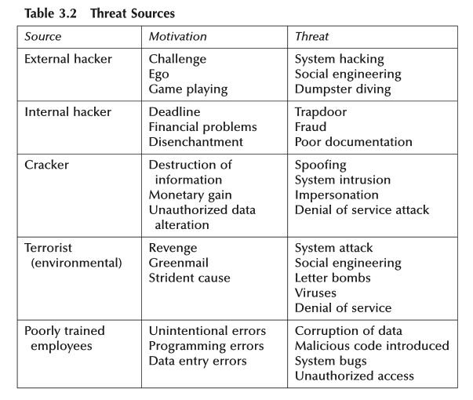
Source: Information Security Risk Analysis, Peltier

Slide 29
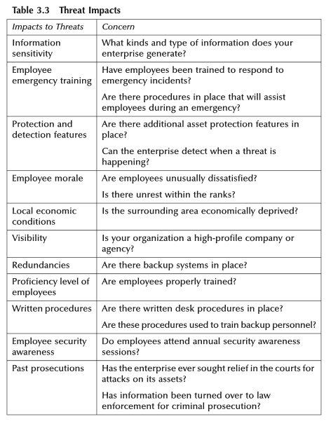
THREAT IMPACTS
Source: Information Security Risk Analysis, Peltier

Slide 30
One of the most basic forms of risk analysis is a process known as an annual loss exposure (ALE).
The ALE takes the value (V) of an asset and then uses the likelihood (L) of a threat occurrence in a formula to calculate the ALE:
V × L = ALE

Slide 31
The ALE would work like this: You have a $3 million data center located in a ﬂood area. A major ﬂood that would destroy the data center occurs once every 100 years. Value = $3 million Likelihood = Once every 100 years (using the table above, L = 0.01) $3 million × 0.01 = $30,000
Insurance companies use the ALE to assist them in determining what kind of premium they should charge. For the risk management professional, this form of risk analysis is often misleading. The loss if a ﬂood occurs is not $30,000, but actually $3,000,000.

Slide 32
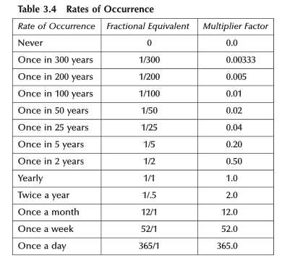

Slide 33
Process Analysis
Every company or organisation has some processes that are critical to its operation
The criticality of a process may increase the impact valuation of one or more assets identified
So
Identify critical processes
Review assets needed for critical processes
Revise impact valuation of these assets

Slide 34
Identifying Assets and Threats Assignment
Using your own organization, determine the assets and threats and impact.
Fill the worksheet for assets (see next slide)
Fill the worksheet for threat and impact

Slide 35
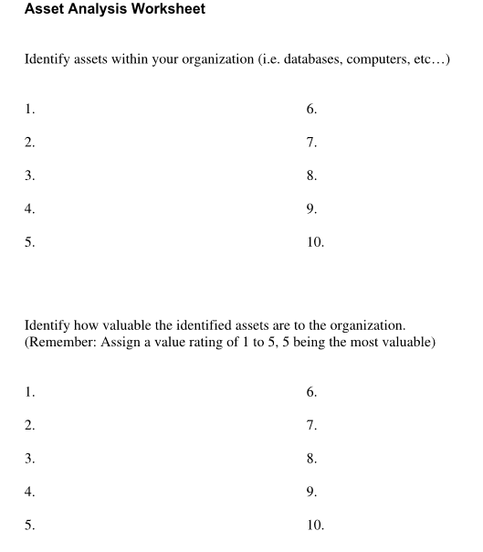

Slide 36
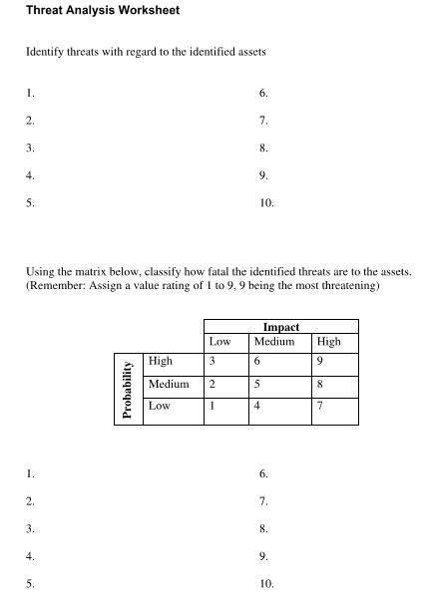

Slide 37
Identifying Assets and Threats Assignment
Design matrices to summary them.

Slide 38
Information Assets
IS
Components
People
Employees
Authorized
Staff
Other staff
Non-
employees
People at
trusted
organizations
Strangers
Procedures
Standard
\Procedures
Sensitive
Procedures
Data
Transmission
Process
Storage
SW
Application
OS
Security
Component
HW
System
Devises
Net Work

Slide 39
How to assess the risks
Risk is assessed by following the following steps:
Identifiying assets
Identifying threats and impact
Identifying vulnerabilities
Relating Threats to Vulnerabilities
determining the likelihood
Evaluate impact for each risk
Evaluate impact
for each risk
determining the
likelihood
Relating Threats
to Vulnerabilities
Identifying vulnerabilities
Identifying threats

Slide 40
Reference
Information Security Risk Analysis, Peltier
Sanjay Goel, School of Business/Center for Information Forensics and Assurance, University at Albany Proprietary Information

