Slide 1
Analisis Resiko Sistem Informasi
Studi Kasus: Identifying Assets, Threats, Impacts
Pertemuan 4 Dosen Pengampu: Alivia Yulfitri (2017)
Prodi Sistem Informasi - Fakultas Ilmu Komputer

Slide 2
STUDI KASUS Identifikasi asset, threat, impact di IT

Slide 3
Information Assets
IS
Components
People
Employees
Authorized
Staff
Other staff
Non-
employees
People at
trusted
organizations
Strangers
Procedures
Standard
\Procedures
Sensitive
Procedures
Data
Transmission
Process
Storage
SW
Application
OS
Security
Component
HW
System
Devises
Net Work

Slide 4
Identifying Assets and Threats Assignment
Using your own organization, determine the assets and threats and impact.
Fill the worksheet for assets (see next slide)
Fill the worksheet for threat and impact

Slide 5
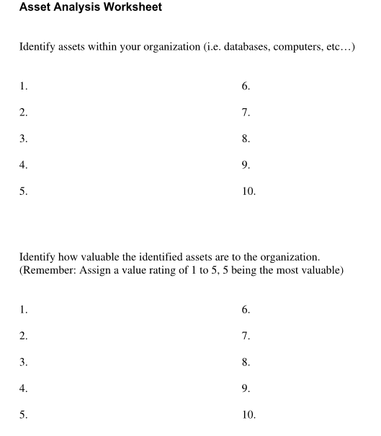

Slide 6
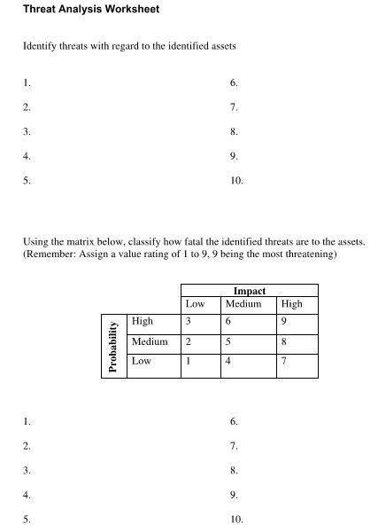

Slide 7
Identifying Assets and Threats Assignment
Design matrices to summary them.

Slide 9
