Slide 1
Analisis Resiko Sistem Informasi
Risk Analysis Methodology 2
Pertemuan 5 Dosen Pengampu: Alivia Yulfitri (2017)
Prodi Sistem Informasi - Fakultas Ilmu Komputer

Slide 2
Introduction
Risk Analysis and Management Framework
Assets Threats Vulnerabilities
}
Analysis
Risks
}
Management
Security Measures

Slide 3
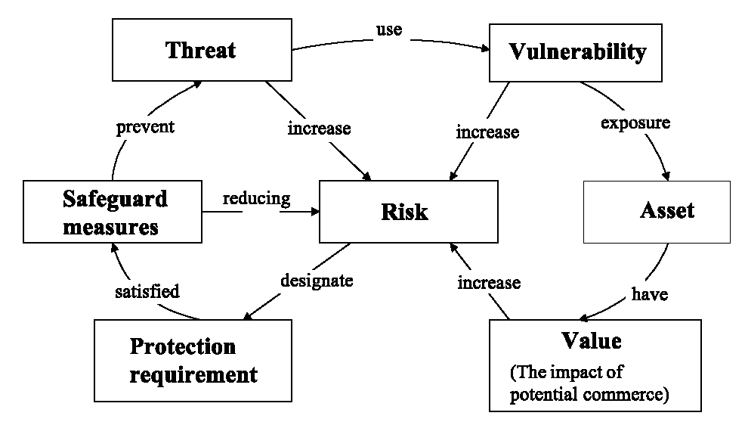
Risk Analysis Conceptualisation map of Information System
Security
Measures/
Source: Australian Standard Handbook of Information Security Risk Management – HB231-2000
Notes:
Threats exploit system vulnerabilities which expose system assets.
safeguard measures protect against threats by meeting security requirements established on the basis of asset values.

Slide 4
Definitions
The meanings of terms in this area is not universally agreed. We will use the following
Threat: Harm that can happen to an asset
Impact: A measure of the seriousness of a threat
Attack: A threatening event
Attacker: The agent causing an attack (not necessarily human)
Vulnerability: a weakness in the system that makes an attack more likely to succeed
Risk: a quantified measure of the likelihood of a threat being realised

Slide 5
Goals of Risk Analysis
All assets have been identified
All threats have been identified
Their impact on assets has been valued
All vulnerabilities have been identified and assessed

Slide 6
Risk Analysis: Methodology Key Steps
Define objectives
Define deliverables
Establish a work plan -> Methodology
Determine tools to assist with process
Notes:
“The terms Risk Analysis, Risk Assessment, and Risk Management are used interchangeably by some individuals and, in the field of Program Management, are construed to represent similar concepts but the order of precedence is inverse to that for Automation or Computer Security.”
Definition: “Risk Analysis is the identification of a specific installation’s assets, the threats to them, the system’s vulnerability to those threats, and the presumed loss in consideration of existing and projected safeguards. To accomplish either qualitative or quantitative analysis of the system’s risk posture, presumptions should be made that the threats actually occur periodically, if unpredictably, and result in significant damage to system assets that constitute some discernable value to the organization; further, safeguards under review should be considered to be properly conceived and to work correctly in order to make reasonable comparisons. Although approximations and simplifications may be made for the sake of expediency to accomplish a risk analysis, objectivity can prevail when reasonable compromises are made. The most realistic portrayal of actual situations can be made when figures used in computations closely represent the documented local conditions as contrasted with generic, averaged conditions. A concurrent or subsequent security test and evaluation of those very safeguards should be made to establish whether, in fact, the presumptions are correct and, if not, what improvement should be effected.”
Definition: “Risk Assessment is a comprehensive determination of the state of risk associated with a system based upon a thorough analysis of the foregoing considerations; by definition, the assessment should include recommendations to support subsequent management decision for (elimination of unnecessarily onerous restrictions and/or) adoption of specific additional safeguards that would reduce the level of system risk to an acceptable level within the constraints imposed by mission, budgetary, political, societal, and other relevant factors.”

Slide 7
How to assess the risks
Risk is assessed by following the following steps:
Identifiying assets
Identifying threats and impact
Identifying vulnerabilities
Relating Threats to Vulnerabilities
determining the likelihood
Evaluate impact for each risk
Evaluate impact
for each risk
determining the
likelihood
Relating Threats
to Vulnerabilities
Identifying vulnerabilities
Identifying threats

Slide 8
3. Identifying Vulnerabilities
Identifying Vulnerabilities : how each of the threats that are possible or likely could be perpetrated , and list the organization’s assets and their vulnerabilities
Vulnerabilities can be identified by numerous means.
Different methodologies for identifying vulnerabilities.
start with commonly available vulnerability lists.
Then, working with the system owners or other individuals with knowledge of the system or organization, start to identify the vulnerabilities that apply to the system.
Specific vulnerabilities can be found by reviewing vendor web sites and public vulnerability archives, such as Common Vulnerabilities and Exposures (CVE - http://cve.mitre.org) or the National Vulnerability Database (NVD - http://nvd.nist.gov).

Slide 9
3. Identifying Vulnerabilities (Cont.)
Identify vulnerabilities against a baseline system
For risk analysis of an existing system
Existing system with its known security measures and weaknesses
For development of a new system
Security facilities of the envisaged software, e.g. Windows NT
Standard good practice, e.g. BS 7799 recommendations of good practice

Slide 10
3. Identifying Vulnerabilities (Cont.) Specific to Organizations
Predict damage that might occur and source of damage
Information
is an asset that has a value to an agency and must therefore be appropriately protected.
The objective of information security is to preserve the agency’s information assets and the business processes they support in the context of:
Confidentiality: Information is only available to authorized individuals
Integrity: Information can only be entered, changed or destroyed by
authorized individuals.
Availability: Information is provided to authorized users when it is
requested or needed.

Slide 11
3. Identifying Vulnerabilities (Cont.) Impact to Assets
Vulnerability- A weak characteristic of an information asset or group of assets which can be exploited by a threat. Consequence of weaknesses in controls.
To organize threats & assets use the following matrix:
Harder to determine impact to non-tangible assets
Asset | Confidentiality | Integrity | Availability
Hardware | X | Overloaded, destroyed, Tampered with | Failed, Stolen, Destroyed, Unavailable
Software | Stolen, copied, pirated | Impaired by Trojan horse, Modified, tampered with | Deleted, Misplaced, Usage expired
Data | Disclosed, accessed by outsider, inferred | Damaged (software error, hardware error, user error) | Deleted, Misplaced, Destroyed
People | X | X | Terminated, Quit, Retired, Vacation
Documentation | X | X | Lost, Stolen, Destroyed
Supplies | X | X | Lost, Stolen, Damaged

Slide 12
3. Identifying Vulnerabilities (Cont.) Guiding Questions
Each vulnerability may affect more than one asset or cause more than one type of loss
While completing the matrix, answer the following questions:
What are the effects of unintentional errors?
e.g. accidental deletion, use of incorrect data
What are the effects of willful malicious insiders?
e.g. disgruntled employees, bribery, espionage
What are the effects of outsiders?
e.g. hackers, dial-in access, people sifting through trash
What are the effects of natural and physical disasters?
e.g. fire, storms, floods, power outage, component failures

Slide 13
How to assess the risks
Risk is assessed by following the following steps:
Identifiying assets
Identifying threats and impact
Identifying vulnerabilities
Relating Threats to Vulnerabilities
determining the likelihood
Evaluate impact for each risk
Evaluate impact
for each risk
determining the
likelihood
Relating Threats
to Vulnerabilities
Identifying vulnerabilities
Identifying threats

Slide 14
4. Relating Threats to Vulnerabilities
Not every threat-action/threat can be exercised against every vulnerability.
For example, a threat of “flood” obviously applies to a vulnerability of “lack of contingency planning”, but not to a vulnerability of “failure to change default authenticators.”

Slide 15
4. Relating Threats to Vulnerabilities (Cont.)
For each threat
Identify vulnerabilities
How to exploit a threat successfully;
Assess levels of likelihood - High, Medium, Low
Of attempt
Expensive attacks are less likely (e.g. brute-force attacks on encryption keys)
Successful exploitation of vulnerability;
Combine them
Likelihood of Attempt
Vulnerability
Low
Med
High
Likelihood of Success
Low
Low
Low
Med
Med
Low
Med
High
High
Low
Med
High

Slide 16
5. Defining Likelihood
Likelihood is :
the estimation of the probability that a threat will succeed in achieving an undesirable event
is the overall rating - often a numerical value on a defined scale (such as 0.1 – 1.0) - of the probability that a specific vulnerability will be exploited
Sample Likelihood Definitions

Slide 17
6. Defining Impact
Impact (Value)
Using the information documented during the risk identification process, assign weighted scores based on the value of each information asset, i.e.1-100, low-med-high, etc
Sample Impact Definitions

Slide 18
Sample Risk Determination Matrix

Slide 19
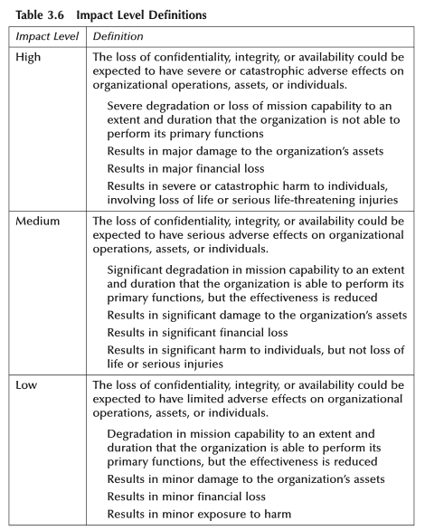

Slide 20
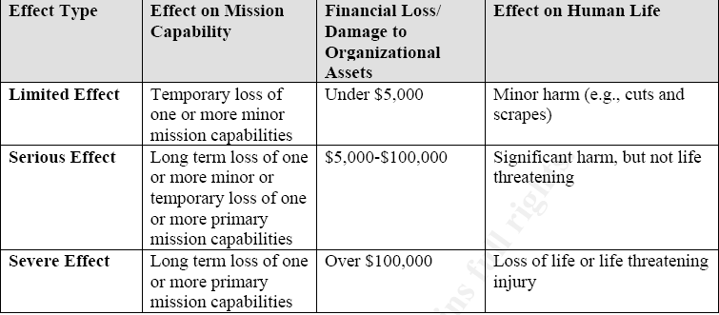
However, in order the risk analysis to be meaningful, reusable and easily communicated, specific ratings should be produced for the entire organization as below example .
Examples of Organizational Effect

Slide 21
Responses to Risk
Responses to risk
Avoid it completely by withdrawing from an activity
Accept it and do nothing
Reduce it with security measures

Slide 22
Security Measures
Possible security measures
Transfer the risk, e.g. insurance
Reduce vulnerability
Reduce likelihood of attempt
e.g. publicise security measures in order to deter attackers
e.g. competitive approach - the lion-hunter’s approach to security
Reduce likelihood of success by preventive measures
e.g. access control, encryption, firewall
Reduce impact, e.g. use fire extinguisher / firewall
Recovery measures, e.g. restoration from backup

Slide 23
CONTROL
The technical controls are safeguards that are incorporated into computer hardware, software, or ﬁrmware.
These would include access control mechanisms, identiﬁcation and authentication processes, encryption tools, and intrusion detection software.
Nontechnical controls are management and operational controls such as policies, procedures, standards, personnel security, and environ- mental control mechanisms.

Slide 25
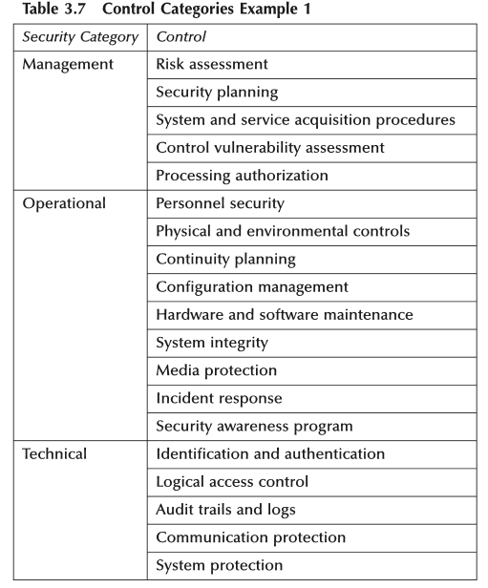

Slide 26
CONTROL CATEGORY
The control categories for both technical and nontechnical control methods can be further classiﬁed as:
Avoidance: Proactive safeguards that attempt to mini- mize the risk of accidental or intentional intrusions.
Assurance: Tools and strategies employed to ensure the ongoing effectiveness of the existing controls and safeguards
Detection: Techniques and programs used to ensure early detection, interception, and response for security breaches.
Recovery: Planning and response services to rapidly restore a secure environment and investigate the source of the breaches.

Slide 27
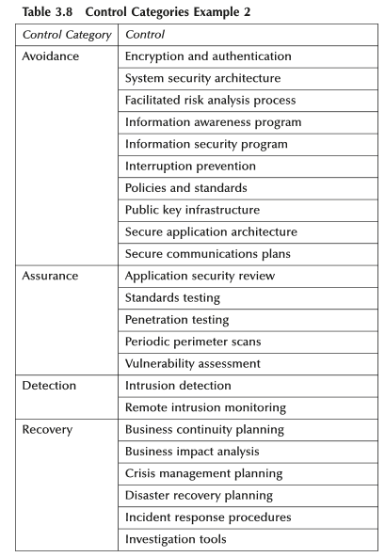

Slide 28
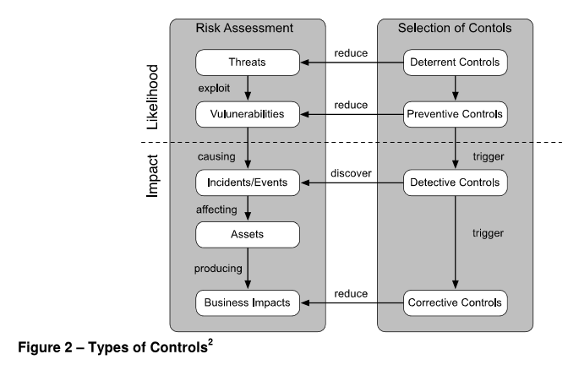
Source: Risk-Assessment-Process-Information-Security, New Zealand Gov

Slide 29
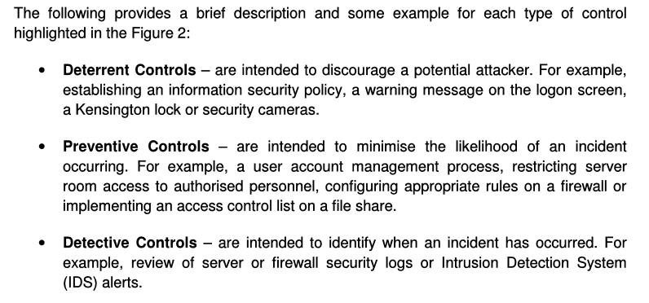

Slide 30
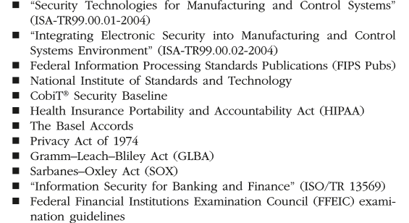
Some Common Risk Assessment methodologies
The following methodologies and tools were developed for managing risks in information systems:
National Institute of Standards & Technology (NIST) Methodology
OCTAVE®
FRAP
COBRA
Risk Watch

Slide 31
Identifying Assets, Vulnerabilities and Control NEXT: Assignment
(Continue your assignment before) Using your own organization, determine the assets, threats, impact, and vulnerabilities.
Fill them into the appropriate matrices.
Create matrices for Relating Threats to Vulnerabilities and control

Slide 32
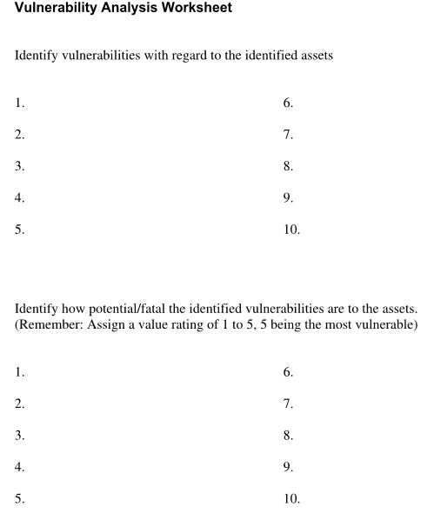

Slide 33
Reference
Information Security Risk Analysis, Peltier
Sanjay Goel, School of Business/Center for Information Forensics and Assurance, University at Albany Proprietary Information

