Slide 1
Analisis Resiko Sistem Informasi
Studi Kasus: Identifying vulnerability and control
Pertemuan 6 Dosen Pengampu: Alivia Yulfitri (2017)
Prodi Sistem Informasi - Fakultas Ilmu Komputer

Slide 2
Identifying Assets, Vulnerabilities and Control Assignment
(Continue your assignment before) Using your own organization, determine the assets, threats, impact, and vulnerabilities.
Fill them into the appropriate matrices.
Create matrices for Relating Threats to Vulnerabilities and control

Slide 3
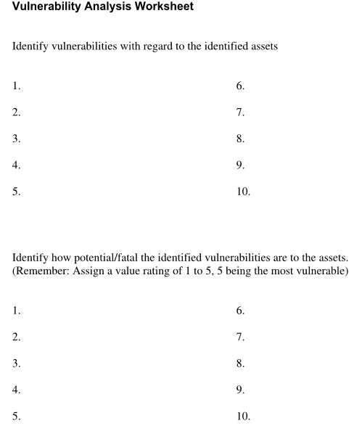

Slide 4
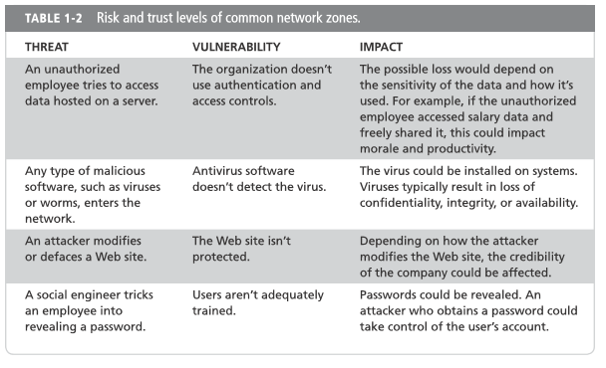
Source: [Darril_Gibson]_Managing_Risk_in_Information_System, page 22

Slide 6
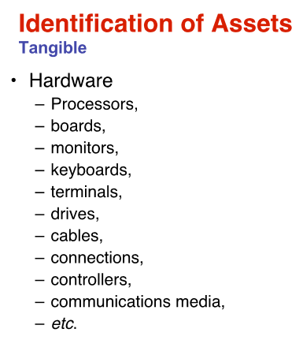
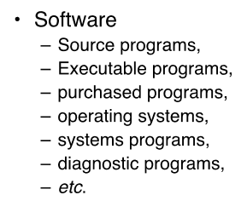
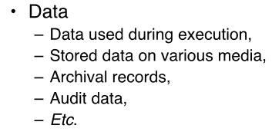

Slide 16
