Slide 1
Analisis Resiko Sistem Informasi
Qualitative Risk Analysis
Pertemuan Dosen Pengampu: Alivia Yulfitri (2017)
Prodi Sistem Informasi - Fakultas Ilmu Komputer

Slide 2
Qualitative Risk Analysis Outline for this unit
1: Qualitative Risk Analysis
2: Determine Assets and Vulnerabilities (Matrix Based Approach)

Slide 3
1 Risk Analysis: Qualitative Risk Analysis

Slide 4
Risk Analysis Outline
What are the difficulties with risk analysis?
What are the two different approaches?
What is the methodology for qualitative risk analysis?

Slide 5
Risk Analysis Approaches
Two Risk Analysis Approaches
Qualitative:
Based on literal description of risk factors and risk is expressed in terms of its potential. Threats and vulnerabilities are identified and analyzed using subjective judgment. Uses checklists to determine if recommended controls are implemented and if different information systems or organizations are secure.
Quantitative:
Relating to, concerning, or based on the amount or number of something, capable of being measured or expressed in numerical terms.

Slide 6
Risk Analysis: Qualitative Methodology
Qualitative risk analysis methodologies involve relative comparison of risks and prioritization of controls
Usually associate relationships between interrelated factors
Things of value for the organization
Threats: things that can go wrong
Vulnerabilities: Weaknesses that make a system more prone to attack or make an attack more likely to succeed
Controls: These are the countermeasures for vulnerabilities
It capitalizes on user experience and doesn’t resort to extensive data gathering.

Slide 7
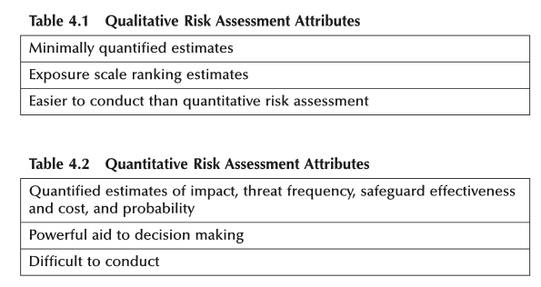

Slide 8
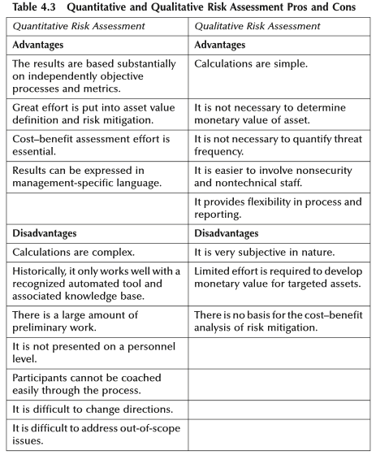

Slide 9
Qualitative Risk Analysis (QRA)
Generally used in Information Security
Hard to make meaningful valuations and meaningful probabilities
Relative ordering is faster and more important
Many approaches to performing qualitative risk analysis
Same basic steps as quantitative analysis
Still identifying asserts, threats, vulnerabilities, and controls
Just evaluating importance differently

Slide 10
10 Step QRA
Step 1: Identify Scope
Step 2: Assemble team
Step 3: Identify Threats
Step 4: Prioritize Threats
Step 5: Threat Impact
Step 6: Risk Factor Determination
Step 7: Identify Safeguards and Controls
Step 8: Cost–Beneﬁt Analysis
Step 9: Rank Safeguards in Recommended Order
Step 10: Risk Assessment Report
Source: Information Security Risk Analysis, Peltier

Slide 11
10 Step QRA
Step 1: Identify Scope
Bound the problem
Step 2: Assemble team
Include subject matter experts, management in charge of implementing, users
Step 3: Identify Threats
Pick from lists of known threats
Brainstorm new threats
Mixing threats and vulnerabilities here...

Slide 12
Step 4: Prioritize Threats
Prioritize threats for each assert
Likelihood of occurrence
Define a fixed threat rating
E.g., Low(1) … High(5)
Associate a rating with each threat
Approximation to the risk probability in quantitative approach

Slide 13
Step 5: Threat Impact
With each threat determine loss impact
Define a fixed ranking
E.g., Low(1) … High(5)
Used to prioritize damage to asset from threat

Slide 14
Step 6: Total impact (Risk Factor Determination)
Sum of threat priority and impact priority
Threat
Threat Priority
Impact Priority
Risk Factor
Fire
3
5
8
Water
2
5
7
Theft
2
3
5

Slide 15
Step 7: Identify Controls/Safeguards
Potentially come into the analysis with an initial set of possible controls
Associate controls with each threat
Starting with high priority risks
Do cost-benefits and coverage analysis (Step 8)
Rank controls (Step 9)

Slide 16
Safeguard Evaluation

Slide 17
Step 10: Risk Assessment Report/ Communicate Result
Most risk analysis projects result in a written report
Generally not read
Make a good executive summary
Beneficial to track decisions.
Real communication done in meetings an presentations

Slide 18
2 Matrix Based Approach

Slide 19
Matrix Based Approach Outline
What are the steps involved?
How do you fill in the matrices?
Asset/Vulnerability Matrix
Vulnerability/Threat Matrix
Threat/Control Matrix

Slide 20
Matrix Based Approach Methodology
Consists of three matrices
Vulnerability Matrix: Links assets to vulnerabilities
Threat Matrix: Links vulnerabilities to threats
Control Matrix: Links threats to the controls
Step 1
Identify the assets & compute the relative importance of assets
Step 2
List assets in the columns of the matrix.
List vulnerabilities in the rows within the matrix.
The value row should contain asset values.
Rank the assets based on the impact to the organization.
Compute the aggregate value of relative importance of different vulnerabilities

Slide 21
Matrix Based Approach Methodology
Step 3
Add aggregate values of vulnerabilities from vulnerability matrix to the column side of the threat matrix
Identify the threats and add them to the row side of the threat matrix
Determine the relative influence of threats on the vulnerabilities
Compute aggregate values of importance of different threats
Step 4
Add aggregate values of threats from the threat matrix to the column side of control matrix
Identify the controls and add them to the row side of the control matrix
Compute aggregate values of importance of different controls

Slide 22
Matrix Based Approach Determining L/M/H
There needs to be a threshold for determining the correlations within the matrices. For each matrix, the thresholds can be different. This can be done in two ways:
Qualitatively
determined relative to other correlations
e.g. asset1/vulnerability1 (L) is much lower than asset3/vulnerability3 (H) correlation. asset2/vulnerability2 correlation is in-between (M)
Quantitatively
determined by setting limits
e.g. if no correlation (0), if lower than 10% correlation (L), if lower than 35% medium (M), if greater than 35% (H)

Slide 23
Matrix Based Approach Extension of L/M/H
Although the example provided gives 4 different levels (Not Relevant, Low, Medium, and High), organizations may choose to have more levels for finer grained evaluation.
For example:
Not Relevant (0)
Very Low (1)
Low (2)
Medium-Low (3)
Medium (4)
Medium-High (5)
High (6)

Slide 24
Matrix Based Approach Assets and Vulnerabilities
Assets & Costs
Critical Infrastructure
Trade Secrets (IP)
Client Secrets
Reputation (Trust)
Lost Sales/Revenue
Cleanup Costs
Info/ Integrity
Hardware
Software
Services
Relative Impact
Scale
Not Relevant - 0
Low – 1
Medium – 3
High – 9
Value
Vulnerabilities
Web Servers
Compute Servers
Firewalls
Routers
Client Nodes
Databases
Customize matrix to assets & vulnerabilities applicable to case
Compute cost of each asset and put them in the value row
Determine correlation with vulnerability and asset (L/M/H)
Compute the sum of product of vulnerability & asset values; add to impact column

Slide 25
Matrix Based Approach Vulnerabilities and Threats
Vulnerabilities
Web Servers
Compute Servers
Firewalls
Routers
Client Nodes
Databases
…
…
…
…
Scale
Not Relevant - 0
Low– 1
Medium – 3
High – 9
Relative Threat Importance
Threats
Value
Denial of Service
Spoofing and Masquerading
Malicious Code
Human Errors
Insider Attacks
Intrusion …
Complete matrix based on the specific case
Add values from the Impact column of the previous matrix
Determine association between threat and vulnerability
Compute aggregate exposure values by multiplying impact and the associations

Slide 26
Matrix Based Approach Threats and Controls
Threats
Denial of Service
Spoofing
Malicious Code
Human Errors
Insider Attacks
Intrusion
Spam
Physical Damage
…
…
Value of Control
Scale
Not Relevant - 0 Low – 1
Medium – 3
High – 9
Controls
Value
Firewalls
IDS
Single Sign-On
DMZ
Training
Security Policy
Network Configuration
Hardening of Environment
Customize matrix based on the specific case
Add values from the relative exposure column of the previous matrix
Determine impact of different controls on different threats
Compute the aggregate value of benefit of each control

Slide 27
Matrix-Based Approach Review
This methodology used for qualitative analysis is a matrix-based approach.
The Matrix-based approach:
Brings transparency to risk analysis process
Provides a comprehensive methodology
Easy to use
Allows organizations to work with partial data
More data can be added as made available
Risk posture can be compared to other organization's
Determines controls needed to improve security

Slide 28
Matrix Based Approach Assignment
Go through the next modules in the unit to appropriately fill in the matrices presented in this module.

Slide 29
Qualitative Risk Analysis Summary
Qualitative risk analysis involves using relative values of assets, threats, vulnerabilities to:
Determine the relative exposure of different assets of the organization
Determine the relative effectiveness of different controls
The methodology developed here uses a series of matrices to collect the data on assets, vulnerabilities, threats and controls
Data from the matrices is integrated to determine the relative importance of controls
This approach is suitable when precise data for different elements is unavailable
Most organizations start with a qualitative analysis and gradually migrate to a quantitative analysis

Slide 30
Qualitative Risk Analysis Summary Cont’d.
Cost Benefit Analysis
LEVERAGE = (RISK EXPOSURE_{before reduction} – RISK EXPOSURE_{after reduction}) ________________________________________________ COST OF REDUCTION
Monte Carlo Simulation
1)Develop risk model, 2) Define the shape and parameters, 3)Run simulation, 4)Build histogram, 5)Compute summary statistics, 6)Perform sensitivity analysis, 7)Analyze potential dependency relationship

