Slide 1
Electronic Business (MGT-485)
Course Instructor: Tahir Mumtaz Awan

Slide 2
Contents to Cover
Instructor’s Profile
Course Readings and Course Distribution
Basics of electronic business
E-Business Types
Benefits of e-business
How Internet works?
History of Internet

Slide 3
Instructor’s Profile
PhD (Marketing) in progress from Sun Yat-sen University, China
Lecturer, Department of Management Sciences, COMSATS INSTITUTE OF INFORMATION TECHNOLOGY, ISLAMABAD since 2007
More than 6 years of Full time Teaching and Training Experience
About 5 years of Corporate Experience in the Marketing and Business Development departments of Construction and IT sector of Pakistan
Organizer and Operations Incharge for various International Conferences and Forums
Author of 19 academic research papers & Training Book for Liaison Officers and Technical Officers of SAF Games, 2004, Pakistan

Slide 4
Course Readings
Textbook:
Introduction to E-Business Management and Strategy
Author: Colin Combe
Publisher: Elsevier
Reference Material:
Handouts Provided by Instructor

Slide 5
Brief Course Contents
Introduction
E-business technology
E-business markets and models
E-marketing
The internet: law, privacy, trust and security
The management of e-business
E-business strategy: formulation
E-business strategy: implementation
E-business strategy: evaluation
Gaining and sustaining a competitive advantage
E-business: the future

Slide 6
E-Business is About Business
Business
Driving IT
E-Business
IT Driving
Business

Slide 7
Defining Business
According to businessdictionary.com
An organization or economic system where goods and services are exchanged for one another or for money.
Every business require some form of investment and enough customers to whom its output can be sold on a consistent basis in order to make a profit.
Businesses can be privately owned, not-for-profit or state-owned.
An example of a corporate business is PepsiCo, while a family catering business is a private enterprise.

Slide 8
Defining IT
According to techterms.com
IT Stands for "Information Technology,“
It refers to anything related to computing technology, such as networking, hardware, software, the Internet, or the people that work with these technologies.
Many companies now have IT departments for managing the computers, networks, and other technical areas of their businesses.
Since we live in the information age, IT has become a part of our everyday lives.

Slide 9
Defining e-Business
Derived from such terms as "e-mail" and "e-commerce”
In a more general sense, the term may be used to describe any form of electronic business — that is to say, any business which utilizes a computer.
This usage is somewhat ancient, however, and in most contexts e-business refers exclusively to Internet businesses.
E-business is a term used to describe businesses run on the Internet, or utilizing Internet technologies to improve the productivity or profitability of a business.
The conduct of business on the Internet, not only buying and selling but also servicing customers and collaborating with business partners.

Slide 10
Defining e-Business
The term was first used by IBM, in October, 1997, when it launched a thematic campaign built around the term.
Today, major corporations are rethinking their businesses in terms of the Internet and its new culture and capabilities.
Companies are using the Web to buy parts and supplies from other companies, to collaborate on sales promotions, and to do joint research.
Exploiting the convenience, availability, and world-wide reach of the Internet, many companies, such as Amazon.com, the book sellers, have already discovered how to use the Internet successfully.

Slide 11
Defining e-Business
One of the first to report sales in the millions of dollars directly from the Web was Dell Computer.
With the security built into today's browsers and with digital certificates now available for individuals and companies from Verisign (a certificate issuer) much of the early concern about the security of business transaction on the Web has decreased and e-business by whatever name is accelerating.

Slide 12
E-Business & E-Commerce
The most common implementation of e-business is as an additional, or in some cases primary, storefront.
By selling products and services online, an e-business is able to reach a much wider consumer base than any traditional brick-and-mortar store could ever hope for.
This function of e-business is referred to as e-commerce, and the terms are occasionally used interchangeably.

Slide 13
E-Business & E-Procurement
An e-business may also use the Internet to acquire wholesale products or supplies for in-house production.
This facet of e-business is sometimes referred to as e-procurement, and may offer businesses the opportunity to cut their costs dramatically.
Even many e-businesses which operate without an electronic storefront now use eprocurement as a way to better track and manage their purchasing.

Slide 14
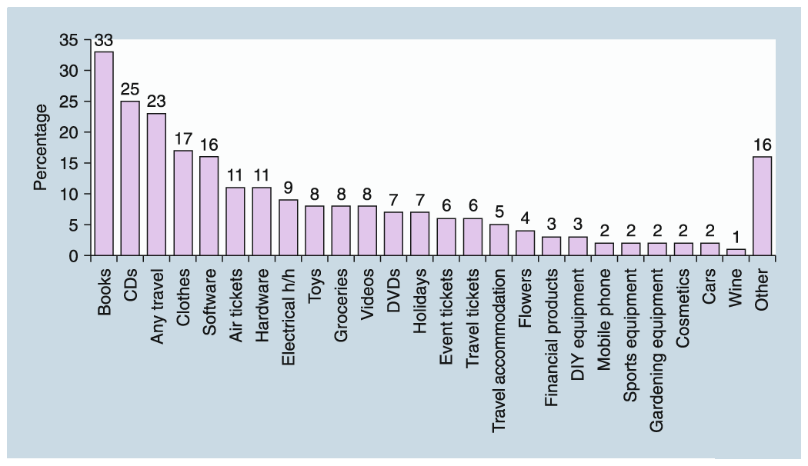
Popularity of online purchases
Source: The Internet Monitor, BMRB

Slide 15
Two early starters in e-business world
Echo-Bay (later became e-bay) and Amazon.com started their businesses with the commercialization of internet in 1995-96.
e-bay did the first sale on internet in 1996.
Amazon did not had profits till 2001.

Slide 16
E-Business Types
B2B
it is that business activity in which 2 firm or business units make electronic transaction in which 1 can be a producer firm and other are raw material supplier firm.
B2C
In B2C commerce, 1 party is the firm and other party is a customer.
Customer can seek information , can place an order, get some items on the Internet and can also make the payment.

Slide 17
E-Business Types
Intra B commerce
Under this, the parties involved are 2 persons or departments of some business unit.
Use of computer network makes it possible for the marketing department to interact constantly with the production.
A firms transactions or interactions with its employees are some time refer to as B to E commerce.
Employees can use electronic catalogue and ordering forms.
C to C commerce
under C to C commerce, both the parties involved are customers.

Slide 18
Benefits of E-Business
Enhanced precision, quality and time required for updating and delivering information on products or services.
Possibility for customers to access the catalogues and prices at any time of the day-every day.
The way of ordering is easy, fast and immediate.
Improved market, industry or competitor intelligence gained through research activities and information gathering.

Slide 19
Benefits of E-Business
Electronic delivery of some products and services ( publications, software, translation services, banking, etc.) via new distribution channels.
Evident expansion of customer base and rise in export opportunities.
Routine administrative tasks such as invoices and order records are reduced by e-business so staff can focus on more strategic activities.

