Slide 1
E-business: the future
Pertemuan ke 12

Slide 2
MEASURING EBUSINESS SUCCESS
Most companies measure the traffic on a Web site as the primary determinant of the Web site’s success
However, a large amount of Web site traffic does not necessarily equate to large sales
Many organizations with high Web site traffic have low sales volumes
The Yankee Group reports that 66 percent of companies determine Web site success solely by measuring the amount of traffic
New customer acquisition ranked second
Revenue generation ranked third
Notes:
An organization must measure more than just traffic to determine the efficiency and effectiveness of its websites
Ask your students what types of things an organization can monitor to determine the efficiency and effectiveness of its websites
Ans: Revenue generated by Web traffic
Number of new customers acquired by Web traffic
Reductions in customer service calls resulting from Web traffic
The Yankee Group reports that 66 percent of companies determine website success solely by measuring the amount of traffic
New customer acquisition ranked second
Revenue generation ranked third

Slide 3
MEASURING E-BUSINESS SUCCESS
Web site traffic analysis can include:
Cookie – a small file deposited on a hard drive by a Web site containing information about customers and their Web activities
Click-through – a count of the number of people who visit one site and click on an advertisement that takes them to the site of the advertiser
Banner ad – a small ad on one Web site that advertises the products and services of another business, usually another dot-com business
Interactivity – visitor interactions with the target ad
Notes:
website traffic analysis can include:
Cookie – a small file deposited on a hard drive by a website containing information about customers and their Web activities
Click-through – a count of the number of people who visit one site and click on an advertisement that takes them to the site of the advertiser
Banner ad – a small ad on one website that advertises the products and services of another business, usually another dot-com business
Interactivity – visitor interactions with the target ad
Analyzing website traffic is one way organizations can understand the effectiveness of Web advertising
Ask your students how interactivity is a giant advancement in the advertising industry
Ans: Prior to computers there was no way for the advertiser to know if the customer actually read or even looked at an ad in a newspaper or magazine
Interactivity measures allow advertisers to know exactly how long a customer spends viewing an ad
Ask your students about privacy and how do these types of Web traffic analysis tools invade user privacy

Slide 4
MEASURING E-BUSINESS SUCCESS
Prior to computers there was no way for the advertiser to know if the customer actually read or even looked at an ad in a newspaper or magazine
Interactivity measures allow advertisers to know exactly how long a customer spends viewing an ad
How do these types of Web traffic analysis tools invade user privacy?
Analyzing Web site traffic is one way organizations can understand the effectiveness of Web advertising

Slide 5
Website Metrics
Clickstream data tracks the exact pattern of a consumer’s navigation through a website
Clickstream data can reveal:
Number of pageviews
Pattern of websites visited
Length of stay on a website
Date and time visited
Number of customers with shopping carts
Number of abandoned shopping carts
Notes:
Click-stream data can reveal a number of basic data points on how consumers interact with websites
Ask your students what an organization can learn from understanding click-stream data
For example, what does number of abandoned shopping carts tell an organization?

Slide 6
Website Metrics
Web site metrics include:
Visitor metrics
Unidentified visitor, session visitor, tracked visitor, identified visitor
Exposure metrics
Page exposure, site exposure
Visit metrics
Stickiness (visit duration), total web pages exposure per session, total unique web page exposure per session
Hit metrics
Hits (each element of a requested page including graphics, text, interactive items is a hit), qualified hits (exclude less important hits such as error messages
Notes:
Review each section of the website metrics Figure for a detailed listing of visitor, exposure, visit, and hit metrics
CLASSROOM EXERCISE
Measuring Metrics
Break your students into groups and assign each group one of the four categories found in the above Figure
Have your students detail each category explaining how each metric can be used to help an organization improve its operations
Ask your students to share their answers with the class

Slide 7
EBUSINESS BENEFITS AND CHALLENGES
E-business benefits include:
Highly Accessible - Businesses can operate 24 hours a day, 7 days a week, 365 days a year
Increased Customer Loyalty - Additional channels to contact, respond to, and access customers helps contribute to customer loyalty
Improved Information Content- In the past, customers had to order catalogs or travel to a physical facility before they could compare price and product attributes. Electronic catalogs and Web pages present customers with updated information in real-time about goods, services, and prices
Notes:
ebusiness benefits include:
Highly Accessible - Businesses can operate 24 hours a day, 7 days a week, 365 days a year
Increased Customer Loyalty - Additional channels to contact, respond to, and access customers helps contribute to customer loyalty
Improved Information Content- In the past, customers had to order catalogs or travel to a physical facility before they could compare price and product attributes. Electronic catalogs and Web pages present customers with updated information in real-time about goods, services, and prices
Increased Convenience - ebusiness automates and improves many of the activities that make up a buying experience
Increased Global Reach - Businesses, both small and large, can reach new markets
Decreased Cost - The cost of conducting business on the Internet is substantially smaller than traditional forms of business communication
Which benefit would you pick if asked to identify the most important ebusiness benefit?
Would it change depending on the industry?
Would it change depending on the company?
Would it change depending on the customer?

Slide 8
EBUSINESS BENEFITS AND CHALLENGES
Increased Convenience - E-business automates and improves many of the activities that make up a buying experience
Increased Global Reach - Businesses, both small and large, can reach new markets
Decreased Cost - The cost of conducting business on the Internet is substantially smaller than traditional forms of business communication
Notes:
ebusiness benefits include:
Highly Accessible - Businesses can operate 24 hours a day, 7 days a week, 365 days a year
Increased Customer Loyalty - Additional channels to contact, respond to, and access customers helps contribute to customer loyalty
Improved Information Content- In the past, customers had to order catalogs or travel to a physical facility before they could compare price and product attributes. Electronic catalogs and Web pages present customers with updated information in real-time about goods, services, and prices
Increased Convenience - ebusiness automates and improves many of the activities that make up a buying experience
Increased Global Reach - Businesses, both small and large, can reach new markets
Decreased Cost - The cost of conducting business on the Internet is substantially smaller than traditional forms of business communication
Which benefit would you pick if asked to identify the most important ebusiness benefit?
Would it change depending on the industry?
Would it change depending on the company?
Would it change depending on the customer?

Slide 9
EBUSINESS BENEFITS AND CHALLENGES
E-business challenges include:
Protecting consumers
Leveraging existing systems
Increasing liability
Providing security
Adhering to taxation rules
Notes:
Review the figure for a full listing of ebusiness challenges
Which challenge would you pick if asked to identify the most difficult ebusiness challenge?
Would it change depending on the industry?
Would it change depending on the company?
Would it change depending on the customer?

Slide 10
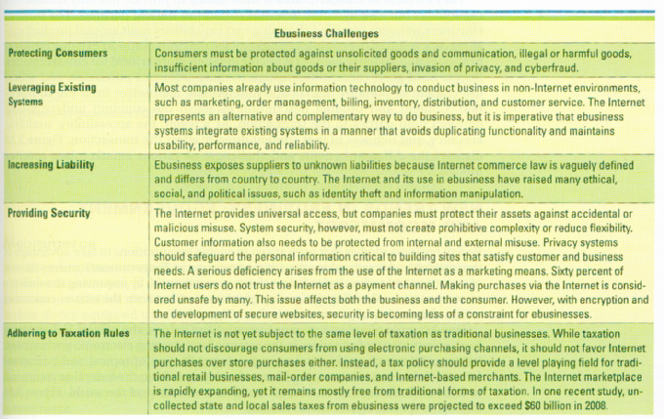
EBUSINESS BENEFITS AND CHALLENGES
Notes:
Review the figure for a full listing of ebusiness challenges
Which challenge would you pick if asked to identify the most difficult ebusiness challenge?
Would it change depending on the industry?
Would it change depending on the company?
Would it change depending on the customer?

Slide 11
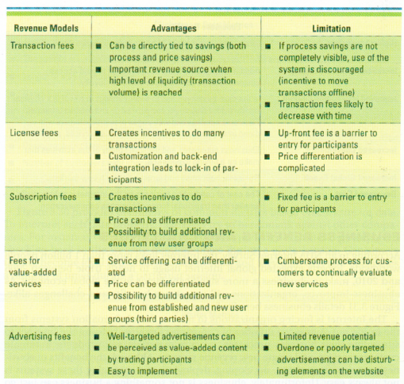
EBUSINESS BENEFITS AND CHALLENGES
Notes:
Review the benefits and challenges Figure for a detailed listing of the various advantages and limitations in the ebusiness revenue model
Which type of revenue model would an ASP find most lucrative?
Which type of revenue model would an ISP find most lucrative?
Which type of revenue model would an online auction website find most lucrative?
Which type of revenue model would an online search engine such as Google find most lucrative?

Slide 12
NEW TRENDS IN EBUSINESS: EGOVERNMENT AND MCOMMERCE
E-government - involves the use of strategies and technologies to transform government(s) by improving the delivery of services and enhancing the quality of interaction between the citizen-consumer within all branches of government
C2G – eGov.com
B2G – lockheedmartin.com
G2B – export.gov,
G2C – medicare.gov
G2G – disasterhelp.gov
Notes:
The chapter discussed many ways that businesses are growing and increasing profits through ebusiness
How can egovernment use some of the trends discussed throughout the chapter to help reduce costs and increase revenue?

Slide 13
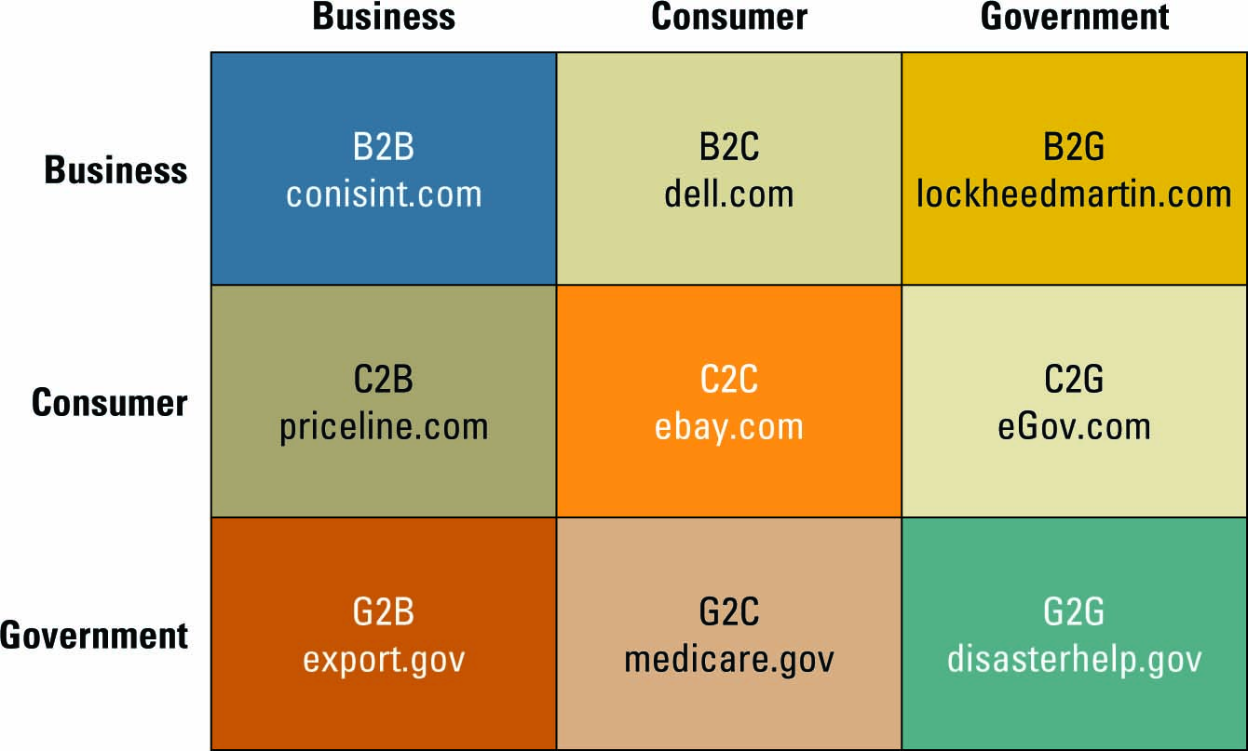
NEW TRENDS IN EBUSINESS: EGOVERNMENT AND MCOMMERCE
Notes:
Review the website http://firstgov.gov/ - the official U.S. gateway to all government information
This website is a catalyst for a growing electronic government
Ask your students to review the following websites to further understand the progress being made in egovernment
C2G – eGov.com
B2G – lockheedmartin.com
G2B – export.gov
G2C – medicare.gov
G2G – disasterhelp.gov

Slide 14
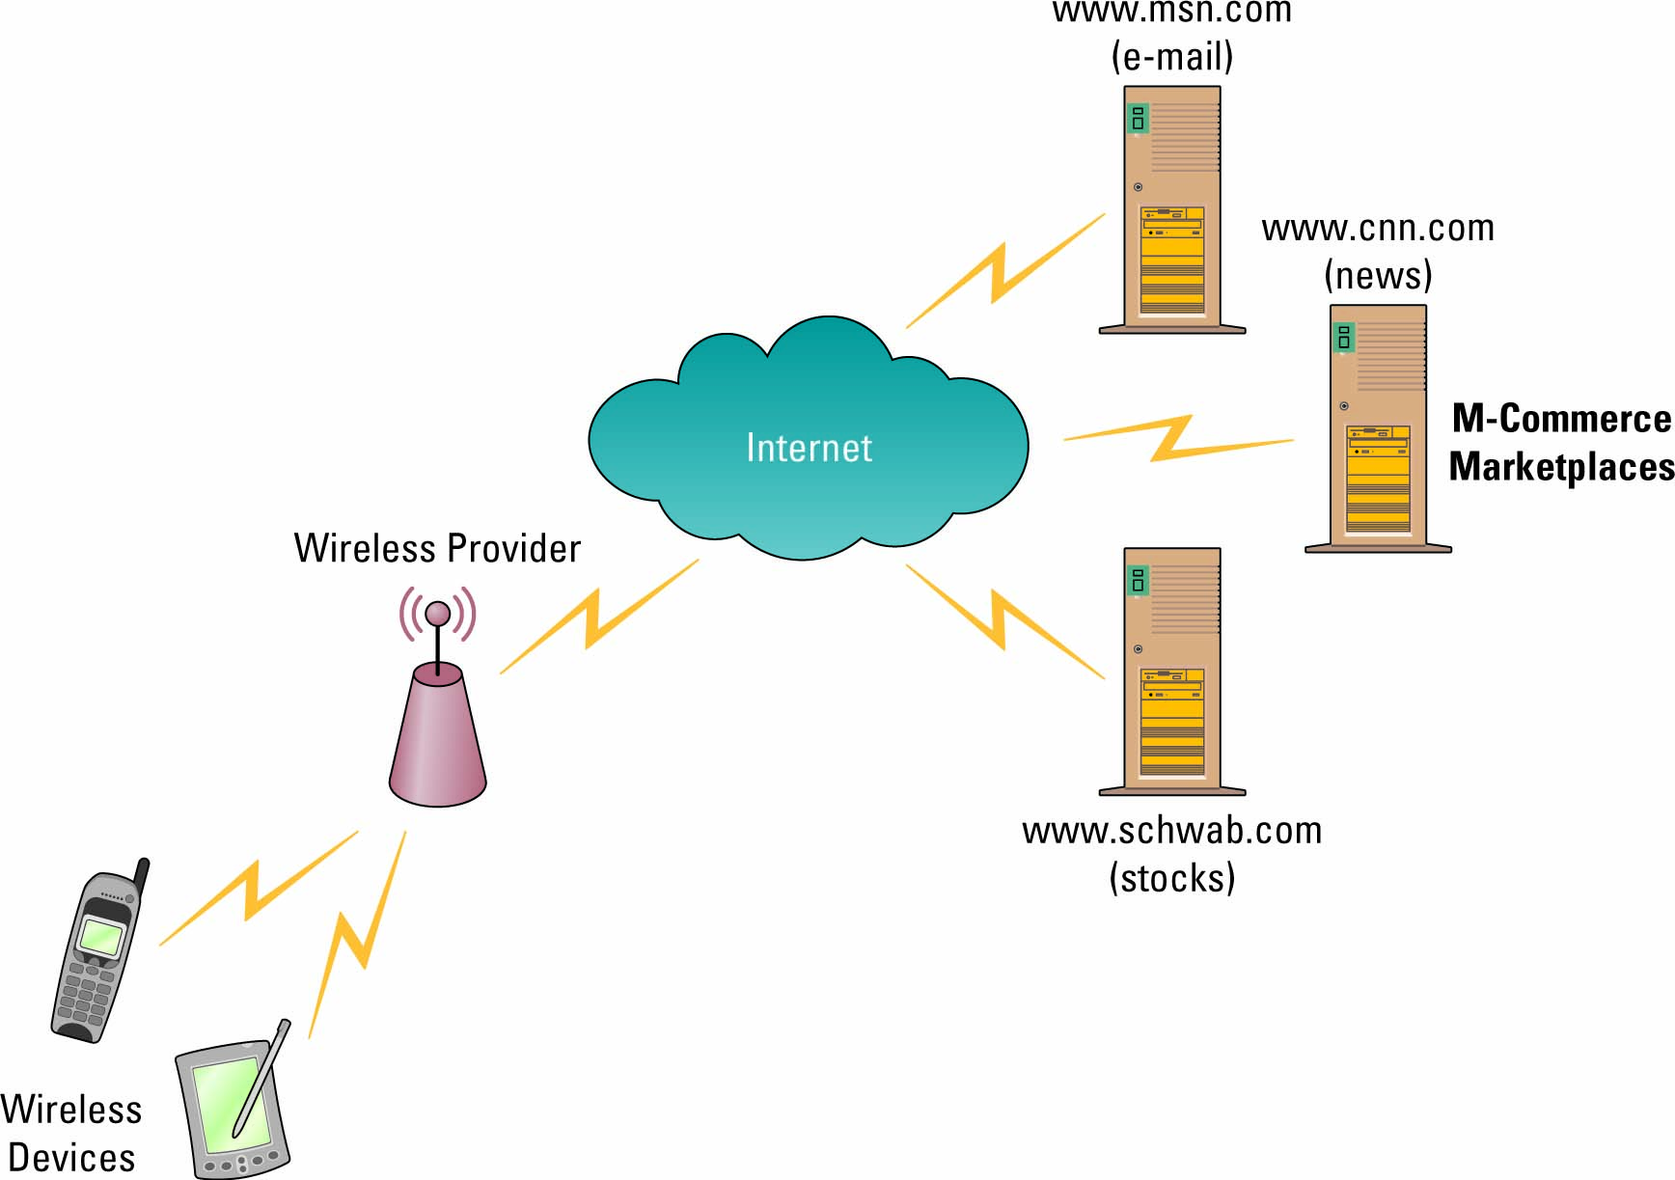
NEW TRENDS IN E-BUSINESS: E-GOVERNMENT AND M-COMMERCE
Mobile commerce - the ability to purchase goods and services through a wireless Internet-enabled device
Notes:
CLASSROOM EXERCISE
Mobile Mania
Ask your students to develop a product or service that could be used in the mcommerce market
A device to download music and videos through wireless
Purchase goods and services through a cell phone

Slide 15
OPENING CASE QUESTIONS Amazon
What is Amazon’s ebusiness model?
Amazon.com is a B2B, C2C, and a B2C. Amazon.com does business with other businesses (B2B), such as Borders, Target, and Office Depot.
Amazon.com also supports a huge business-to-consumer model with their main website interface.
Amazon also supports customers doing business with other customers (C2C).

Slide 16
OPENING CASE QUESTIONS Amazon
How can Amazon use m-commerce to influence its business?
m-commerce enables consumers to buy on the fly, from handheld devices and mobile phones.
Using Amazon.com’s one-click, customers could search for and buy any of Amazon's offerings, from DVDs and CDs to books and toys, and do it anywhere.
Which means customers would have the use of shopping in a traditional brick-and-mortar store, use comparative shopping methods, search Amazon.com for its price, and make a purchasing decision accordingly.

Slide 17
OPENING CASE QUESTIONS Amazon
Which metrics could Amazon use to assess the efficiency and effectiveness of Amazon’s website?
click-through – to determine how many customers visit the site from another site
banner-ad – to determine how many customers visit the site from a banner ad on another site
the number of page views to determine the number of pages presented to a visitor, the pattern of websites visited, including most frequent exit page and most frequent prior website
Notes:
5. What is Amazon’s ebusiness model?
This is somewhat of a trick question, because the answer is that Amazon.com is a B2B, C2C, and a B2C. Amazon.com does business with other businesses (B2B), such as Borders, Target, and Office Depot. Amazon.com also supports a huge business-to-consumer model with their main website interface. Amazon also supports customers doing business with other customers (C2C).
6. How can Amazon use mcommerce to influence its business?
mcommerce enables consumers to buy on the fly, from handheld devices and mobile phones. Using Amazon.com’s one-click, customers could search for and buy any of Amazon's offerings, from DVDs and CDs to books and toys, and do it anywhere. Which means customers would have the use of shopping in a traditional brick-and-mortar store, use comparative shopping methods, search Amazon.com for its price, and make a purchasing decision accordingly.
7. Which metrics could Amazon use to assess the efficiency and effectiveness of Amazon’s website?
Amazon could use the following metrics to asses its website.
Click-through – to determine how many customers visit the site from another site, banner-ad – to determine how many customers visit the site from a banner ad on another site, the number of page views to determine the number of pages presented to a visitor, the pattern of websites visited, including most frequent exit page and most frequent prior website, length of stay on the website, dates and times of visits to determine customer spending habits, number of abandoned shopping carts to determine why customers are leaving the site, identified visitors who purchase recommended products to determine if personalization is working
8. What are some of the business challenges facing Amazon?
There are several challenges facing Amazon including protecting its customers from unsolicited goods and illegal or harmful communication. Amazon offers a number of third-party services and it must ensure those parties are operating as expected. If a customer purchases a product from a third-party seller on Amazon and the goods are never shipped, Amazon is held responsible. It must also deal with security issues such as identity theft if there was a breach in its customer systems since it maintains customer credit card numbers. It must also ensure it is adhering to tax laws.

