Slide 1
IoT Paradigm
CSI 421-Internet Of Things
Universitas Esa Unggul

Slide 2
IoT Paradigm
Semua Bahan mengacu kepada buku : The Internet of Things: Enabling Technologies, Platforms, and Use Cases [Pethuru Raj, Anupama C. Raman]

Slide 3
Why the IoT Is Strategically Sound
IoT Leads to Smarter Computing
IoT Delivers Smarter Environments
IoT Prescribes the Shift toward People IT

Slide 4
Enterprise transformation happens by doing the following ve things:
Infrastructure optimization
Process excellence
Architecture assimilation
Technology adaption and adoption
Leverage data (internal as well as external) toward actionable insights

Slide 5
The Diversity of IoT Data Sources
Data from passive sources
Data from active sources
Data from dynamic sources (fog devices)

Slide 6
The evolution of the Internet paradigm

Slide 7
The Popular M2M Applications
Smart Energy
Smart Health Care
Smart Home Security
Smart Cargo Handling
Smart Traffic Management
Smart Inventory and Replenishment Management
Smart Cash Payment
Smart Tracking
Smart Displays
Smart Cargo Handling
Smart Traffic Management
Smart Inventory and Replenishment Management
Smart Cash Payment
Smart Tracking
Smart Displays
Smarter Manufacturing
Smart Asset Management
Smarter Retailing

Slide 8
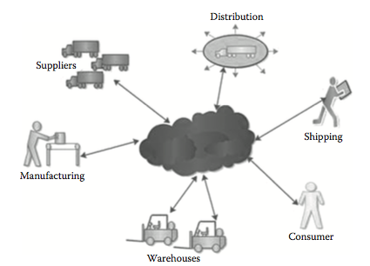
A cloud-based integrated environment

Slide 9
Google cloud platform architecture for stream processing from millions of intelligent devices.

Slide 10
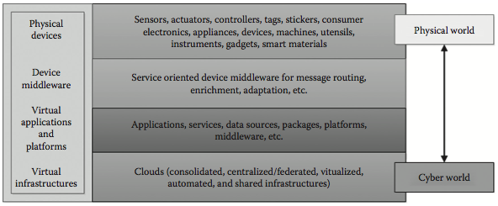
The integration of cyber and physical worlds.

Slide 11
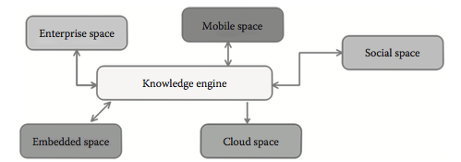
The futuristic integrated environments.

Slide 12
The IoT: The Key Application Domains
New business possibilities
Tending toward the insights as a service (IaaS) era
Fresh revenue opportunities
Automation at its peak

Slide 13
The IoT Challenges and the Research Domains
Energy-efficient device architectures
Elastic IoT infrastructures
Highly optimized communication protocol
Data deduplication and compression mechanisms
Data reliability
Device security

Slide 14
The Industrial Internet of Things (IIoT)
Improving operational effciency
Optimizing assets
Envisioning next-gen services
Exploring fresh avenues for higher revenues

Slide 15
Few sectors wherein the IoT is bound to make waves of distinct automation:
Automotive industry
Energy industry
Health care
Industrial
Retail
Smart buildings

Slide 16
Device-to-cloud integration by AWS IoT.

Slide 17
Consumer IoT market are as follows:
Revenue generation solutions
An ecosystem of developers to create great apps
Help at the design stage to make apps an integral part of a manufacturer’s IoT strategy
A global highly scalable cloud platform to handle connections with millions of connected devices
Security solutions for authentication and data protection
Compelling on-device and companion app store experience
Web stores for ease of viewing IoT app catalog on regular devices
Software updating and management solutions
An app supply chain compatible with, and tested for, each device
Integrations with the device and the manufacturer’s back-end systems
Support for the lifecycle of the device software

Slide 18
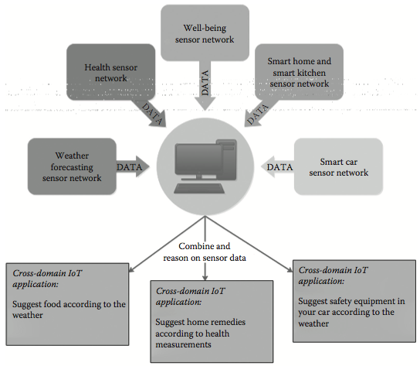
Device-to-device (D2D) integration

Slide 19
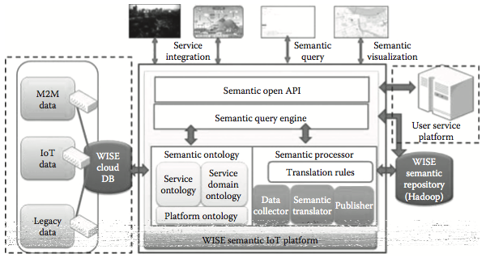
The semantic IoT platform architecture for weather information service engine

