Slide 1
Futuristic Smart Case : smart airport
CSI 421-Internet Of Things
Universitas Esa Unggul

Slide 2
Futuristic Smart
Case : smart airport
Semua Bahan mengacu kepada buku : The Internet of Things: Enabling Technologies, Platforms, and Use Cases [Pethuru Raj, Anupama C. Raman]

Slide 3
Present day airports are at the forefront of technological innovation. is is mainly due to the fact that the number of air travel passengers is exponentially increasing every year, and the present day airports do not have the infrastructure to support this ever-increasing number of passengers and o er them a pleasurable travel experience.
Travel experience of the passengers plays a vital role in determining the revenue which is generated by the aviation sector.
In order to boost the revenue by apt adoption of processes and technological interventions, present day airport authorities have become frontrunners in the adoption of all cutting edge technologies like cloud computing, big data analytics, and Internet of Things (IoT).

Slide 4
the core pillars of this airport
◾ Mobiledevices
◾ Mobiletechnology
◾ Wearables
◾ RFID/sensors
◾ Beacons

Slide 5
the burning issues faced by passengers :
◾ Baggage issues: Missing, lost or mishandled baggage, delay in baggage claiming and tracking
◾ Check-in delays: Delays for check-in at airport entrance and check-in counters especially in peak travel and holiday season
◾ Disruption management: Passenger inconvenience caused due to delayed and cancelled ights

Slide 6
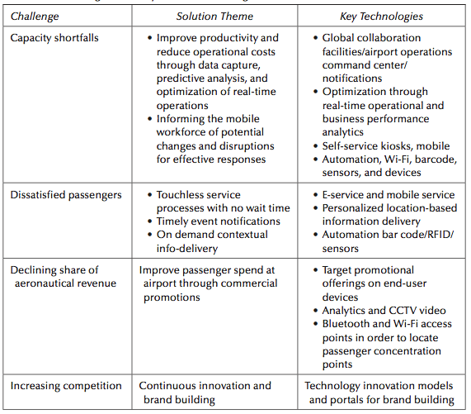

Slide 7
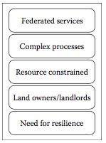
Operational model of manual airport

Slide 8
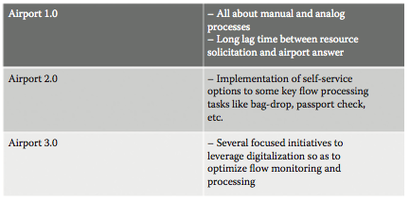
Classification of airports

Slide 9
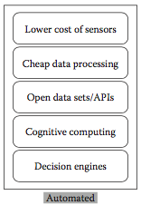
Features of automated airports (Airport 3.0 )

Slide 10
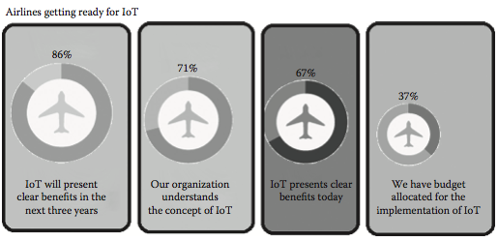
Recent studies of IoT integration in airports

Slide 11
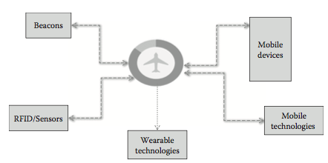
Components of IoT ecosystem in airports

Slide 12
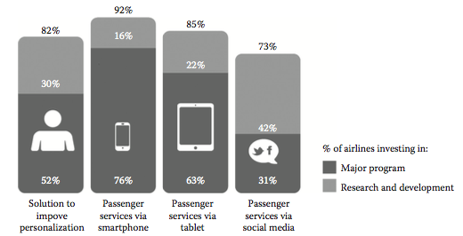
Role of mobile devices in airports

Slide 13
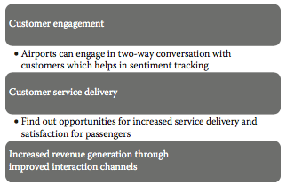
Uses of social media for airports

Slide 14
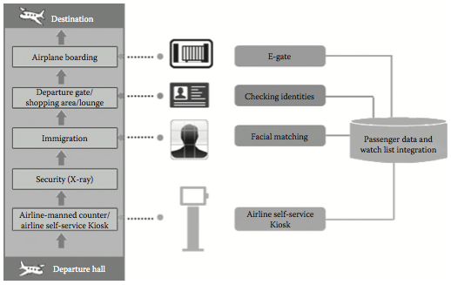
Biometric applications in airports

