Slide 1
Futuristic Smart Case : smart Health Care
CSI 421-Internet Of Things
Universitas Esa Unggul

Slide 2
Futuristic Smart
Case : smart Health Care
Semua Bahan mengacu kepada buku : The Internet of Things: Enabling Technologies, Platforms, and Use Cases [Pethuru Raj, Anupama C. Raman]

Slide 3
The health care sector is amidst an era of technological revolution in an attempt to overcome the various issues which are faced by them due to various aspects like aging infrastructure and lack of adoption of appropriate technologies at correct points in time in the past.
Another critical problem which is faced by the health care sector is the huge amounts of large-sized data sets which are generated by them.
Traditional storage infrastructure and technologies are not efficient to handle these huge amounts of data.

Slide 4
Promising bene ts to the health care organizations
◾ Drastic reduction in the infrastructure cost of health care organizations
◾ Scalable infrastructure which can store the huge piles of data which are generated by the health care sector
◾ 24/7 availability of the infrastructure components which can o er enhanced experience for the patients

Slide 5
The main drivers
◾ Provide quick access to health care
◾ Increase the quality of health care facility
◾ Reduce the time required to get good-quality health care

Slide 6
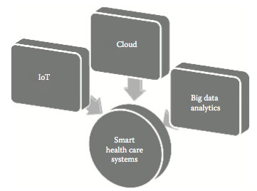
Role of IoT, cloud, and big data analytics in smart health care

Slide 7
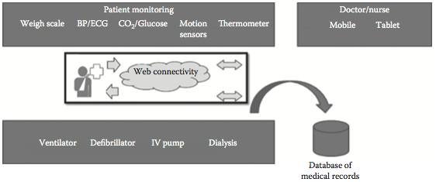
Clinical care system

Slide 8
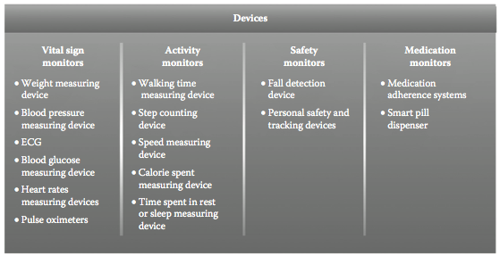
Different types of monitoring devices

Slide 9
The different types of sensors and devices used :
◾ Weight sensors
◾ Activitymonitors
◾ Heart rate and pressure monitors
◾ Connectedtreadmill

Slide 10
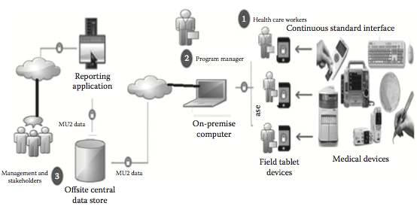
Architecture for telemedicine

Slide 11
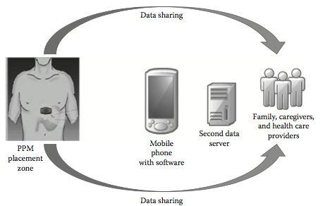
Architecture of ingestible sensor.

Slide 12
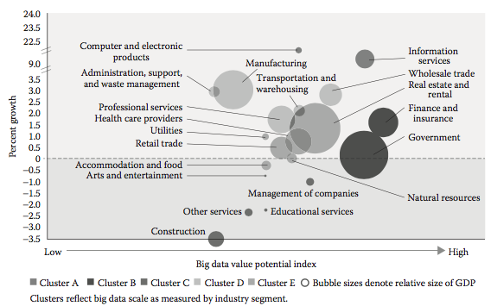
Amount of data generated by various industry sectors

Slide 13
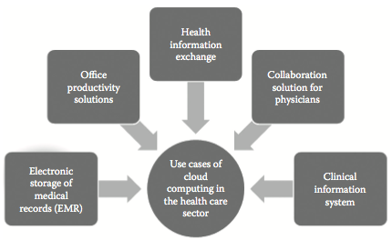
Use cases of cloud computing in health care

Slide 14
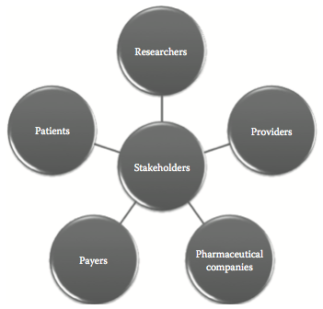
Stakeholders of big data analytics in health care sector

Slide 15
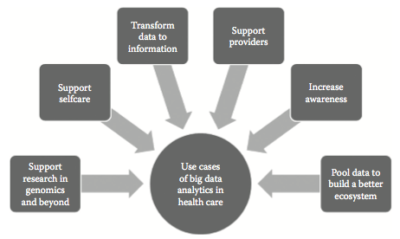
Use cases of big data analytics in health care

Slide 16
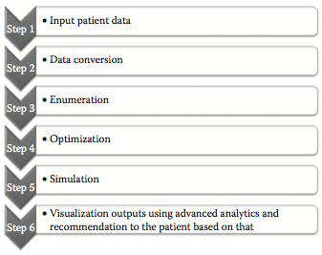
Process steps in GNS Healthcare

Slide 17
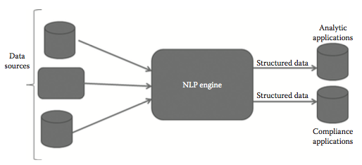
Architecture of NLP System

Slide 18
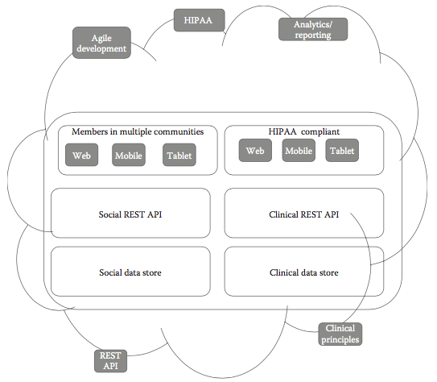
Platform of One Health Solutions

