Slide 1
Futuristic Smart Case : smart use case in Home living
CSI 421-Internet Of Things
Universitas Esa Unggul

Slide 2
Futuristic Smart
Case : smart use case in Home living
Semua Bahan mengacu kepada buku : The Internet of Things: Enabling Technologies, Platforms, and Use Cases [Pethuru Raj, Anupama C. Raman]

Slide 3
By the year 2020, we are expected to have 7.6 billion people and approximately about 50–75 billion connected objects.
What does this figure indicate? e number of connected devices will soon surpass the number of human beings who are present on earth. is gure itself throws light on the plethora of opportunities that IoT and its allied technologies o er to mankind.
The key objective of using the IoT technology is for the transformation of objects into smart objects, which can make our lives easy.

Slide 4
The three broad categories, which we have considered in this chapter, are the following:
◾ Industrialusecases
◾ Consumer use cases
◾ Governanceusecases

Slide 5
Under industrial use cases, we have mainly focused on two broad use cases:
◾ Smart energy
◾ Smarttransportationsystems

Slide 6
Under consumer use cases, we have mainly focused on the following:
◾ Smarthomes
◾ Smartbuildings
◾ Smart education systems

Slide 7
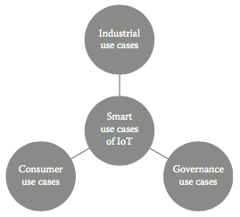
Smart use cases of IoT

Slide 8
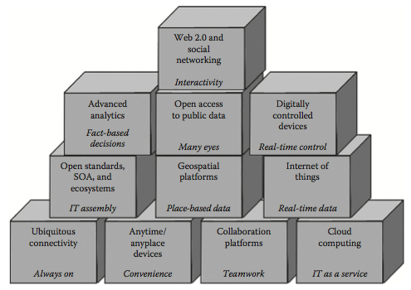
Technologies for building smart cities

Slide 9
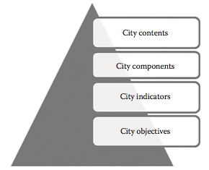
Strategic governance framework for smart city

Slide 10
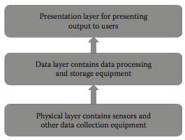
Architecture for intelligent energy conservation

Slide 11
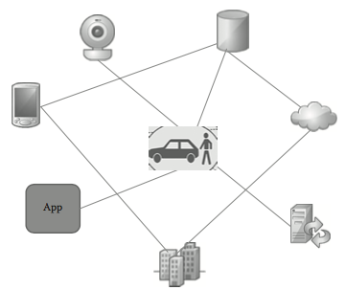
Connected Car.

Slide 12
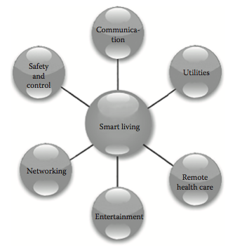
Use cases of smart homes

