Slide 1
Security Management of an IoT Ecosystem
CSI 421-Internet Of Things
Universitas Esa Unggul

Slide 2
Security Management of an IoT Ecosystem
Semua Bahan mengacu kepada buku : The Internet of Things: Enabling Technologies, Platforms, and Use Cases [Pethuru Raj, Anupama C. Raman]

Slide 3
The IoT infrastructure in its entirety contains a wide gamut of technologies like cloud, big data, mobile devices, and Internet of things.
Each of these technological components are susceptible to various types of security vulnerabilities and threats, which can render them ine ective.
It is very important to ensure that the IoT infrastructure components are adequately safeguarded from various security breaches.
The crux of this chapter is the techniques to be adopted for securing the IoT platforms and technologies, which form a part of the IoT ecosystem.

Slide 4
identify security threats based on the four key platforms and technologies
◾ Security concerns in mobile devices and platforms, which are used by IoT applications
◾ Security concerns in big data platforms
◾ Security concerns in cloud
◾ Security concerns in IoT platforms

Slide 5
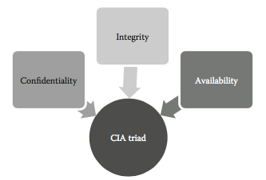
CIA triad.

Slide 6
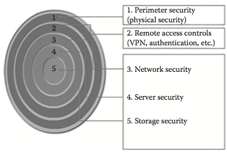
Architecture of defense-in-depth

Slide 7
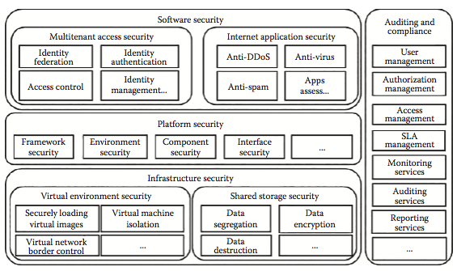
Cloud security architecture.

Slide 8
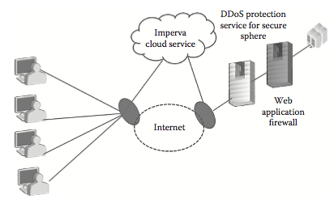
Architecture of Imperva SecureSphere.

Slide 9
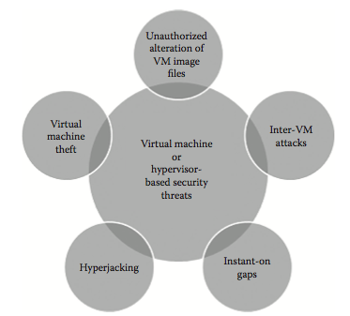
Virtual machine based security threats

Slide 10
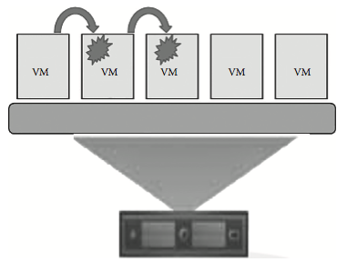
How inter-VM attacks happen

Slide 11
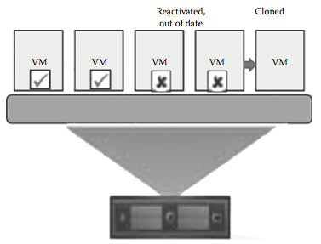
Instant-on gaps

Slide 12
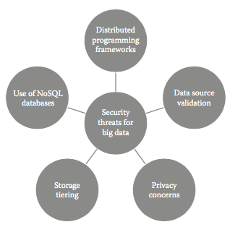
Security threats for big data.

Slide 13
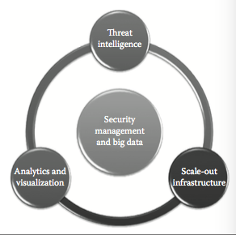
Security management framework for big data

Slide 14
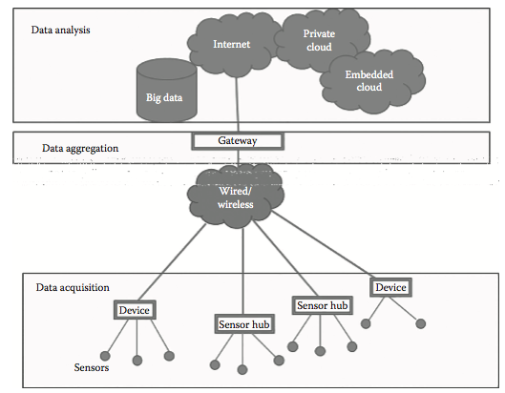
Security concerns in IoT devices

Slide 15
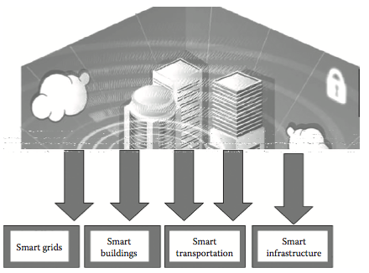
Security threats in different IoT use cases.

