Slide 1
Machine to machine integration
CSI 421-Internet Of Things
Universitas Esa Unggul

Slide 2
Konsep Device to device integration
Konsep Machine to machine integration
Popular M2M application
Semua Bahan mengacu kepada buku : The Internet of Things: Enabling Technologies, Platforms, and Use Cases [Pethuru Raj, Anupama C. Raman]

Slide 3
Machine-to-machine (M2M) services have revolutionized the wireless world leading to the evolution of a plethora of technologies and services to support M2M.
M2M services are closely tied to the IoT device world, and hence the mobile technologies and services that have evolved to support M2M are part of IoT ecosystem as well

Slide 4
Some of the protocols and technologies for IoT :
◾ 5G
◾ UWB
◾ NFC
◾ ISO 18000 7 DASH7
One of the key challenges of the IoT world is power management, that is, how to provide power to the billions and trillions of devices that are a part of the IoT ecosystem.

Slide 5
Low-power wide area networking (LPWAN) technologies are prominently used for interconnection of devices and applications in the IoT ecosystem.
The protocols are following:
Sigfox
Weightless
Nwave
Ingenu
LoRa

Slide 6
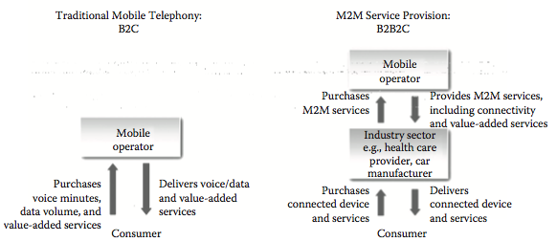
Traditional mobile versus M2M

Slide 7
Architecture for IoT Using Mobile Devices
Data are collected from a wide range of sources and equipment using mobile phones.
These data are transferred using the various wired and wireless networking options.
These data are used as an input for service delivery platform (SDP) that runs several IoT application services.

Slide 8
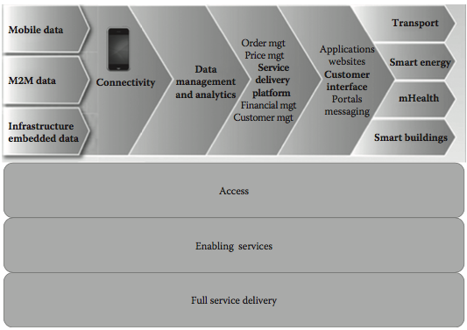
Architecture for IoT using mobile devices

Slide 9
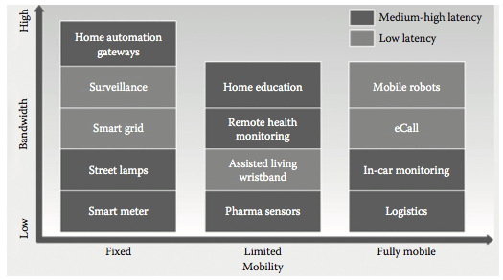
Latency and bandwidth requirements of various types of IoT services.

Slide 10
Mobile Technologies for Supporting IoT Ecosystem 5G Technology
The main requirements of a mobile network to support IoT devices are the following:
◾ Support for massive number of devices (10–100 times more device support than the existing networks)
◾ Support for high data rate (increase the existing data rate 10–100 times)
◾ Reduce the latency between end-to-end devices; ideally, the latency should be less than 5 ms
◾ Provide consistent quality of experience (QoE)
◾ Reduce capital and operations cost

Slide 11
The key features that are used in 5G networks in order to cater to the above-mentioned require- ments are as follows:
◾ Software defined networking(SDN) ◾ Network functions virtualization(NFV)

Slide 12
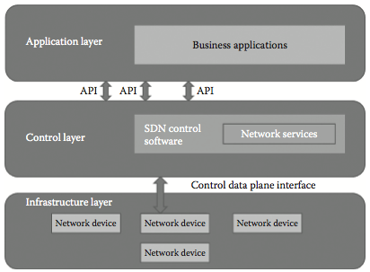
Software-Defined Networking
Architecture of software-de ned networking

Slide 13
The benefits of SDN:
◾ Centralized control of multivendor network equipment:
◾ Reduced complexity through automation:
◾ Improved network reliability and security:
◾ Better user experience:

Slide 14
Network Functions Virtualization
NFV is a concept that uses virtualization technologies to provide speci c network related services without the necessity to have custom hardware appliances for each network function.

Slide 15
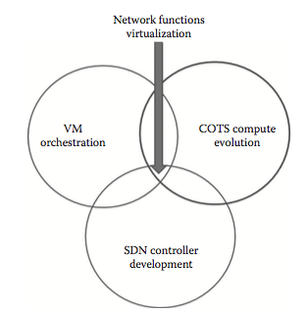
Network functions virtualization (NFV).

Slide 16
5G Architecture
High frequency bands su er from huge amounts of propagation loss, and this severely limits the coverage area. Hence, cells that work at high frequency bands have small coverage area and are called small cells.
In order to boost mobility performance, small cells are overlaid on the coverage of macro cells that operate in low frequency bands that leads to the formation of heterogeneous networks.

Slide 17
the proposed 5G architecture vision are the following:
◾ Presence of 2 logical network layers: a radio network layer that provides minimum function- alities of layers 1 and 2 and a network cloud that provides functionalities of all the other higher layers.
◾ Dynamic deployment and scaling of network functions of the network cloud using SDN and NFV that was explained earlier.
◾ A lean protocol stack by eliminating redundant functionalities.
◾ Separate provisioning of capacity and coverage in the radio network (RN) by using the C or
U plane split architecture and by using di erent frequency bands for capacity and coverage.
◾ Presence of data-driven network intelligence to optimize usage of network resources and to
ensure appropriate planning.

Slide 18
Ultra Wide Band Technology
Ultra wide band (UWB) is a technology that is used for communication among low-range and low-power sensors and mobile devices that require very low power and high bandwidth.
◾ Possibility of high accuracy transmission even indoors
◾ Resistance to multipath fading
◾ Good scalability in dense deployment
◾ Low-powerconsumption
◾ Highbandwidthtransmission

Slide 19
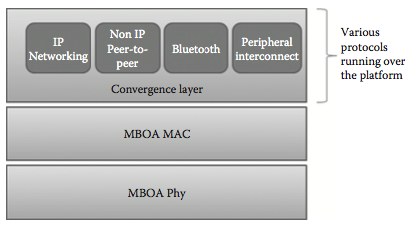
ISO 18000 7 DASH7
^{Layered architecture of UWB}

Slide 20
Near Field Communication Technology
Near feld communication technology (NFC) is a combination of radio frequency identi cation (RFID) and networking technologies.
It is a unique wireless technology that enables easy and con- venient short-range communication between electronic devices.
Following features of NFC make it very suitable for IoT communication:
◾ Ease of use
◾ Instantnaturalconnectivity
◾ Zerocon guration
◾ Smart key access

Slide 21
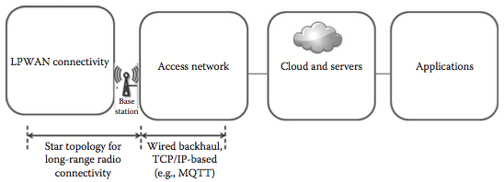
Direct device connectivity topology of LPWAN

Slide 22
Sigfox
Sigfox is very popular in the LPWAN industry. It has partnership with a lot of vendors in the radio space such as Texas Instruments, Silicon Labs, and Axom.
Sigfox does not support bidirectional networks and o ers support for uplink only sensor applications.

Slide 23
Indirect device connectivity through an LPWAN gateway.

Slide 24
Weightless
Weightless is an open LPWAN standard. It operates in sub-1 GHz unlicensed spectrum.
NWave
NWave operates in UNB radio spectrum, which runs in sub-1 GHz ISM bands. ey use a star networking topology for their operation.
Ingenu
Ingenu uses a technology called random phase multiple access (RPMA).
Random Phase Multiple Access
Random phase multiple access (RPMA) technology is a combination of technologies that are designed exclusively for wireless M2M communication.
LoRa
LoRa Alliance12 promotes use of an open standard for LoRa-based networks called LoRaWAN.

