Slide 1
Integration Technology and Tools for IoT Environment
CSI 421-Internet Of Things
Universitas Esa Unggul

Slide 2
Integration Technology and Tools for IoT Environment
Semua Bahan mengacu kepada buku : The Internet of Things: Enabling Technologies, Platforms, and Use Cases [Pethuru Raj, Anupama C. Raman]

Slide 3
The technologically inspired capability of instrumenting and intercon- necting computationally powerful as well as resource-constrained devices (physical, mechanical, electrical, and electronics) with one another in the vicinity as well as with cloud-hosted software applications and data sources over any network is to enable the devices to exhibit a kind of shrewdness in their operations and outputs.

Slide 4
integration scenarios:
1. Sensor and actuator networks 2. Device-to-device (D2D) integration 3. Cloud-to-cloud (C2C) integration 4. Device and sensor-to-cloud (D2C) integration

Slide 5
IoT Communication Protocol Requirements
One definition of IoT is connecting devices to the Internet that were not previously connected.
A factory owner may connect high-powered lights. A triathlete may connect a battery-powered heart-rate monitor.
A home or building automation provider may connect a wireless sensor with no line power source.
But the important thing here is that in all the above cases the thing must communicate through the Internet to be considered an IoT node.

Slide 6
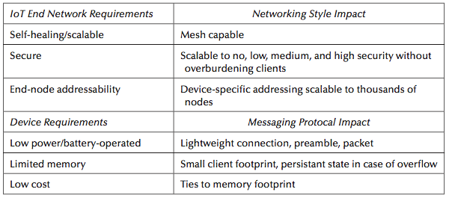
The IoT Devices Networking Requirements

Slide 7
enterprise transformation happens through the following ve tasks:
◾ Infrastructureoptimization
◾ Processexcellence
◾ Architectureassimilation
◾ Technology adaption and adoption
◾ Leveraging data (internal as well as external) for deriving insights

Slide 8
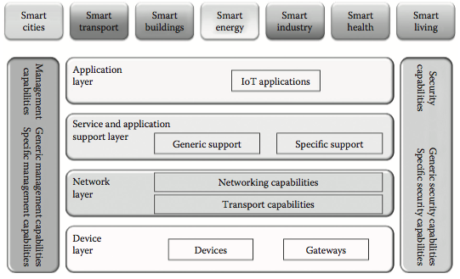
The IoT reference architecture.
(From ITU Telecommunication Standardization Sector, http://www.itu.int/en/ITU-T/Pages/default.aspx.)

Slide 9
Sensor and Actuator Networks
Sensing is tending to be ubiquitous.
Sensors are being touted as the eyes and ears of next-generation software applications.
A number of technologies especially miniaturization, networking, com- munication, and so on are contributing immensely to the unprecedented success of the sensing paradigm.
Sensors are becoming exceptionally tiny to be easily disposable, disappearing, and yet elegantly deft.

Slide 10
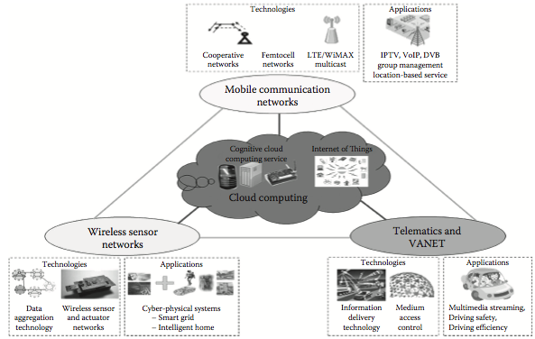
Networks of networks of sensors and actuators

Slide 11
Sensor-to-Cloud Integration
Sensor and actuator data need to be taken to nearby or faraway clouds for storage and analyt- ics. ere are multiple cloud options ranging from o -premise, on-premise, and to edge clouds.
Public clouds are typically for historical, comprehensive, and batch processing whereas interac- tive, stream, and real-time processing in a secure fashion are better accomplished by edge or fog clouds wherein proximate or local processing gets done comfortably.

Slide 12
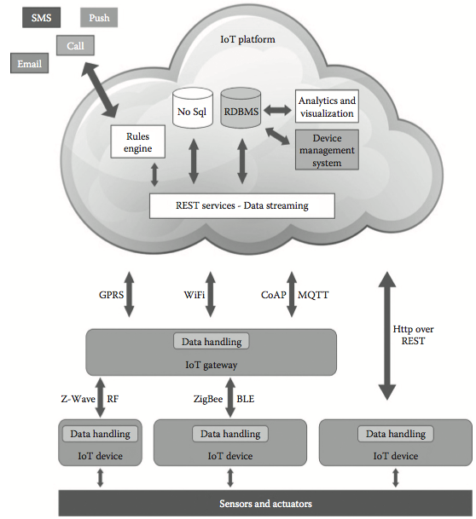
The passaging architecture for sensor and actuator data to cloud

Slide 13
The layered architecture for sensor-to-cloud integration

Slide 14
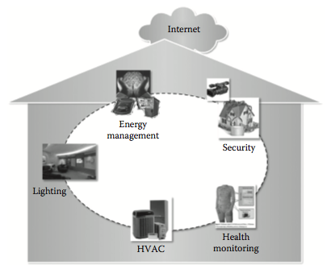
A smarter home use case.

Slide 15
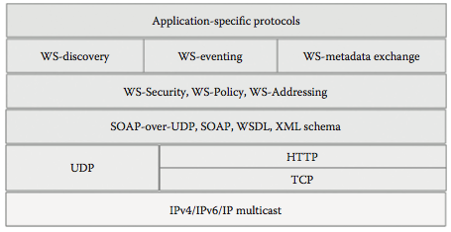
The DPWS OSI model.

Slide 16
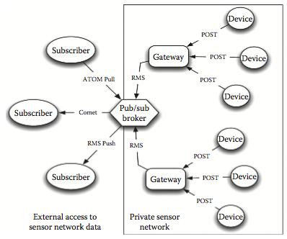
The role of pub/sub broker toward device integration.

Slide 17
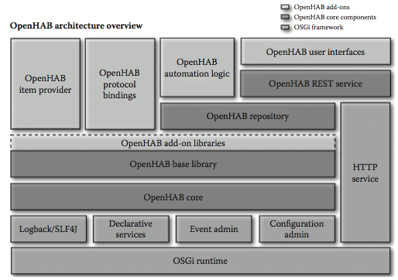
The openHAB reference architecture.

Slide 18
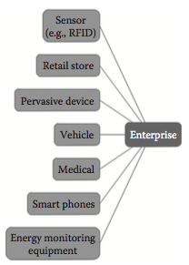
The MQTT-enabled device connectivity

Slide 19
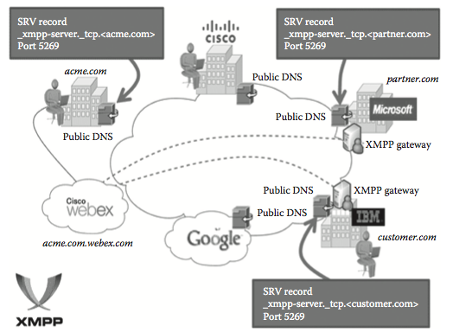
The device interactions scenario

Slide 20
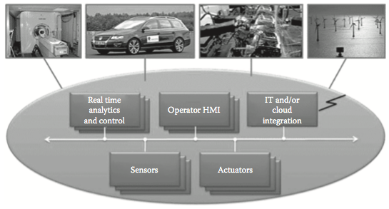
The device interactions scenario

Slide 21
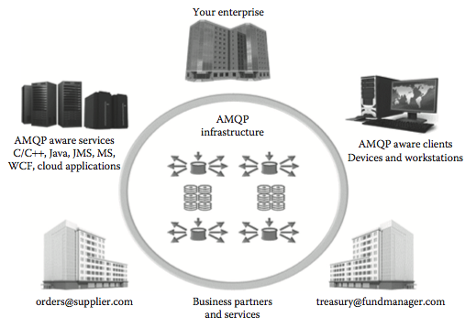
Internal and external interactions through AMQP.

Slide 22
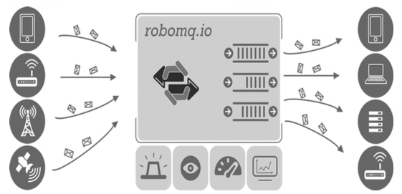
The robomq’s queuing solution for device interactions.

Slide 23
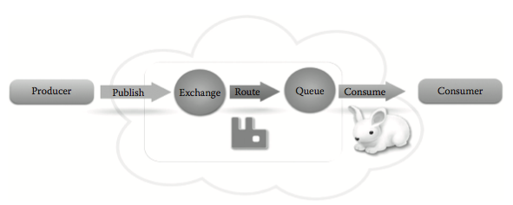
The end-to-end steps of cloud AMQP.

Slide 24
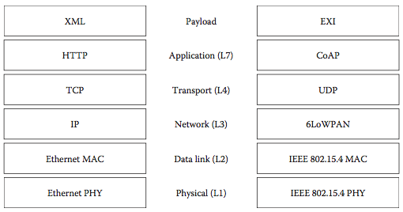
The comparison of HTTP and CoAP stacks

