Slide 1
Enablement Platform for IoT Application and Analytics
CSI 421-Internet Of Things
Universitas Esa Unggul

Slide 2
Enablement Platform for IoT Application and Analytics
Semua Bahan mengacu kepada buku : The Internet of Things: Enabling Technologies, Platforms, and Use Cases [Pethuru Raj, Anupama C. Raman]

Slide 3
The Internet of ings (IoT) paradigm is de nitely on fast track. ere are a number of viable and value-adding business and technical cases being unearthed and articulated well by business as well as IT professionals for enabling worldwide governments and organizations to deeply focus on bringing forth a well-intended IoT strategy.

Slide 4
Describing the IoT Journey
The IoT idea is percolating into every industry vertical.
IT professionals and computer science professors are actively working on making it pervasive and persuasive.
There are several forecasts from world-leading market researchers that by 2020, all kinds of tangible things in our everyday environments will be technologically modernized to be web-enabled.
We are unequivocally read- ing a lot of distinct advantages of our ordinary articles getting hooked to the Internet. E’
There are unique bene ts for end users and technical professionals whereas newer business models are being talked about in order to explore fresh revenue-generating avenues through such kinds of web- enablement.

Slide 5
The IoT Building Blocks
Digitized Entities and Connected Devices
IoT or Sensor Data Gateway
Application Enablement Platforms
Data Analytics Platforms
Knowledge Discovery and Dissemination
Storage, Backup, and Archival
Cognitive Clouds
The Major Players in the IoT Space

Slide 6
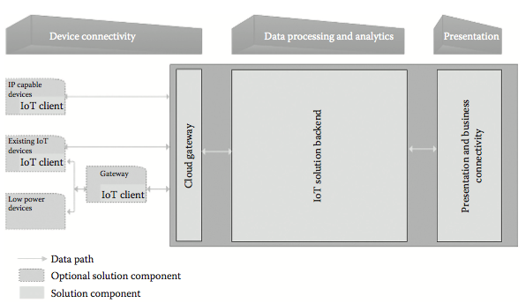
Cloud-based IoT data processing and application development.

Slide 7
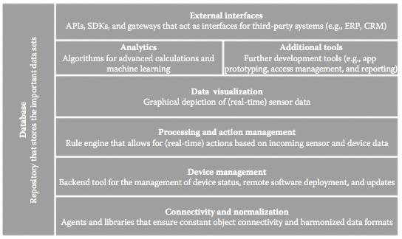
The principal building blocks of IoT AEPs

Slide 8
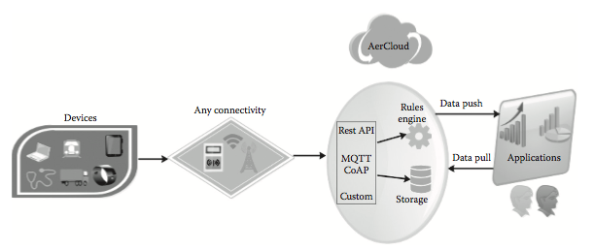
IoT and M2M sensor data platform by AerCloud

Slide 9
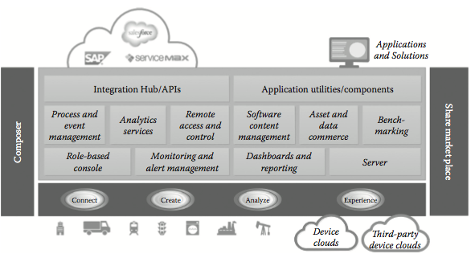
The system architecture of the ThingWorx IoT AEP.

Slide 10
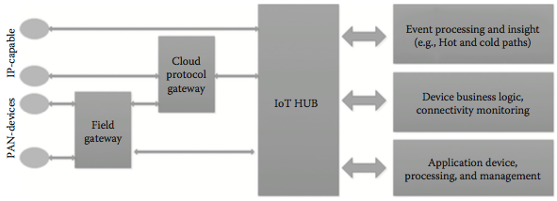
The system architecture for the Microsoft Azure IoT hub

Slide 11
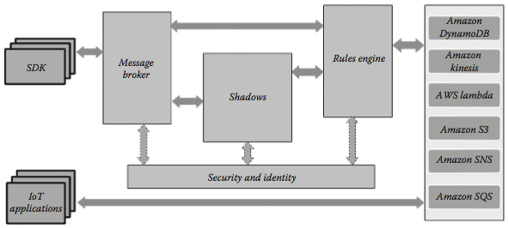
The AWS IoT platform architecture.

Slide 12
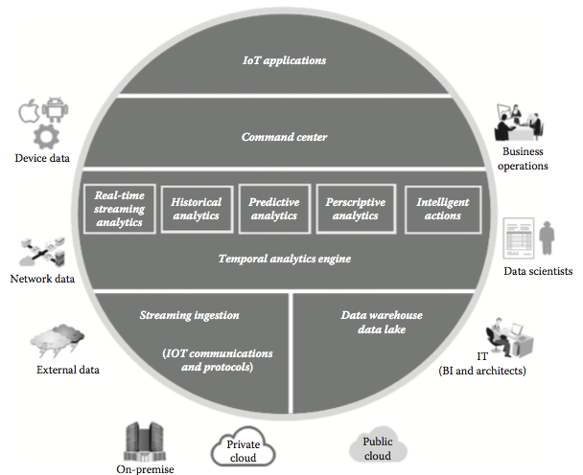
The vitria IoT analytics platform architecture

