Slide 1
Next Generation Clouds for IoT Application
CSI 421-Internet Of Things
Universitas Esa Unggul

Slide 2
Next Generation Clouds for IoT Application
Semua Bahan mengacu kepada buku : The Internet of Things: Enabling Technologies, Platforms, and Use Cases [Pethuru Raj, Anupama C. Raman]

Slide 3
The foremost objective of the hugely popular cloud paradigm is to realize highly organized and optimized IT environments for enabling business automation, acceleration, and augmentation.
Most of the enterprise IT environments across the globe are bloated, closed, static, complex, and expensive.
The brewing challenges are therefore how to make IT elastic, programmable, dynamic, modular, and cost- e ective.
Especially with the worldwide businesses cutting down their IT budgets, the enterprise IT team has to embark on a systematic and strategic journey to accomplish more with less through a host of pioneering technological solutions.

Slide 4
The powerful and pioneering cloud o erings:
◾ Hybrid and federated clouds
◾ Edge or fog clouds
◾ Software-defined clouds
◾ Cognitive clouds

Slide 5
About the Cloud Technology
With the overwhelming acceptance of cloud concepts, there is a big turnaround and transforma- tion waiting to happen for IT, the overwhelmingly accepted key enabler of business operations.
Especially in the infrastructure front, there are possibilities and opportunities for dramatic and decisive optimizations.
The cloud paradigm has also brought in newer service deployment, delivery, pricing, consumption, and composition models.

Slide 6
Smarter Homes
Home automation elements are being manufactured in plenty, linking of distributed and dispa- rate devices are being smoothened out, conceiving newer and nimbler services are in full swing, enabling frameworks, infrastructures are virtualized and pooled, and proven processes are in place, clustered, brokered, federated, and cloud architectures are being worked out, and so on.

Slide 7
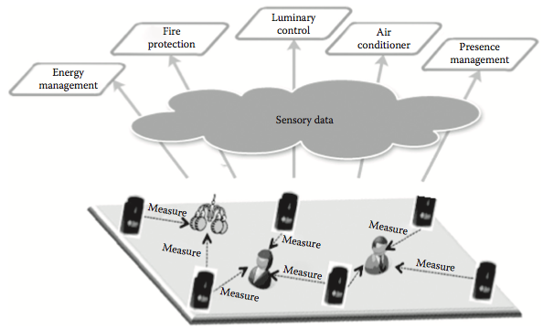
A sensor-stuffed smarter environment

Slide 8
Smarter Grids
Due to vociferous demands, the modern power grid is transforming into a cyber-physical systems (CPS), where the physical infrastructure and cyberinfrastructure must coordinate to ensure an efficient and reliable power energy grid.
However, there are some practical challenges. Existing grid operations require human decisions.
Also, renewables such as wind and solar energy are inherently unreliable and cause the electricity supply to be susceptible to the vagaries of nature.

Slide 9
IoT and Cloud for Smarter Cities
Technological innovations such as extremely and deeply connected devices, distributed, dispos- able, and diminutive sensors and actuators, and the emergence of the Internet as the open, public and a ordable WAN communication infrastructure, clouds as the core, centralized and cognitive one-stop platform for hosting software applications and services, and so on, are enabling cities to capture valuable data, develop and deploy new services, and enhance existing services substan- tially, ushering in the era of smarter cities.

Slide 10
The benefits of these new services to citizens are varied and numerous:
◾ Increase citizens’ bene ts by timely welfare services information distribution.
◾ Improve information accessibility by delivering information through various media channels and devices.
◾ Improve learning experiences by two-way video communication enabled mentoring.
◾ Increase free education contents and its quality for low-income community residents and students, and thus to deal with social divide issues.
◾ Reduce overall or regular health care cost, especially for low-income residents and solitude living aged people.
◾ Improve access to care services for chronic diseases, reducing the need for patients to visit remote hospitals.
◾ Create new markets for participatory urban regeneration projects applying u-City technologies.
◾ Provide wider revenue creation opportunities by open innovation-based urban regeneration framework.

Slide 11
Sensor-Cloud Integration for Smarter Cities
Sensors and actuators are the eyes and ears of future IT in order to e ortlessly capture disparate data from an increasing array of distinct sources.
Correspondingly there are cloud-based ana- lytical solutions to incredibly capitalize the accumulated data to extract actionable knowledge toward achieving and sustaining the smarter world vision.

Slide 12
Social and Sensor Data Fusion in Cloud
Mobile phones are not only enabled with communication capabilities but also blessed with more computing power these days.
Further on, a variety of minuscule sensors are smartly embedded inside mobile phones to make them multifaceted in their o erings and outputs.

Slide 13
Smarter Health Care
There are several types of smarter environments emerging and a litany of attractive use cases is being proposed.
Ambient assisted living (AAL) is a very prominent use case for smarter homes.
The need is to empower bed-ridden, debilitated, and diseased people to lead an independent and digitally assisted living.

Slide 14
Cloud-Inspired Smarter Health Care Services
The unprecedented adoption of the cloud concepts by various business verticals has impacted the health care industry too.
The health care industry’s technology infrastructure has been highly fragmented, in exible, closed, and expensive.
Due to the widely expressed concerns of data security, IT platforms, and health care applications and data are overwhelmingly maintained in-house IT infrastructures.

Slide 15
The Era of Hybrid Clouds
Due to a variety of reasons, private cloud options are being seriously considered by business houses.
Especially for the sake of having deeper visibility of the total IT environment, the end-to- end controllability, the guaranteed performance and dependability with nil network latency, and above all, impenetrable, and fool-proof security, private cloud environments are being prescribed as a part of IT strategy enterprise.

Slide 16
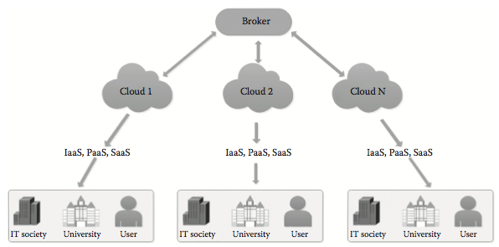
The centralized approach.

Slide 17
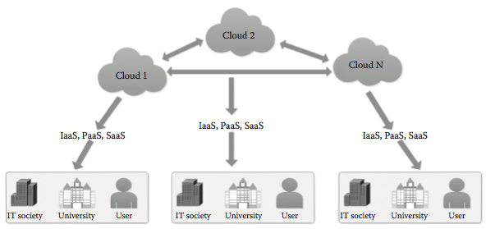
The decentralized approach

Slide 18
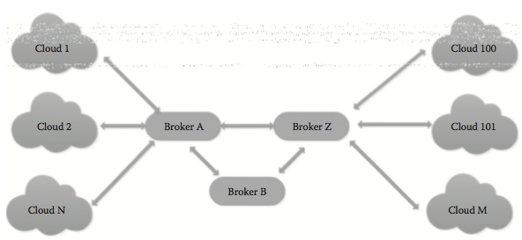
The hierarchical approach.

Slide 19
Special-Purpose Clouds
Apart from the generic public, private, community, and hybrid clouds, there are several pur- pose-speci c clouds being built and sustained by various organizations.
For example, there are mobile backup clouds for stocking up all kinds of mobile messages, videos, audio clips, photos, e-mails, and so on.

Slide 20
Device Clouds
As we all know, read, and experience, the device ecosystem is on the fast track these days. Every human being is all set to be assisted by tens of devices (wearable, portable, pocketable, implant- able, etc.) in his daily walks and works.
Every home is getting stu ed with hundreds of hi- elec- tronics, appliances, media players, Wi-Fi routers, and so on, every car is being empowered with hundreds of edge devices such as in-vehicle infotainment system, network gateway, controllers, sensors, chips, and actuators, every manufacturing oor is saturated with a number of connected machines, equipment, instruments, and so on, every library is lled up with hundreds of tagged books, and so on.

Slide 21
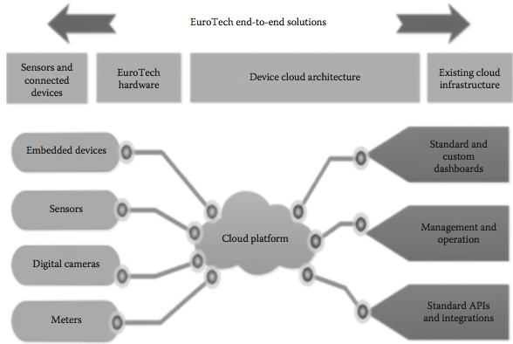
Cloud-based device management platform

Slide 22
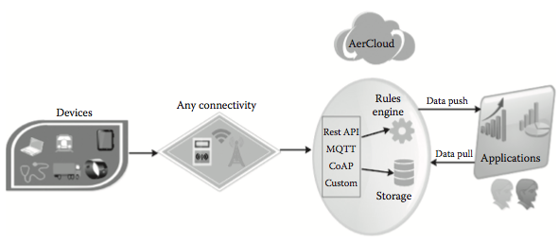
Empowering device applications

Slide 23
A hybrid version of local and remote clouds

