Slide 1
Emerging Filed of IoT Data Analytics
CSI 421-Internet Of Things
Universitas Esa Unggul

Slide 2
Emerging Filed of IoT Data Analytics
Semua Bahan mengacu kepada buku : The Internet of Things: Enabling Technologies, Platforms, and Use Cases [Pethuru Raj, Anupama C. Raman]

Slide 3
As explained in the beginning of this book, the overwhelming leverage of miniaturization, digitization, distribution, consumerization (mobility), consolidation, centralization and industrialization (cloud), compartmentalization (virtualization and containerization), and deeper connectivity technologies has a number of trendsetting and transformational implications on information technology (IT) organizations and business houses/behemoths across the globe.
Edge or fog computing through cloudlets and microclouds is another potential phenomenon for next-generation IT.

Slide 4
IT requirements are being insisted for enabling data analytics:
◾ Highly optimized and organized IT infrastructures (compute, storage, and network) for transmitting, storing, and processing large volumes of data published at a high speed.
◾ Data security while in transit, rest, and usage.
◾ Robust and resilient mining, processing and analysis algorithms, processes, and patterns.
◾ Highly synchronized platforms for faster data virtualization and ingestion, pioneering data analytics, and knowledge visualization.
◾ With the projected trillions of digitized objects and billions of connected devices, the data, user, and analytics loads on IT infrastructures are hugely variable, and hence load-aware infrastructures are insisted.
◾ Data and application integration standards and middleware with diverse sensors, devices, networks, and systems.
◾ Data archival, backup, and recovery plus access control are very important for the big, fast, streaming, and IoT data world.

Slide 5
data heaps gleaned from multiple sources:
Aggregate
Preprocess and transform
Ingest and store
Investigate
Visualize
Actuate the knowledge extracted:

Slide 6
Using Big Data Analytics in Health Care
Patient monitoring—inpatient, outpatient, emergency visits, and ICU:
Preventive care for ACO:
Epidemiology:
Patient care quality and program analysis:

Slide 7
Machine Data Analytics by Splunk
◾ Monitor end-to-end transactions for online businesses providing 24 × 7 operations
◾ Understand customer experience, behavior, and usage of services in real time
◾ Ful ll internal service level agreements and monitor service provider agreements
◾ Identify spot trends and sentiment analysis on social platforms
◾ Map and visualize threat scenario behavior patterns to improve security posture

Slide 8
Some real-world customer
◾ E-Commerce:
◾ Software as a Service (SaaS):
◾ Digital publishing:

Slide 9
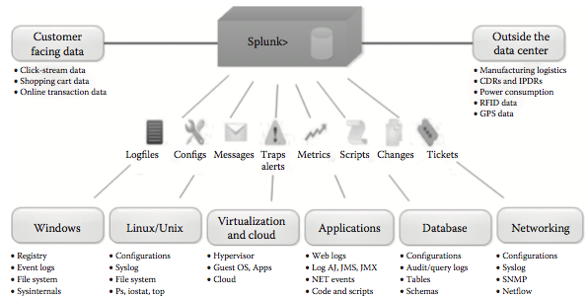
The Splunk reference architecture for machine data analytics.

Slide 10
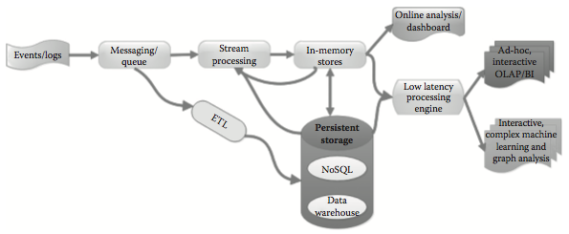
The real-time and streaming analytics architecture

Slide 11
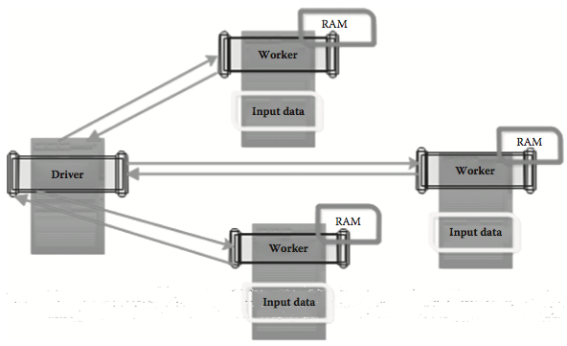
The Apache Spark architecture for real-time processing through in-memory data storage.

Slide 12
The technological components of the hybrid IoT analytics platform

Slide 13
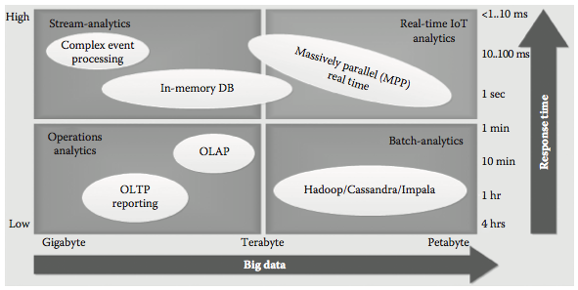
The real-time processing of big data

Slide 14
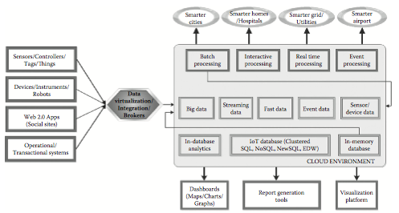
The reference architecture (RA) for IoT data analytics platform

Slide 15
Connected Cars
A specialized IoT data analytics platform is capable of bringing the much-needed transformations for the automotive enterprise with a number of new-generation capabilities such as real-time data about vehicles and their parts and pragmatic insights in time for car users and producers through highly advanced diagnostic, predictive, prescriptive, and prognostics analytics.

Slide 16
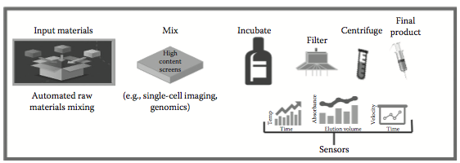
The IoT data analytics process

Slide 17
The role of IoT gateway for IoT data analytics

