Slide 1
Edge/ Fog Computing Paradigm
CSI 421-Internet Of Things
Universitas Esa Unggul

Slide 2
Edge/ Fog Computing Paradigm
Semua Bahan mengacu kepada buku : The Internet of Things: Enabling Technologies, Platforms, and Use Cases [Pethuru Raj, Anupama C. Raman]

Slide 3
As we all know, smart sensors and actuators are being randomly deployed in many signi cant environments such as homes, hospitals, and hotels in order to minutely monitor, precisely measure, and insightfully manage the various parameters of the environments.
Further on, powerful sensors are embedded and etched on di erent physical, mechanical, electrical, and electronics systems in our everyday environments in order to empower them to join in the mainstream com- puting.

Slide 4
The Introduction of Fog/Edge Computing
Traditional networks, which feed data from devices or transactions to a central storage hub (data warehouses and data marts), cannot keep up with the data volume and velocity cre- ated by IoT devices.
Nor can the data warehouse model meet the low latency response times that users demand.

Slide 5
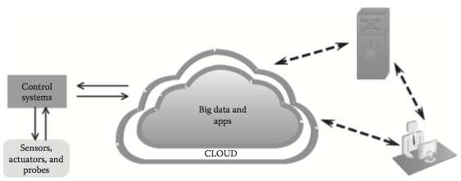
The end-to-end fog—cloud integration architecture.

Slide 6
Fog versus Edge Computing
This is the opportune time to clarify the perceptible di erences between fog and edge computing models. With the faster penetration of the IoT devices, instruments, monitors, controllers, sensors, actuators, robots, machines, and so on in our daily environments, there is a leaning toward per- forming a portion of computing at IoT devices.
However due to the constrained resources of these IoT devices, the overwhelming usage of microcontrollers as the IoT device gateway for remote connectivity (IoT device-to-enterprise/cloud integration) has dawned upon us.

Slide 7
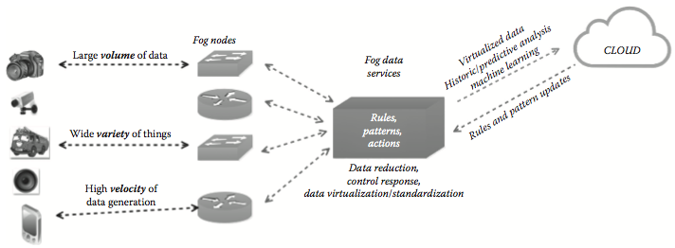
Depicting the control ow for the fog device data analytics

Slide 8
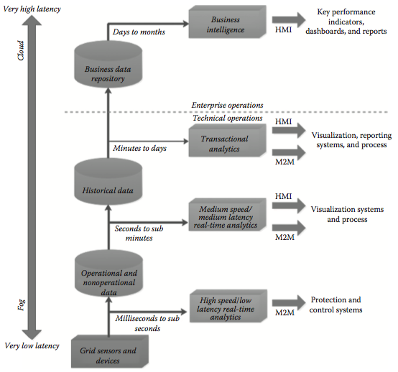
Describing fog device-based and cloud-based data analytics

Slide 9
Major IoT Data Types
Measurement Data
Event Data
Interaction and Transaction Data
Diagnostics Data

Slide 10
Describing the Fog Computing-Like Concepts
Local/Proximate Clouds
Cloudlet Facilities

Slide 11
Mobile Edge Computing (MEC)
We have mobile base stations in many locations in order to fail-safe relay mobile communica- tion.
These facilities are being recommended for doing the edge data processing and analytics.

Slide 12
Mobile Cloud Computing (MCC)
smartphones do not have su cient processing, memory, and storage capabilities as a typical and traditional cloud does (of course, as per newspaper reports, there are smartphones empowered with 6-GB memory).
THerefore, there are research works initiated in order to bring in an appropriate partition of software applications into a set of easily manageable modules.
The specific and smaller modules are kept within smartphones, whereas the common and reusable service modules are being taken to cloud environments.

Slide 13
The Use Cases of Fog/Edge Computing
The rapid growth of personal, social, and professional devices at our daily environments has seeded this inimitable computing style.
The communication becomes wireless, sensors and devices are heterogeneous and large in number, geodistribution becomes the new normal, the interconnectiv-ity and interactions among various participants emit a lot of data, and so on.
The amount of data getting generated and gathered at the edge of the network is really massive in volumes.

Slide 14
Smart Homes
There is a home security application profoundly discussed in a research paper.
As we all know, there are a myriad of home security products (smart lock, video/audio recorder, and security sensors) and monitors (alarm, presence, occupancy, motion sensors, etc.).
These are stand-alone solutions; and due to disparate data transport protocols and data formats, these products do not interoperate with one another.

Slide 15
Smart Grids
Smart electric grid is an electricity distribution network with smart meters deployed at various locations to measure the real-time power consumption level.
A centrally hosted supervisory con- trol and data acquisition (SCADA) server frequently gathers and analyzes status data to send out appropriate information to power grids to adapt accordingly.
If there is any palpable increment in power usage or any kind of emergency, it will be instantaneously conveyed to the power grid to act upon.

Slide 16
Wireless Sensor and Actuator Networks
Traditional wireless sensor networks fall short in applications that go beyond just sensing and tracking.
That is, actuators need to plunge into physical actions like the opening, closing, or even carrying sensors.
In this scenario, actuators serving as fog devices can control the measurement process itself, the stability and the oscillatory behaviors by creating a closed-loop system.

Slide 17
Smart Vehicles
The fog concept can be extended to vehicular networks also. e fog nodes can be deployed along the roadside.
The fog nodes can send and receive information from vehicles. Vehicles through their in-vehicle infotainment systems can interact with the roadside fog systems as well as with other vehicles on the road. us, this kind of ad hoc networks lead to a variety of applications such as tra c light scheduling, congestion mitigation, precaution sharing, parking facility management, and trafic information sharing.

Slide 18
Smarter Security
Security and surveillance cameras are being tted in di erent important junctions such as air- ports, nuclear installations, government o ces, and retail stores.
Further on, nowadays, smart- phones are embedded with powerful cameras to click sel es as well as produce photos of others.
Running images can be captured and communicated to nearby fog nodes as well as to faraway cloud nodes in order to readily process the photos and compare them with the face images of radicals, extremists, fundamentalists, terrorists, arsonists, trouble-makers, and so on in the already stored databases.

Slide 19
Smart Buildings
Like homes, o ce and corporate buildings are stu ed with a number of sensors for minute monitoring, precise measurement, and management.
There is a school of thought that mul- tiple sensor values, when blended, throw more accurate value. ere are advanced sensor data fusion algorithms, and hence smart sensors and actuators work in tandem toward automat- ing and accelerating several manual tasks. For providing a seamless and smart experience to employees and visitors, the building automation domain is on the fast trajectory with a series of innovations and improvisations in the IT space.

Slide 20
Real-Time IoT Data Analytics
For certain scenarios such as historical, comprehensive, and posterior processing, the traditional clouds are insisted.
Faraway clouds are typically for batch processing or at the most near real-time processing.
But the faster maturity and stability of edge computing readily enable real-time pro- cessing of device data.

Slide 21
Instantaneous Response
There are many use cases wherein faster responses are not needed.
Turning on the lights, closing the garage door, or checking the vending machine status, and so on come under this category.

Slide 22
Resource-Constrained Sensors Behind Fog Devices
Many sensors do not have enough compute, memory, and storage power in order to have their own IPv6 address.
Hence, they can hide behind an edge device which has the power to have its own IPv6 address.
It is, therefore, pertinent to con gure ground-level and resource-constrained sensors and actuators behind the edge device.

Slide 23
IoT Data Security
Any external attack on sensors can be stopped at the edge device, which acts as a shelter, strength, stronghold, and savior for feeble sensors.
The idea is to prolong the livelihood of sensors.
Also, the sensor data are transmitted to edge devices to be stocked and subjected to specific investigations over any local network only.

Slide 24
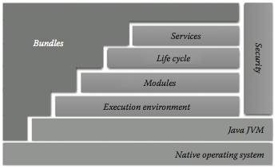
The OSGi stack.

Slide 25
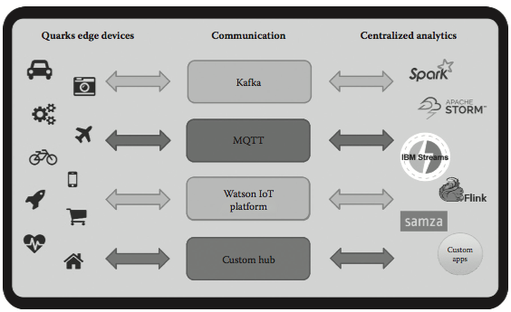
The reference architecture of Apache Quarks.

Slide 26
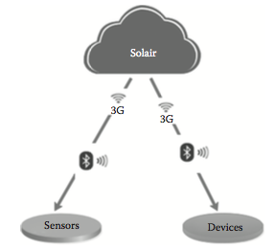
The Solair platform.

