Slide 1
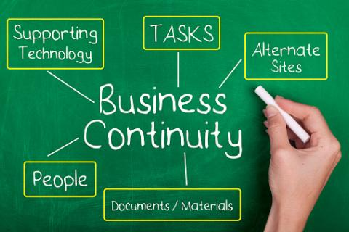
Business Continuity Planning
Introduction
by Yulhendri
Director/ Payments and Settlements Department
Central Bank of Sri Lanka

Slide 2
Business Continuity Planning (BCP)
The creation of a strategy through the recognition of threats and risks facing a company, with an eye to ensure that personnel and assets are protected and able to function in the event of a disaster
Disaster Recovery Plan (DRP)
Developed in the mid-to late 1970s.
Computer center managers began to recognize the dependence of their organizations on their computer systems.
Plan for business continuity in the event of a disaster that destroys part or all of a business's resources, including IT equipment, data records and the physical space of an organization.

Slide 3
Outline
The requirement of a BCP
Responsibilities of the Board
BCP process
Business Impact Analysis
Risk Assessment
Risk Management
Risk Monitoring and Testing
Testing Strategies
Testing Methods

Slide 4
WHY Does an organization need BCP?
To continue business as usual during a disruption to the organization’s ordinary operations.
Minimize financial losses to the organization.
To maintain the system stability, if the organization is a part of a system.
Lessen the negative impact of disruptions on business operations.
To gain the confidence of customers about the organization’s ability to continue operations during a disaster or a similar event.

Slide 5
Responsibilities of the board and the senior management
Identify
Assess
Prioritize
Manage
Control
RISK

Slide 6
Responsibilities of the board and the senior management
Policies should be established by the Board or the Senior Management to determine how the organization will manage and control identified risks.
Established policies should be implemented with the blessings of the Board/ Senior Management. Sufficient financial resources should be allocated to implement the BCP policies and personnel who are conversant in the field should be allocated to oversee the implementation.

Slide 7
Responsibilities of the board and the senior management
BCP should be reviewed by an independent auditor (internal or external) at least once a year to capture significant policy revisions.
After the policy is formulated, the staff should be properly trained to implement the BCP policy. The role of each employee in the implementation process should be identified and training should be provided so that each employee can play their role during the implementation of the plan.

Slide 8
Responsibilities of the board and the senior management
The Board/ Senior Management should ensure that the BCP is regularly tested (at least once a year) to make sure that backup systems and employees are well prepared to continue business during a disruption to regular activities.
The results of each BCP drill should be discussed at Board meetings and prompt action should be taken by the Board to address the issues identified during the BCP drill.

Slide 9
Business Continuity Planning Process
Covers the
Recovery
Resumption and
Maintenance of the entire business (technology, human element etc.)
Include a business recovery plan for the short term and the long term
Should prioritize business objectives and critical processes essential for recovery.
An assessment of how critical processes, departments and systems will react to disruptions and what measures should be taken to resume operations is done.

Slide 10
Business Continuity Planning Process
BCP should be tested at least once a year to identify the flaws of the plan.
BCP should be regularly updated based on;
Changes in business methods such as technical improvements
Audit recommendations
Lessons learned from testing the BCP
An officer should be specially assigned to be responsible for updating the BCP regularly

Slide 11
Business Continuity Planning Process
Good practices for organizations regarding BCP;
Take BCP in to account when making Business Decisions.
Including BCP responsibilities in the job description of every employee.

Slide 12
Four Steps in the BCP Process
Business Impact Analysis
Risk Assessment
Risk Management
Risk Monitoring and Testing

Slide 13
Business Impact Analysis (BIA)
First step in BCP.
Should include a work-flow analysis containing;
Assessment and
Prioritization
of critical business functions.
Potential impacts of uncontrolled events on critical processes should be identified and the probability of having natural disasters in the area (eg: flood prone areas) where the institution is located should also be considered.

Slide 14
Business Impact Analysis (BIA)
The maximum allowable down time should also be estimated. (Measures should be taken to reduce this estimated down-time to an acceptable level (eg: according to BIS standards- two hours)
The acceptable level of data, financial, operations, market share, reputation losses with this down time should also be estimated.
Based on these estimates, the Recovery Time Objective (RTO) and the Recovery Point Objective (RPO) can be estimated.

Slide 15
Recovery Time Objective (RTO)
The maximum tolerable downtime of a process. In other words, the targeted time duration for the recovery of the process.
RTO is established by the owner of the process during BIA.
According to the Principle 17 of the Principles of Financial Market Infrastructure (PFMI), which are the international standards for Financial Market Infrastructures (FMIs) issued by the Committee on Payments and Market Infrastructures (CPMI) of Bank for International Settlements (BIS) and the International Organization of Securities Commissions (IOSCO), FMI should ensure that critical IT operations can resume operations within TWO hours following a disruptive event.

Slide 16
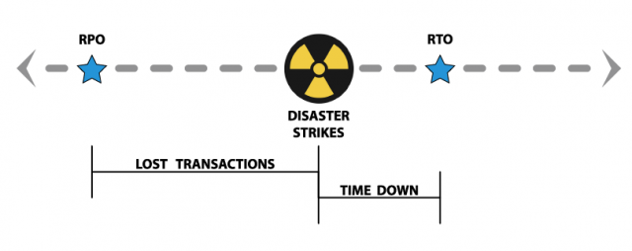
Recovery Point Objective (RPO)
RPO is the point to which the process will recover. Eg: the last dataset backed up before a disaster destroys the data in a server.

Slide 17
Business Impact Analysis (BIA) cont.…
After the BIA is completed, it should be assessed in the course of the risk assessment process.
The Board should review the BIA periodically and the BIA should be updated whenever there are changes to the business process.
BIA should be tested during the BCP drill and the issues identified during the drill should be incorporated in to the BIA
A copy of the BIA should be kept at the Disaster Recovery Site.

Slide 18
Risk Assessment
The second step of BCP.
Evaluation of BIA assumptions and all other business processes based on different threat scenarios (such as malicious activities, natural disasters, technical problems, epidemics of infectious diseases) and the severity of the threat is done in this step.
Based on the results of this evaluation, changes are made to the BCP.

Slide 19
Gap Analysis
During the Risk Assessment stage, the organization should conduct a Gap Analysis.
In a Gap Analysis, the required policies and procedures of the institution to recover and resume operations are methodically compared against the existing policies and procedures of the institution.
The difference between the two (the Gap) is addressed when the BCP is developed.

Slide 20
Risk Management
The third step in BCP.
The BCP is developed in this step based on the outputs of BIA and risk assessment. Development can be done internally or can be outsourced.
Strategies should be developed to address the risks faced by the institution.
The BCP should include the events which could prompt an declaration of a disaster and the steps to be followed to activate the BCP.

Slide 21
Risk Management
The BCP should also contain;
the responsibilities and a guideline to be followed for each business continuity team during a disaster.
Contact details of key personnel to be contacted during a disaster situation.
The process to relocate to the Disaster Recover Site.
Steps to be taken to ensure the safety of all employees and minimize the damage to institution property.
Processes to be given priority during business resumption. (critical processes)
Management of risk due to the interdependencies of processes or department.

Slide 22
Risk Monitoring and Testing
Final step of BCP
Testing of the BCP is necessary to validate the viability of the Plan and to demonstrate the ability of the organization to continue operations until permanent operations are restored.
A testing policy should be in place to facilitate an efficient and a transparent testing of the BCP which contain the execution, evaluation, independent assessment and reporting of test results.

Slide 23
Risk Monitoring and Testing
The testing policy should be improved continuously by adjusting to changes in the business environment.
A comprehensive test of the BCP should be carried out at least once a year.
The test results are compared against the BCP to identify any deviations from the plan, which needs to be address immediately with the support of the Board/ Senior Management.

Slide 24
Testing Strategies
The testing strategy should include the following;
What is the level expected to achieve regarding the BCP test objectives?
What is the extent of the BCP test to be accomplished?
What are the expectations for testing internal and external interdependencies?
How reasonable are the assumptions made during the development of the plan?

Slide 25
Testing Strategies
Additionally, the testing strategy should clearly mention the scope and the objectives of the test.
Test objectives should have quantifiable measurements.
Testing process should not have a negative impact on normal business operations.

Slide 26
Testing Methods
Tabletop Exercise/ Structured Walkthrough test
Walk-Through Drill/ Simulation Test
Functional Drill/ Parallel Test
Full Interruption/ Full-Scale Test

Slide 27
Tabletop Exercise/ Structures Walkthrough test
A preliminary step in the overall testing process.
Staff members who have a critical role in the BCP process get together and go through the BCP step-by-step.
Can be used as a training option
The plan is meticulously discussed and the issues are highlighted.

Slide 28
Walk-Through Drill/ Simulation Test
Participants select a specific event scenario and a walk-though of the process to be followed is done.
Can be used as a training exercise.
Specific functions related to the specified event are tested.
A good method to test the coordination between critical business units and processes.

Slide 29
Functional Drill/ Parallel Test
Actual mobilization of personnel to a Disaster Recovery Site is done.
The procedure in BCP is put in to practice.
The BCP is fully tested with all critical personnel in attendance.
The organization’s capability to face a disaster situation along with medical response and warning procedure is tested.
The ability to achieve RTO and RPO is also tested.

Slide 30
Full Interruption/ Full-Scale Test
The most comprehensive type of test.
The disaster situation is simulated as closely as possible.
The coordination of processes and the decision making is done in situ.
Test conducted for a longer period of time to identify issues that may not occur in the short term

Slide 31
Evaluation and Reporting of Test Results
Auditors should observe the proceedings of the BCP drill and based on their observations and the reporting done by each business unit, the test results can be evaluated to find out whether all the test objectives have been achieved.
The quantitative outputs of the result such as RTO and RPO can give a clear idea about the extent to which the objectives have been achieved.
If the objectives have not been achieved, the corrective measures to be taken should be identified.

Slide 32
Evaluation and Reporting of Test Results
The assessment by Auditors should be as independent as possible.
The assessment of the BCP Test results should be submitted to the Board and the Board should review the audit report and take necessary actions to implement corrective measures in a timely manner.
A re-test can be conducted after implementing the corrective actions.

Slide 33
THANK You…
kum@cbsl.lk

