Slide 1
TRAINING TESTING AND AUDITING IN BCP & DRP
By Yulhendri

Slide 2
Agenda
BSI: Introduction
Why we need BCM?
1.
2.
Benefits of BCM
3.
International Development of BCM
4.
Getting started with BCM
5.
Related standard to BCM: ISO/IEC 27000
series

Slide 3
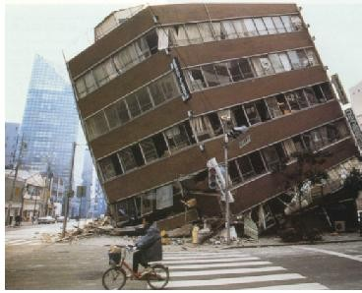
Business Continuity Management (BCM) facts
and future trends
Copyright © 2012 BSI. All rights reserved.

Slide 4
1. Why we need BCM
Definition
“Business Continuity Management (BCM) is a framework for
identifying potential threats to an organization and building
organizational capability to respond to such threats, in order to
safeguard the interests of key stakeholders, reputation, brand and
value-adding activities”(1)
(1) Joint statement: Bristish Standards Institution, Business Continuity Institute, Cabinet
office, Chartered Management Institute
Copyright © 2012 BSI. All rights reserved.

Slide 5
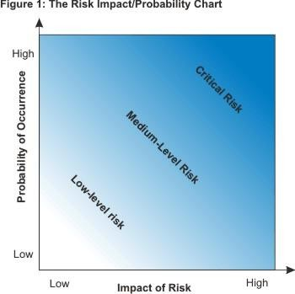
Examples of
Disruption
• Natural disasters
• Economic disruption and market turbolence
• Terrorism
• Physical security disruptions
• Infrastructure or IT failures
• Fraud or hacking
• New regulations
• Potential consequences:
• Employee safety jeopardized
• Reduced customer confidence
• Loss in image or brand equity
• Decline in revenues
• Decline in market share
BCM
Risks
Copyright © 2012 BSI. All rights reserved.

Slide 6
Are you prepared for disaster?
CMI/BSI UK survey – March 2011
• 84% of managers realize the benefits of BCM planning
• 58% of managers report that their organization has BCM in place (significant YoY growth in SMB sector)
• Only 50% of organizations with BCM test their BC plan once a year or more
• 60% of organizations with BCM provide training to relevant staff
• Only 55% of organizations ensure that their supply chain have BCM plans in place
Copyright © 2012 BSI. All rights reserved.

Slide 7
2. BCM: The Benefits & Business Case
•
•
•
•
•
•
Expedite recovery after disruption
Understand overall business exposure
Prepared to respond should the unexpected occur.
Raises awareness in the organization
Proxy for good overall management.
Demonstrates to customers, partners and other
organization takes a robust approach to risk
Reassurance that the business can keep going
stakeholders that the
•
Copyright © 2012 BSI. All rights reserved.

Slide 8
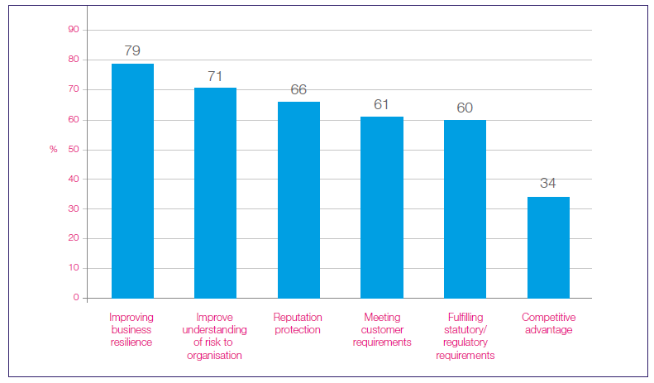
Perceived benefits of BCM
Copyright © 2012 BSI. All rights reserved.

Slide 9
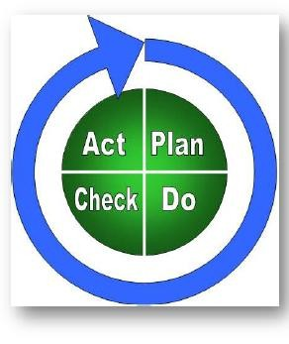
3. International development of BCM 25999
PAS 2003
BS 2006
ISO 2012
•
•
•
Started as a “PAS” (Publicly Available Specification) by BSI (PAS 56)
Moved to a BS 25999 in 2006 & 2007 in two parts as “Umbrella Standard”
Scheduled to move to ISO in 2012 (ISO 22301)
Copyright © 2012 BSI. All rights reserved.

Slide 10
International usage of BS25999
BSI
•
•
BSI translations into French, German and Spanish
BS 25999 sold by BSI in over 100 countries
Other National Standards Bodies
•
•
Adoption of BS 25999 outside the UK (Brazil, Spain etc.)
Local translation/distribution (Japan, China, Russia, etc.)
US
•
As part of the ‘PS-Prep program’ the US Department for Homeland Security
recommended 3 standards for BCM, including BS 25999.
Copyright © 2012 BSI. All rights reserved.

Slide 11
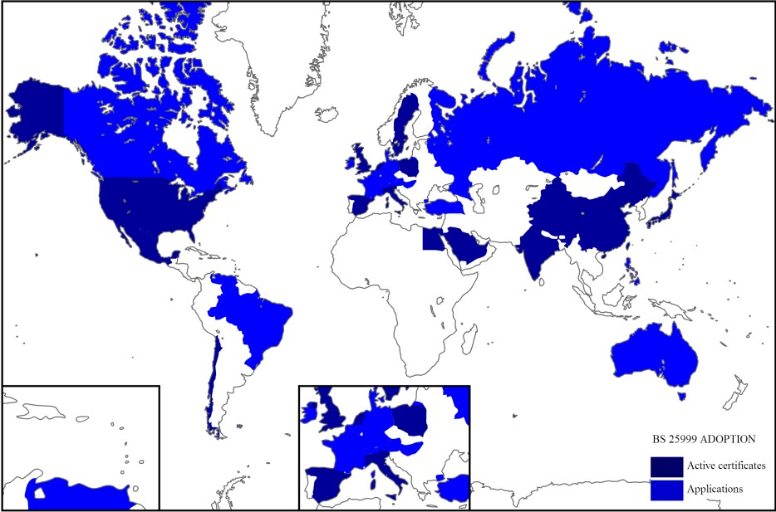
Copyright © 2012 BSI. All rights reserved.

Slide 12
18
The new ISO 22301
•
The growing success of the BSI developed BS 25999 has prompted ISO (the
International Organisation for Standardization) to begin work on publishing an ISO recognised standard which is expected to be released in May 2012
•
BSI is well placed to assist clients in making a smooth transition to the new
ISO standard in 2012 (ISO 22301)
Copyright © 2012 BSI. All rights reserved.

Slide 13
4.
Getting Started with BCM
Recommendations
•
Senior managers must take ultimate responsibility for the quality and
robustness of their organizations BCM.
Use BCM based on a common framework (such as BS 25999) as part of a
wider programme and train employees
Develop a clearly defined approach for responding to the media; BCM is
“multi-functional” not just IT
Review which suppliers are critical to your operations and ask whether they
have BCM
Test your BCM through regular exercises
•
•
•
•
Copyright © 2012 BSI. All rights reserved.

