Slide 1
Business continuity management (BCM) by Yulhendri

Slide 2
Agenda
Introduction to workshop
Presentation and background briefing
Scenario review and facilitated discussion
  Move 1 Emergency response

Slide 3
Business continuity management
Introduction
Malcolm Cornish FBCI
BCM business development manager

Slide 4
What is BCM?
Business Continuity Institute (BCI) and PAS 56¹
  holistic management process
  identifies potential impacts
  framework for resilience and response capability
  safeguard interests of key stakeholders
or more simply…
A process that establishes a secure and resilient business environment capable of mounting an immediate and effective response to a major incident.
Not just a paper plan, it also requires organisation, planning, assessment, training, rehearsal and more.
¹ PAS 56 – Guide to Business Continuity Management is a Publicly Available Specification developed through the British Standards Institution.
Notes:
BCM is an holistic management process that identifies potential impacts that threaten an organisation and provides a framework for building resilience and the capability for an effective response that safeguards the interests of key stakeholders, reputation, brand and value creation activities.
Business Continuity Management – A process that establishes a secure and resilient business environment with the capability of mounting an immediate and effective response to major incidents. It is more than just organisation and a paper plan, it also requires planning, assessment, analysis, training, rehearsal and more.

Slide 5
Objective of business continuity management
Fully tested effective BCM
Level of business
No BCM – ‘lucky’ escape
No BCM – likely outcome
Critical recovery point
Time
Notes:
In some instances the company has gone on to recover better than before the incident occurred.
Confidence with the market. If it can deal with a disaster or a crisis well it can deal with general everyday business.
Interesting to note that according to a paper from the Cranfield School Management entitled ‘barriers to growth’, it points out that the word ‘crisis’ derives from the Chinese and translates literally as ‘dangerous opportunity’.
No plan due to lucky escape because recovered with the critical recovery point.

Slide 6
The business continuity plan
Emergency
response plan
A successful outcome
Crisis management/
communication plan
A
Business
recovery plan
Activity
Time objective
Notes:
Components of a business continuity plan
Emergency response – the immediate response to an incident where immediate action needs to be taken to safeguard life and, if it is safe to do so, limit damage to the site.
Crisis management – taking appropriate actions to mitigate or reduce the sources, size and impact of the crisis, manage the impacts, aid recovery and exploit opportunities. Also known as a crisis communications because of the need to communicate with all stakeholders and deal effectively with the press and media.
Business recovery – The capability to recover business processes before the impact of their loss causes irrecoverable damage and to provide an acceptable level of level of service to clients, customers and other business partners regardless of any events or incidents that occur

Slide 7
Emergency response
Establishing a capability to protect people and business
Doede de Waij, MBCI
BCM practice leader
Notes:
When you begin speaking stress the line:
“Establishing a CAPABILITY to protect employees and business.” A capability is more than an organisation chart or paper plan. It requires planning, training and more (as you will see in the coming slides).
The following slide will address the value proposition.

Slide 8


Why emergency response?
Safeguard employees, visitors, and public
Protect physical assets (buildings and equipment)
Minimise damage and business impact
Avoid environmental contamination
Protect reputation and image
Ensure regulatory compliance
Good corporate governance
Notes:
Hopefully, before you present this slide, you will have learned about the prospect’s industry, types of losses that the industry has suffered, and the types of losses/emergencies that the prospect has suffered. Try to learn about the locations of their facilities, so you can see which ones are exposed to natural hazards, might in urban areas vulnerable to terrorism, or types of operations where there is a history of losses.
Emphasis protecting people. No one will discount this publicly.
Protection of physical assets goes hand in hand with protection of business operations. If you respond promptly and effectively, then you minimize damage and consequential business interruption.
Environmental contamination occurs when there is a loss – piping or tanks fail or runoff from firefighting water can create a huge environmental mess.
Most companies are very sensitive to their image and reputation. A poorly handled emergency can focus significant negative attention on a company. However, a prompt and effective response can actually garner positive attention as a ‘well managed company’.
Emergency response is highly regulated. Companies are required to have basic plans, and companies in hazardous industries or in buildings with large numbers of people require enhanced planning.
Last, in the world of corporate scandals, good ERP is good governance.

Slide 9
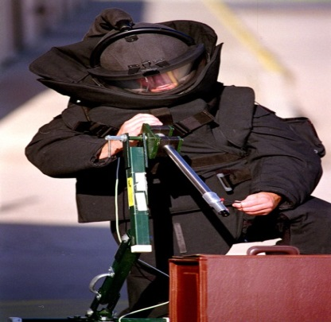
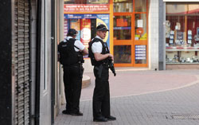
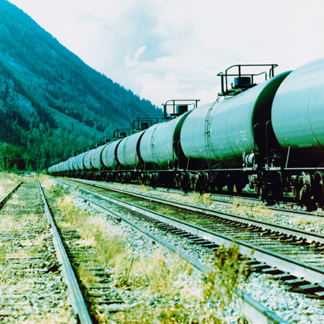
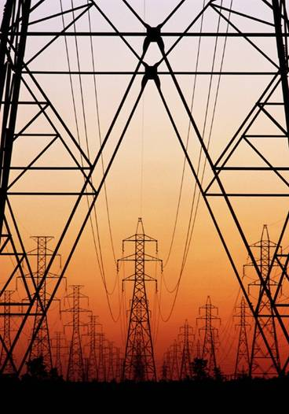
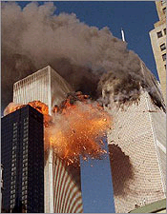
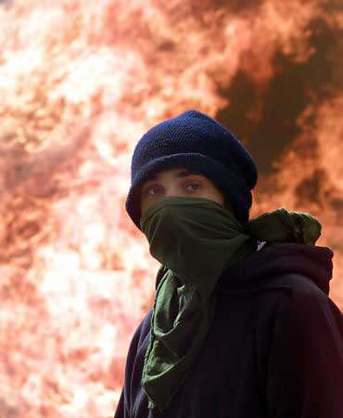
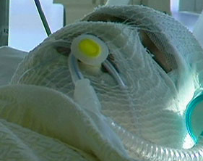
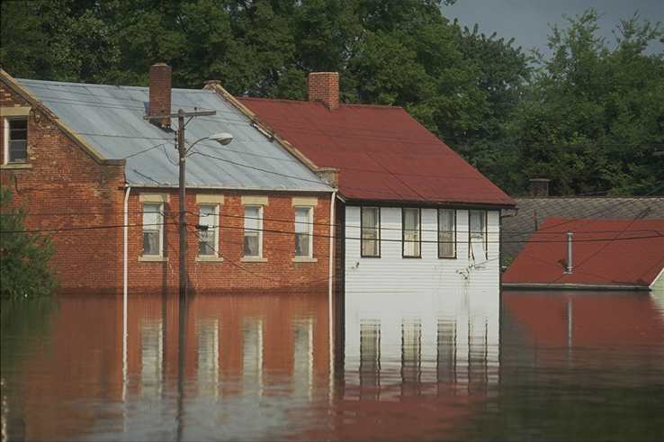
Threat assessment
What to plan for?
High
Continuity risks
Impact
(Daily)
Management
Accept
Low
High
Frequency
Notes:
This slide requires you to press the [Enter] key or click the mouse for each element to appear on the screen.
Risk assessment identifies what threats, hazards, or perils can injure or kill people, damage property, interrupt business operations, or contaminate the environment – either directly or indirectly.
Since many hazards are site-specific (e.g., most natural hazards), you need to determine what is the probability of occurrence and the magnitude of consequences. Keep in mind that low-impact events occur relatively frequently (e.g., micro-earthquake occur daily in California), but high impact events occur relatively infrequently (e.g., a magnitude 8.3 earthquake in San Francisco occurs about once in 783 years.)
You need to determine whether a catastrophic event is possible. If so, you have to plan for it. And you need to know the potential impact (e.g., what building damage is possible, what buildings would be flooded, what fire damage is possible, etc.)
As you hit the [Enter] key, each threat/hazard/peril will appear. Be prepared to discuss how each could impact a client’s facilities. If you can connect here, you build your case for the sale. Most pictures are self-explanatory. The yellow suited person exemplifies a hazardous materials incident. The electrical high-tension power lines exemplify loss of utilities (could be electricity, gas, water, etc.) The black suited person is a bomb squad technician, and the gun-toting person exemplifies workplace violence.

Slide 10
Emergency response plan
Recognition
Evaluation
(Analysis)
Plan execution
Strategy
(Problem solving)
Communicate
Debrief
Preparation
Assess
incident
ER
structure
Evacuate
Shelter-
in-place
Security
Internal
comms
Threat Assessment
Determine availability & capabilities of internal resources
Determine availability & capabilities of external resources
Rescue
First Aid
Assess
damage
CM inter-face
Media
comms
Notification criteria
Activation criteria
Stand-down Team
Claims processing
Fight fire
Haz-Mat
Conserve
property
External
comms
Time

Slide 11
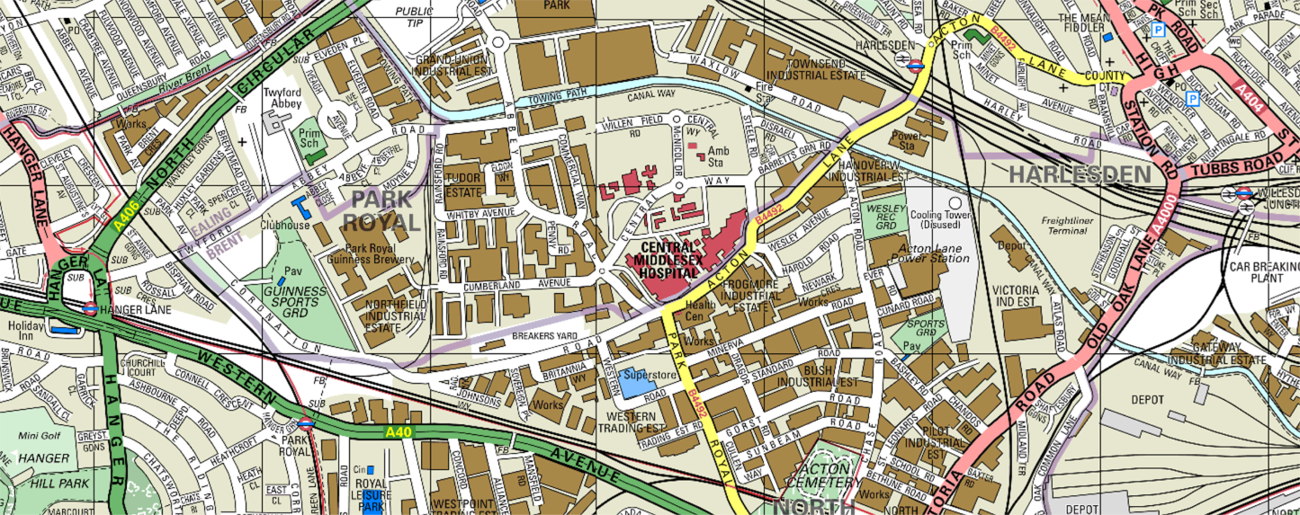
Scenario
Move 1
Your head office, where you are now situated accommodates 600 employees. It is a six-storey building on the brand new £400m FastCentral Business Park next to the A40 west of London. Yours is the first building to be occupied.
Wind direction
Chemical vapour cloud is moving towards your head office building.
Cause of release and exact type of chemical are unknown.

Slide 12
Move 1 – Questions
What are your most urgent priorities at this time?
What information and authority do you need to determine protective actions?
Do you shelter employees in place, or do you begin evacuation immediately? If you decide to evacuate, where will you move your employees?
Describe the team structure that you would need to establish in order to execute the protective actions. What authority must be vested in the team leader, and why?

Slide 13
Move 1 – Emergency response
Plenary session

Slide 14
Business continuity management (BCM) workshop
Workshop 2 – Crisis management
May 26
Malcolm Cornish – BCM business development manager
Doede de Waij – BCM practice leader
Marsh Technology Conference 2005
Zurich, Switzerland.

Slide 15
Agenda
Introduction to workshop
Presentation and background briefing
Scenario review and facilitated discussion
  Move 2 Crisis management

Slide 16
Business continuity management
Introduction
Malcolm Cornish FBCI
BCM business development manager

Slide 17
What is BCM?
Business Continuity Institute (BCI) and PAS 56¹
  holistic management process
  identifies potential impacts
  framework for resilience and response capability
  safeguard interests of key stakeholders
or more simply…
A process that establishes a secure and resilient business environment capable of mounting an immediate and effective response to a major incident.
Not just a paper plan, it also requires organisation, planning, assessment, training, rehearsal and more.
¹ PAS 56 – Guide to Business Continuity Management is a Publicly Available Specification developed through the British Standards Institution.
Notes:
BCM is an holistic management process that identifies potential impacts that threaten an organisation and provides a framework for building resilience and the capability for an effective response that safeguards the interests of key stakeholders, reputation, brand and value creation activities.
Business Continuity Management – A process that establishes a secure and resilient business environment with the capability of mounting an immediate and effective response to major incidents. It is more than just organisation and a paper plan, it also requires planning, assessment, analysis, training, rehearsal and more.

Slide 18
Objective of business continuity management
Fully tested effective BCM
Level of business
No BCM – ‘lucky’ escape
No BCM – likely outcome
Critical recovery point
Time
Notes:
In some instances the company has gone on to recover better than before the incident occurred.
Confidence with the market. If it can deal with a disaster or a crisis well it can deal with general everyday business.
Interesting to note that according to a paper from the Cranfield School Management entitled ‘barriers to growth’, it points out that the word ‘crisis’ derives from the Chinese and translates literally as ‘dangerous opportunity’.
No plan due to lucky escape because recovered with the critical recovery point.

Slide 19
The business continuity plan
Emergency
response plan
A successful outcome
Crisis management/
communication plan
A
Business
recovery plan
Activity
Time objective
Notes:
Components of a business continuity plan
Emergency response – the immediate response to an incident where immediate action needs to be taken to safeguard life and, if it is safe to do so, limit damage to the site.
Crisis management – taking appropriate actions to mitigate or reduce the sources, size and impact of the crisis, manage the impacts, aid recovery and exploit opportunities. Also known as a crisis communications because of the need to communicate with all stakeholders and deal effectively with the press and media.
Business recovery – The capability to recover business processes before the impact of their loss causes irrecoverable damage and to provide an acceptable level of level of service to clients, customers and other business partners regardless of any events or incidents that occur

Slide 20
Crisis management
Is your company ready to deal with a crisis?
Doede de Waij, MBCI
BCM practice leader
Notes:
When you begin speaking stress the line:
“Establishing a CAPABILITY to protect employees and business.” A capability is more than an organisation chart or paper plan. It requires planning, training and more (as you will see in the coming slides).
The following slide will address the value proposition.

Slide 21
The value of crisis management
IMPACT
Crisis
event
Lost time/productivity
With
crisis management
Without
crisis management
It reduces the
negative impact and speeds recovery from all kinds of corporate crises
Time
Damage to
financial results, reputation and
key relationships
Negative impact

Slide 22
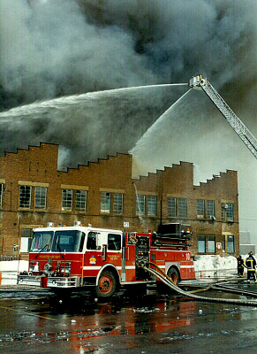
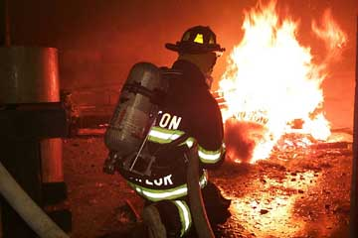
Major crisis for mobile-phone giants
Source: Logistics Europe February 2004
Background
  Booming mobile phone industry
  Philips semiconductor plant in Albuquerque (USA)
  Produced mobile phone chips, crucial components
  40% of output to:
    Nokia, Finland
    Ericsson, Sweden
The incident
  Furnace fire caused by lightning bolt
  Brought under control in minutes
  Smoke and water damage
The impact
  Flow of chips suddenly stopped
  Weeks to get plant up to capacity
Nokia
Monitored supply chain
Took immediate action to secure supply
Reconfigured manufacturing to accommodate different specification
Ericsson
Took supplier word that not a major problem
Delayed taking remedial action (2 weeks)
Notes:
From Logistics Europe 2004 - A close call
In March 2000 worldwide demand for mobile telephones was booming. Two of the international market leaders were Finnish electronics company Nokia and its Swedish rival Ericsson. This is the tale of how an ‘Act of God’ half a world away would set off a train of events that would eventually displace one from the market forever.
The story begins on the evening of March 17th 2000, with a thunderstorm over Albuquerque, in central New Mexico. A lightening bolt hit a power line, which caused a fluctuation in the power supply, resulting in a fire in a furnace in a nearby semiconductor plant owned by Dutch firm Phillips Electronics NV. The fire was brought under control in minutes, but eight trays containing enough silicon wafers for thousands of mobile phones were destroyed. The damage to the factory from smoke and water was much more extensive than the fire itself, contaminating its entire stock of millions of chips. The suppliers immediately prioritised customers, according to the value of their business. Between them, Nokia and Ericsson accounted for 40 per cent of the plant’s output of the vital radio frequency chips, so these companies were put at the top of the supplier’s list.
On 20th March, over in Finland, Nokia’s event management systems indicated that something was amiss. Orders were not coming through as expected, so a components purchasing manager telephoned the supplier who informed him that there had been a fire in the plant which was likely to disrupt production for around a week. Nokia was not unduly alarmed, but dispatched engineers to New Mexico to investigate the situation. Philips was refusing to allow visitors to inspect the damaged facility.
Having been unable to investigate the problem further Nokia staff increased monitoring of in-coming supplies from weekly to daily checks. It became clear soon afterwards that the problem was so serious that supplies would be disrupted for months. Pressure was brought to bear at the highest levels between Nokia and its supplier to ensure that all other Philips plants were commissioned to use any additional capacity to meet Nokia’s requirement. In addition, Nokia immediately sent representatives out to its other suppliers in the US and Japan to secure priority status for all available supplies of chips, and persuading them to ramp up production as quickly as possible. Because Nokia was such an important customer, the suppliers obliged with a lead-time of less than one week. Nokia also set about reconfiguring its products to take slightly different chips from other sources.
Ericsson had also found out about the fire soon after it occurred, but having been assured by the suppliers that the fire was unlikely to cause a major problem, had not acted further until early April. By then Nokia had already moved to secure its supplies, and unlike the quick acting Finns, Ericsson had no alternative sources of supply. It had taken the decision some years earlier to single source key components in a bid to simplify its supply chains as a cost reduction measure. Ericsson lost an estimated €400m in new product sales as a result of the fire. An insurance claim would later offset some of the direct losses, nevertheless Ericsson was forced to cease manufacturing mobile phones. In contrast, Nokia claimed it was able to maintain production levels throughout, enabling it to cement its position as global market leader.

Slide 23
Crisis management plan
Recognition
Evaluation
(Analyse)
Strategy
(issues &
Implications)
Plan Execution
Communicate
Debrief
Preparation
Holding
Statement
1st.
Actions
Agenda
Strategy
Strategy
Internal
comms
Identify stakeholder /
contingency issues
Identify functional / stakeholders
interface requirements
General
Human-
itarian
Stake-
holders
Info share & tracking
Media
comms
Notification criteria
Consistent
Message
Activation criteria
Stand-down Team
Loss of life
Claims processing
Reputation
Market &
trading
Legal &
finance
Team replacement
External
comms
Product
recall
Terrorism
Time

Slide 24
Scenario
Move 1
Your head office, where you are now situated accommodates 600 employees. It is a six-storey building on the brand new £400m FastCentral Business Park next to the A40 west of London. Yours is the first building to be occupied.
Wind direction
Chemical vapour cloud is moving towards your head office building.
Cause of release and exact type of chemical are unknown.

Slide 25
Scenario
Move 2
Your head office, where you are now situated accommodates 600 employees. It is a six-storey building on the brand new £400m FastCentral Business Park next to the A40 west of London. Yours is the first building to be occupied.
Wind direction
Chemical vapour cloud has moved west towards your building. Roads are gridlocked. Vapour is hydrochloric acid. Staff have been overcome.
News reports suggest terrorists are responsible.

Slide 26
Move 2 – Questions
How are you going to contact and account for employees? What internal and external stakeholders do you need to communicate with? How should they be prioritised?
How (what method) will you communicate with employees? How will you support injured employees and their families; especially those who lose loved ones during the crisis?
How will you respond to and manage the media? What are the possible legal and public relations implications and who will resolve them?
What are the potential long-term implications for your business?

Slide 27
Move 2 – Crisis management
Plenary session

Slide 28
Business continuity management (BCM) workshop
Workshop 3 – Business recovery
May 26
Doede de Waij – BCM practice leader
Malcolm Cornish – BCM business development manager
Marsh Technology Conference 2005
Zurich, Switzerland.

Slide 29
Agenda
Introduction to workshop
Presentation and background briefing
Scenario review and facilitated discussion
  Move 3 Business recovery

Slide 30
Business continuity management
Introduction
Doede de Waij, MBCI
BCM practice leader

Slide 31
What is BCM?
Business Continuity Institute (BCI) and PAS 56¹
  holistic management process
  identifies potential impacts
  framework for resilience and response capability
  safeguard interests of key stakeholders
or more simply…
A process that establishes a secure and resilient business environment capable of mounting an immediate and effective response to a major incident.
Not just a paper plan, it also requires organisation, planning, assessment, training, rehearsal and more.
¹ PAS 56 – Guide to Business Continuity Management is a Publicly Available Specification developed through the British Standards Institution.
Notes:
BCM is an holistic management process that identifies potential impacts that threaten an organisation and provides a framework for building resilience and the capability for an effective response that safeguards the interests of key stakeholders, reputation, brand and value creation activities.
Business Continuity Management – A process that establishes a secure and resilient business environment with the capability of mounting an immediate and effective response to major incidents. It is more than just organisation and a paper plan, it also requires planning, assessment, analysis, training, rehearsal and more.

Slide 32
Objective of business continuity management
Fully tested effective BCM
Level of business
No BCM – ‘lucky’ escape
No BCM – likely outcome
Critical recovery point
Time
Notes:
In some instances the company has gone on to recover better than before the incident occurred.
Confidence with the market. If it can deal with a disaster or a crisis well it can deal with general everyday business.
Interesting to note that according to a paper from the Cranfield School Management entitled ‘barriers to growth’, it points out that the word ‘crisis’ derives from the Chinese and translates literally as ‘dangerous opportunity’.
No plan due to lucky escape because recovered with the critical recovery point.

Slide 33
The business continuity plan
Emergency
response plan
A successful outcome
Crisis management/
communication plan
A
Business
recovery plan
Activity
Time objective
Notes:
Components of a business continuity plan
Emergency response – the immediate response to an incident where immediate action needs to be taken to safeguard life and, if it is safe to do so, limit damage to the site.
Crisis management – taking appropriate actions to mitigate or reduce the sources, size and impact of the crisis, manage the impacts, aid recovery and exploit opportunities. Also known as a crisis communications because of the need to communicate with all stakeholders and deal effectively with the press and media.
Business recovery – The capability to recover business processes before the impact of their loss causes irrecoverable damage and to provide an acceptable level of level of service to clients, customers and other business partners regardless of any events or incidents that occur

Slide 34
Business recovery
Recovering your business before it’s too late
Malcolm Cornish, FBCI
BCM business development manager
Notes:
When you begin speaking stress the line:
“Establishing a CAPABILITY to protect employees and business.” A capability is more than an organisation chart or paper plan. It requires planning, training and more (as you will see in the coming slides).
The following slide will address the value proposition.

Slide 35
Business recovery and disaster recovery
Business recovery
The recovery of the business processes needed to maintain an acceptable level of operations in the event of significant interruptions to normal business
Disaster recovery
The technical or IT portion of the Business Recovery
Includes: Mainframe, Midrange (VAX, AS/400), Client Server
(UNIX, NT, etc.)
Disaster recovery is a component of business continuity

Slide 36
Normal operations
Business Units
Processes

Slide 37
Business recovery solution
Work Area
Computer Centre
Business Units
DATA STORAGE
Back Up
Mirroring
INFORMATION TECHNOLOGY
Computer Equipment
Communications
Operating Systems
Applications
Processes
Objectives
Recovery Teams
Suppliers
Customers
Control Centre

Slide 38
Scenario
Move 1
Your head office, where you are now situated accommodates 600 employees. It is a six-storey building on the brand new £400m FastCentral Business Park next to the A40 west of London. Yours is the first building to be occupied.
Wind direction
Chemical vapour cloud is moving towards your head office building.
Cause of release and exact type of chemical are unknown.

Slide 39
Scenario
Move 2
Your head office, where you are now situated accommodates 600 employees. It is a six-storey building on the brand new £400m FastCentral Business Park next to the A40 west of London. Yours is the first building to be occupied.
Wind direction
Chemical vapour cloud has moved west towards your building. Roads are gridlocked. Vapour is hydrochloric acid. Staff have been overcome.
News reports suggest terrorists are responsible.

Slide 40
Scenario
Move 3
Your head office, where you are now situated accommodates 600 employees. It is a six-storey building on the brand new £400m FastCentral Business Park next to the A40 west of London. Yours is the first building to be occupied.
Wind direction
Chemical vapour cloud carried about five miles and contaminated your building, which has been closed indefinitely. Fourteen employees have been hospitalised. One died of heart attack.
Executive board is dealing with the media. As senior managers, you have to get the business up and running.

Slide 41
Move 3 – Questions
How do you contact your most important customers, business partners and other stakeholders?
What are the immediate needs to address continuity of business operations? How do you relocate people and/or processes? What are the implications for your service and operational levels?
What resources do you need, when do you need them and how do you obtain them? Since your recovery resources are constrained (you do not have all the people, facilities and equipment you would like to have), how do you establish your recovery priorities to meet your business priorities?
How will your business and operational processes work in an environment where systems, data, and specialised equipment are either not available in the short term or the long term, (or for IT potentially not backed-up or in sync)?

Slide 42
Move 3 – Business recovery
Plenary session

Slide 43
Business continuity management (BCM) workshop
Final wrap up
May 26
Malcolm Cornish – BCM Business Development Manager
Doede de Waij – BCM Practice Leader
Marsh Technology Conference 2005
Zurich, Switzerland.

Slide 44
Be prepared
Business continuity plan
Emergency
Response
Initial control of emergency situation
Blue light services – safeguarding human life
Stabilising, security, damage assessment
Crisis
Management
Strategic direction/policy issues
Crisis communications – internal and external (media)
Outward facing liaison - stakeholders, users etc
Co-ordination of service recovery efforts
Business
Recovery
Phased recovery of business-critical processes
Recovery of infrastructure and services
Returning to “business as normal”
Disaster
Recovery

Slide 45
BCM methodology
BCM programme management – driven top-down by executive management ensuring ownership and establishing policy. Managed at corporate/operational and operational/facility levels.
Measure results through auditing, exercising, maintenance and training. Support continuous improvement through constructive feedback.
Identify overall strategic objectives, values and activities; identify stakeholders, business processes, products and services
Measure
Identify
BCM
programme
management
Develop business continuity plans in line with agreed strategies; embed BCM within culture of the organisation.
Execute
Analyse financial and non-financial business impacts resulting from disruption of business processes (BIA); identify business-critical processes; identify gaps in recovery capability; develop prioritised recovery timeline.
Analyse
Design
Design appropriate levels of recovery strategies that provide practical, cost-effective solutions to close the gaps; design organisational structure to implement the formulated strategic objectives and operating model to respond to major incidents.

Slide 46
Marsh’s BCM services
Marsh’s
business continuity
management services
BCM consultants
  100+ (Global)
  32 (Europe)
Plan development
  familiar Microsoft products
  visual and action-orientated
Proven methodology
Combine risk management
and business interruption strategies
World’s leading risk and insurance services firm
Awareness and
programme definition
Business impact analysis
and risk assessment
Continuity strategy design
and development
Emergency response plan
Crisis management plan
Business recovery plan
Training and exercising
Business continuity audit
BCM programme management
Notes:
BCM risk assessment and mitigation at front end, at back end insurance (claims & broking). Risk Consulting provides support at all stages.

Slide 47
For additional information
Talk to your client executive
or contact:
BCM practice leader: Doede de Waij
Tel: +31 (0)10 40 60 368 0
Email: Doede.deWaij@marsh.com
BCM business development manager: Malcolm Cornish
Tel: +44 (0)1737 775317
Email: Malcolm.Cornish@marsh.com

Slide 48

The information contained herein is based on sources we believe reliable, but we do not guarantee its accuracy, and it should be understood to be general insurance information only. Marsh makes no representations or warranties, expressed or implied, concerning the financial condition, solvency, or application of policy wordings of insurers or reinsurers. The information is not intended to be taken as advice with respect to any individual situation and cannot be relied upon as such. Insureds should consult their insurance advisors with respect to individual coverage issues.
This document or any portion of the information it contains may not be copied or reproduced in any form without permission of Marsh Ltd, except that clients of Marsh Ltd need not obtain such permission when using this report for their internal purposes.
Marsh Ltd is authorised and regulated by the Financial Services Authority
© Copyright 2005 Marsh Ltd All rights reserved

