Slide 1
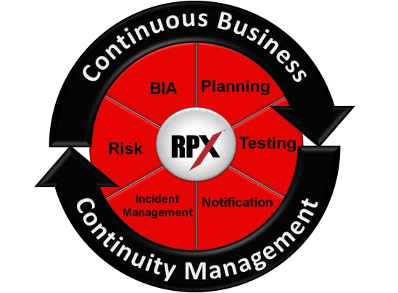
Business Impact Analysis (BIA) I
Yulhendri
Sistem Informasi
Fasilkom UEU

Slide 2
Agenda
• What is a Business Impact Analysis (BIA)?
• Why do a BIA?
• Elements of a BIA
• Presenting your BIA Results
• Common Mistakes

Slide 3
What is a BIA?
A Business Impact Analysis (BIA) ….
… is a process that identifies & evaluates the
potential effects of events on business operations
… is a detailed inventory of critical business functions
and/or processes
… is an assessment & prioritization of all business functions & their interdependencies
… provides an estimation of MOTs, RTOs, RPOs, and recovery procedures

Slide 4
What is a BIA?
A Business Impact Analysis (BIA) ….
… includes the identification of department critical business functions as well as organization-wide products and/or services.
Products and Services are created by processes that are made up of activities. Products and Services are prioritized first; this sets the time and service level parameters for process prioritization.
- ISO Technical Specification Ref # ISO/TS 22317:2015(E)

Slide 5
Why do a BIA?
^{Processes} Applications
Vital Records People
Vendors

Slide 6
Why do a BIA?
More than because you HAVE to

Slide 7
Why do a BIA?
• Organizes / Prioritizes ALL the Data
• Provides a Basis for your Recovery Plan
• Aids in Resource Allocation
• Aids in Development of Recovery Strategies
• Provides a Focus for Testing

Slide 8
Why do a BIA?
Identifies processes that are most critical
to the survival of an organization.
Activities that an organization performs in support of its primary purpose(s); the production & delivery of goods and/or services.

Slide 9
Why do a BIA?
Identifies processes that are most critical
to the survival of an organization.
Processes and systems that your business absolutely needs in order to perform its main functions.

Slide 10
Why do a BIA?
Identifies processes that are most critical
to the survival of an organization.
Saving your business from suffering a catastrophic blow that could result in substantial damage to the business, including closing its doors for the last time and shutting down for good.

Slide 11
Elements of a BIA
Elements of a BIA

Slide 12
Elements of a BIA
• Initiation (Developing the Mindset)
• Establishing the Process
• Gathering the Information (Data Collection)
• Documenting / Organizing the Information
• Analyzing the Collected Information
• Presenting the BIA Results to Management

Slide 13
Elements of a BIA
• Initiation (Developing the Mindset)
• Define objectives, goals and scope
• Form BIA project team
• Kick off BIA with an Executive Sponsor with buy-in
• Establish business importance of the BIA

Slide 14
Elements of a BIA
• Establishing the Process
• EDUCATE participants and PREPARE in advance!
• Set Priorities
• Time commitments for departments / deadlines
• Consistent Recovery Time Objectives
• Budget time for interviews – allot enough time
• Set expectations for follow up
• Establish relevant Impacts
• Establish RTO / Criticality determination
• Subjective
• Objective (Formula based – criticality increasing over time)

