Slide 1
Business Impact Analysis (BIA) II
Yulhendri
Sistem Informasi
Fasilkom UEU

Slide 2
Calculate an RTO

Slide 3
Scoring Min / Max
• Critical 4
3 ^{• High 3}
^{Customer} • Low 1
• Critical 4
2 ^{• High 3}
^{Operational} • Low 1
Impact ^{• N/A} 0
• Critical 4
1 ^{• High 3}
Financial ^{• Low} 1
Impact ^{• N/A 0}
Customer Impact 0 / 12.00
Financial Impact 0 / 4.00
• Medium
2
Operational Impact
0 /
8.00
Impact
• N/A
0
Recovery Time Objectives
25 – 48 hrs (12/8/4)
>1 week (12/8/4) (48/32/16) = 96
0 – 24 hrs (12/8/4)
• Medium
2
49 – 7 days (12/8/4)
Overall Criticality
Medium (49h-7d) 25 - 49
High (25-48h) 50 - 74
Critical (0-24h) 75 - 96
• Medium
2
Low (>1 wk)
1 - 24

Slide 4
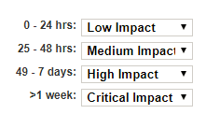
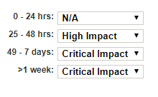
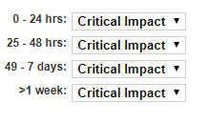
If the function was unavailable what would
be the
impact?
Customer Impact
30 + 22 + 16 = 68
3 x 1 = 3
3 x 2 = 6
3 x 3 = 9
3 x 4 = 12
³⁰ Overall Criticality
Operational Impact
Low 1 - 24
Medium 25 - 49
^{2 x 0 = 0} High 50 - 74
2 x 4 = 8 Critical 75 - 96
2 x 4 = 8
22
2 x 3 = 6
Financial Impact
Overall Criticality = High
1 x 4 = 4
1 x 4 = 4
1 x 4 = 4
Calculated RTO = 25-48 hrs
1 x 4 = 4
16

Slide 5
Threshold RTO

Slide 6
If the function
was
unavailable what would
be the
impact?
Customer Impact
Establish RTO Threshold = Critical
The earliest RTO where Critical is
selected
Operational Impact
This is your Function RTO
0 – 24 hrs
Financial Impact
Overall Criticality = Critical

Slide 7
Elements of a BIA
• Gathering the Information (Data Collection)
• Create a consistent Questionnaire for everyone
• Set up BIA Workshops and/or Interviews
• Quantify as much as possible – gather FACTS
• Quantify responses OVER TIME (Impacts/RTOs)
• Ask people what they do? Don’t assume.

Slide 8
Elements of a BIA
• Documenting / Organizing the Information
• Prioritize by Criticality
• Report the facts for discussion – do not provide opinion
• Be careful of adding “conversational” notes not factual
• Analyzing the Collected Information
• Note trends/observations that you have uncovered

Slide 9
Elements of a BIA
Analyzing Your Data

Slide 10
By
Department
Maximum Outage Criticality
Timeframe (Dept) (calculated)
Email
Fedline Advantage
GFX
Internet Access
Shared Drive
Network Drives
Static IP Address
Te ep ones
Email
Essbase S stem
Lawson AP System
Lawson GL System
Shared Drive
Network Drives
DWPRD Database
Email
Essbase System
Internet Access
Microsoft Office Suite
set Liability Management Medium >24 - 72 hours PC's
Sendero Client and Database
Shared Drive
Network Drives
VPN Access
Department
Function
RTO (Calculated)
Dependent Resources
cash Management
24 Hours
Treasury
Daily Loan and Deposit Reporting
48 Hours
Medium
>24 - 72 hours
On Demand

Slide 11
By
Criticality
Department ^{Criticality} Oei>endent Re,ources
c it
ral Processing Back Office Wire Processing
Microsoft Office sone
8ranch Systems Development
Tellerl'ro/ln8ranch Recovery
Cent
Deposit Products
Deposit Suppon and Communication

Slide 12
Resource
Report
ERT
Resouroes Estimeted � Earliest RTO from BIA Department Function Criticality Level
T-(TT aeco..e.y)
CENTRAL PROC6SING Back Office Wire Processing
DEPOSIT PRODUCTS Deposit Account Opening
ACCOUNTING Payroll
TREASURY DEPARTMENT Cash Management
ACCOUNTING Daily General Ledger Balancing ail 4 hoors 0- 8 hours
MSCC Research Items
ACCOUNTING Accoonts Payable
ACCOUNTING Financial Reporting
VISA PROC6SING Card Production
VISA PROC6SING VtSa Transaction Posting, Balancing,
PAYMENT SERVICES ACH Origination File (OOFI)
TREASURY DEPARTMENT Cash Management
PAYMENT SERVICES Deposited Oleck Processing and Deposited Returns
PAYMENT SERVICES ACH ROFI - Incoming File and Exceptions Processing
CENTRAL PROC6SING Fed�ine Cash Ordering High
PAYMENT SERVICES Business Remote Deposit Medium
st Upload 8 hours 0- 8 hours PAYMENT SERVICES ACH ROFI - Incoming Fi!e and Exceptions Processing
CENTRAL PROC6SING Fed�ine Cash Ordering
Em
Fed!ine Advantage
24 hours
0- 8 hours
Google Chrome
4 hours
0- 8 hours ACCOUNTING
Daily General Ledger Balancing
High
Ho

Slide 13
Elements of a BIA
• Presenting the BIA Results to Management
• Create high level / “easy on the eye” reporting
• Executive Summary Reports
• Objectives / Goals / Scope
• Methodology
• Participants
• Summary of Results
• Most Critical Items
• Concerns
• Recommendations

Slide 14
Overall Function Count

Slide 15
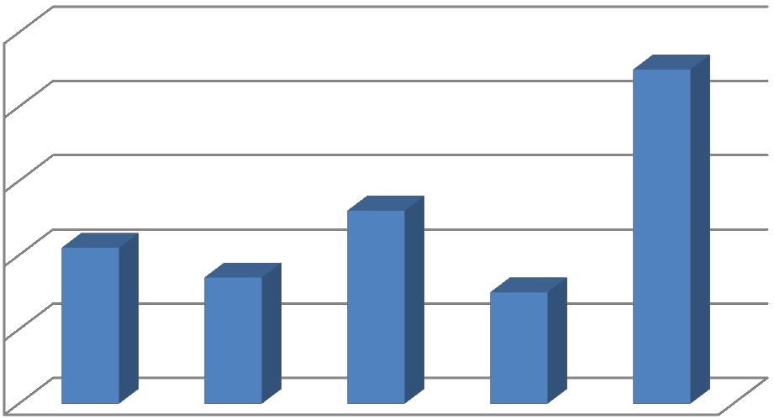
Functions by Criticality
Functions by Criticality
₅₀ 45
40
₃₀ ₂₁ 26
₁₀ Criticality
0
20 ¹⁷ ¹⁵ Functions by

Slide 16
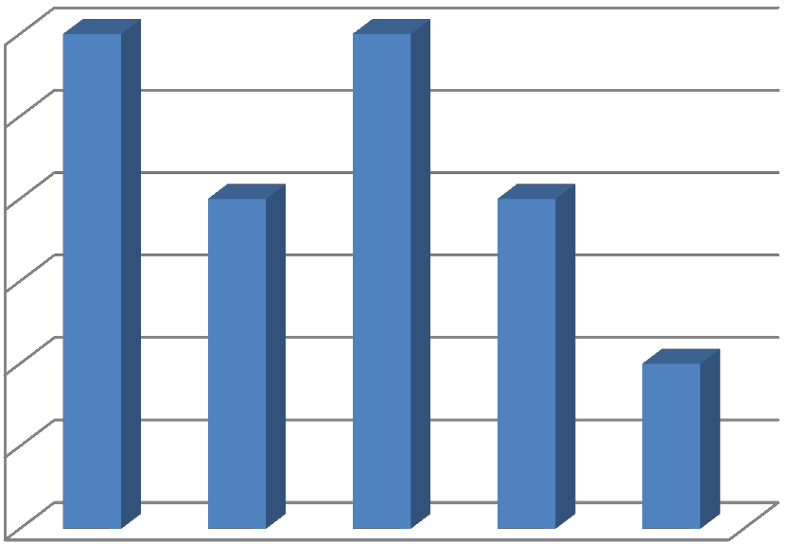
Department Functions
Accounting Department Functions
Accounting Department Functions
3
2.5
2
1.5
1
0.5
0
Critical High Significant Medium Low

Slide 17
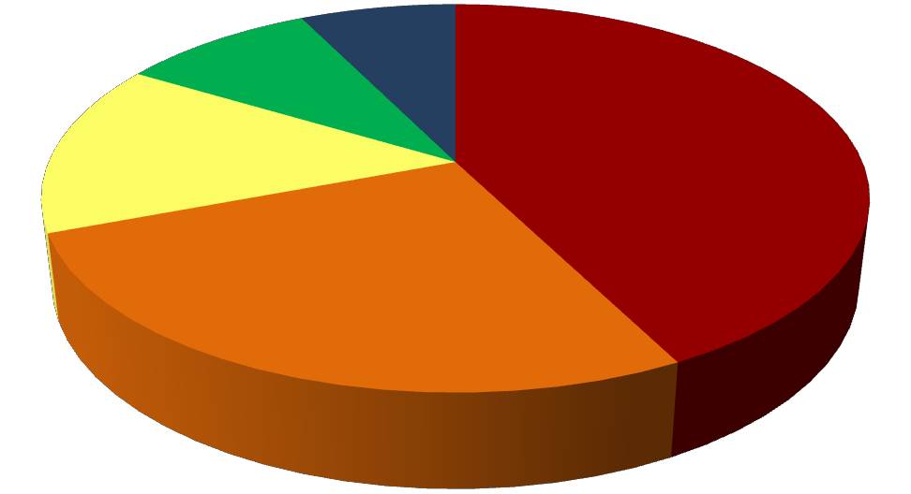
Resource Summary Count
Resource RTO Distribution
5-10 Days ^{10+ Days}
3-5 Days 0-24 Hours ^{2-3 Days}
14% 43% ^{3-5 Days}
5-10 Days
10+ Days
2-3 Days
27%
_{9%} 7% 0-24 Hours

Slide 18
Why do a BIA?
• Organizes / Prioritizes ALL the Data
• Provides a Basis for your Recovery Plan
• Aids in Resource Allocation
• Aids in Development of Recovery Strategies
• Provides a Focus for Testing

Slide 19
Common Mistakes
Mistakes to Avoid

Slide 20
Common Mistakes
• Minimal or No Management Support
• Backing into the BIA Results
• Lack of Preparation for the Interviews/Meetings
• Gathering Too Much Data
• Focus on the Tools/Applications instead of the Processes
• Doing a Risk Assessment and NOT a BIA (do both)
• No Timely Follow Up / Result Presentation
• Unclear Presentation of Results

Slide 21
References
ISO Standards
- ISO 22301
2012 Societal security – Business continuity management systems
- ISO 22317
2015 Societal security -- Business continuity management systems -- Guidelines for
business impact analysis (BIA)
DRII.org
Professional Practices
NCUA.gov
- Letter #: 06-CU-12
- Letter #: 01-CU-21
Ready.gov
https://www.ready.gov/business/implementation/IT
Gartner – IT Library
https://www.gartner.com/it-glossary/library

Slide 22
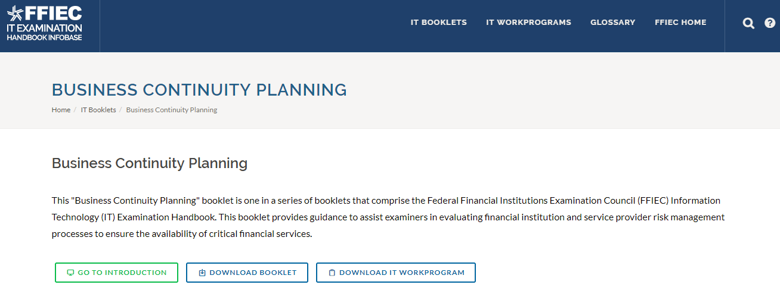
References
FFIEC https://ithandbook.ffiec.gov/
- BCP Examination Booklet
- BCP Examiners Checklist (IT Work Program)

