Slide 1
Emergency Response

Slide 2
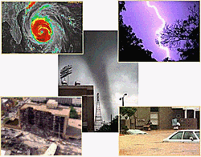

Workplace Emergency
An unforeseen situation that threatens your employees, customers, or the public, disrupts or shuts down your operations, or causes physical or environmental damage.

Slide 3

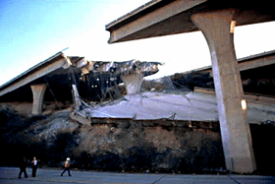

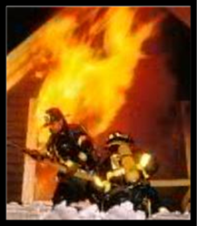

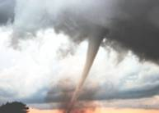
Types of Emergency
• Earthquakes
• Hurricanes
• Tornadoes
• Energy/utility outages
• Fire hazards
• Hazardous materials releases
• Terrorism

Slide 4


Workplace Emergency
Reporting and alerting emergencies
Employees must know how to report emergencies
"911" is a common method for reporting emergencies if external emergency personnel are used at your workplace

Slide 5
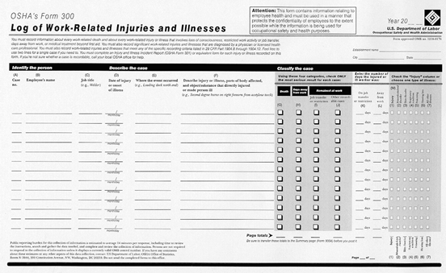
Workplace Emergency
OSHA’s Recordkeeping and Reporting
Fatality: Death of one or more employees from a work-related incident
Catastrophe: In-patient hospitalization of three or more employees as a result of a work-related incident

Slide 6

Emergency Preparedness
Essential elements of emergency preparedness planning:
• Identify hazards and assess risk.
• Assess capabilities and resources.
• Develop an emergency plan and procedures.
• Integrate the plan with the community plan.
• Conduct training.
• Public relations.
• Conduct Drills and Exercises.
• Develop Plan Audit Procedures.

Slide 7

OSHA’s Response Plans
National Emergency Management Plan (NEMP)
Regional Emergency Management Plan (REMP)

Slide 8

OSHA’s Response to Emergency
To assist local response agencies in any way possible within agency capabilities (Non-enforcement)
To initiate workplace investigation (Enforcement)

Slide 9
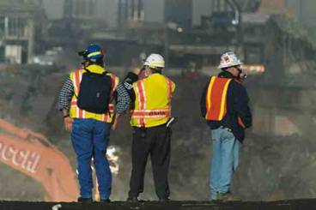
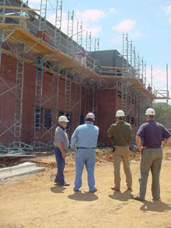
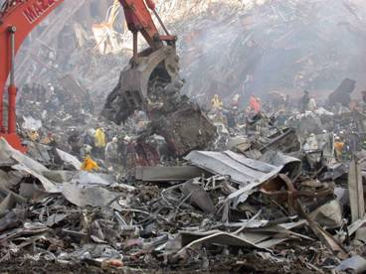
Non-enforcement role vs. Enforcement
World Trade Center after 9-11
Construction site

Slide 10
Incident Command System
INCIDENT COMMANDER
SAFETY
INFORMATION
LIAISON
FINANCE/ ADMINISTRATION
OPERATIONS
PLANNING
LOGISTICS

Slide 11
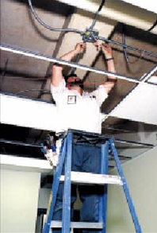
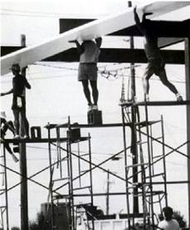
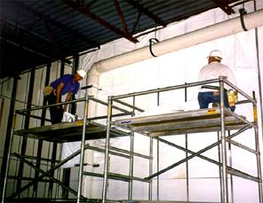
OSHA Requirements for Emergency Response and Preparedness in Construction Industry
29 CFR 1926

Slide 12
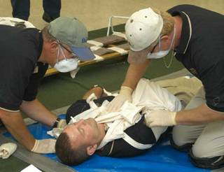
OSHA Requirements for Emergency Response and Preparedness in Construction Industry
29 CFR 1926
General Requirements for all Workplaces
  29 CFR 1926.23: First Aid and Medical attention, and
  1926.50: Medical services and first aid
  Procedures:
  Ensure medical personnel is available for consultation and advice on occupational health matters
  Provide suitable facilities for quick drenching and flushing of the eye
Training:
  In the absence of readily accessible medical services, a person with a valid certificate in first aid training

Slide 13

OSHA Requirements for Emergency Response and Preparedness in Construction Industry
29 CFR 1926
Additional Requirements for Workplaces referenced in other standards
  29 CFR 1926.35: Employee emergency action plan
  Procedures:
  Prepare and implement a written action plan that includes:
    Emergency escape procedures
    Procedures for those who remain to conduct critical operations
    Means of reporting fires and emergencies
    Procedures to account for employees after the emergency
Training:
  Review emergency action plan with each employee when the plan is developed, responsibilities shift, or the emergency procedures change.
  Provide specific training to employees who are expected to assist in evacuation

Slide 14
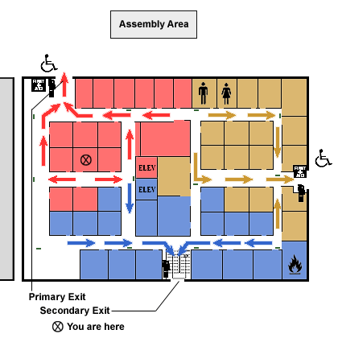
OSHA Requirements for Emergency Response and Preparedness in Construction Industry
29 CFR 1926
General Requirements for all Workplaces
  29 CFR 1926.34: Means of egress
  Procedures:
  Maintain unobstructed egress from every building and structure where employees are working
  Mark all exits with signs and mark access to exits where it is not immediately apparent how to exit

Slide 15
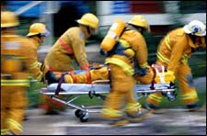
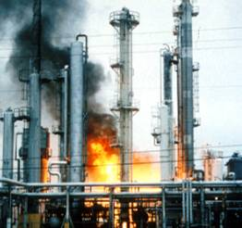
OSHA Requirements for Emergency Response and Preparedness in Construction Industry
29 CFR 1926
General Requirements for all Workplaces
  29 CFR 1926.24: Fire protection and prevention,
  1926.150: Fire protection
  1926.151: Fire prevention
  Procedures:
  Develop fire protection program
  Provide fire extinguishers and other firefighting equipment
  Training:
  If a fire brigade is necessary, adequately train them.

Slide 16
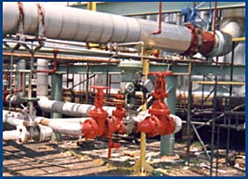
OSHA Requirements for Emergency Response and Preparedness in Construction Industry
29 CFR 1926
Additional Requirements for Specific Workplaces/Operations
  29 CFR 1926.64: PSM of highly hazardous chemicals
  29 CFR 1926.65: HazWoper, Emergency response to hazardous substance releases

Slide 17
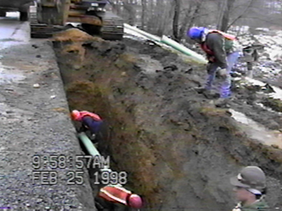
OSHA Requirements for Emergency Response and Preparedness in Construction Industry
29 CFR 1926
Additional Requirements for Specific Workplaces/Operations
  29 CFR 1926.651: Specific excavation requirements
  Procedures:
  Provide emergency rescue equipment when an excavation contains or potentially contains a hazardous atmosphere
  Ensure that person(s) attend the equipment in case of emergency.
  Provide and ensure the use of a safety harness and lifeline when employee(s) perform work in bell-bottom pier holes or similar deep and confined footing excavations

Slide 18
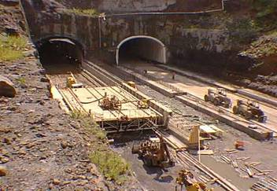
OSHA Requirements for Emergency Response and Preparedness in Construction Industry
29 CFR 1926
Additional Requirements for Specific Workplaces/Operations
  29 CFR 1926.800: Underground construction
  Procedures:
  Develop and maintain a check-in/check-out procedure
  Provide means to summon emergency assistance
  Ensure monitoring is performed
  Select, provide, and make available approved self-rescuers
  Training:
  Instruct employees on fire prevention and emergency procedures
  Ensure rescue teams are familiar with jobsite conditions
  Qualify rescue team members at least annually

Slide 19
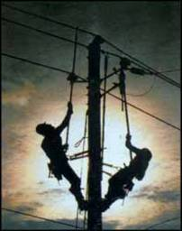
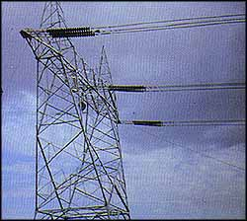
OSHA Requirements for Emergency Response and Preparedness in Construction Industry
29 CFR 1926
Additional Requirements for Specific Workplaces/Operations
  29 CFR 1926.950: Power Transmission and Distribution
  Procedures:
  Provide spotlights or portable lights for emergency lighting when needed to work safely at night
  Training:
  Provide training and ensure that employees understand emergency procedures and first aid fundamentals, including CPR

Slide 20
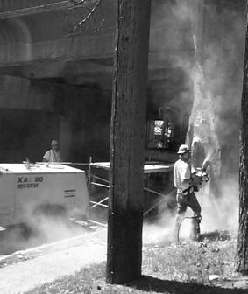
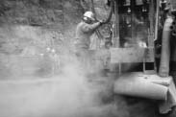
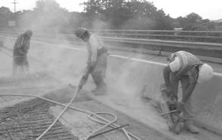
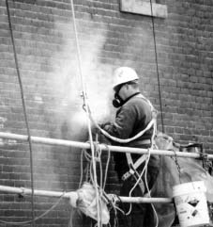
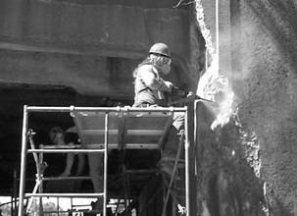
Exposure to silica dust in construction work

Slide 21
OSHA Requirements for Emergency Response and Preparedness in Construction Industry
29 CFR 1926
Requirements that Support Emergency Response and Preparedness
  29 CFR 1926.55: Gases, vapors, fumes, dust, and mists
  Procedures:
  Ensure that employee exposures do not exceed the limits provided by the standard.
  Exposures should be limited through engineering controls, administrative controls, and, as a last resort, PPE
  29 CFR 1926.59: Hazard Communication
  29 CFR 1926.103: Respiratory Protection
  29 CFR 1926.1103: 13 Carcinogens
  29 CFR1926.1117: Vinyl chloride

Slide 22

OSHA Requirements for Emergency Response and Preparedness in Construction Industry
29 CFR 1926
Additional Requirements for Specific Workplaces/Operations
  29 CFR 1926.60: Methylenedianiline (MDA)
  Procedures:
  Develop and implement a written plan for emergency situations where there is a possibility of an emergency:
    Identify emergency escape routes before construction begins
    Equipped employees with PPE and clothing until emergency is abated
    Include elements prescribed in 1910.38 and 1910.39
Training:
  Provide employees with info and training on MDA, IAW 1910.1200(h)
  Ensure employees who must wear respiratory protection, receive training as per 1910.134

Slide 23

OSHA Requirements for Emergency Response and Preparedness in Construction Industry
29 CFR 1926
Health Hazard Related Standards: Cadmium (Cd)
  29 CFR 1926.1127: Cadmium
  Wrecking, demolishing, and salvaging structures
  Cutting, brazing, grinding, or welding
  Procedures:
  Develop and implement a written
  plan
  Select and provide appropriate respirators for emergencies
  Training:
  Provide training to include emergency procedures, prior to/at the time of initial assignment to a job involving potential exposure to Cd
  Ensure employees who must wear respiratory protection receive training (29 CFR 1910.134)
  DANGER...CADMIUM...CANCER HAZARD...CAN
  CAUSE LUNG AND KIDNEY DISEASE...
  AUTHORIZED PERSONNEL ONLY...RESPIRATORS
  REQUIRED IN THIS AREA

Slide 24
OSHA Requirements for Emergency Response and Preparedness in Construction Industry
29 CFR 1926
Requirements that Support Emergency Response and Preparedness
  29 CFR 1926.28: Personal Protection Equipment (PPE)
  29 CFR 1926.95: Criteria for PPE
  Procedures:
  Provide and ensure the use and maintenance of appropriate PPE for site operations and hazards
  Ensure any employee-owned equipment is adequately and properly maintained

Slide 25
III – Recovery strategies
Recovery strategies are based on MTDs
Predefined
Management-approved
Notes:
Predefined means we don’t have to make it up as we go along. We have a documented, tested plan in place.
Management approved means you will get the resources to implement the BCP.

Slide 26
III – Recovery strategies
Different technical strategies
Different costs and benefits
How to choose?
Careful cost-benefit analysis
Driven by business requirements
Notes:
Driven by business requirements means going back to the BIA, which identified critical business processes and ranked them in terms of the MTD/MAO.

Slide 27
III – Recovery strategies
Strategies should address recovery of:
  Business operations
  Facilities & supplies
  Users (workers and end-users)
  Network, data center (technical)
  Data (off-site backups of data and applications)
Notes:
Business operations were enumerated in the BIA – what IT and other requirements are necessary to support them?
Facilities and supplies – where do I sit at the DR site? Where is my conference room? Do I get a whiteboard? And by the way, I need a pencil.
Users – can manual processes be used as part of DR? If so, how does the manual processing get integrated back into the electronic processing later? Do we need housing, transportation?
Recovery of data centers and networks is an obvious necessity requiring careful planning. There are technical solutions available, though. (Bring money.)
You mean we’ve got all these computers in the DR site and no data? Who forgot the DATA??
I’m only going to go into detail on the last two bullets. The first three are also quite detailed planning processes.

Slide 28
III – Recovery strategies
Technical recovery strategies - scope
  Data center
  Networks
  Telecommunications
Notes:
The data center is obvious.
Network connectivity (loss of) could be defined as a disaster all by itself.
Telecommunications are vital to most businesses. You don’t want to get to the DR site and realize you forgot the need for a PBX or a FAX machine.

Slide 29
III – Recovery strategies
Technical recovery strategies – methods
  Subscription services
  Mutual aid agreements
  Redundant data centers
  Service bureaus
Notes:
These four types are covered in subsequent slides

Slide 30
III – Recovery strategies
Technical recovery strategies – subscription service sites
  Hot – fully equipped
  Warm – missing key components
  Cold – empty data center
  Mirror – full redundancy
  Mobile – trailer full of computers
Notes:
Hot – expensive, testable
Warm – missing key components like computers, hence not testable
Cold – slower to recover, cheaper
Mirror – sounds great if you can afford it
Mobile – the semi tractor-trailer pulls up to your site

Slide 31
III – Recovery strategies
Technical recovery strategies – mutual aid agreements
  I’ll help you if you’ll help me!
  Inexpensive
  Usually not practical
Notes:
Suppose, for instance, that Purdue can’t afford a hot DR site and neither can IU. We agree to help each other in this case.
But we probably don’t have identical hardware and software at both institutions.
Most likely neither institution has excess capacity to make available in a DR scenario
Does this sound like it’s going to work? It is probably better than nothing, though.

Slide 32
III – Recovery strategies
Technical recovery strategies – redundant processing centers
  Expensive
  Maybe not enough spare capacity for critical operations
Notes:
Think of load balanced redundant sites, for instance. Operations are going OK, but are both sites running at less than 50% capacity? Can site A handle the load if site B goes down?

Slide 33
III – Recovery strategies
Technical recovery strategies –service bureaus
  Many clients share facilities
  Almost as expensive as a hot site
  Must negotiate agreements with other clients
Notes:
The claim in the (ISC)2 book is that service bureaus are shared by many clients and usually run at about 100% capacity. If a client has to transfer operations to the service bureau as part of a DR, the other clients take a hit in diminished processing capacity. Agreements need to be negotiated in advance with the other clients.

Slide 34
III – Recovery strategies
Technical recovery strategies –data
  Backups of data and applications
  Off-site vs. on-site storage of media
  How fast can data be recovered?
  How much data can you lose?
  Security of off-site backup media
  Types of backups (full, incremental, differential, etc.)
Notes:
Full backups are what you think they are – everything.
Incremental backups are files changed since *previous* backup, which might be a full backup or an incremental. Potentially a long recovery period.
Differential backups are all files changed since previous full backup – quicker recovery.
Continuous backups – like a journal file system, or like Oracle’s Dataguard hot spare environment. Geographically separated systems are kept up to date in real time.

